Slide 1
WELCOME!

Slide 2
LCIF Coordinators Meeting Zagreb, October 27, 2022
Bent Jespersen
Claudia Balduzzi
Robert Rettby
Constitutional Area Leaders

Slide 3
INCREASING Service Impact
FIGHTING
Diabetes
EXPANDING
Global Causes
Notes:
Noting that donations from Campaign Sight First II were finite, and that increasing the number of causes would allow LCIF to serve important needs of more communities, Lion leadership announced the introduction of additional LCIF cause areas with the launch of Campaign 100. In the interest of raising awareness in one of the fastest growing diseases in the world, LCIF and LCI agreed to work together to promote programs around diabetes.

Slide 4
PROGRESS TO GOAL
50%
TO GOAL
As of June 30, 2020
Notes:
Despite growing public health fears and isolation, this was a year that Lions supported one another, and continued to support LCIF Campaign 100 reach 50% of its goal by June 30, 2020.
LCIF’s records indicate that US$45,612,239 were received in cash donations this year, with another US$1,631,735 attributed to partner project funding. LCIF disbursed US$40,800,521 in grants this year meaning the foundation received roughly US$4,000,000 more in cash than was disbursed. Remembering that 2018-2019’s campaign performance reflects two years of donations, we can see that CA IV’s rate of Campaign performance remained the same.

Slide 5
PROGRESS TO GOAL
70%
TO GOAL
As of June 30, 2021
Notes:
Donations to LCIF by the end of this year reached two-thirds of the campaign goal, with one more year to go. You can see that this was Europe’s strongest year thus far. Efforts including CA IV’s LCIF Day and an Online Recognition Day. At the end of the year, CA IV was at exactly 50%. Our volunteers, including International Committee team of Former President Grimaldi, PID Claudette Cornett and PID Robert Rettby were nervous, but resolute. We wanted to represent our Constitutional Area well.
When Campaign 100 launched, this year was intended to be the final year. Early in this year, LCIF’s board of Trustees recognized that despite exciting innovations in fundraising, the pandemic was interfering with key region’s ability to raise donations. The campaign was extended for one more year.
Cash received during this year included roughly US$191 million for the campaign to date with US$161 million in grants approved.
No need to read these numbers, they are only for reference in case of a question:
CA I: US$ 32,285,321 = 58%
CA II: US$ 2,748,010 = 44%
CA III: US$ 4,837,089 = 52%
CA IV: US$ 24,618,749 = 50%
CA V: US$111,431,815 = 85%
CA VI: US$ 20,230,095 = 56%
CA VII: US$ 4,031,700 = 65%
CA VIII US$ 4,485,895 = 56%
Total 204,668,674

Slide 6
PROGRESS TO GOAL
108%
TO GOAL
As of June 30, 2022
Notes:
Many of us know that Campaign 100 ended with the foundation exceeding its goal. Several CAs had extraordinary boosts in participation during the final year of the campaign. You can see that CA V reached its goal by 2021, its donations extend off this chart! CA VIII, reached 87% of it’s US$8,000,000 goal, but that was a stretch goal. They surpassed their original goal by 12%! CA IV had the largest jump of the final campaign year, achieving 50%. Technically, a little more since we finished at 101% of our final goal!
We know that some of this generosity of spirit was related to the desire by Europeans to help their fellow Europeans in Ukraine. But it was also because our Lions had learned to trust LCIF and its approach to supporting this crisis. LCIF discovered a way to serve along with a number of other supporting agencies, including local Lion foundations during this time. It is so very moving to continue to be a part of this work.
No need to read these numbers, they are only for reference in case of a question:
CA I: US$52,213,916 =94%
CA II: US$4,722,259 =76%
CA III: US$6,253,033 =67%
CA IV: US$49,461,980 =101%
CA V: US$$155,266,608 =119%
CA VI: US$32,771,726 =91%
CA VII: US$5,566,296 =90%
CA VIII US$6,947,356 = 112% to goal/ 87% to stretch goal

Slide 7
US$325 in perspective:
Cash donations received: US$247,115,521
Expectancies: US$ 63,965,536
Partner project funding: US$ 14,063,351
Campaign total: US$325,144,409
C100 grant disbursements: US$196,136,013
Notes:
You remember how this ends I believe: numbers
I’ve added on number here, the amount in grant disbursements from the start of Campaign 100 to its conclusion: grant totals disbursed by LCIF during Campaign 100. You will note that the foundation concluded the Campaign with about US$50,000,000 more than grant disbursed. The foundation’s average annual grant disbursal during Campaign 100 was nearly US$40,000,000, meaning that if we completely stopped fundraising, LCIF would have enough money to fund grants at its average pace for just over one year.
We know prices for construction and medical equipment are raising. We know that natural disasters like flooding are on the rise due to climate change, and we know that capacity and heart of our Lions to serve is full. LCIF’s Board of Trustees has approved a 4-year plan to bring fundraising to level that is anticipated to serve our needs. Let’s take a look at the numbers, but also at the principles that will help us get there.

Slide 8
What’s next?
The beauty of being a part of the Lion community is we can all support one another to achieve our goal.
Notes:
We know prices for construction and medical equipment are raising. We know that natural disasters like flooding are on the rise due to climate change, and we know that capacity and heart of our Lions to serve is full. LCIF’s Board of Trustees has approved a 4-year plan to bring fundraising to level that is anticipated to serve our needs. Let’s take a look at the numbers, but also at the principles that will help us get there.

Slide 9
INCREASE LION CONTRIBUTIONS TO LCIF
Create a membership-wide culture of giving with the goal of increasing LCIF annual donations to US$60 million.
Milestones
CAIV’s 2022-23 goal = US$6 Million: 12% of the global goal
To be confirmed By the BoT
2022-23
2023-24
2024-25
2025-26
US$50 Million
US$55 Million
US$57 Million
US$60 Million
Notes:
Not many people have seen these goals, but for the purposes of understanding our strategic direction, it is important for our team to understand them. These are the fundraising goals for LCIF as an organization over the next 4 years. They have been established to meet the needs of our changing world. Our goal is to reach US$60 annually. Remember that we just finished a 5-year period where US$325 Million was raised, so these goals are lower than fundraising goals during Campaign 100. You can see at the bottom of this slide that CA IV’s goal for this year is US$6 million dollars. When we calculate the amount of money that has already been promised through outstanding Model Club Commitments, and pledges from individuals and MDs, this goal is lower then 8 out of 10 of the CA’s last fundraising results. We can do this, and perhaps more, and I am proud to be working to represent Europe to help us contribute our part.
In addition to providing district-by-district goals, this weekend’s workshops is also designed to provide you with a deep understanding of LCIF’s contribution to our global community, and with some practical tactics and tools to use to reach these goals. In addition to ensuring our Lions know and understand LCIF, these goals are ours.

Slide 11
OUR GLOBAL CAUSES
Lion Claudia Balduzzi
Constitutional Area Leader
Notes:
This presentation is called “Stewarding Donations.” It is important for our team of volunteers to understand because we want you to be confident in the way we manage donations; and we want you to be able to make other people confident and trust the way we manage donations too.

Slide 12
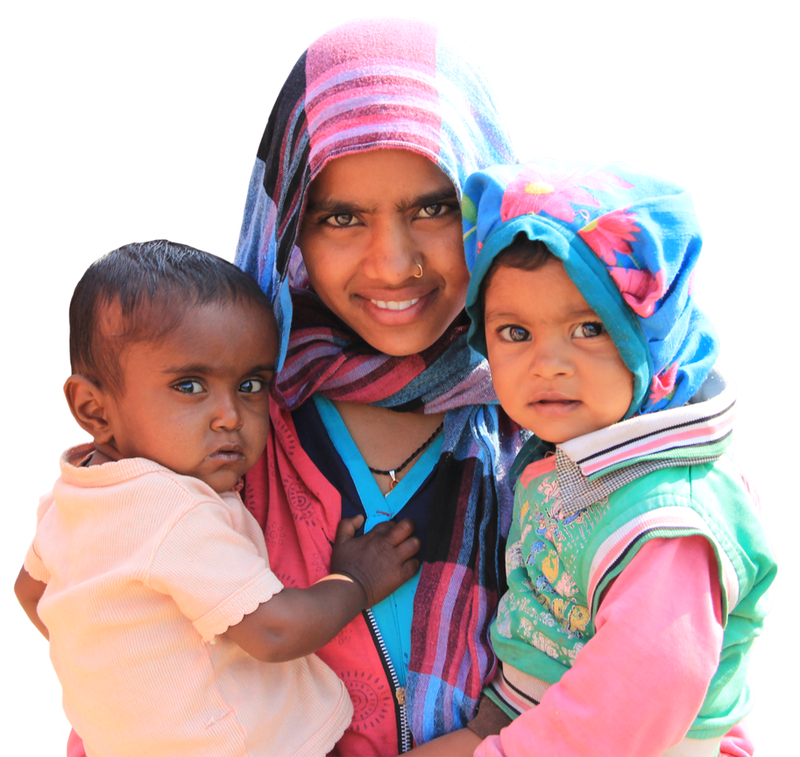
LCIF GRANTS AND PROJECTS
Julie Boonprasarn
Senior Programs Specialist

Slide 13
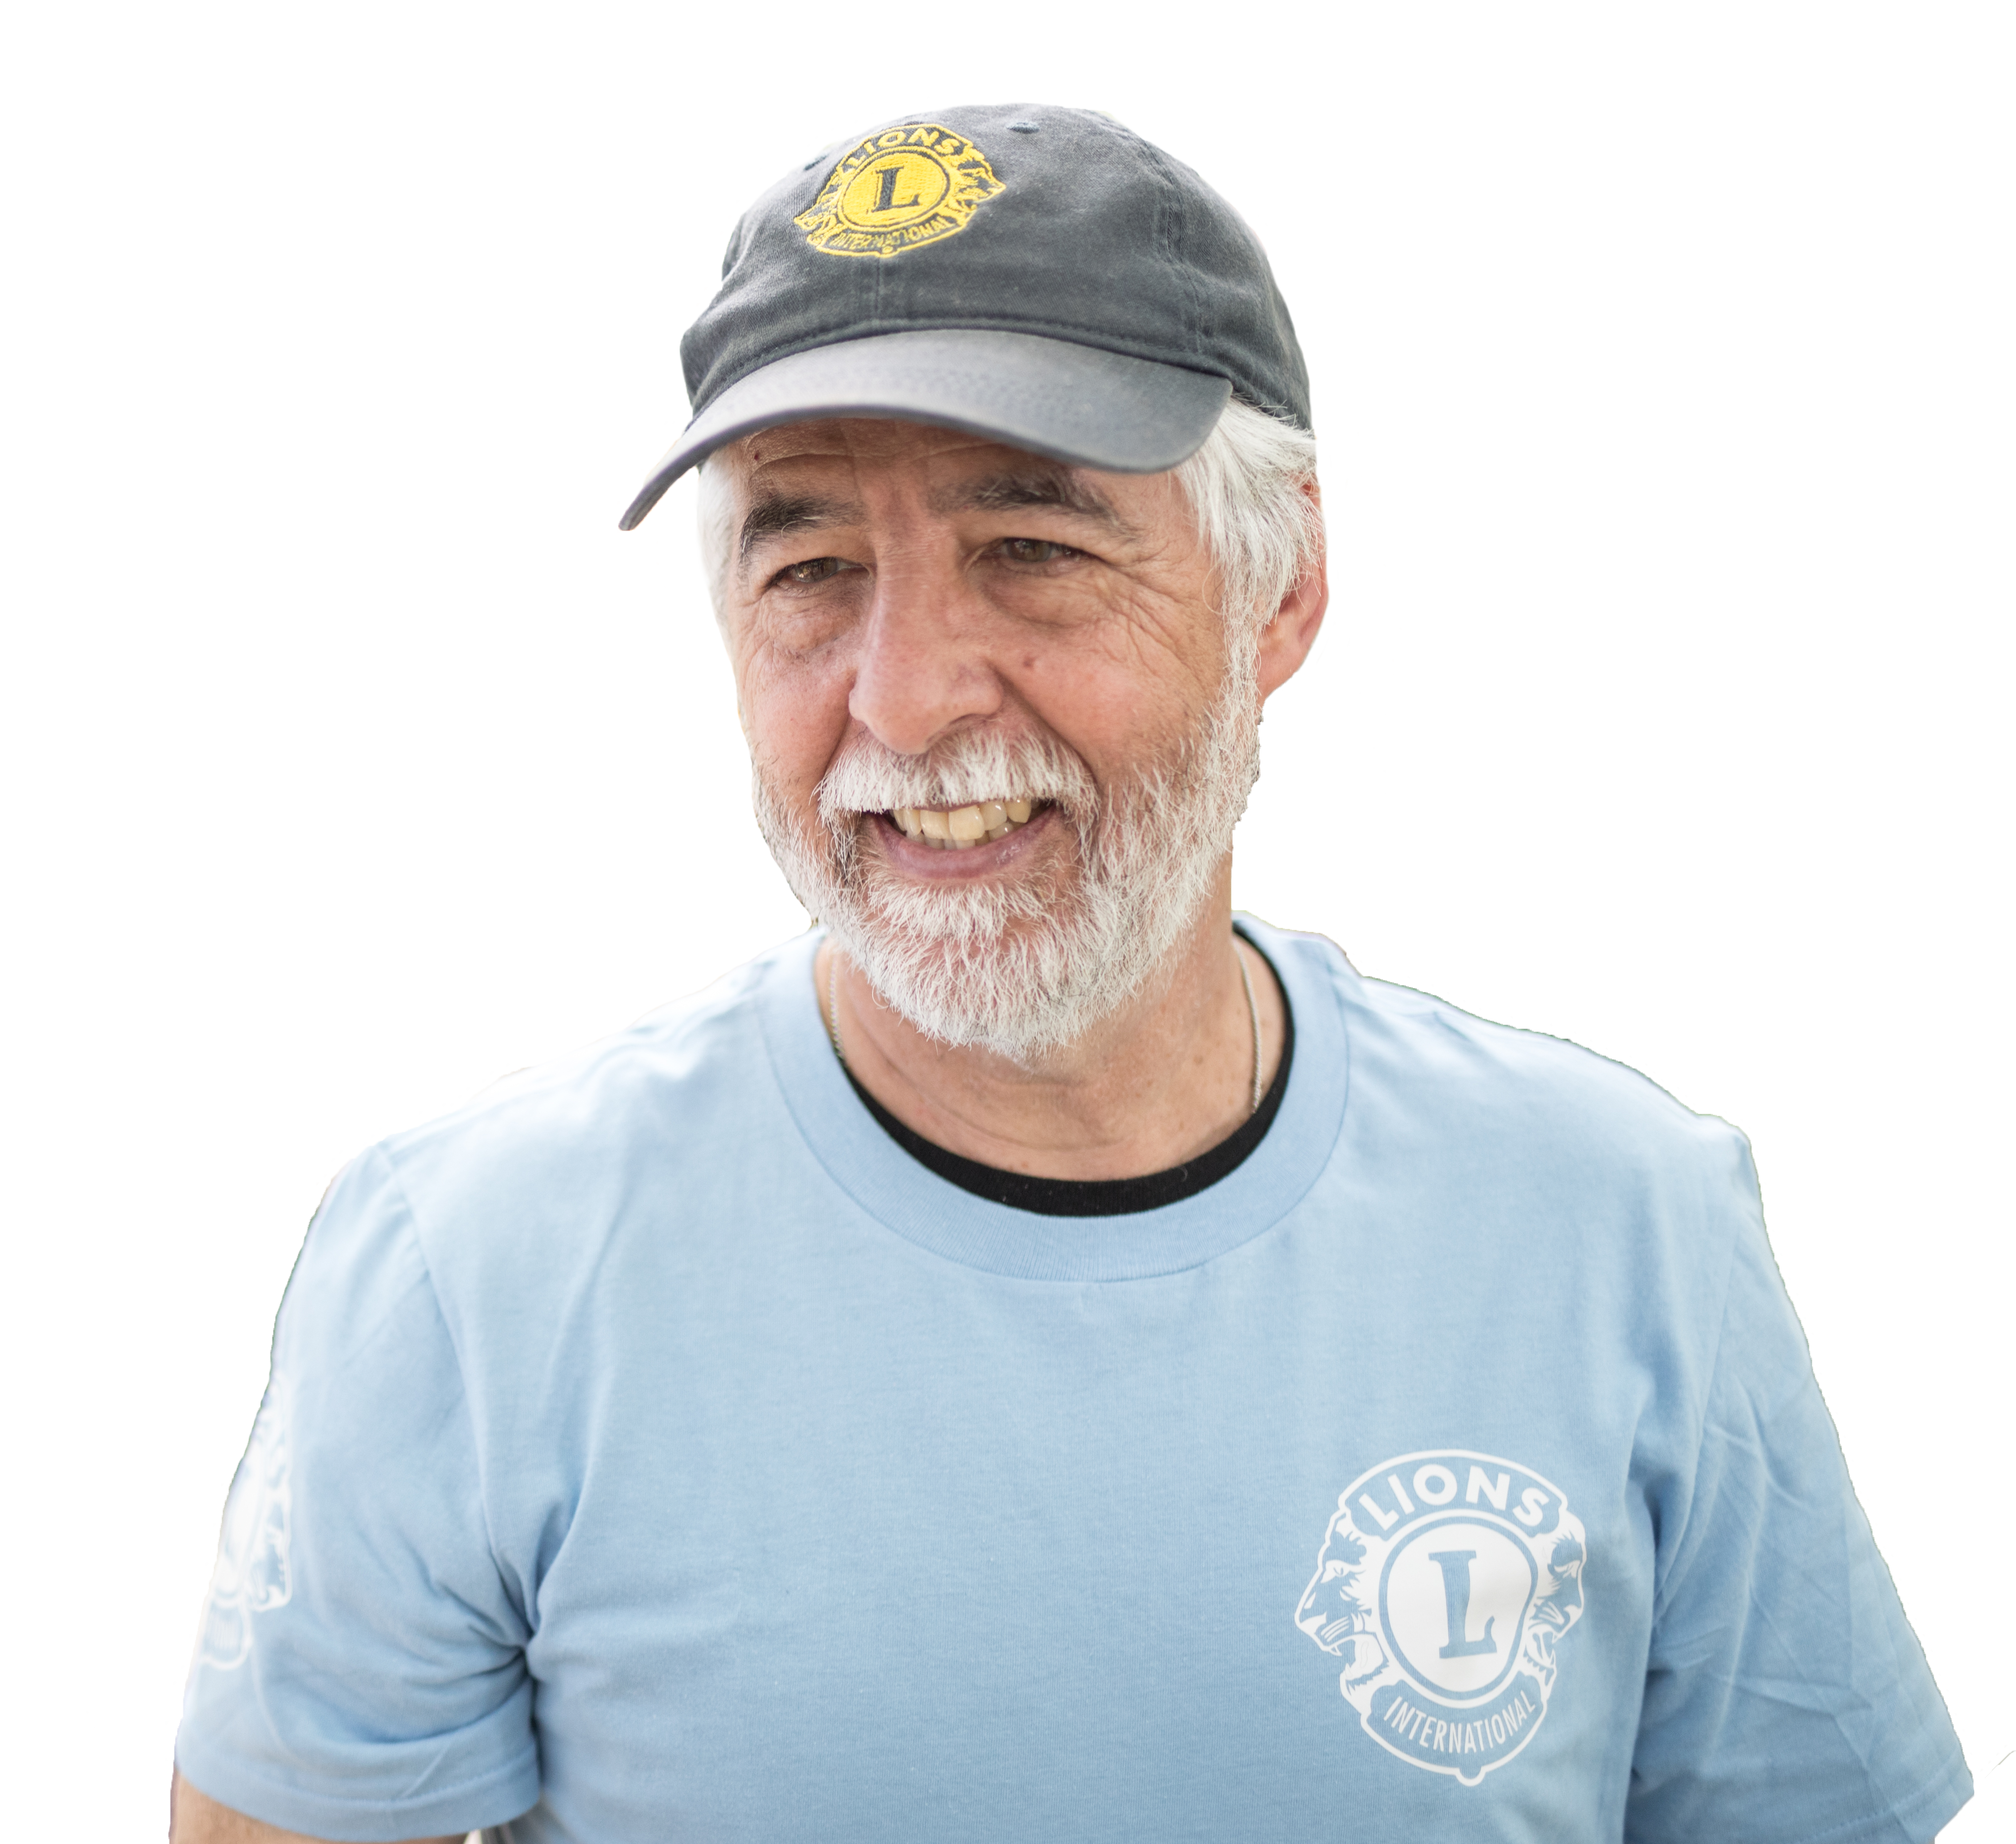
STEWARDING DONATIONS
PID Bent Jespersen
Constitutional Area Leader
Notes:
This presentation is called “Stewarding Donations.” It is important for our team of volunteers to understand because we want you to be confident in the way we manage donations; and we want you to be able to make other people confident and trust the way we manage donations too.

Slide 14
STORYTELLING
PID Bent Jespersen & Lion Claudia Balduzzi
Constitutional Area Leaders

Slide 15
RECOGNITION AS MILESTONES TO GOALS
PID Bent Jespersen
Constitutional Area Leader
Notes:
This topic is about using recognition as milestones to your district goals, but also as a way to identify opportunities to celebrate clubs and individual and to ask them to stand up for their beliefs by receiving recognition. We are aware that there are some areas in Europe, in particular, some of LCIF’s recognition is used as more of an award, and that is a choice those Lions make. I think the way LCIF sees recognition is as a way to say “thank you.” It is just and it is ethical for us to thank our donors. So we have talked a little about some of the tools you can use to learn a little more about your club. Let’s talk now about ways to access the information on some of those tools to engage the Lions in your district.

Slide 16
PLANNING CLUB VISITS
Claudia Balduzzi
Constitutional Area Leader
Notes:
At the start of Campaign 100 we had a lot of volunteers with very strong enthusiasm, but who did not know how to identify the nuance required to discuss LCIF with a club. They jumped too quickly into requesting donations and did not always spend enough time helping the club understand why LCIF seeks donations. We have spent a lot of time in this workshop discussing LCIF’s service and impact. Once you discover the stories that you are most comfortable telling, you are halfway to planning your visit to a club. In this presentation we want to consider the other half: how the characteristics of a club might help determine your message to them.

Slide 17
LCIF DAY IN EUROPE
Third Annual
Week of 12 June 2023
PID Robert Rettby &
Lion Claudia Balduzzi
Constitutional Area Leaders
Notes:
Self introduction

Slide 18
lcifday.eu Lions Ukraine Task Force
LCIF Training
October 9TH, 2022

Slide 19
INTERNET RESOURCES Paul Steele Regional Development Manager CA IV & VIII
Notes:
Lots of teamwork today

Slide 20
Questions Stories Plans
Notes:
Welcome to LCIF’s volunteer training workshop for district Coordinators, Multiple District Coordinators and Area Leaders from Areas D, E, and F. We are an international organization, and communication is so important to our success, so it is a great pleasure to join you today, and to be supported by our incredible team of interpreters for this event. Please join me in thanking them.
This group of volunteers is tasked with representing LCIF and building on the foundation’s momentum now that Campaign 100 has ended. For those of you who were a part of our campaign team, thank you very much for your efforts, and thank you for returning. Your experience will be important to our new volunteer fundraisers. I hope you will share your experience and your journey from the campaign, with members of your team. For those of you new to the LCIF team, thank you for joining us. Representing the foundation is an opportunity for to learn, and to grow, and to do something amazing for the world and our community of Lions in the process.

