Slide 1
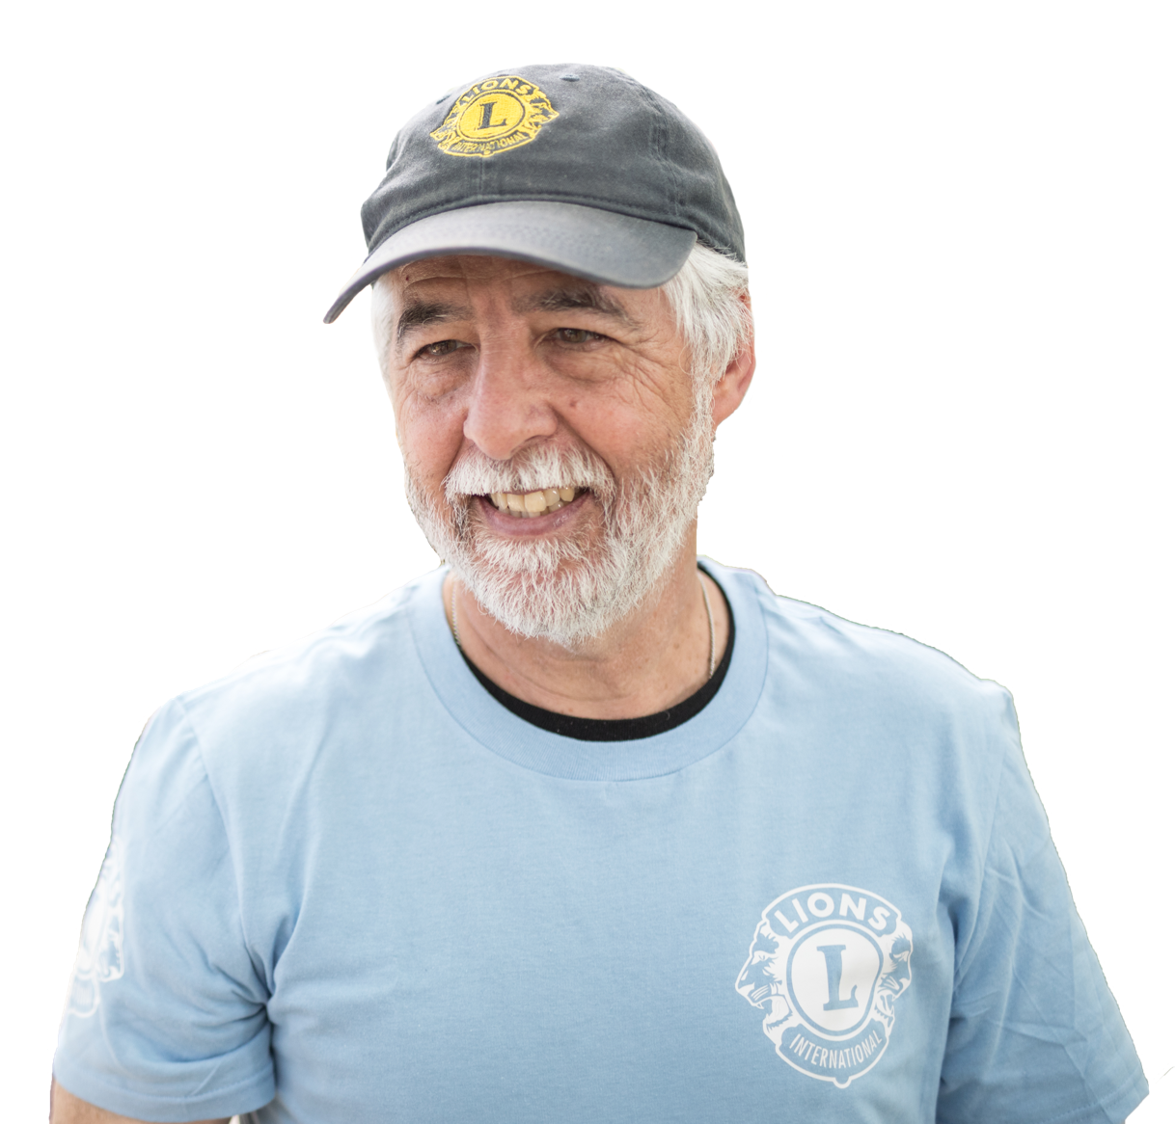
HISTORY OF CAMPAIGN 100
Notes:
Greetings friends and fellow Lions,
My name is Dr. Professory Giuseppe Grimaldi and I am the Campaign 100 Chairperson for CA IV.
It is wonderful to see you all here today! Welcome.
As we move through the final year of Campaign 100, I would like to take some time to thank everyone who has worked and donated to make our service possible. It is true that we have a long way to go in this final year of the campaign, but it is important not to become so obsessed with our goal that we fail to appreciate our accomplishments as Lions to date. This presentation is about the ways Lionism has continued to thrive and grow with our campaign. Even in our recent, difficult times:

Slide 2
Launched
2018
101st LCICon
Las Vegas, USA
Notes:
Campaign 100 was launched at Lions Clubs’ 101st International Convention, in July of 2018, in Las Vegas Nevada.

Slide 3
2018 Convention
Celebrating LCIF’s 50th Anniversary
Election of the first woman International President
Past International President Dr. Naresh Aggarwal became LCIF Chairperson
Notes:
The 2018 Convention was the 50th anniversary of the founding of LCIF. We as Lions elected our first Woman President, Past International President Gudrun Yngvadottir of Iceland, and Past President Dr. Naresh Aggarwal, concluding his presidential term, became the LCIF Chairperson.

Slide 4
INCREASING Service Impact
FIGHTING
Diabetes
EXPANDING
Global Causes
Notes:
Noting that donations from Campaign Sight First II were finite, and that increasing the number of causes would allow LCIF to serve important needs of a larger number of communities, Lion leadership announced the introduction of additional LCIF cause areas, and the launch of Campaign 100: designed to serve 21st century needs of Lions communities.

Slide 5
LCIF Grants Awarded IN FY2018-2019
US$100,000 Major Catastrophe grant to India
Clean water projects in Burkina Faso with the Lions of Italy
Equipping a stroke rehabilitation center in Estonia
US$1 million to support measles outbreak vaccination activities with Measles and Rubella Initiative
Notes:
That year over 1,000,000 people were displaced and over 400 died in flooding throughout India. LCIF responded with a US$100,000 Major Catastrophe grant, providing food, water and other immediate needs to more than 60,000 people displaced by flooding and landslides. LCIF ran smaller grants too, including Clean Water Projects for Schools in Burkina Faso with the Lions of Italy; and Equipping a Stroke Rehabilitation Center in Estonia; and in May of 2019 LCIF’s Board of Trustees approved US$1 million to support measles outbreak vaccination activities in partnership with the Measles and Rubella Initiative.

Slide 6
PROGRESS TO GOAL
36%
TO GOAL
As of June 30, 2019
Notes:
By the end of the year we had reached 36% of our goal for the campaign. We were on our way. Europe had a slow start, but we have always known that we would finish strong.

Slide 7
2019 Convention
Past International President Gudrun Yngvadottir became the first woman LCIF Chairperson
Election of Lion Dr. Jung-Yul Choi as International President
Notes:
LCIF’s 102nd convention was held in Milan, and began the 2019-2020 Lion Year. Past President Gudrun Yngvadottir became the first woman Chairperson of LCIF. Lion Dr. Jung-Yul Choi became the President of Lions Clubs International.

Slide 8
LCIF’s Response to COVID-19
LCIF’s Oak Brook staff began working remotely
Forums and conventions were cancelled, postponed, or held virtually
The difficult decision was made to cancel LCICon 2020 and extend all officer terms by one year
LCIF began a new COVID-19 Relief grant which helped provide much needed personal protective equipment
39 grants were issued in Constitutional Area IV totaling US$1,682,259
Notes:
LCIF’s Oak Brook staff began working remotely and several forums were cancelled, postponed, or held remotely. At the height of Europe’s struggles with the virus, between March and May of 2020, LCIF issued 39 Covid-related grants for US$1,682,259 in CA IV. CA IV had received the most Coronavirus-related grants in all of Lionism, until it was recently surpassed by CA VI during public health challenges in India.

Slide 9
Additional Program Milestones and Grants IN FY2019-2020
Renewed Carter Center partnership to combat river blindness and trachoma with a 4-year agreement
Launched partnership between LCIF, Texas Children’s Hospital, and Global HOPE
Equipped a cardiology unit in Italy
Developed vocational training center for deaf in Tanzania
Equipped pediatric surgical room in Cyprus
Notes:
LCIF and the Carter Center renewed their partnership to combat river blindness and trachoma with a four-year agreement, following the successful completion of a previous four-year agreement from 2016-2020 during which over 200,000 trachoma surgeries were performed.
This was also the year that LCIF launched its partnership with Global HOPE to improve survival rates of children with cancer in sub-Saharan Africa. 16-year-old Palema was the first patient to ring the Botswana center’s Bell of Bravery, signifying successful treatment of Hodgkin Lymphoma. Additional examples of smaller, but great projects around Europe include the equipping of a cardiology unit in Italy; the development of a vocational training center for the deaf in Tanzania in cooperation with the Lions of Belgium; and equipping of a pediatric surgical room in Cyprus.

Slide 10
PROGRESS TO GOAL
50%
TO GOAL
As of June 30, 2020
Notes:
Despite growing public health fears and isolation, this was a year that Lions supported one another, and continued to support the foundation. Campaign 100 reach 50% of its goal by the end of this year.

Slide 11
HISTORY OF CAMPAIGN 100 LION YEAR 2020-2021
Notes:
For the first time in the Lions history, the international convention, scheduled to be held in Singapore in the end of June, was cancelled. In the absence of elections, Lion Dr. Jung-Yul Choi became the first President of the Lions Club International Association to serve for two years. Past International President Gudrun became the first LCIF Chairperson to serve for two years.

Slide 12
International News
Explosion in the Port of Beirut leaving 300,000 homeless
COVID-19 vaccines became available
First double arm and shoulder transplant was performed in France
12 European football clubs announced a “Super League” – later changing their minds
Shell was ordered to align its carbon emissions with Paris Climate Accord
Polio became the second virus eradicated from Africa
United states became first country to surpass 500,000 COVID-19 deaths
Notes:
As the 2020-2021 Lion year began, an explosion in the Port of Beirut, Lebanon caused up to US$15 billion in damage and left 300,000 homeless. The response by Lions around the world, in support of the repair efforts was inspiring. Several vaccines for COVID19 successfully completed clinical trials in November, and the world’s first double arm and shoulder transplant was performed in Lyon, France on a patient from Iceland. 12 European football clubs announced their intention to form a “Super League,” then changed their minds 2 days later. The oil company Shell was ordered to align its carbon emissions with the Paris Climate Accord by a court in the Netherlands. Polio became the second virus eradicated from the continent of Africa after Smallpox. The United States became the first country to surpass 500,000 COVID19 deaths.

Slide 13
Additional Program Milestones and Grants IN FY2020-2021
Surpassed US$6 million in COVID-19 grants
CA VI largest recipient of grants as COVID-19 in India skyrocketed
Purchase of vehicles for hospice in-home patient visits in Poland
Guest house for patient families in Germany
All-inclusive playground in Turkey
Notes:
LCIF continued to provide grants for Covid-related programs, surpassing US$6 million in grants donated this year. CA VI became the largest recipient of LCIF Covid19 grants as public health concerns in India skyrocketed. Lion-led programs continued including the purchase of vehicles for hospice in-home patient visits in Poland; the development of a guest house for patient families in hospital in Germany; and building an all-inclusive playground for disabled children in Turkey.

Slide 14
PROGRESS TO GOAL
70%
TO GOAL
As of June 30, 2021
Notes:
Donations to LCIF by the end of this year reached two-thirds of the campaign goal, with one more year to go.

Slide 15
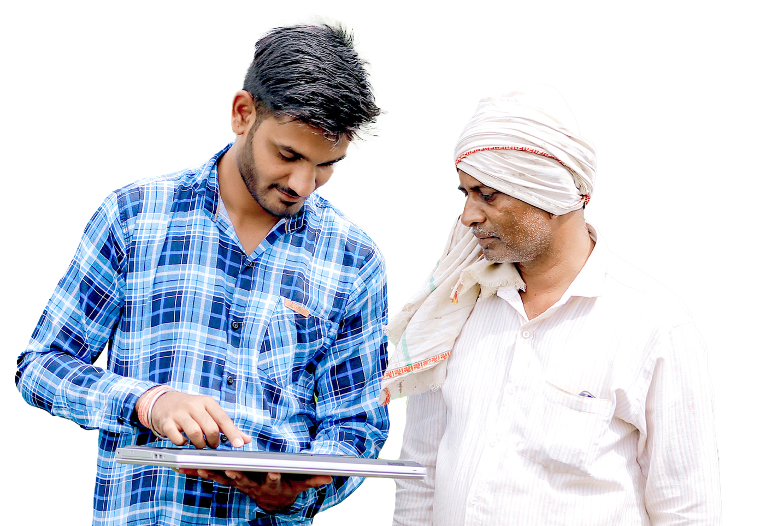
HISTORY OF CAMPAIGN 100 LION YEAR 2021-2022

Slide 16
2021 Convention
LCICon goes virtual
Election of the Douglas X. Alexander, first black International President, from Brooklyn, New York, USA
Past International President Dr. Jung-Yul Choi became LCIF Chairperson
Election of Fabricio Oliveira as the first Vice-President from Latin America in 25 years
Notes:
Lions clubs international hosted its first online convention, inclusive of elections. The first black president of Lions Clubs International, Douglas Alexander was elected. Immediate Past International President, Dr. Jung-Yul Choi became LCIF’s Chairperson. Lion Fabricio Oliveira of Brazil was elected Third Vice President.

Slide 17
International News
Historic flooding in Northern Europe
2020 Summer Olympic and Paralympic games were held
More in person events being held as vaccination rates increase
Notes:
This year has already seen horrible flooding across Northern Europe. LCIF responded immediately, with Major Catastrophe grants. The 2020 Summer Olympic and Paralympic Games were also held this year: a year late; in Japan. We continue to live with the Coronavirus, but as more and more people get vaccinated, we are seeing opportunities to meet again as Lions. Many of us will do so at the upcoming European Forum this year.

Slide 18
INCREASING Service Impact
FIGHTING
Diabetes
EXPANDING
Global Causes
Notes:
The Corona virus has given many of us a renewed appreciation for the opportunities we have to make a difference in this world, and it is clear that there are more opportunities now, than ever. To prevent the spread of Corona virus many measles, diabetes, nutrition, and other public health programs have been put on hold around the world. Increasing risks to health for millions of people. We know the need to address disaster relief and to keep first responders safe has become more complicated with the pandemic as well. We need the help of all our Lions now more than ever, and the truth is that these programs require money to be successful.

Slide 19
LCIF: RESPONDING TO COVID-19 IN CA IV
CA IV:
44 grants || US$1,671,259
Notes:
During the Covid-19 Pandemic, LCIF awarded 44 grants to Constitutional Area IV totaling over 1.6 million dollars. Because of the generosity of Lions, both before and during the pandemic, LCIF was able to quickly begin sending these grants. They met immediate needs of communities including the purchasing of personal protective equipment for healthcare and frontline workers.
Thank you to the Lions of CA IV for your service to your community. It is an honor to serve alongside such dedicated humanitarians.
(next slide)

Slide 20
Together, we serve
The beauty of being a part of the Lion community
is
we can all support one another to achieve our goal.
Notes:
The Corona virus has given many of us a renewed appreciation for the opportunities we have to make a difference in this world, and it is clear that there are more opportunities now, than ever. To prevent the spread of Corona virus many measles, diabetes, nutrition, and other public health programs have been put on hold around the world. Increasing risks to health for millions of people. We know the need to address disaster relief and to keep first responders safe has become more complicated with the pandemic as well. We need the help of all our Lions now more than ever, and the truth is that these programs require money to be successful. That is why now, more than ever, we need your support of LCIF. I’m asking if it is possible for you, and your friends to consider donating a little more than usual this year, while still staying secure. Are we talking about one Euro? That is fine. Gifts are meaningful because of their value to the giver. Would you forgive me if I asked if you might be able to add an additional Euro to your regular donations to LCIF? How about an additional Euro per week to your typical giving? How about two Euros? If every Lion in Europe committed to donating what they could, above their regular LCIF donations, imagine what could be possible. I hope you will choose to make an additional donation this year- whatever is right for you- and that you will tell your fellow Lions about your choice. The Lions of Constitutional Area IV are capable of incredible things, and will continue empowering incredible Lions Service through their support of LCIF and Campaign 100.

Slide 21
THANK YOU VERY, VERY MUCH!
Notes:
Thank you very, very much for your attention, and for your continued support of LCIF, our Foundation!
Now, it is my honor to introduce Past International Director Claudette Cornet.

Slide 22
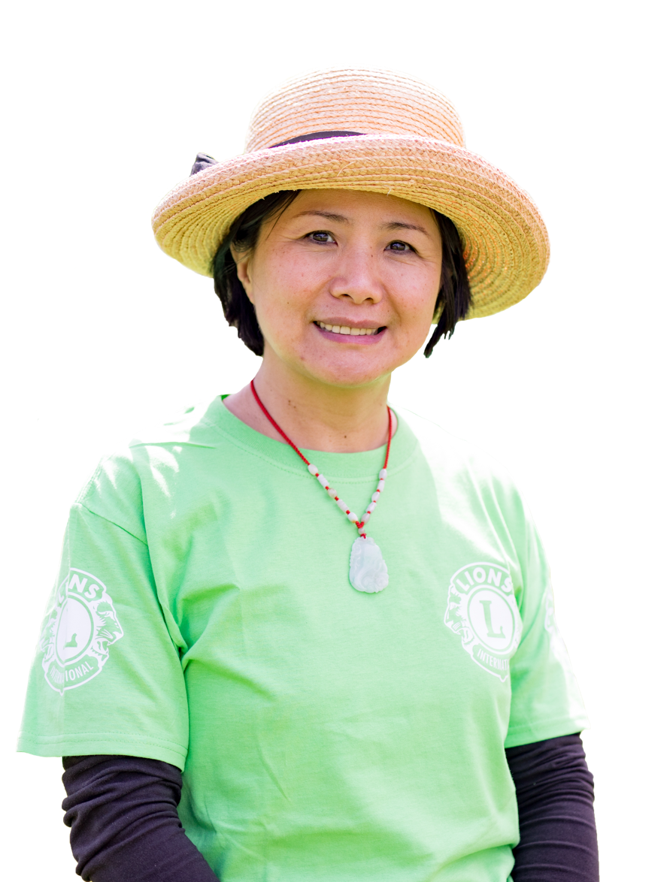
CAMPAIGN 100: BE PART OF HISTORY
Notes:
Thank you, Former President Grimaldi, for your inspiring words. The accomplishments we as Lions around the world, and we the Lions of Europe have seen during these past years of Campaign 100 is incredible. It is something I am always happy to be reminded of. It inspires me to do even more, and continue growing the impact that we as Lions have in our communities, and around the world.
This year is an important one. We are in the final year of our largest campaign in Lions’ history. Simply put, your involvement in Campaign 100 makes YOU part of history.
(next slide)

Slide 23
Since
1968
US$1.1
billion
Notes:
For those who may be new to Lions or not as familiar with OUR foundation, it is with LCIF grant funding that our clubs and districts are able to help more people in need and create even deeper, lasting impact. With this vital support, we help those most vulnerable. We help communities heal after natural disaster. We restore vision. Prevent avoidable blindness. LCIF also helps us screen and educate more people about diabetes. It also empowers us to support children with cancer, and their families. And help youth learn valuable life skills. Our global foundation is also helping Lions and Leos worldwide create systems to feed the hungry and protect our environment.
Since 1968, LCIF has awarded more than 1.1 billion U.S. dollars in grants! Just think of the millions of lives Lions have changed with grant funding from LCIF.
Simply put, our Foundation changes lives around the world.
(next slide)

Slide 24
100%
of donations
support those in need
Notes:
As you know, the ability to award these grants takes funding. Generous Lions like you, and clubs like yours, donate to LCIF each year. I want you to know that 100% of each donation – every gift you make, no matter the size – support Lions projects in our communities!
(next slide)

Slide 25
OUR WORLD IN NEED
One-third of teens worldwide have experienced bullying
Weather-related disasters have increased 50% in 40 years
2.2 billion people have vision impairment or blindness
Each day, 300 people die from measles
1 in 11 people has diabetes
300,000 children are diagnosed with cancer each year
By 2025, 50% of the world will live in water- stressed areas
~1 in 9 people lacks enough food to be healthy and active
Notes:
As you see here, our world is in need. And where there’s a need there’s a Lion.
Together, Lions and LCIF are improving health and well-being, strengthening communities, and protecting those who are vulnerable. Together, we’re ensuring YOUR community service for causes you care deeply about is as impactful as possible!
Simply put, by taking advantage of LCIF grants, you’ll take your service to the next level.
(next slide)

Slide 26
OUR PAST CAMPAIGNS
SIGHTFIRST I (1990 - 1994)
US$140 million || Goal: US$130 million
SIGHTFIRST II (2005 - 2008)
US$205 million || Goal: US$150 million
Since SightFirst launch:
1,398 grants totaling more than US$372 million
Vision impacted for 488+ million
Notes:
As a Lion since [YEAR], I’ve witnessed firsthand the power of what we do in our communities and on a global scale. In 1990, LCIF announced Campaign SightFirst with a goal to raise 130 million U.S. dollars. By the end of that campaign, we’d collectively raised more than 140 million.
Campaign Sight First two launched in 2005 with a goal to raise 150 million dollars. By the end of THAT campaign, LCIF again exceeded its goal and raised 205 million.
Since the launch of SightFirst in 1990, LCIF has awarded nearly 1,400 grants totaling 372 million U.S. dollars and impacted vision for 488 million people worldwide.
Today, we continue the momentum with Campaign 100 in order to magnify the impact of your community service in cause areas you care about most.
(next slide)

Slide 27
CAMPAIGN 100: LCIF EMPOWERING SERVICE
Prof. Dr. Giuseppe Grimaldi
Former International President
Notes:
It is a true honor to join campaign leaders in all constitutional areas, districts and clubs; and YOU on this Campaign 100 journey. This is OUR campaign. A campaign designed to benefit YOU. A campaign that at this very moment is helping take our service to new heights in all eight LCIF cause areas. And a campaign ensuring the service upon which you are building your Lions legacy becomes the foundation on which the next-generation of Lions begins their legacy.

Slide 28
Notes:
LCIF’s commitment to you and 1.4 million Lions and Leos worldwide is why I am proud to be the Vice-Chairperson of Campaign 100 in Constitutional Area IV. Together with your local leaders, Campaign Chairperson Former President Grimaldi, my Co-Vice-Chairperson PID Robert Rettby and I are championing our campaign because it is so very important to your service today and to the service of Lions and Leos for decades to come. We dedicate ourselves because ultimately, Campaign 100 benefits your community and our world in need.
I promise you… With your support, and with your club’s support, Campaign 100 WILL be the most impactful campaign in LCIF history. I hope you’ll join us in becoming part of Lions’ and Foundation history!
(next slide)

Slide 29
INCREASING Service Impact
FIGHTING
Diabetes
EXPANDING
Global Causes
Notes:
The cause areas served by LCIF and our campaign bear repeating.
Through Campaign 100, we are increasing our service impact in vision, youth development, disaster relief, and humanitarian efforts.
(click)
We are also fighting the global epidemic of diabetes and improving quality of life for those diagnosed
(click)
And we’re also expanding our focus on childhood cancer, hunger, and the environment.
The needs of our world are changing rapidly. And with your help, LCIF will be there with funding to help us meet those needs.

Slide 30
US$300 MILLION
To serve our world in need. We must significantly add to our progress.
Notes:
Campaign 100’s fundraising goal is 300 million U.S. dollars. That’s a tremendous sum of money but remember the goals we just discussed. The world needs our service. Together, Lions and clubs worldwide have already helped us progress toward our goal.

Slide 31
US$49 MILLION
To serve our world in need. We must significantly add to our progress.
Notes:
In Constitutional Area IV, we aim to play a crucial role in Campaign 100 by reaching our ambitious goal of US$49 million in fundraising.
As I said, this goal is ambitious. But we Lions of Europe are NOT going to back down from a challenge. We will be successful. And in this success, we will empower incredible Lions Service for years to come.

Slide 32
LAUNCHING NEW GRANT PROGRAMS
CHILDHOOD CANCER GRANT
15 grants || US$851,935
HUNGER GRANT
37 grants || US$1,552,144
Notes:
Speaking of the needs of the future, we can be extremely proud of progress we have already made to meet these needs.
In 2019, LCIF launched two new grant programs addressing Childhood Cancer and Hunger. To date, these pilot grant programs have together awarded 52 grants totaling more than 2.4 million U.S. dollars.
In India, Lions used a Hunger grant to upgrade kitchens and dining facilities in NINETY childcare centers throughout the state of Kerala. These improvements are helping more than twenty-two hundred children enjoy freshly prepared meals in clean, welcoming environments.
(next slide)

Slide 33
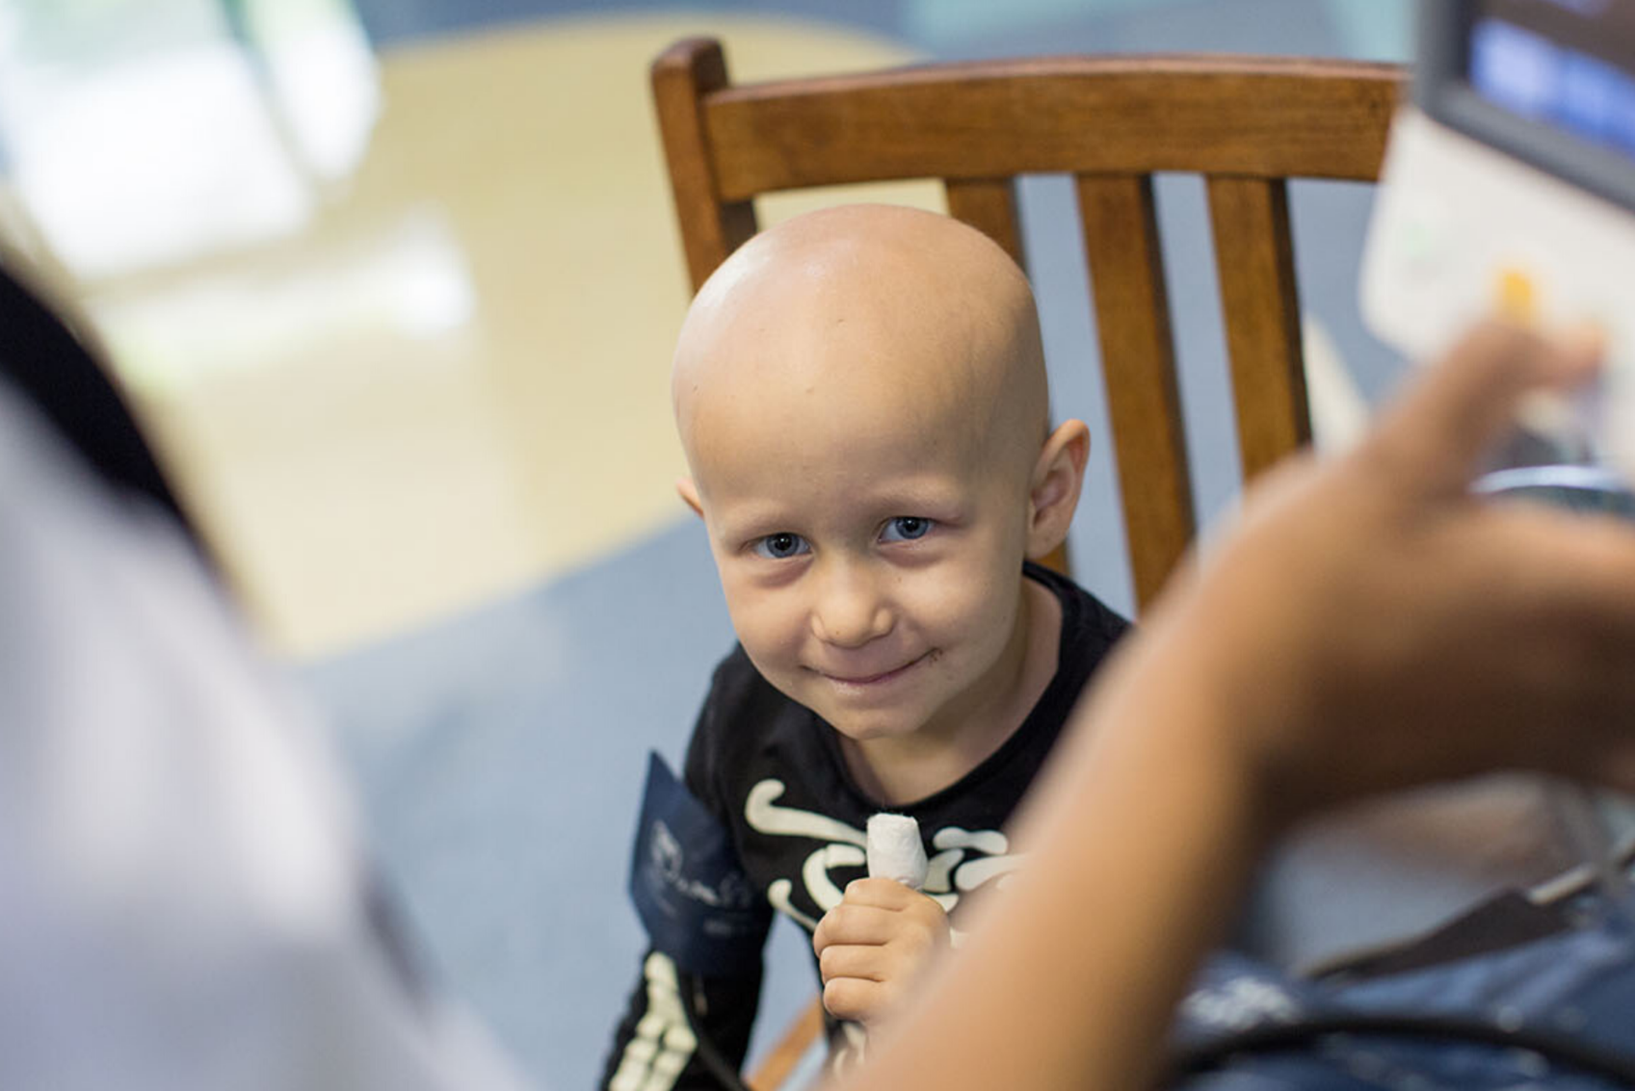
NEUROBLASTOMA GENE SEQUENCING KIT
Bosnia & Herzegovina
MAT16802 || US$36,900
Children’s oncology ward at Dokuz Eylul University Institute of Oncology
Van for mobile response team
Travels to cancer survivors’ homes; recommend specially designed after-care
33
Notes:
300 thousand children are diagnosed with childhood cancer every year. It is a vulnerable period in their lives, and a great challenge for their families. At a time that seems so sad, and so desperate, parents must quickly understand their medical options and plan a path forward. Many parts of the world lacks access to critical treatment and follow-up care.
In Bosnia and Herzegovina- a country of over 3.3 million people, only one hospital provides cancer treatment for children. Many in the country experience economic hardship and live far from the hospital, making it difficult to continue regular checkups once initial cancer treatment ends. With 75 percent of children experiencing complications after treatment, Lions recognized the serious inadequacy and turned to LCIF, our foundation, for funding to take impactful action.
Lions responded by purchasing a van: establishing the country’s first mobile follow-up program for childhood cancer survivors.
The van, is equipped with medical instruments and technology for delivering follow-up services to children in need across the country. Families no longer need to travel to the hospital, the hospital comes to them. A team of childhood cancer experts, including a doctor, nurse, psychologist, social worker, educator, and a peer counselor deliver treatment. The peer counselor is often a young cancer survivor.
Each year, the van serves as many as 200 children recovering from cancer, along with their families, and provides the critical follow-up care at no cost.
Programs for childhood cancer are so powerful because access to treatment makes such a big difference to survival. 80% of children with pediatric cancer in high-income countries live. 80% of children from low-income countries die.
Many of you already know about LCIF’s Global Hope hospitals in Uganda, Malawi and Botswana. If you don’t, I encourage you to learn more. The program includes training medical staff, and strengthening infrastructure to provide a faster, higher level of treatment. The program is new, and last year, the facility in Botswana rang a bell at its entrance for the first time. That bell is rung every time a child receiving treatment is diagnosed to be cancer free. This pandemic has made treating cancer more challenging because patients have compromised immune systems, but programs continue. We look forward to continuing to providing assistance in these challenging time.

Slide 34
MOVING CHILDREN FROM HUNGRY TO HOPEFUL
Repairing old kitchens to prepare healthy futures
US$95,000 // Kerala State, India
4 in 10 children face undernutrition, stunting
Thousands receive meals at childcare centers; many had failing kitchen equipment
LCIF Hunger grant and DCG to refurbish kitchen, dining facilities in 90 Anganwadies
2,200 children each year benefit
Notes:
I think we all agree that NO ONE should ever go hungry. Yet the sad truth is that hunger is an ongoing and worldwide issue, with chronic undernutrition leading to illness and to delayed physical and mental development for children. It’s heartbreaking to know that in India, a staggering four in 10 children, 40 percent, face undernutrition or stunting.`
As you may know, thousands of youngsters in rural Kerala depend on government-run Anganwadies, or childcare centers, for their meals. With many of the facilities having old kitchen equipment in need of repair, preparing meals for the children was both unhygienic and challenging.
Knowing the importance of the Anganwadies, Lions took action. They turned to LCIF, which awarded them more than 95,000 U.S. dollars in funding through a Hunger grant and a District and Club Community Impact grant. Lions used the funds to refurbish kitchen and dining facilities in 90 Kerala Anganwadies with upgraded appliances, plumbing and furniture.
Because of Lions and our foundation, more than 2,200 children each year can enjoy fresh cooked food prepared in clean and updated environments, easing the minds of parents and teachers: that’s 2,200 children receiving safe, healthy nourishment every day, for years to come.
Sustainability and impact are an important part of the assessment of all grant applications, and you can see that reflected in the type of projects that LCIF approves.

Slide 35
LCIF RESPONSE TO COVID-19
WORLDWIDE
385 grants || US$6,846,917
CA IV:
44 grants || US$1,671,259
Because of your generosity, LCIF able to award grants quickly
Purchased protective equipment for healthcare, frontline workers
Notes:
COVID-19 has drastically changed all our lives and quickly shifted how we ALL connect and serve our communities.
However, I have some great news to share on how LCIF continues to support Lions and Leos service through the pandemic.
Since March 2020, LCIF has awarded more than 6 million U.S. dollars for COVID-19 relief. 1.6 million US dollars were sent to Constitutional Area IV. How was LCIF able to award this funding so quickly? With support from donors like you giving what you can. Your gifts to LCIF and our campaign are why much needed personal protective equipment and other necessities reached healthcare workers in your community and mine.
Thank you for looking after your neighbors on the front line of pandemic relief.
And, thank you for your attention today. It has been wonderful being here with you.
I am proud to introduce, now, my co-vice Chairperson of Campaign 100 in CA IV, Past International Director Robert Rettby.
(next slide)

Slide 36
CAMPAIGN 100: HOW WE REACH OUR GOAL
Notes:
Thank you, PID Claudette, and hello Lions! What an honor it is to be here, speaking with you all about this Campaign, and how important and impactful it is.
Now that PID Claudette has spoken about what we have accomplished thus far during our Campaign, and the impact that it is already having, I am excited to tell you about how we can meet our goals in this Campaign!
(Next slide)

Slide 37
OUR LARGEST CAMPAIGN IN HISTORY
Increase Model Clubs
Increase Club and Individual donations
LCIF District and Club Community Impact grant program
Notes:
This year we are focusing on three initiatives to help us reach our goal of US$300 million globally, US$49 million in CA IV:
With your help, we need to increase the number of Model Clubs
We need more members to participate in our campaign. We need EVERY Lion and Leo – and club – on board!
And we need to make sure we all spread the word of LCIF’s District and Club Community Impact grant program, which returns a portion of what we donate to LCIF to our communities in the form of grant funding. More on this wonderful grant program for your club or district in a few minutes.

Slide 38
MODEL CLUBS
Model Clubs: leaders in our sense of community. Commitments from Model Clubs support areas of greatest need for Lion communities worldwide.
Consider giving goal that makes your club a model club, or take it to next Model Club level.
3 key things to remember about Model Clubs:
All funds raised since July 1, 2017 count!
All funds from all sources count!
*UPDATE* Clubs have 3 years from commitment date to reach goal!
Notes:
Model Clubs are crucial to Campaign 100’s success AND to your service impact. To reach Model Cub status, clubs commit to raising an amount based on a formula of the number of club members multiplied by 500. Thus, a club with 25 members would commit to raising 12,500 US dollars. Model Clubs use a variety of fundraising strategies to reach their goal. Their commitment is crucial to LCIF’s ability to contribute to our community of Lions around the world.
Examining how much in donations your club has given to LCIF since July 1, 2017, you may find that you are closer to becoming a model club then you think! We have had several clubs in CA IV change to becoming a Premier club after performing similar exercise.
The Model Club fundraising commitment becomes quite achievable by keeping in mind:
All funds raised since July 1, 2017 count – most clubs have a head start!
All funds raised from all sources count. Each member is NOT responsible for donating 500 dollars!
Clubs now have three years from the date they commit to becoming a Model Club to reach their goal AND earn limited-edition campaign recognition.

Slide 39
INCREASING MEMBER PARTICIPATION
Individual Donations, Immense Impact
2.2% of Lions have donated directly to LCIF during Campaign 100
Compared to 65% of clubs that have contributed
A cup of coffee (2 €) per week
Notes:
Our next goal is to increase member participation in CA IV.
In the coming weeks, many of you will receive a letter from Former International President Grimaldi, asking you to make a personal commitment to support LCIF and Campaign 100. Some of you may be asked to follow the lead of a Lion Leader in your region, like your District Governor, or a Past District Governor, who has committed to supporting individually.
During Campaign 100, just 2.2% of Lions have individually donated directly to LCIF. We know that here in CA IV, we almost always donate as a club, from the proceeds of our fundraising efforts. Our clubs support many causes, locally, nationally and internationally; over 65% of clubs in CA IV have donated to LCIF to support Campaign 100.
Imagine if 65% of individual Lions committed to supporting the Campaign! Can you support LCIF? How about donating the equivalent of a cup of coffee, 2 € per week, for the remainder of this year?
If every Lion in Europe committed to participating in this way, imagine what we could do. Imagine the impact we could have.

Slide 40
AMPLIFYING OUR IMPACT LCIF DAY AND THE ONLINE RECOGNITION EVENT
LCIF Day challenges every Club to participate. Host a fundraiser, and commit to donating about US$10 per member to LCIF from your fundraiser.
The Online Recognition Event will shine a spotlight on our most generous clubs, and Lions in CA IV. We will recognize new MJFs and PMJF recipients, Lead and Major Donors, and Model Clubs. Think about someone in your club who deserves to be recognized on this international scale.
Notes:
Our third goal for the year is to increase engagement with, and participation in LCIF Day and in our Online Recognition Event. Both events were launched last year, and we are so excited to see them grow, and become more impactful each year.
There will be a presentation committed to LCIF Day tomorrow at 14:15, but I will describe it briefly for you here. LCIF Day is designed to bring every club in CA IV together in one collective effort in support of our Foundation. Clubs can commit to participating by hosting a fundraising event that supports LCIF. By donating US$10 per member from the proceeds of the event, clubs will meet their commitment! Some clubs will donate even more than this, as we saw last year!
Our second annual Online Recognition Event will build off of the successes of last year’s event. If you were able to attend, you know how exciting it was. We saw Lion Leaders from across CA IV come together to share inspiring stories of success, and impact empowered by LCIF. MJF and PMJF recipients were honored, as well as Model Clubs and Lead and Major Donors.
This is an incredible opportunity for you, and your fellow Lions to honor and recognize those more deserving of it on this international scale. Think about a Model Club commitment, if you can. Think about who in your club, or who from your community, has done something meriting this kind of recognition, and consider honoring them with an MJF or PMJF.
We hope that many of you will join us in both of these impactful events!

Slide 41
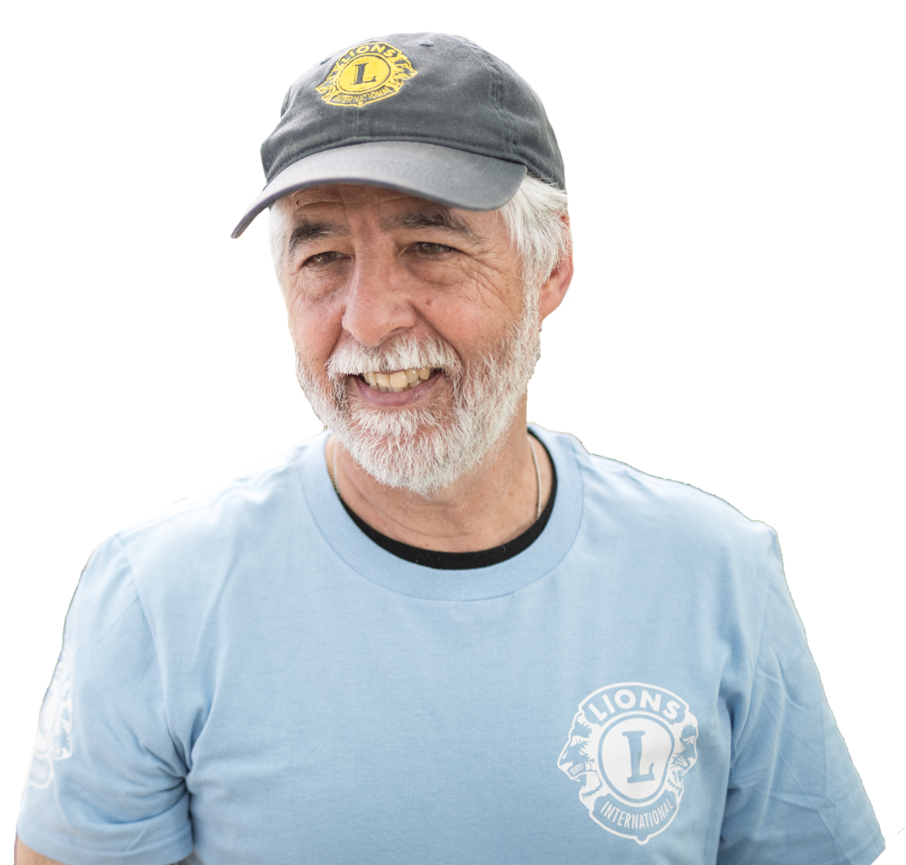
CAMPAIGN 100: BE PART OF HISTORY
Notes:
Thank you all so much for your time today, and for supporting Campaign 100 and LCIF. I ask you today to continue being a leader among leaders. Set an example for fellow Lions. Continue sharing the importance of Campaign 100 and how donating to LCIF magnifies EVERY Lions service. Every Leos service. Share stories of service that inspire you. Your leadership will inspire others, and together we WILL achieve our goal.
(next slide)

Slide 42
QUESTIONS
Notes:
At this time, I am happy to invite Former President Grimaldi and PID Claudette to join me in answering any questions, or comments you have about today’s presentation and about Campaign 100.

