Slide 1


LCIF Day 2022
October 8, 2021 - 14:15
Room Artemis
Lions Europa Forum ‘21 Thessaloniki

Slide 2
LCIF Day 2022
PID Robert Rettby
Vice-Chairperson CA4 Campaign 100

Slide 3
LCIF Day 2022
Agenda:
Introduction
Goal
LCIF Day 2021
LCIF Day 2022
Communication and Web-page
Q&A & Discussions

Slide 4
CA4 LCIF Day 2022
Speakers:
FIP Pino Grimaldi
PID Robert Rettby
PCC Jürg Vogt, MD102
1VDG Vanessa Horrod, MD103
PCC Hilde Straumsheim, MD104
PDG Claudia Balduzzi MD108

Slide 5


LCIF Day
The LCIF Day is an extraordinary Europe-wide event.
The goal of this initiative is, for all Lions Clubs in Europe, to be seen, giving our clubs and our service activities visibility, as well as to raise funds for the LCIF Campaign 100.
This first European LCIF Day was on June 12, 2021.
The next edition will be on June 11, 2022

Slide 6








Gain visibility and awareness for Lions in their communities, and throughout Europe.
Engage with the public, tell stories of our local and global impact, welcome new members.
Raise funds for the Lions Clubs International Foundation to empower Lions service.
We encourage all clubs across Europe to join.
LCIF will provide support to our clubs, such as resources, press releases or international promotion.

Slide 7
PROGRESS TO GOAL
70%
TO GOAL
As of June 30, 2021
Notes:
Donations to LCIF by the end of this year reached two-thirds of the campaign goal, with one more year to go.
CA I: US$ 32,285,321 = 58%
CA II: US$ 2,748,010 = 44%
CA III: US$ 4,837,089 = 52%
CA IV: US$ 24,618,749 = 50%
CA V: US$111,431,815 = 85%
CA VI: US$ 20,230,095 = 56%
CA VII: US$ 4,031,700 = 65%
CA VIII US$ 4,485,895 = 56%
Total 204,668,674

Slide 8

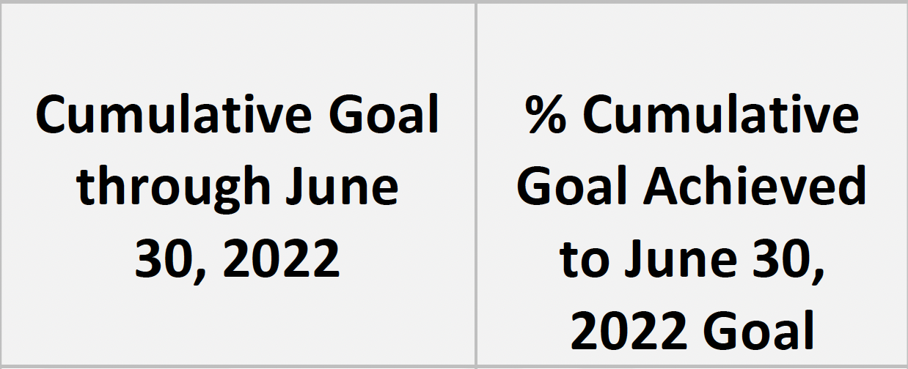

PROGRESS TO GOAL

Slide 9

LCIF Day 2021
Among the many great activities on June 12, 2021:
1VDG Vanessa Horrod, MD103
PCC Hilde Straumsheim, MD104
PDG Claudia Balduzzi MD108
PCC Jürg Vogt, MD102

Slide 10
LCIF Day 2021
MD103 – D103 SO
1VDG Vanessa Horrod

Slide 11
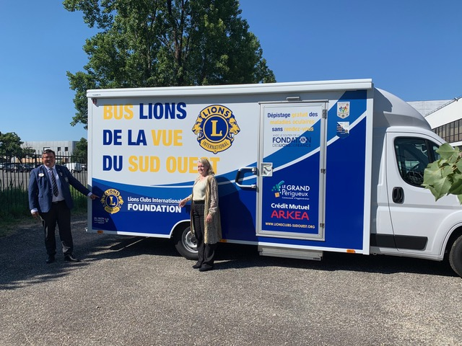
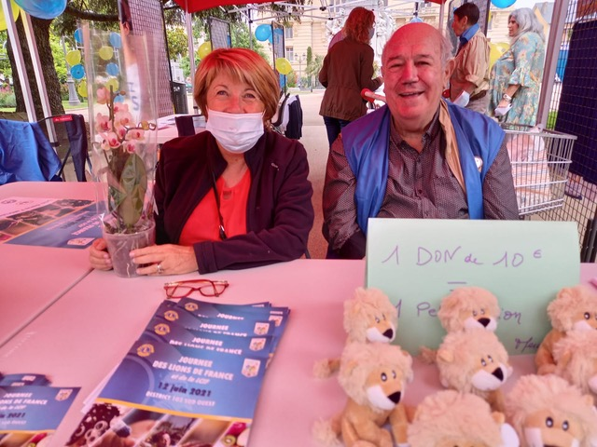

Slide 12
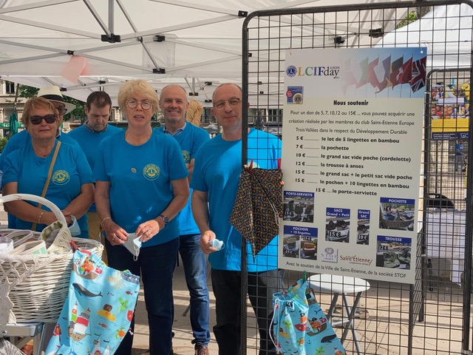
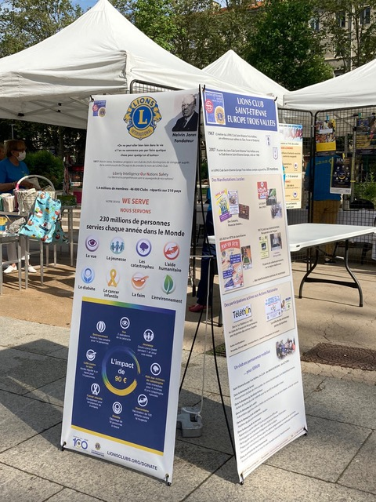
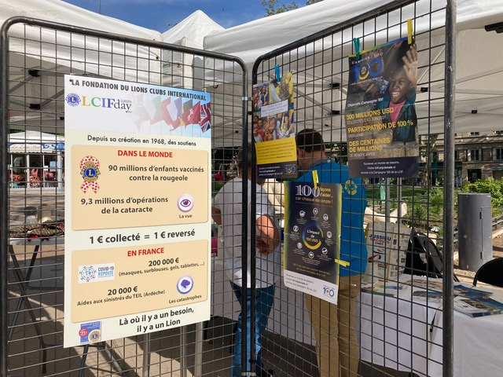

Slide 13
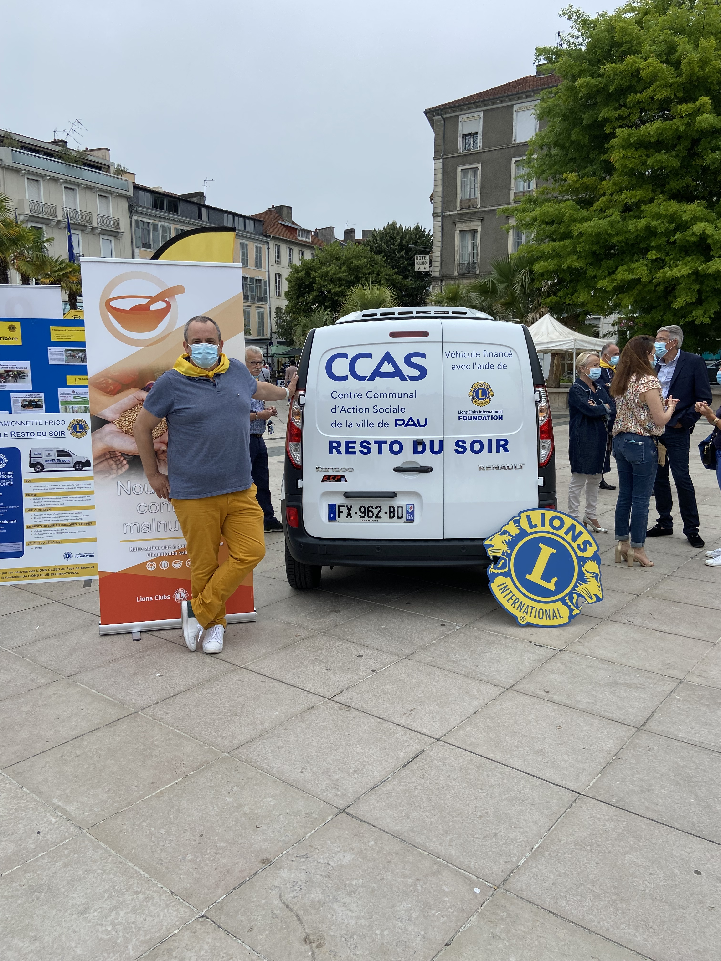
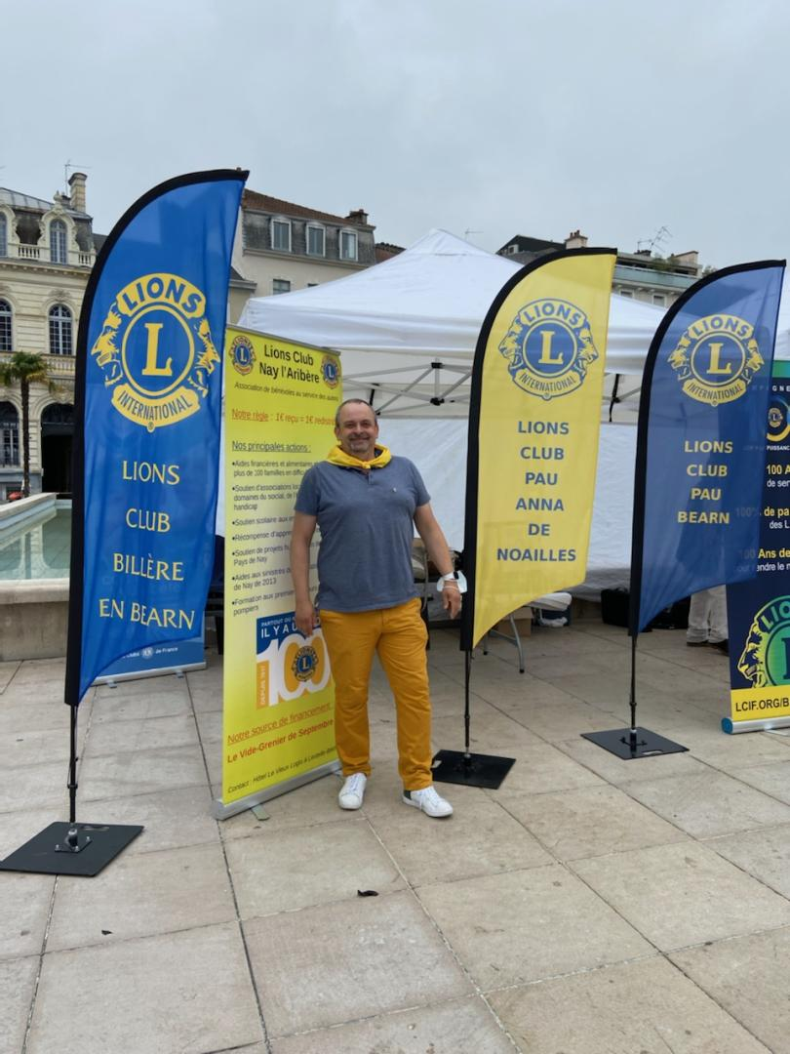
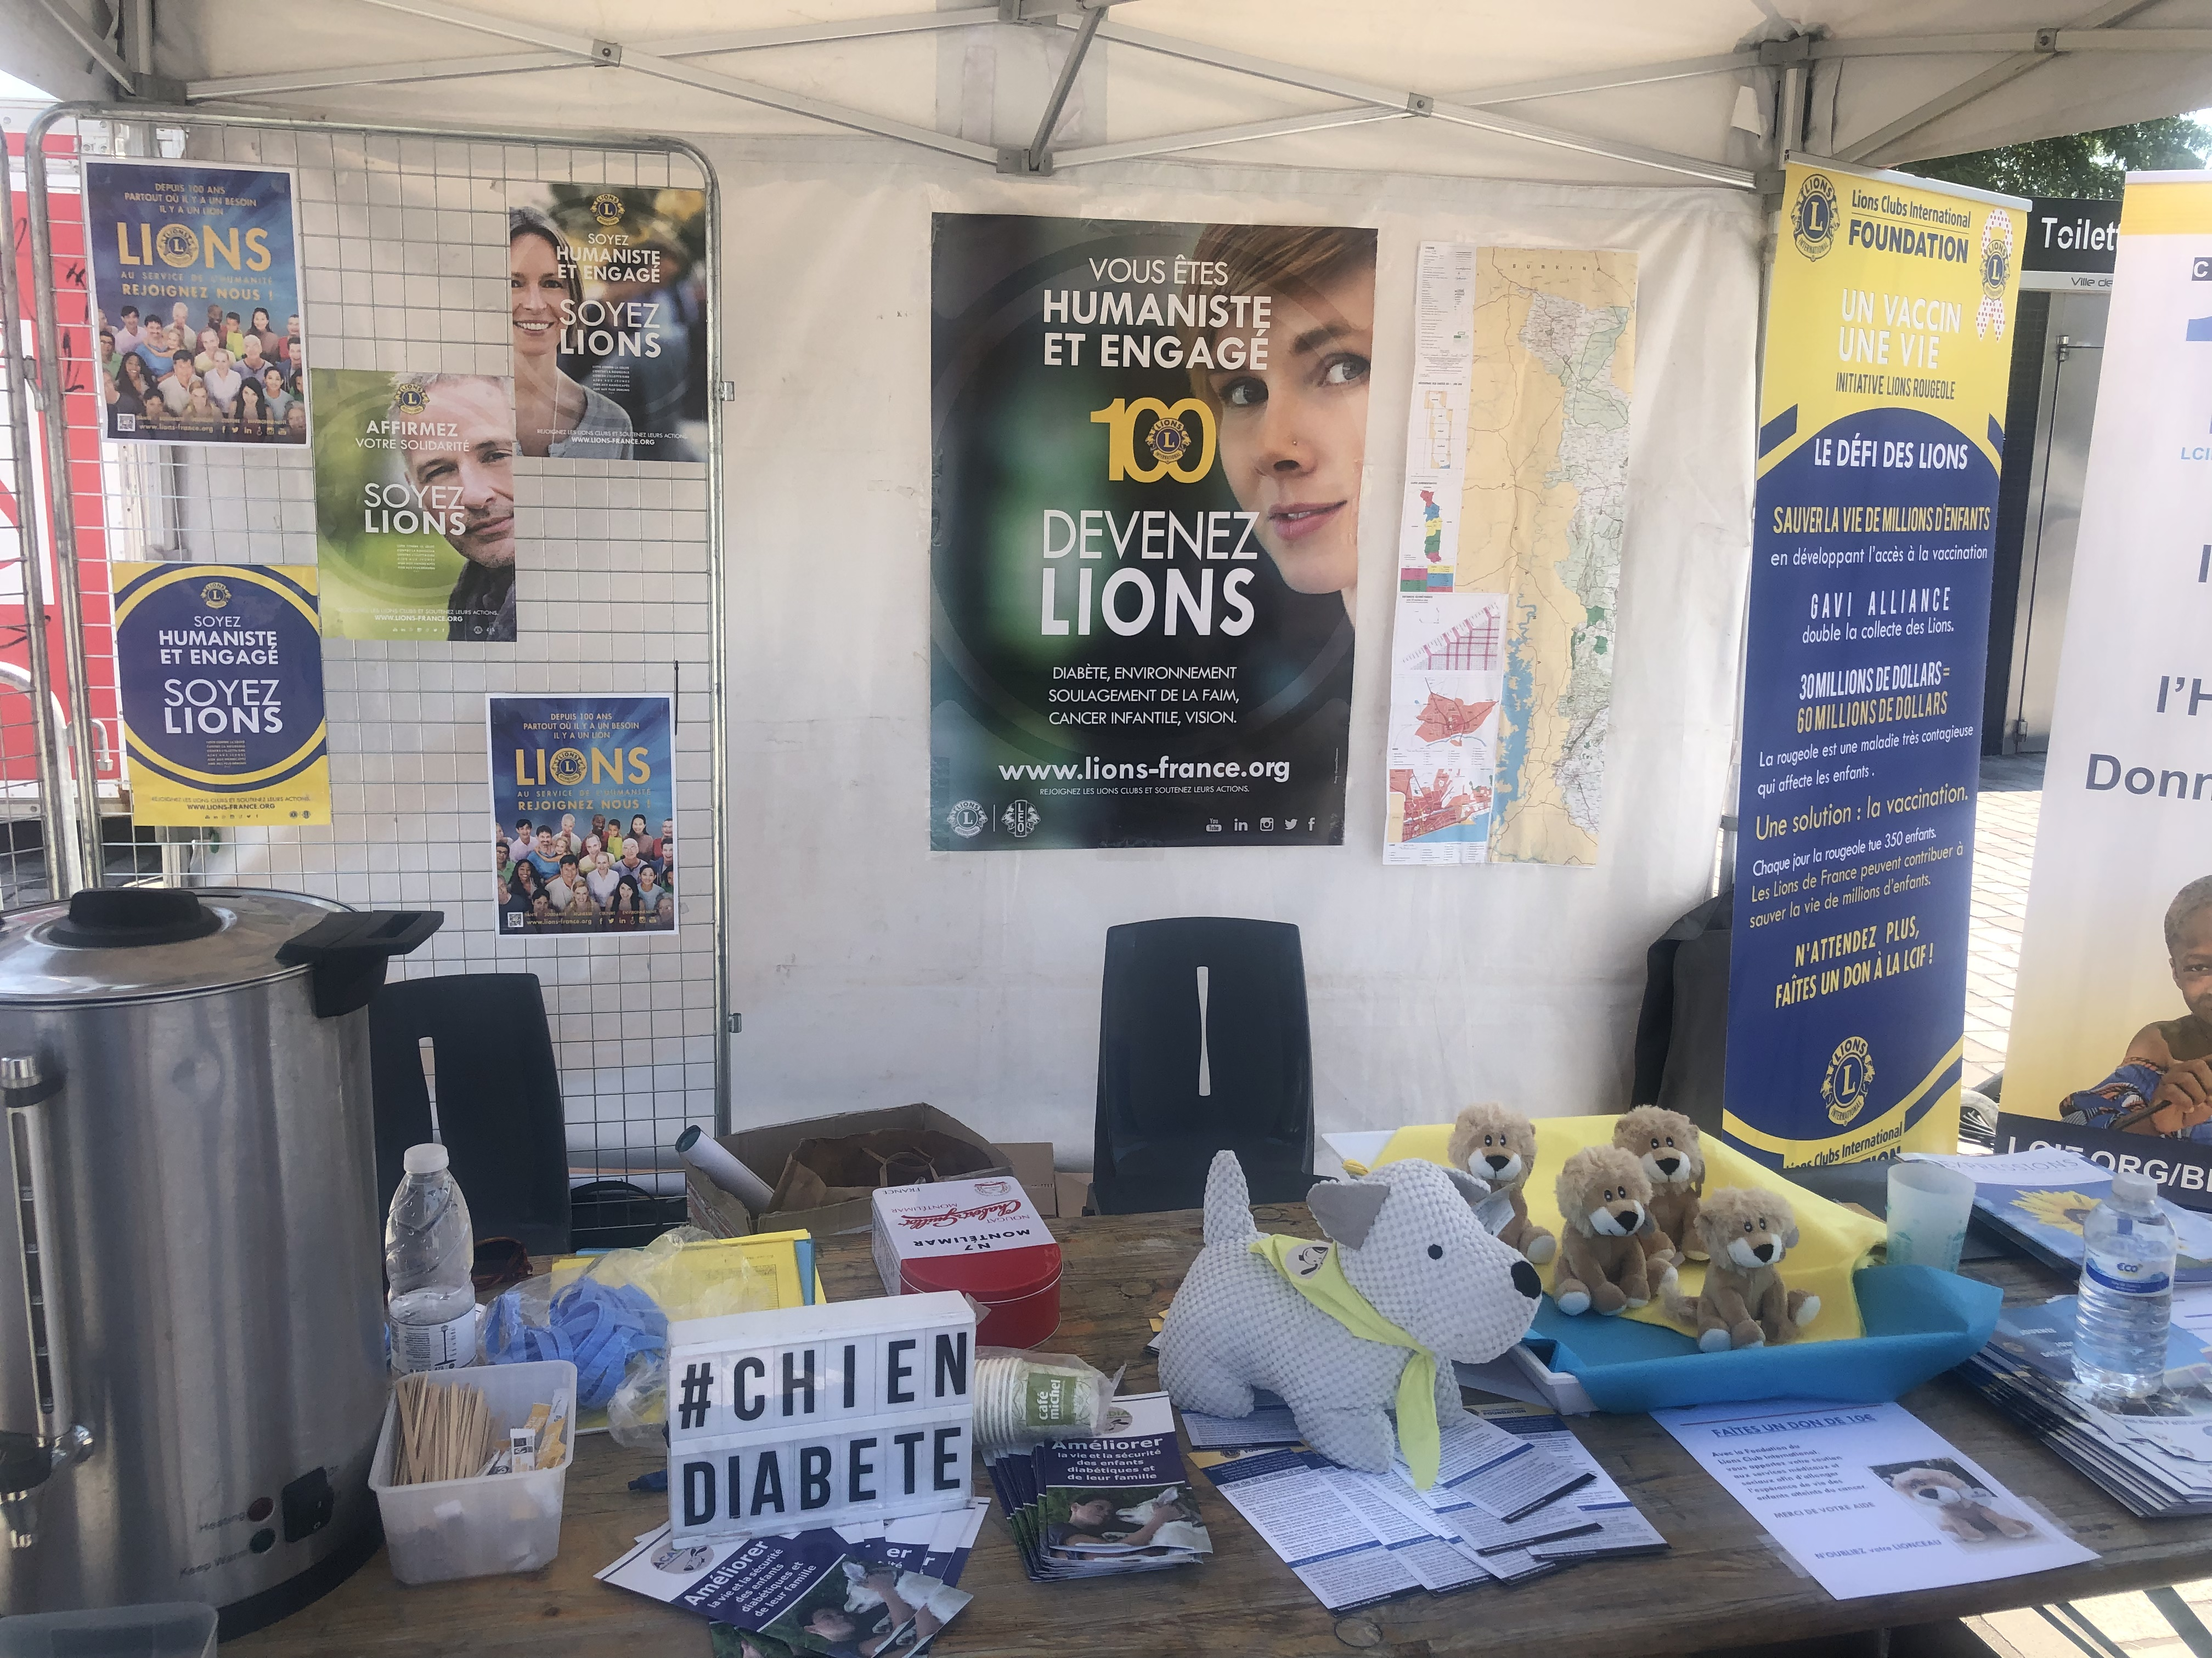

Slide 14
LCIF Day 2021
MD104
PCC Hilde Straumsheim

Slide 15
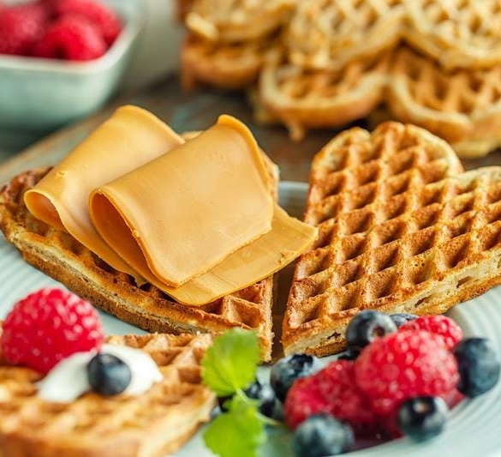
Lions International Waffle-day in NORWAY
Campaign 100 Coordinators idea :
LCIF Day = Waffle- day in Norway!
Starting June 12th 2021
Information / material to all clubs:
LCIF fact sheet
Bookmarks, how to do it
Suggested press release
Suggested text for social media
Email to all clubs – about the idea
Roll-up idea
Suggested posters
Notes:
LCIF seems very simple – we receive money as donations, and we give money as grants, give support to clubs doing service in communities and in the world. And, the results are life-changing for so many people. LCIF provides grants for large-scale projects that clubs can’t do alone.
As a nonprofit organization, we rely 100% on donations from Lions and others. They donate to us because they share our mission.
So, it is very important to promote LCIF’s mission and values. Since 1968, LCIF has given out more than US$950 million in grants! Please think about the millions of lives that Lions have changed through these grants.
Our Foundation changes lives around the world.
And it is through four areas of service…
(Transition to next slide)

Slide 16
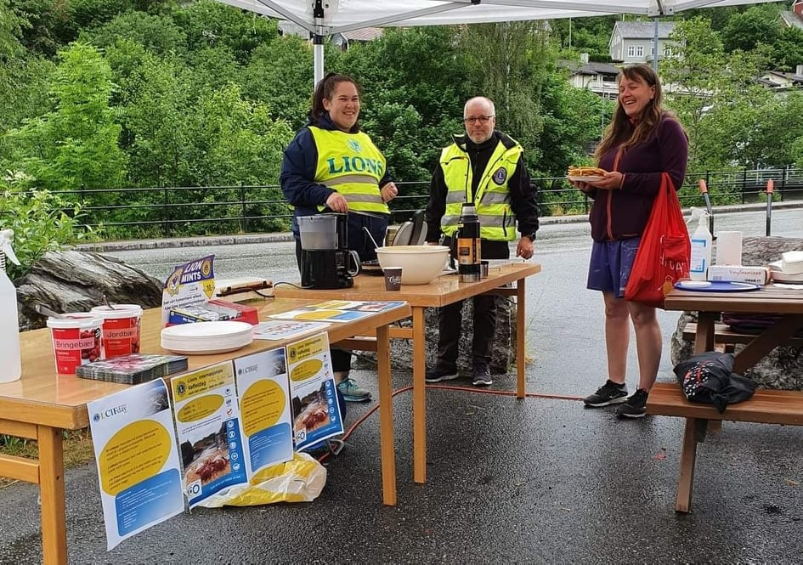
Lions International Waffle-day
FIRST STEP
TO A YEARLY CAMPAIGN FOR LCIF
Some clubs in all districts
Covid a challenge
Selling waffles not the most important
Informing about LCIF, be visible
Notes:
LCIF seems very simple – we receive money as donations, and we give money as grants, give support to clubs doing service in communities and in the world. And, the results are life-changing for so many people. LCIF provides grants for large-scale projects that clubs can’t do alone.
As a nonprofit organization, we rely 100% on donations from Lions and others. They donate to us because they share our mission.
So, it is very important to promote LCIF’s mission and values. Since 1968, LCIF has given out more than US$950 million in grants! Please think about the millions of lives that Lions have changed through these grants.
Our Foundation changes lives around the world.
And it is through four areas of service…
(Transition to next slide)

Slide 17

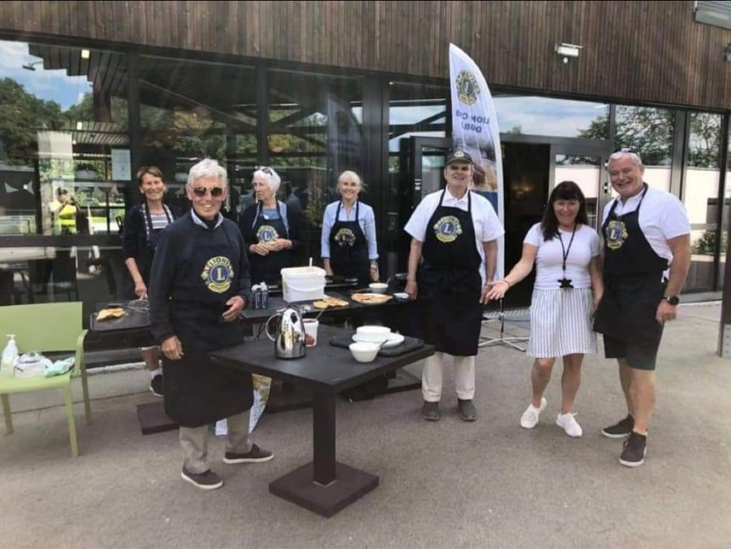
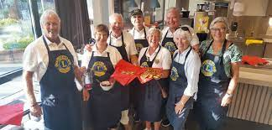

Lions International Waffle-day
BENEFITS:
Members had to be more aware / get more knowledge about LCIF
Public (and members) learned that Lions Clubs has a huge impact internationally
There was more visibility by end of the year
Significant increase of donations – more clubs than usual donated in this period
All clubs can manage
Every dollar counts, Waffles 30.000 NOK
Donations 274.000 NOK
Notes:
LCIF seems very simple – we receive money as donations, and we give money as grants, give support to clubs doing service in communities and in the world. And, the results are life-changing for so many people. LCIF provides grants for large-scale projects that clubs can’t do alone.
As a nonprofit organization, we rely 100% on donations from Lions and others. They donate to us because they share our mission.
So, it is very important to promote LCIF’s mission and values. Since 1968, LCIF has given out more than US$950 million in grants! Please think about the millions of lives that Lions have changed through these grants.
Our Foundation changes lives around the world.
And it is through four areas of service…
(Transition to next slide)

Slide 18
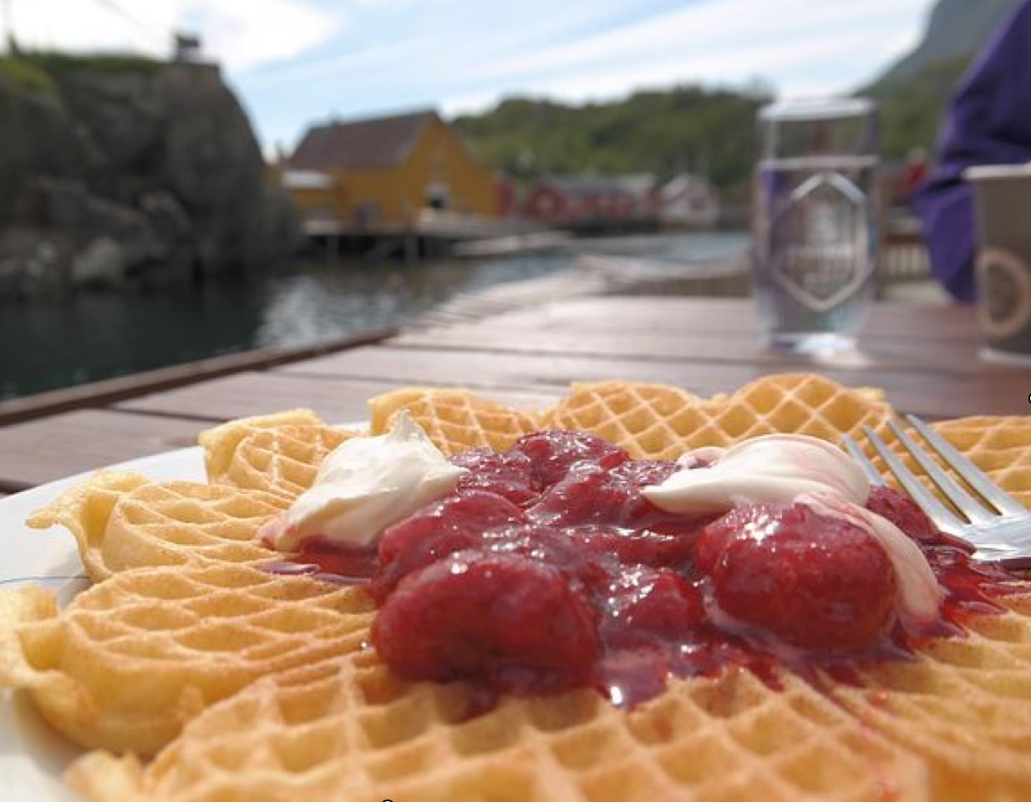

Lions International Waffle-day
Welcome
to copy
the idea!
Notes:
LCIF seems very simple – we receive money as donations, and we give money as grants, give support to clubs doing service in communities and in the world. And, the results are life-changing for so many people. LCIF provides grants for large-scale projects that clubs can’t do alone.
As a nonprofit organization, we rely 100% on donations from Lions and others. They donate to us because they share our mission.
So, it is very important to promote LCIF’s mission and values. Since 1968, LCIF has given out more than US$950 million in grants! Please think about the millions of lives that Lions have changed through these grants.
Our Foundation changes lives around the world.
And it is through four areas of service…
(Transition to next slide)

Slide 19
LCIF Day 2021
MD108
PDG Claudia Balduzzi

Slide 20
LCIF Europe Day value
Implement service activity
Serve millions of people
Raise the visibility of what Lions do - when we serve, we make a mark in our local community
Empower Lions to serve more
Help clubs and Lions fulfill their mission
Growing Together Clubs

Slide 21



Slide 22


