Slide 1
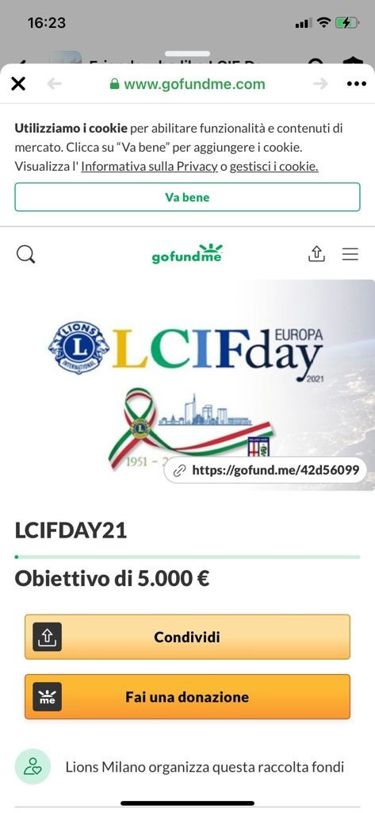
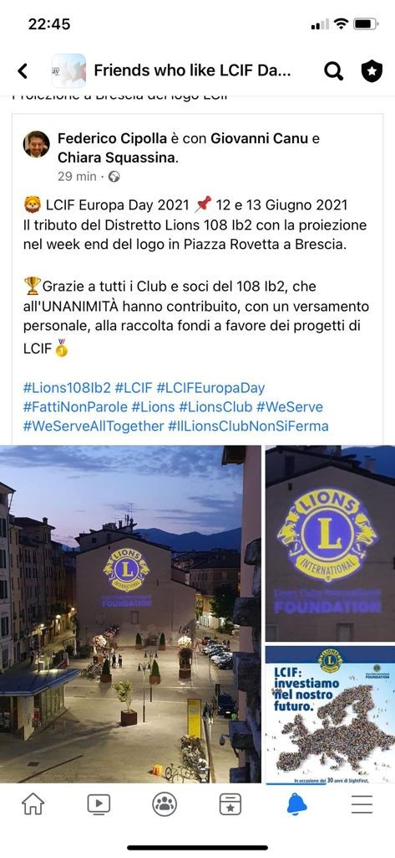

Slide 2
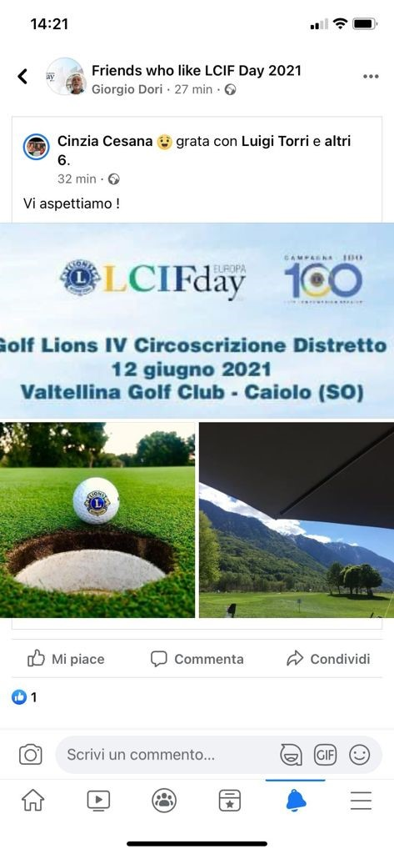
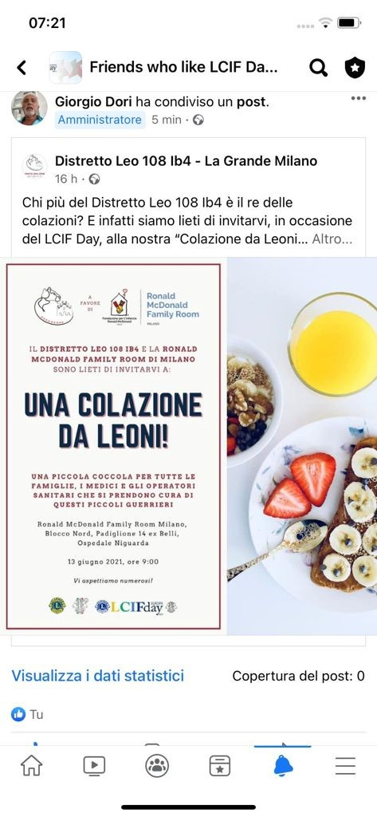

Slide 3
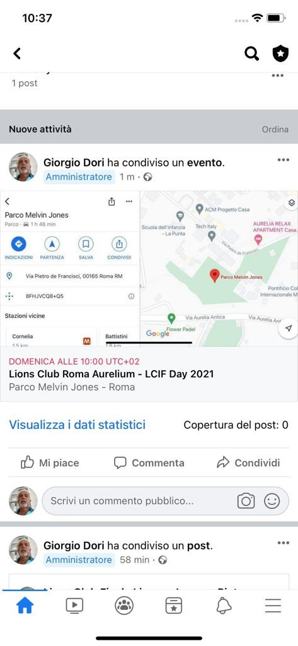
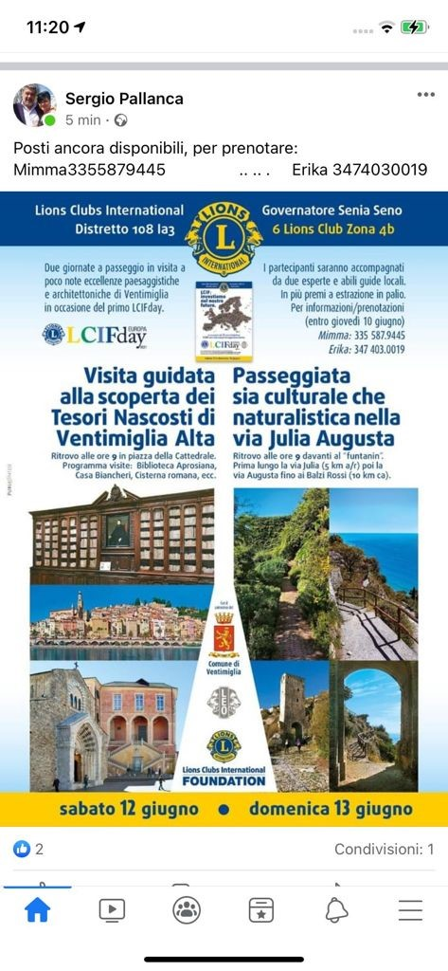

Slide 4
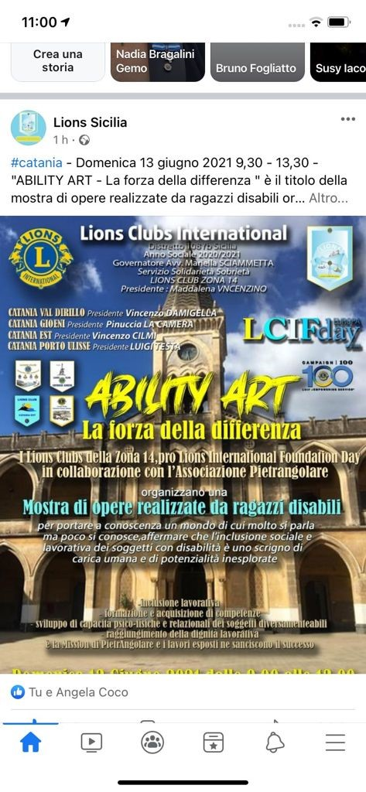


Slide 5

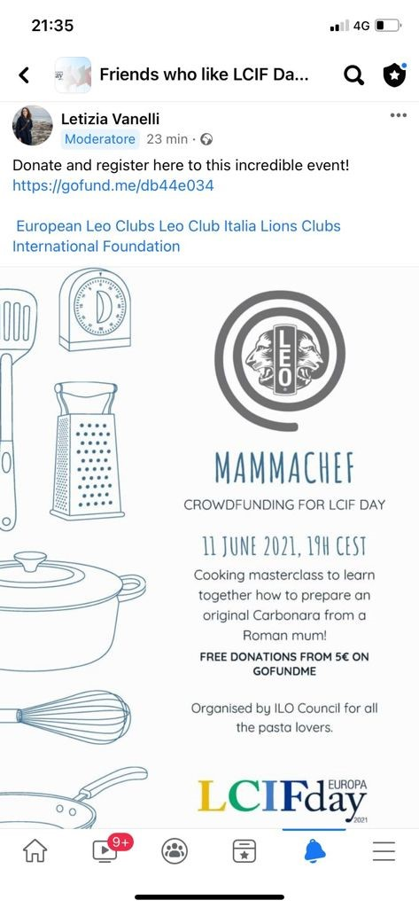

Slide 6

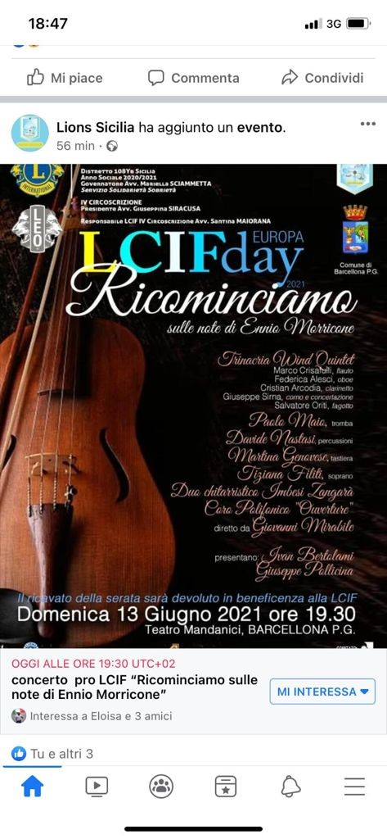

Slide 7
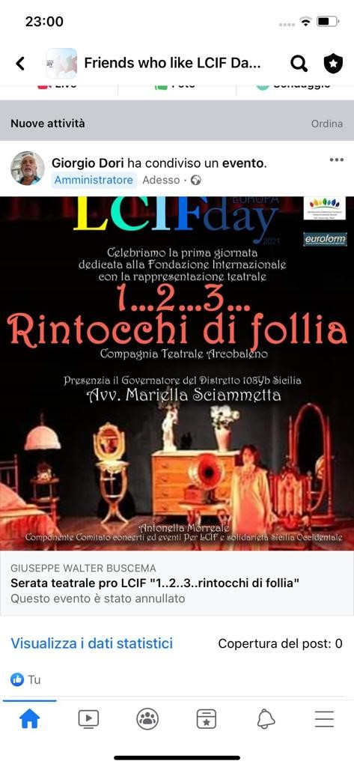
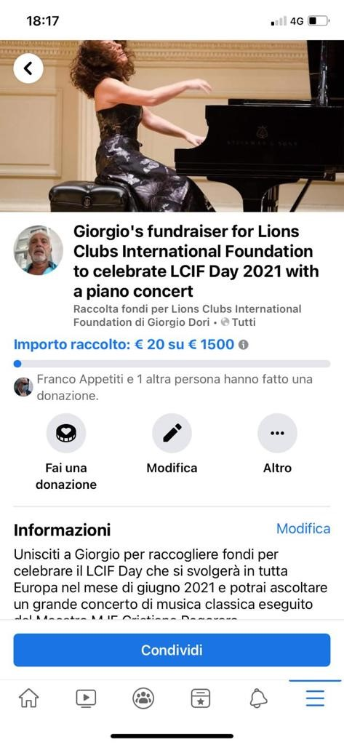

Slide 8
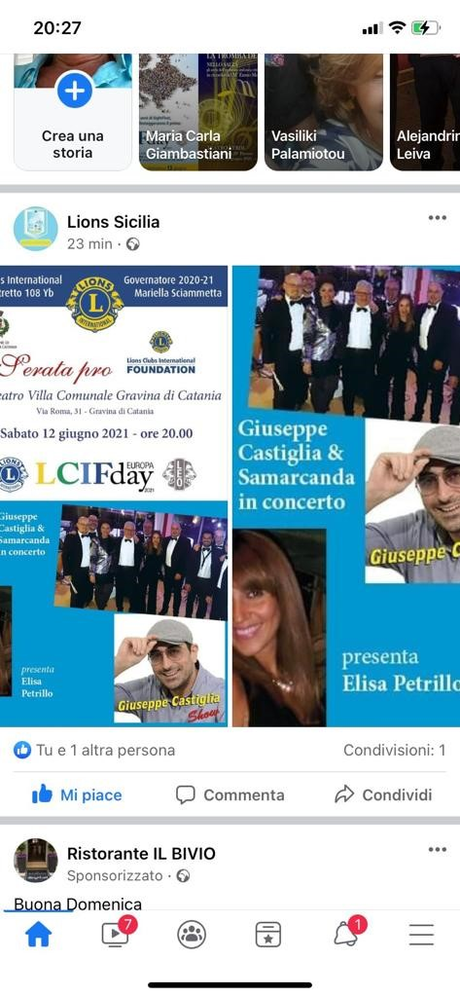
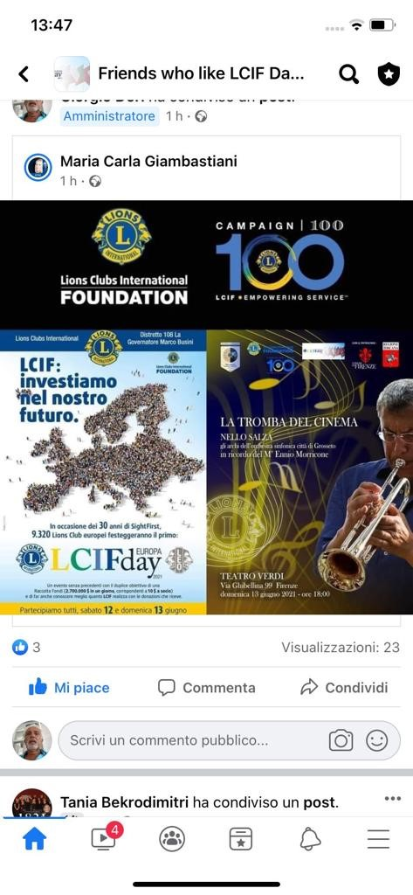

Slide 9

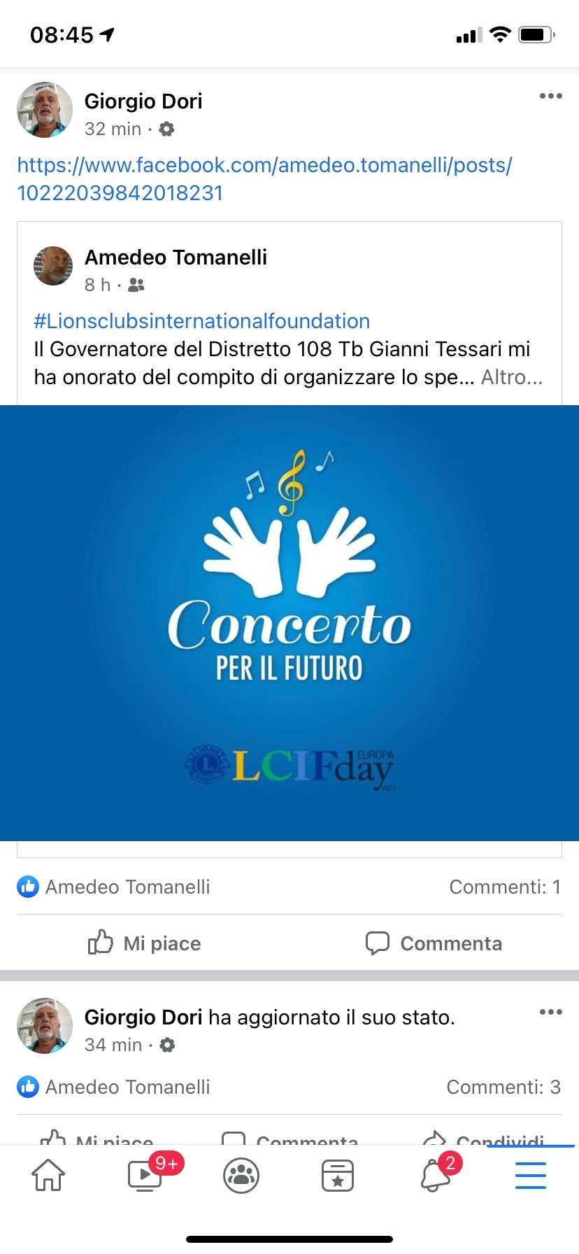

Slide 10


LCIF EUROPE Day
OUR IDEA
Together we can.
Together we will.
Involve ILO Council and all Leo Clubs of Europe and Mediterranean Area
to support our Foundation and CAMPAIGN 100
and also….
to contribute at this FIRST IMPORTANT EVENT in our history!

Slide 11
LCIF EUROPE DAY
Common format for Lions and Leos
Events on the road, open air
To be widely visible and known
To raise awareness on LCIF
To raise funds also from non Lions/Leos
2 . Shared themes between CA IV Countries
Environment
Culture
European identity

Slide 12
LCIF EUROPE Day
3. Fil rouge: European Cultural Routes
www.coe.int/en/web/cultural-routes
  Via Francigena
  Via Teutonica
  Camino de Santiago
  King Olaf’s path
  many others (national and transnational)
4. Fundraising
  Local and/or global sponsors
  Social media (Facebook, etc)
  App’s (Charity Miles, Walking for Charity, etc.)

Slide 13
LCIF EUROPE Day
5. Leo’s will have a very important role
  Organizing
  Communicating
  Implementing advanced tools
  Bringing enthusiasm
  Developing innovative approaches
6. EU institutions can be possibly involved
  Communication
  Support
  Funding

Slide 14
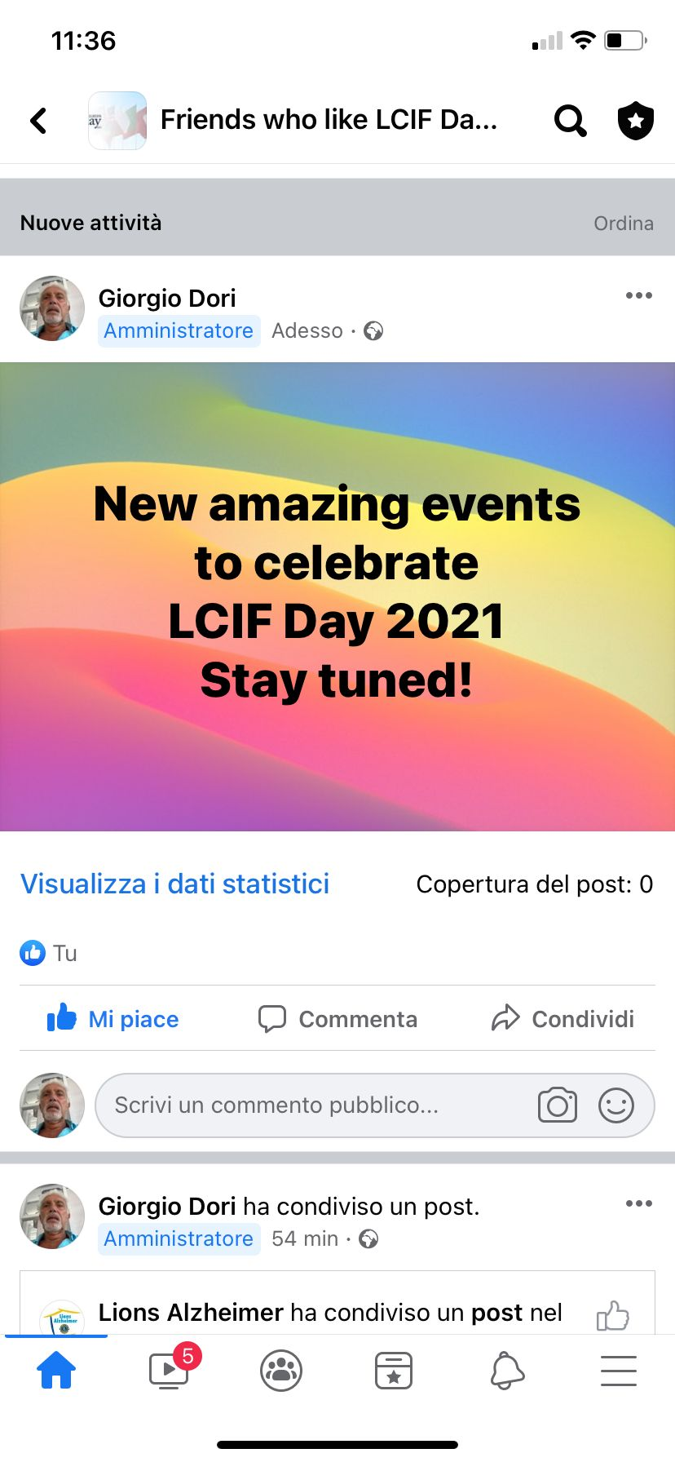
The show must goes on … June 11, 2022 we are waiting for all of you every gift counts specially whom from the heart

Slide 15

Thank you
“When we serve together, our hearts beat stronger.”
IP Douglas X. Alexander

Slide 16
LCIF Day 2021
MD102
PCC Jürg Vogt

Slide 23
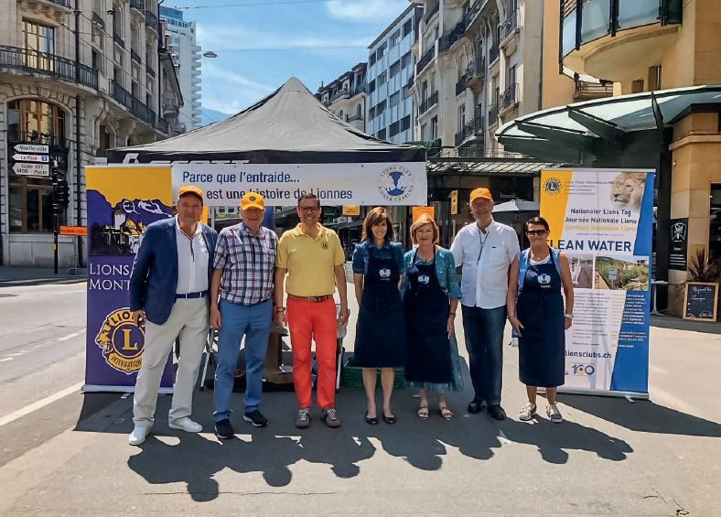
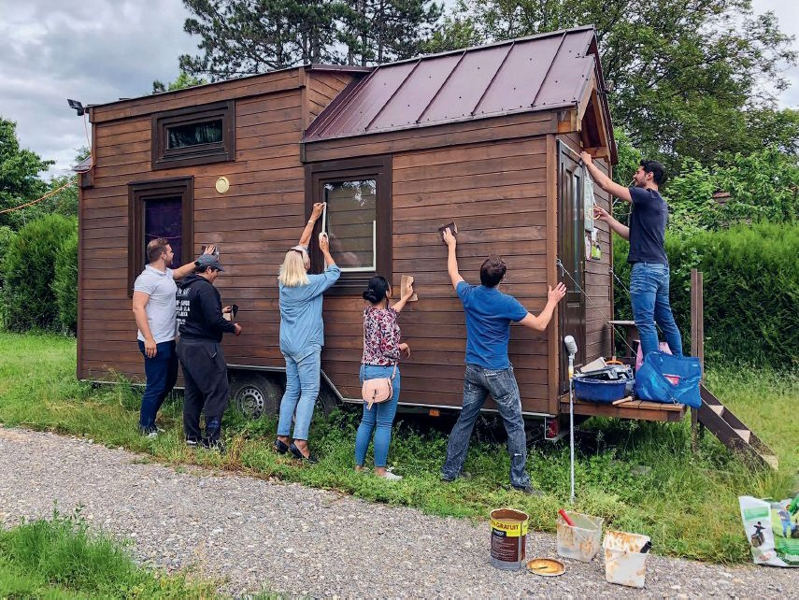
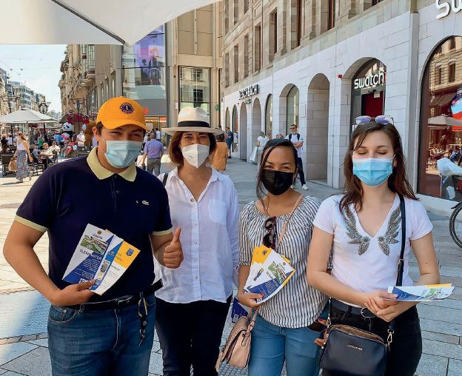
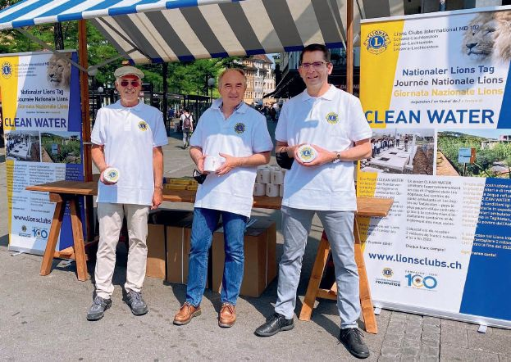
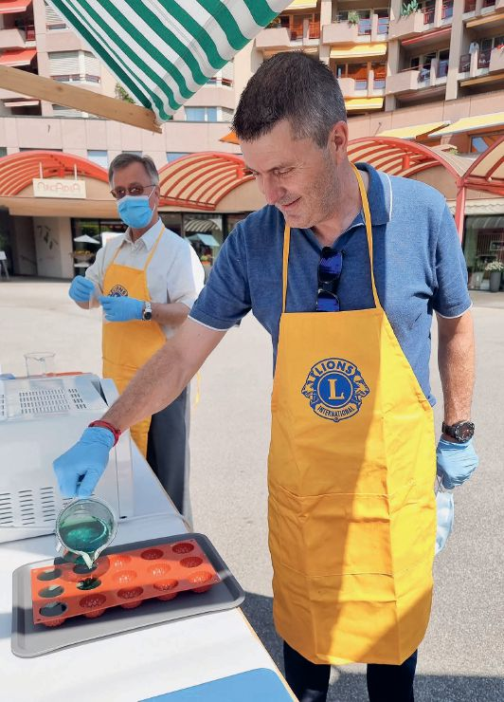
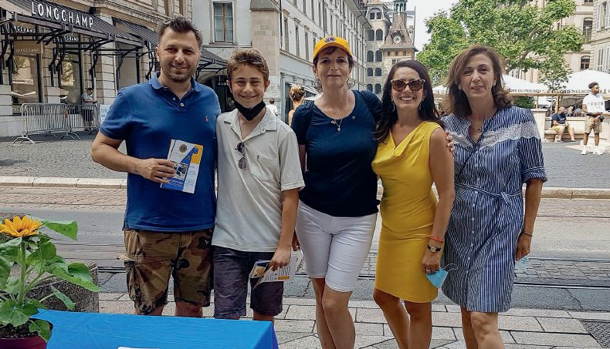
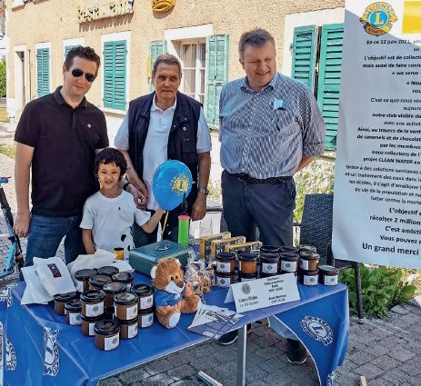
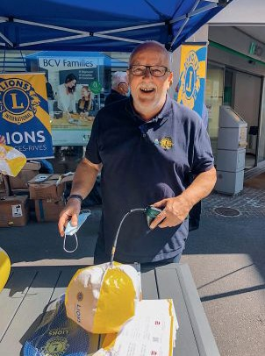
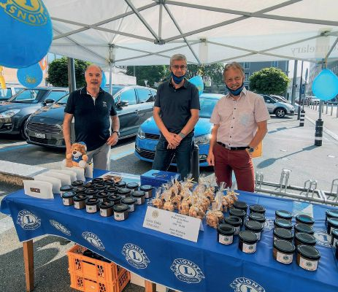
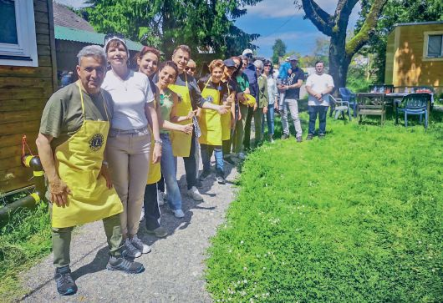
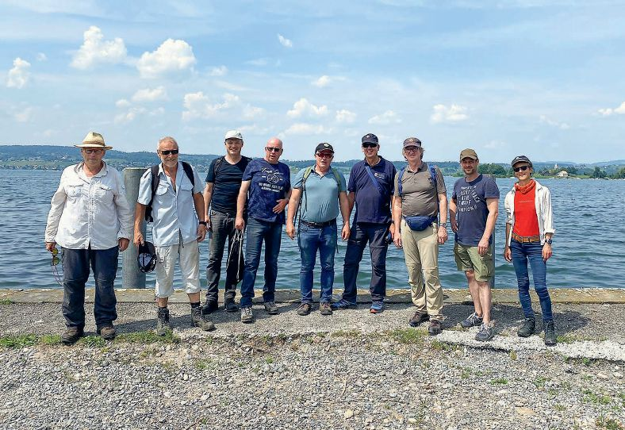
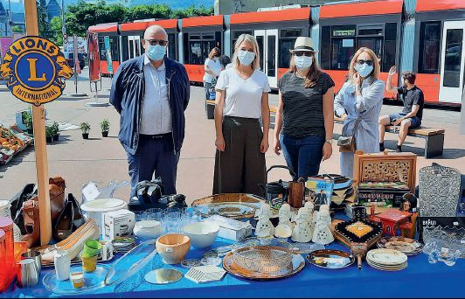
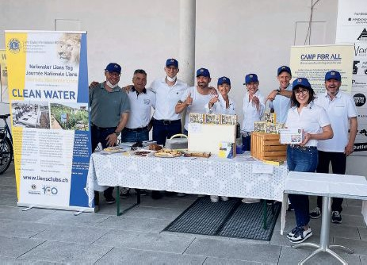
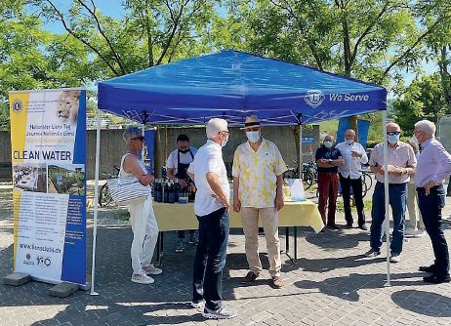
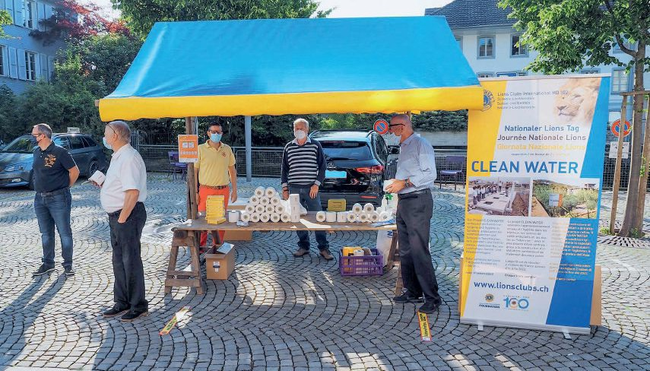
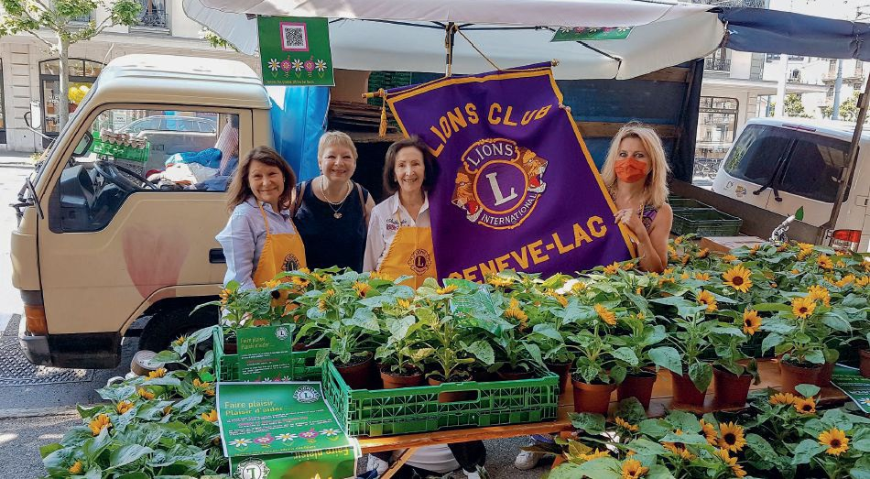
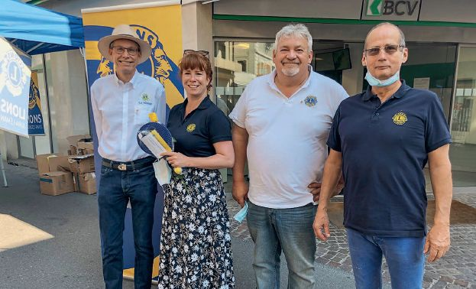
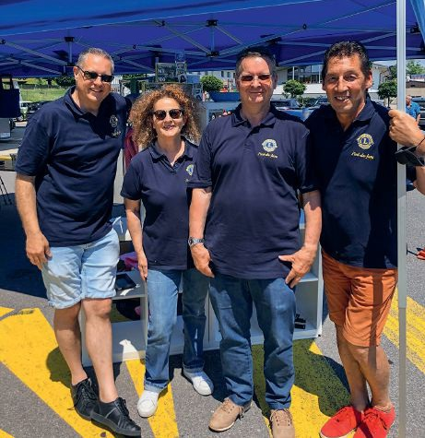
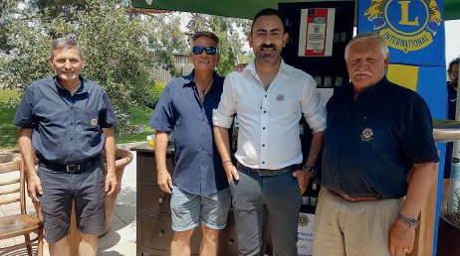
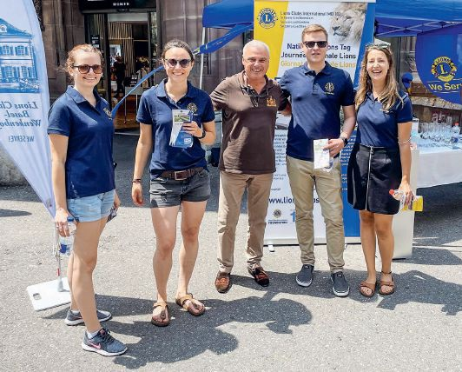
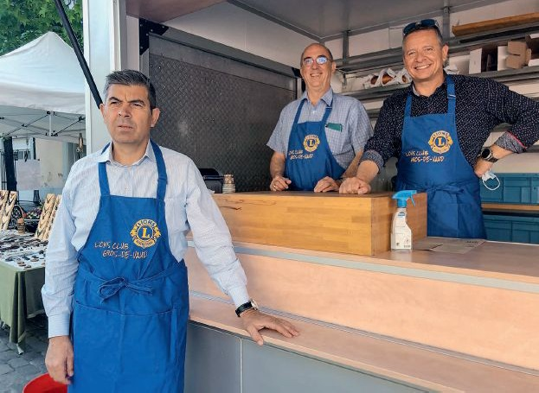
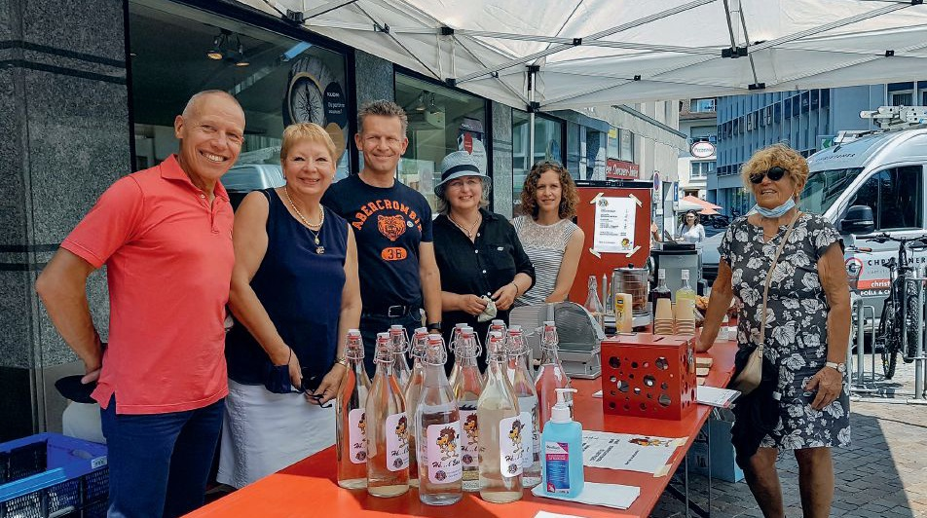
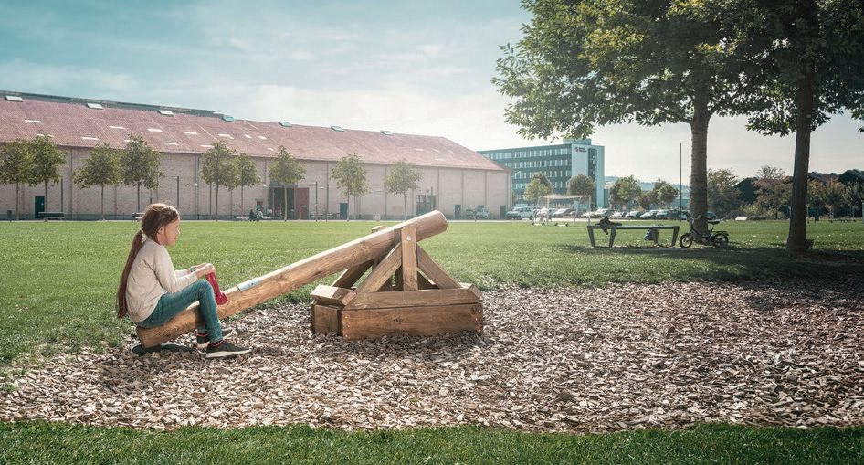
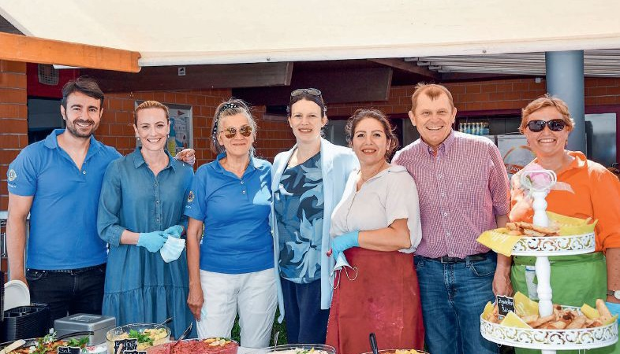
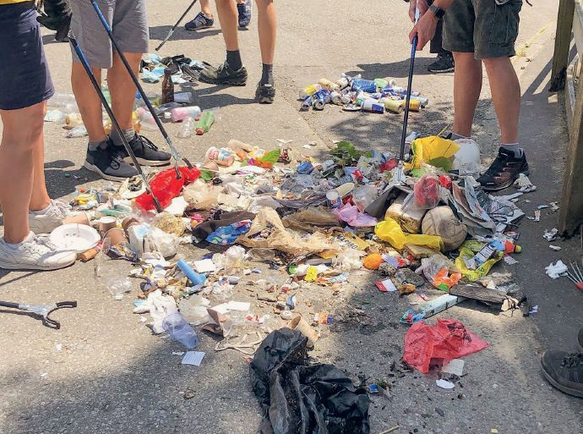
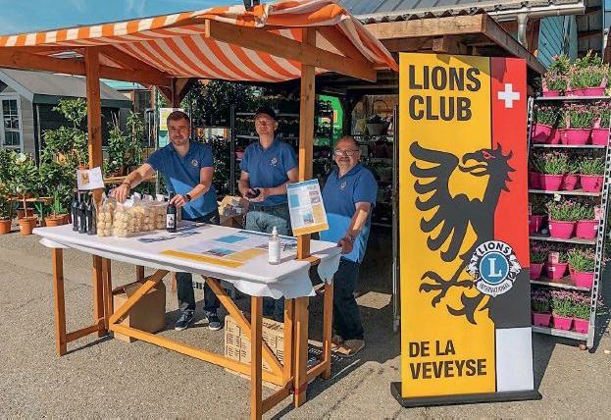
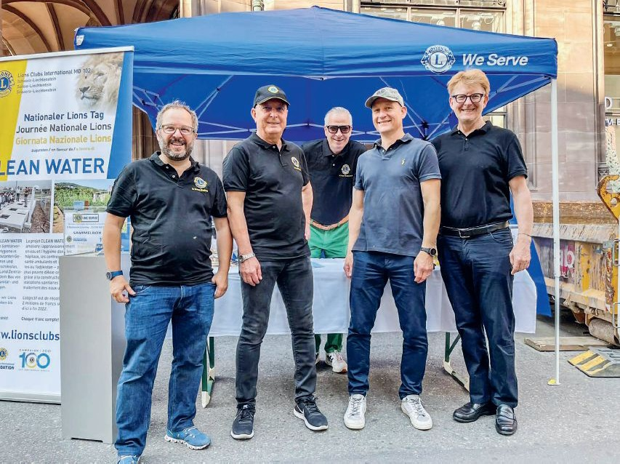
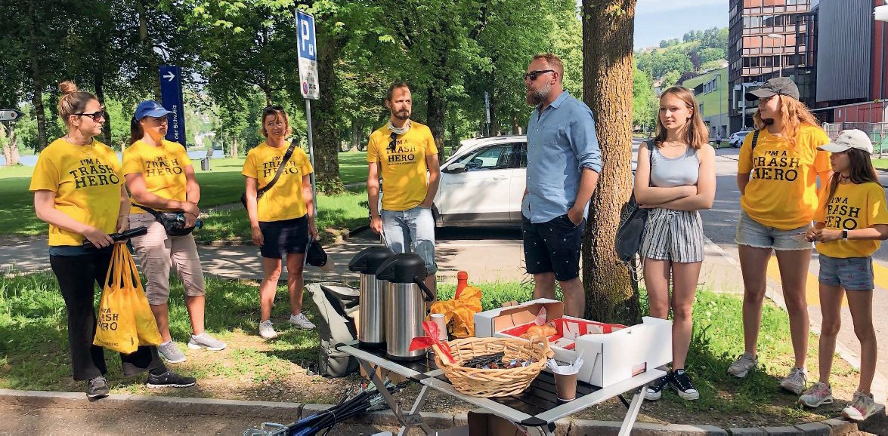
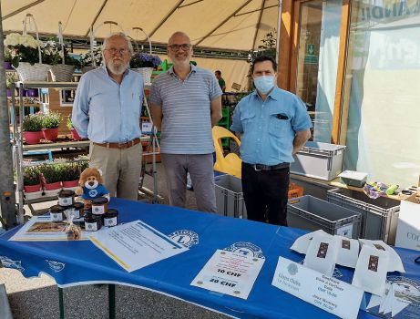
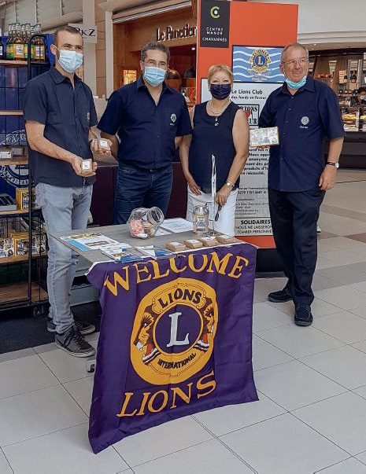
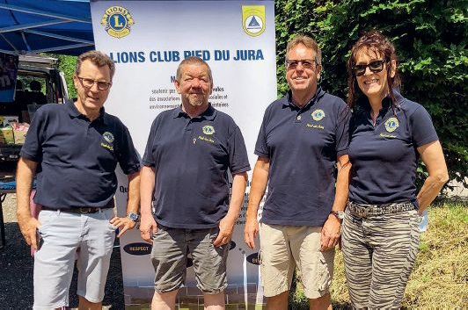
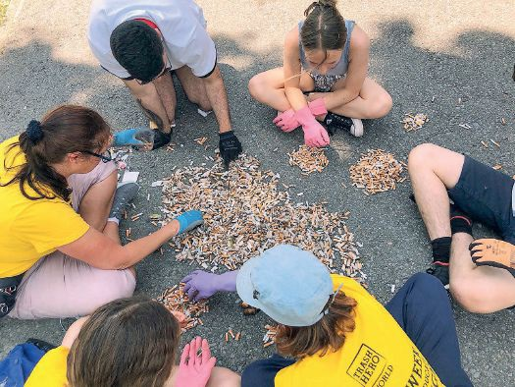
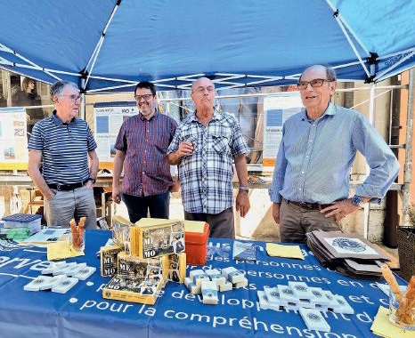
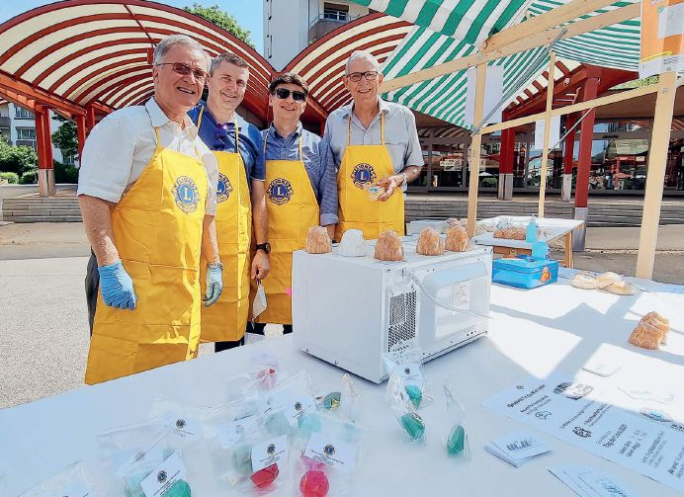

Slide 24
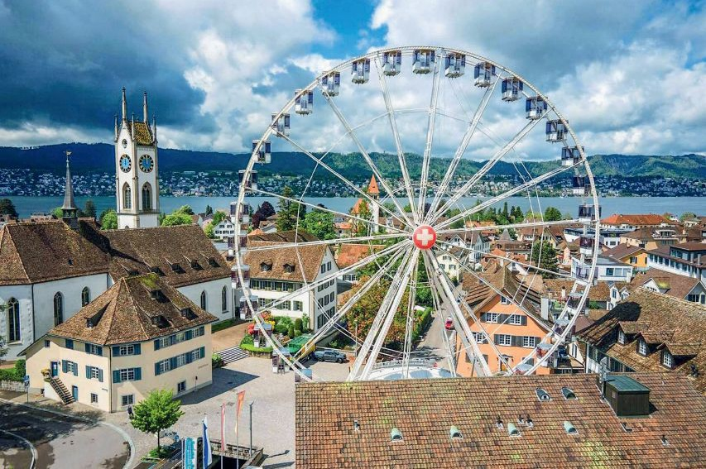


Slide 25
Thank you to all speakers
Congratulations for great
LCIF Day 2021 successes

Slide 26

LCIF Day 2022
On or around Saturday June 11, 2022
Club events
Coordinated by your districts
Coordinated in Europe by a CA4 LCIF Day Committee
Let medias and the public know
Start planning NOW!

Slide 27
CA4 LCIF Day 2022 Committee
FIP Pino Grimaldi, Chairperson
PID Robert Rettby, Vice-Chairperson
And other members, from all areas, yet to be confirmed

Slide 28

Communication
Communication with Lions:
  LCIF/C100 Newsletters
  LCIF/C100 Trainings
  Resources available
  Zone meetings
  District events
  lcifday.eu

Slide 29


Slide 30
Communication
Communication media and public:
  Press releases available
  Invite local medias to the club events
  Communication time-line
  Highlight the extraordinary Europe-wide event

Slide 31
Q & A
Discussions

Slide 32


Thank You!
LCIF Day 2022
Lions Europa Forum ‘21 Thessaloniki

