Slide 1
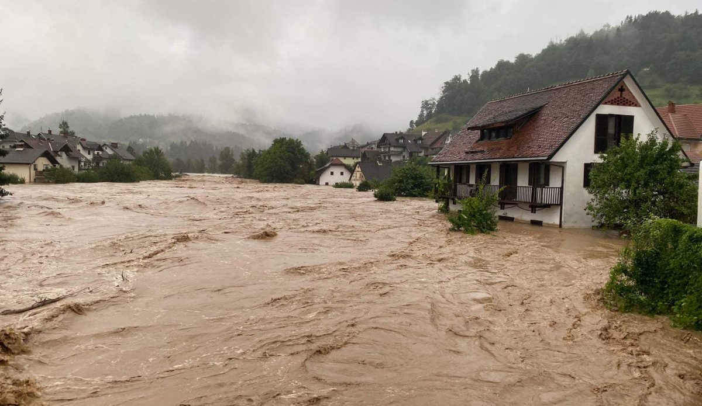
DEEDS. NOT WORDS.
We serve
FLOODING IN SLOVENIA
And Lions response

Slide 2
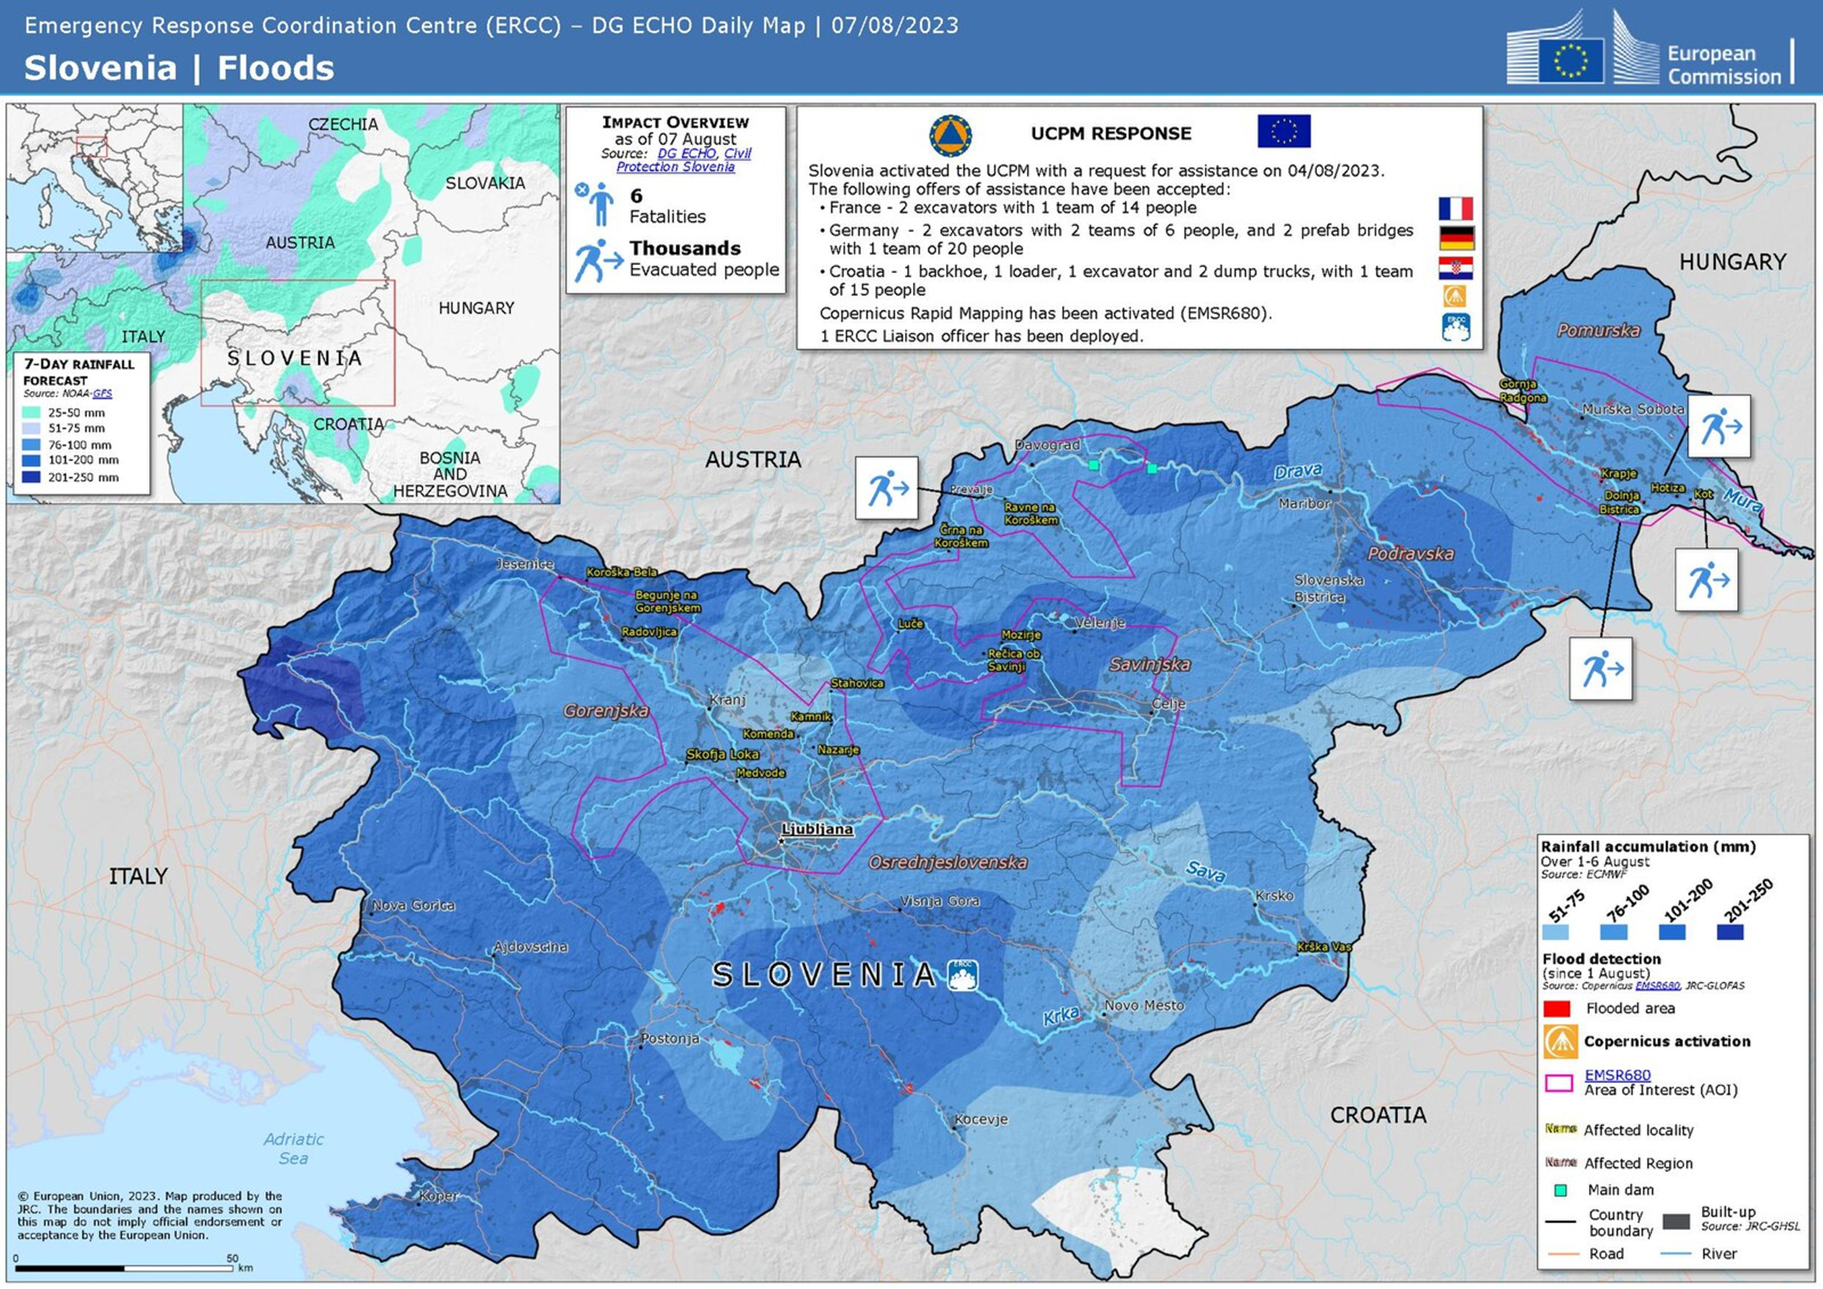
Flooding in Slovenia 2023
Flooding occured on 4-5th of August
Official Intensity: floods were the sum of all the major floods of the past decades
LCIF Leadership Training, Bologna, september 2023

Slide 3
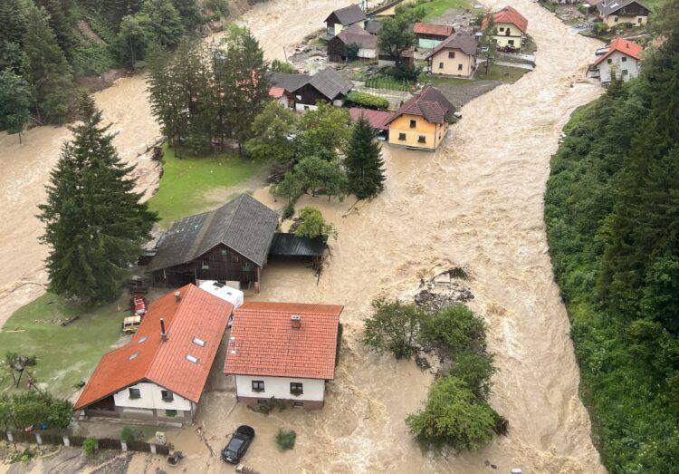
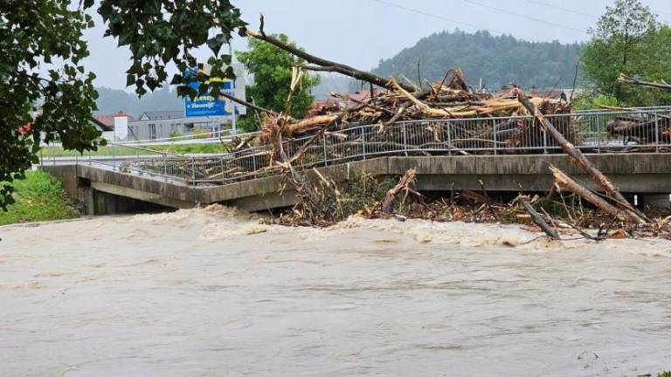
Flooding in Slovenia 2023
1. Flooding (August 3rd-7th):
LCIF Leadership Training, Bologna, september 2023

Slide 4
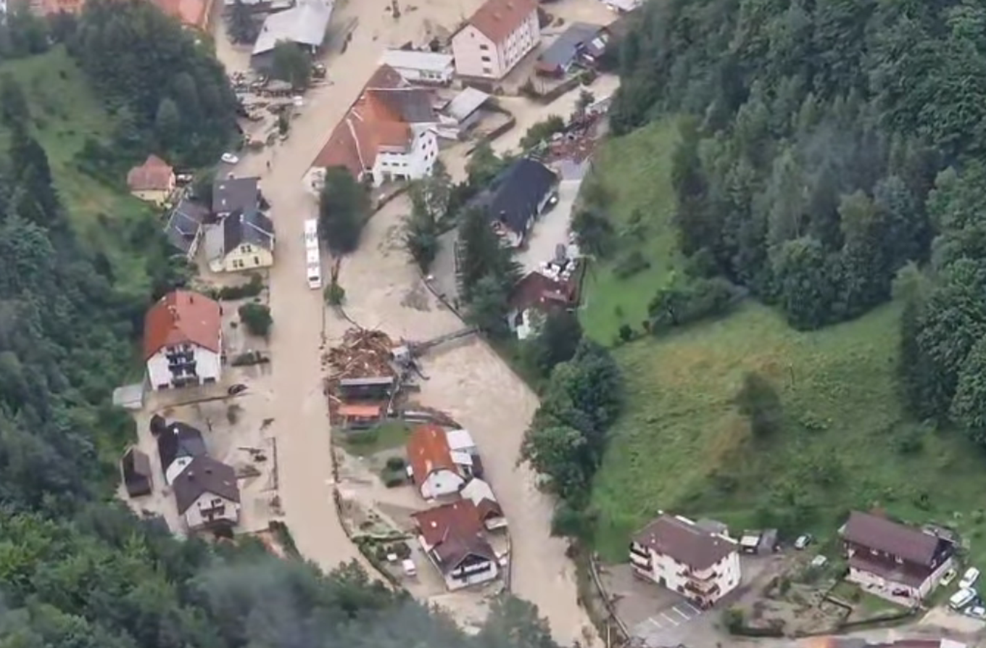
Flooding in Slovenia 2023
LCIF Leadership Training, Bologna, september 2023

Slide 5
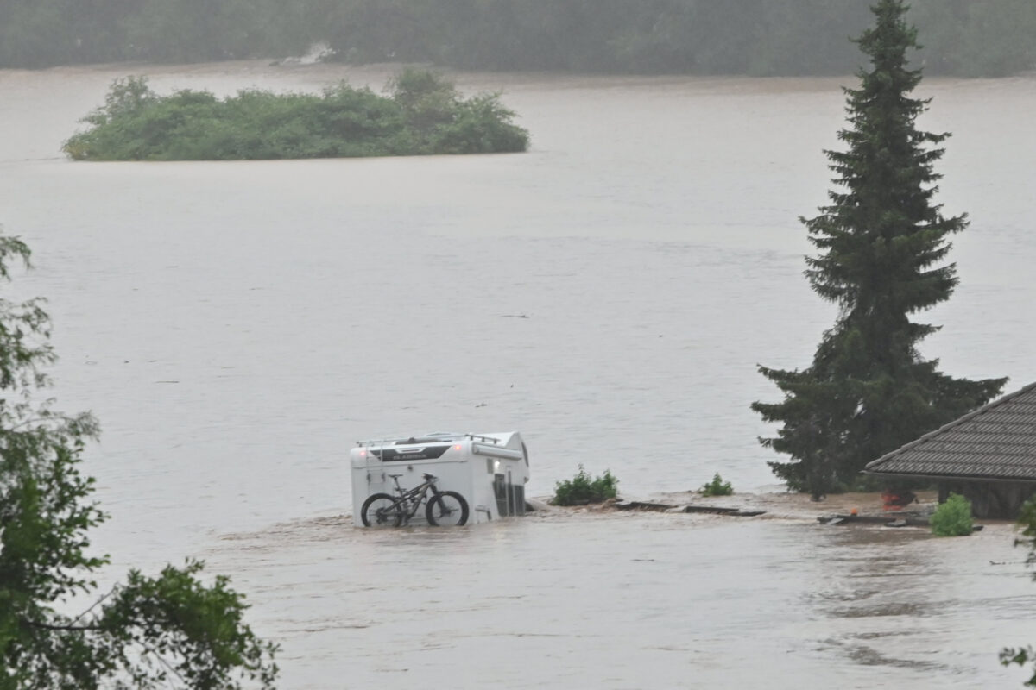
Flooding in Slovenia 2023
LCIF Leadership Training, Bologna, september 2023

Slide 6
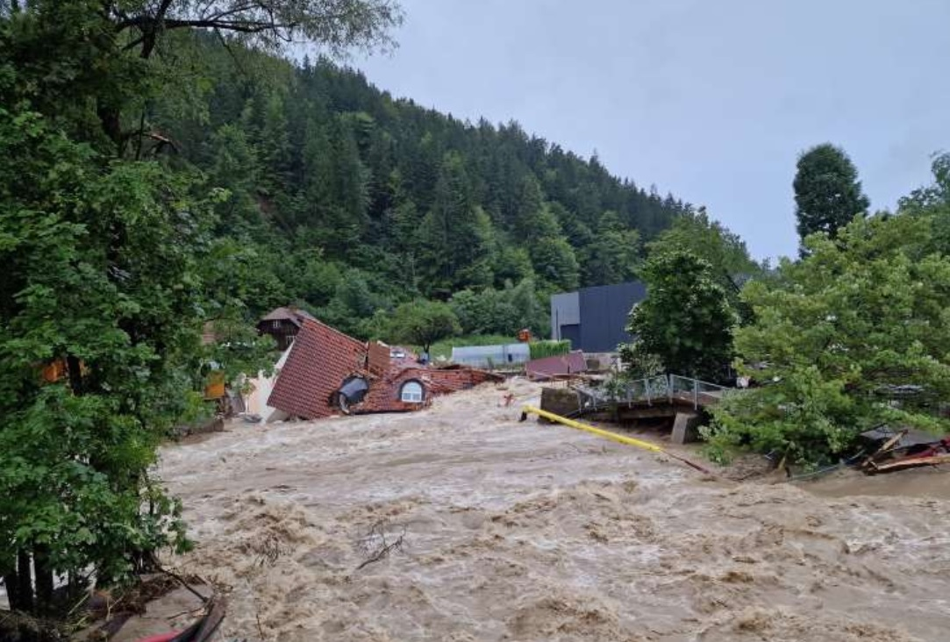
Flooding in Slovenia 2023
LCIF Leadership Training, Bologna, september 2023

Slide 7
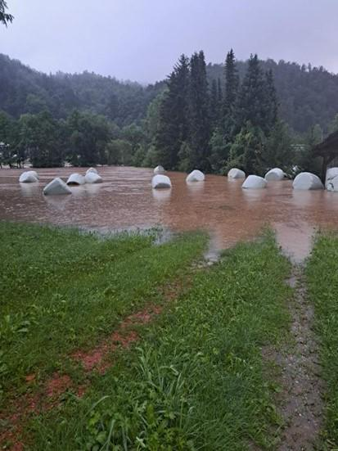
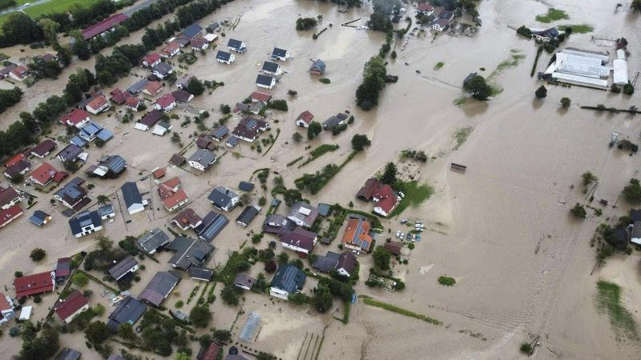
Flooding in Slovenia 2023
LCIF Leadership Training, Bologna, september 2023

Slide 8
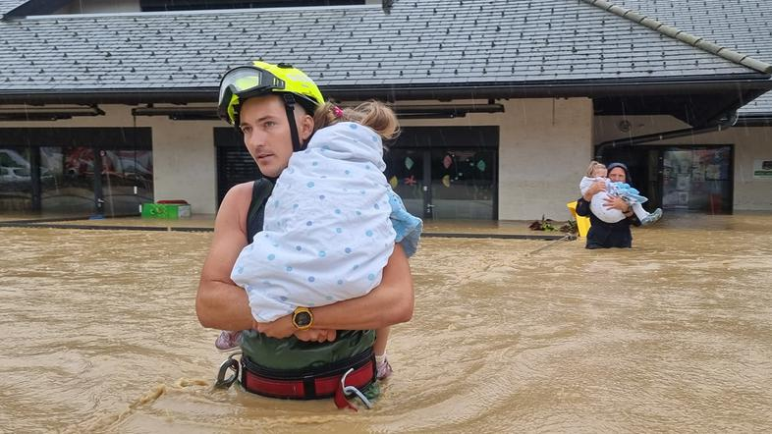
Flooding in Slovenia 2023
LCIF Leadership Training, Bologna, september 2023

Slide 9
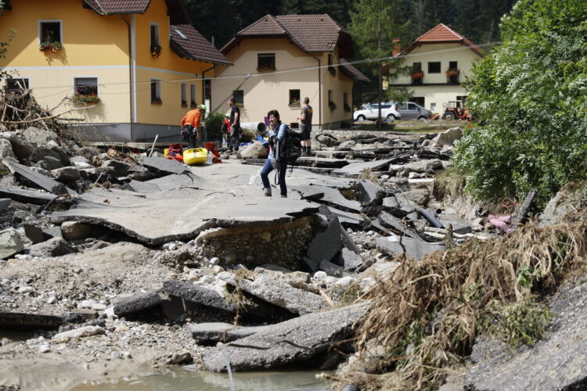
Flooding in Slovenia 2023
Aftermath:
LCIF Leadership Training, Bologna, september 2023

Slide 10
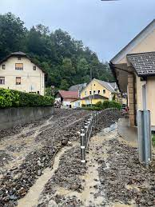
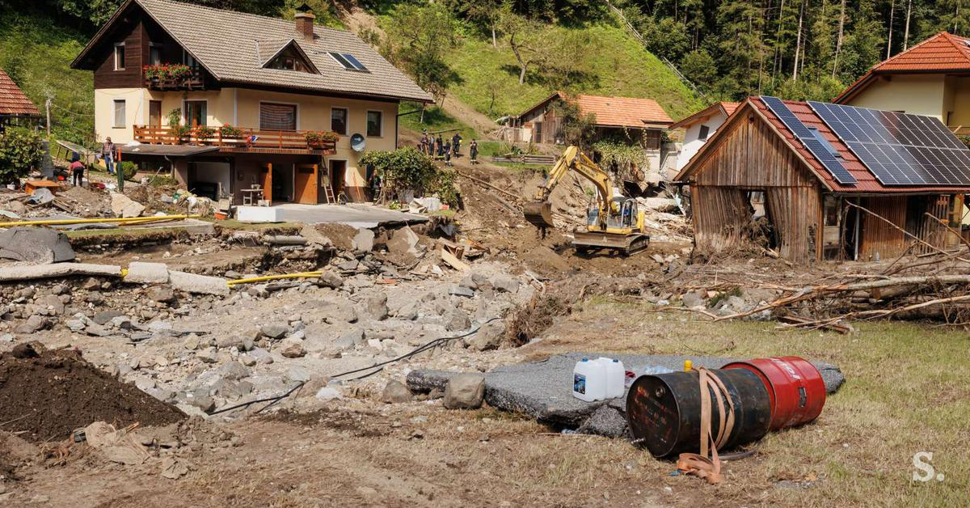
Flooding in Slovenia 2023
LCIF Leadership Training, Bologna, september 2023

Slide 11
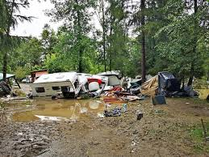
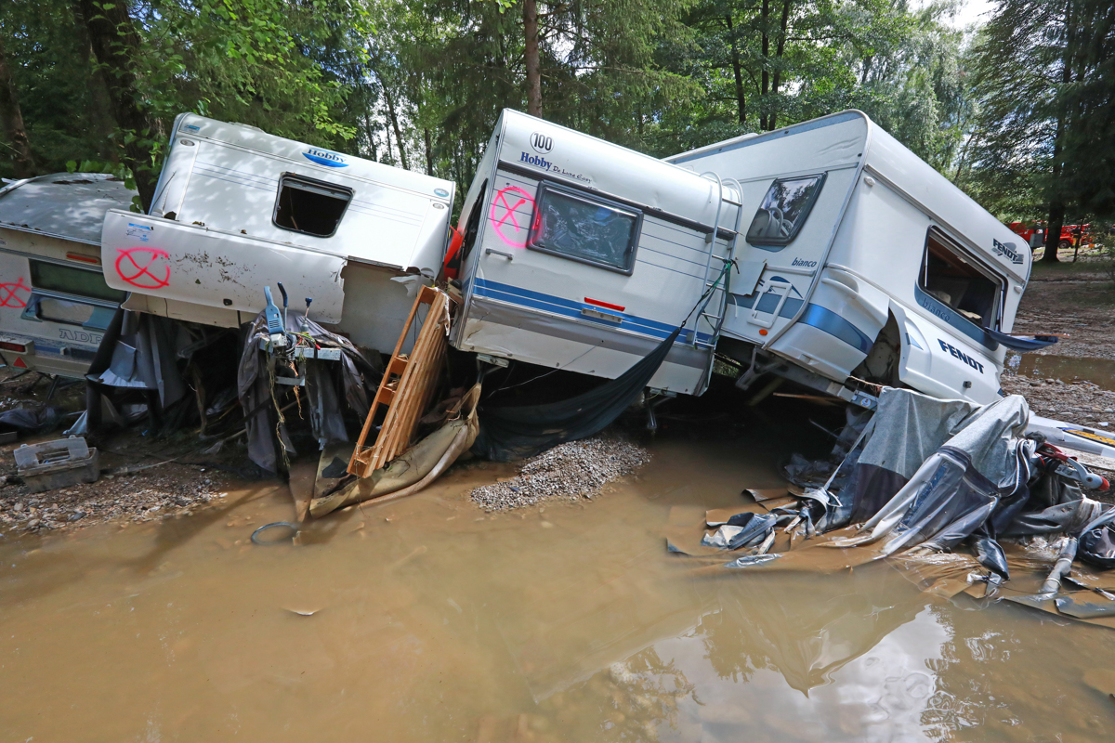
Flooding in Slovenia 2023
LCIF Leadership Training, Bologna, september 2023

Slide 12
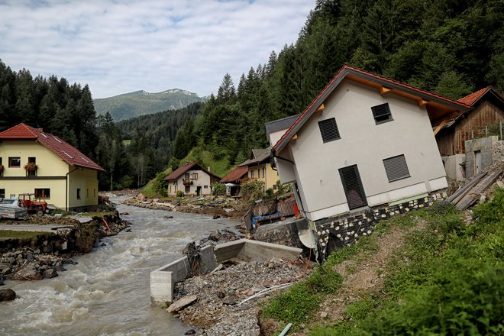
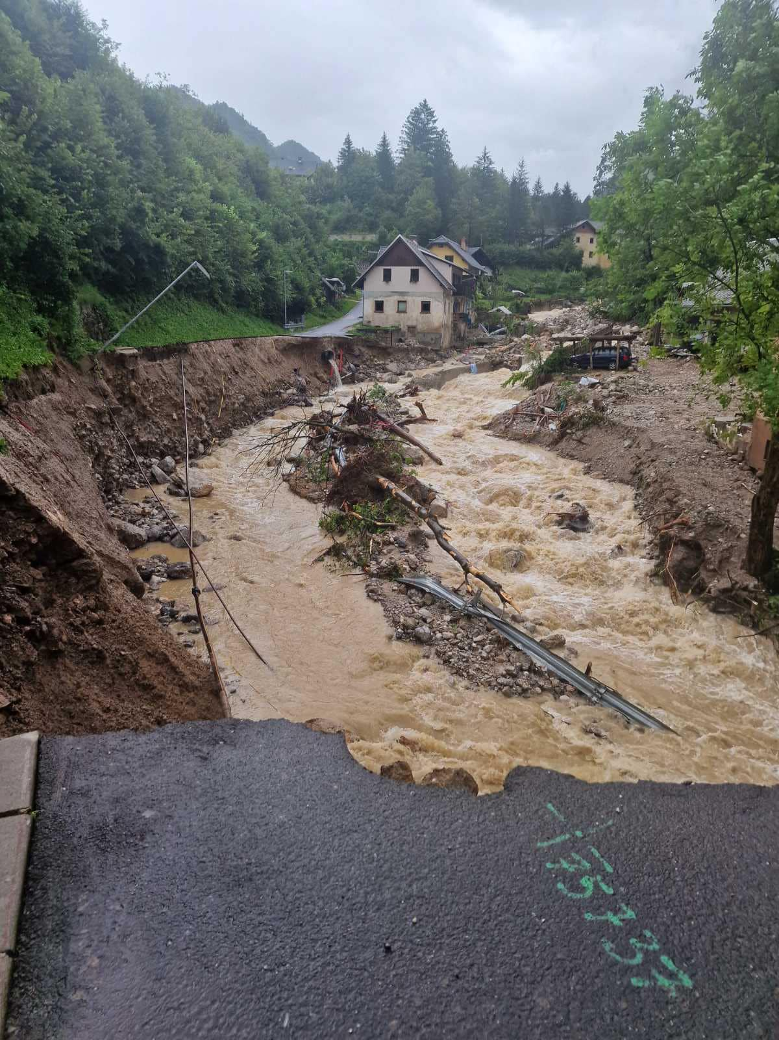
Flooding in Slovenia 2023
LCIF Leadership Training, Bologna, september 2023

Slide 13
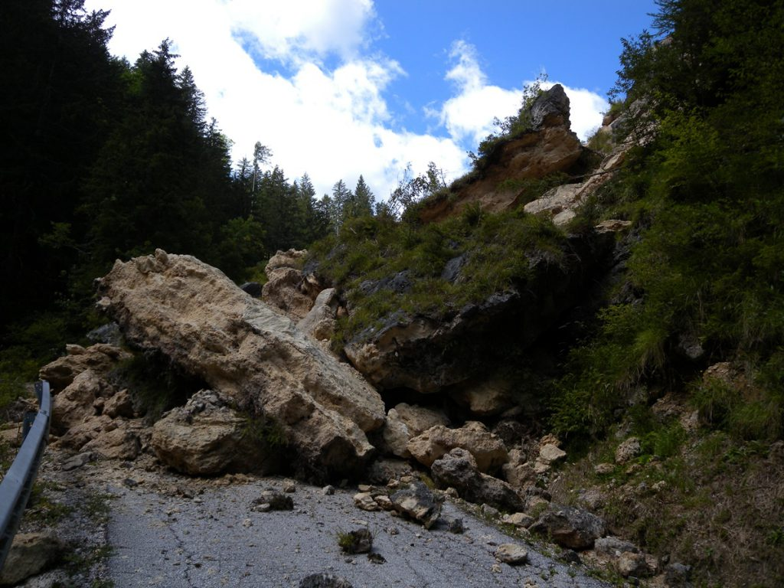
Flooding in Slovenia 2023
LCIF Leadership Training, Bologna, september 2023

Slide 14
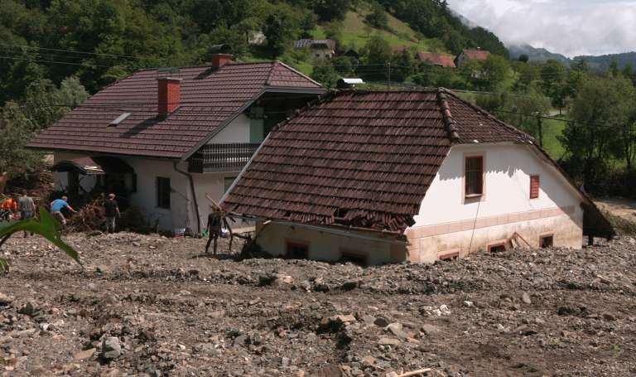
Flooding in Slovenia 2023
Aftermath in numbers:
6 lives lost
484 uninhabitable residential buildings
34 demolished residential buildings
649: number of displaced people
Preliminary damage around 2.000.000.000 Eur equal to about 3,3% Slovenian GDP
In comparisation to Italy GDP this means about 70.000.000.000 Eur.
LCIF Leadership Training, Bologna, september 2023

Slide 15
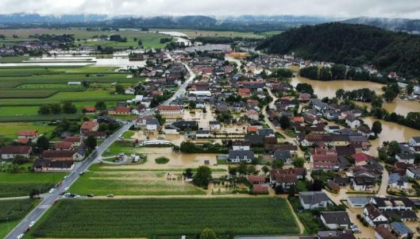
Flooding in Slovenia 2023
Lions actions:
First: saving lives (unfortunately 6 peoples lost their lives)
Actions of the clubs on site, contacts with clubs
First coordination on national level- DG, Alert, LCIF Emergency grant
August 8.th Message from DG: Appeal & Instruction for help to district Clubs and neghbour Districts:
Identification of the peoples in needs (common mail, forms, …)
Financial donations
Material donations
LCIF Leadership Training, Bologna, september 2023

Slide 16
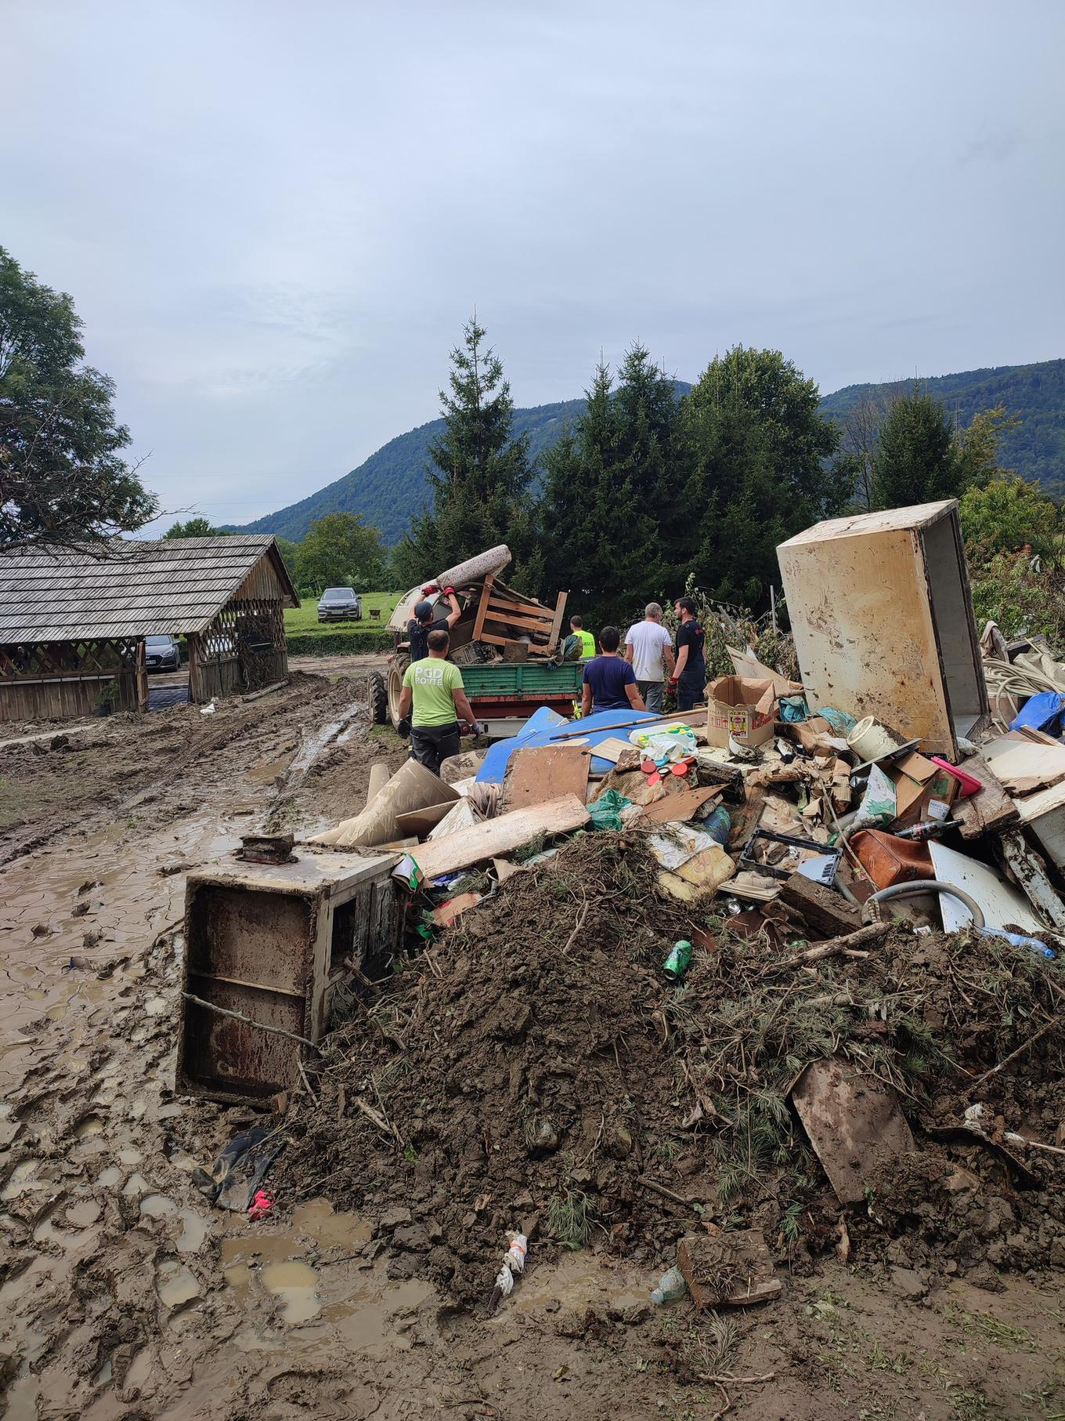
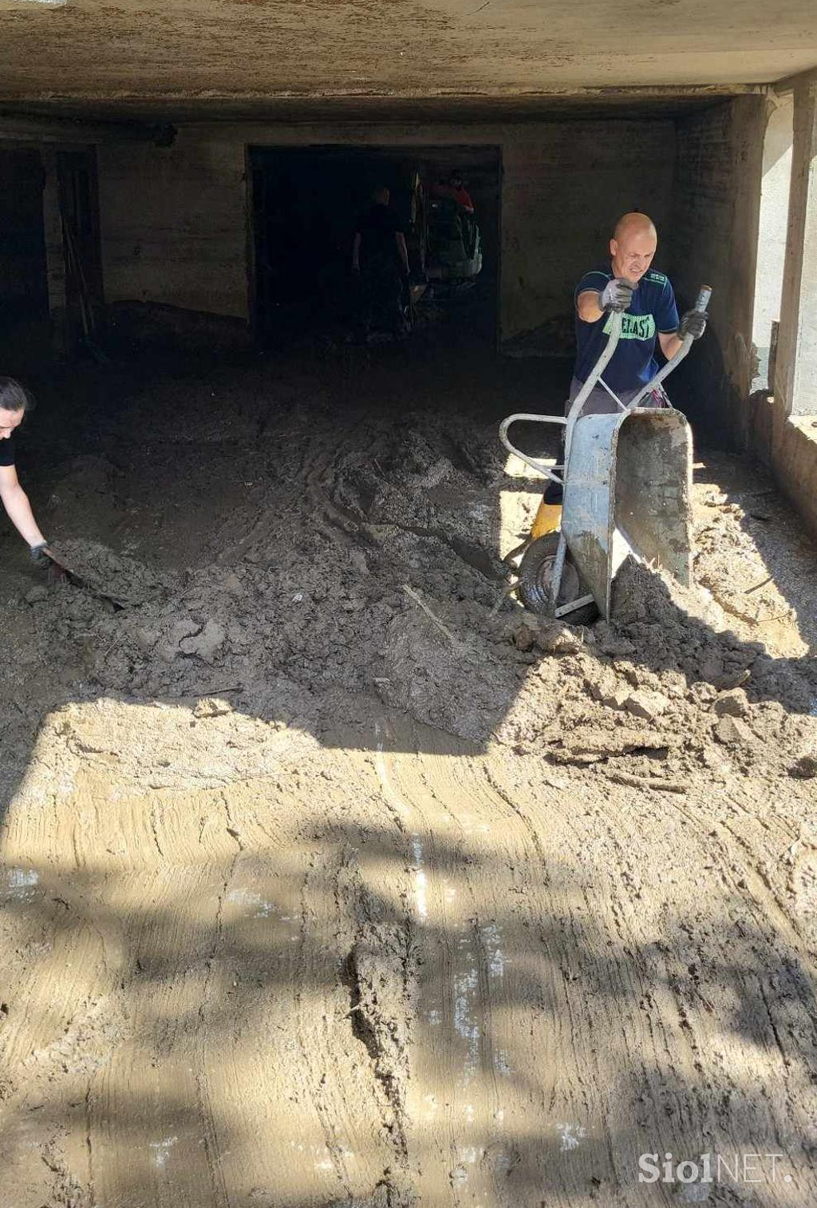
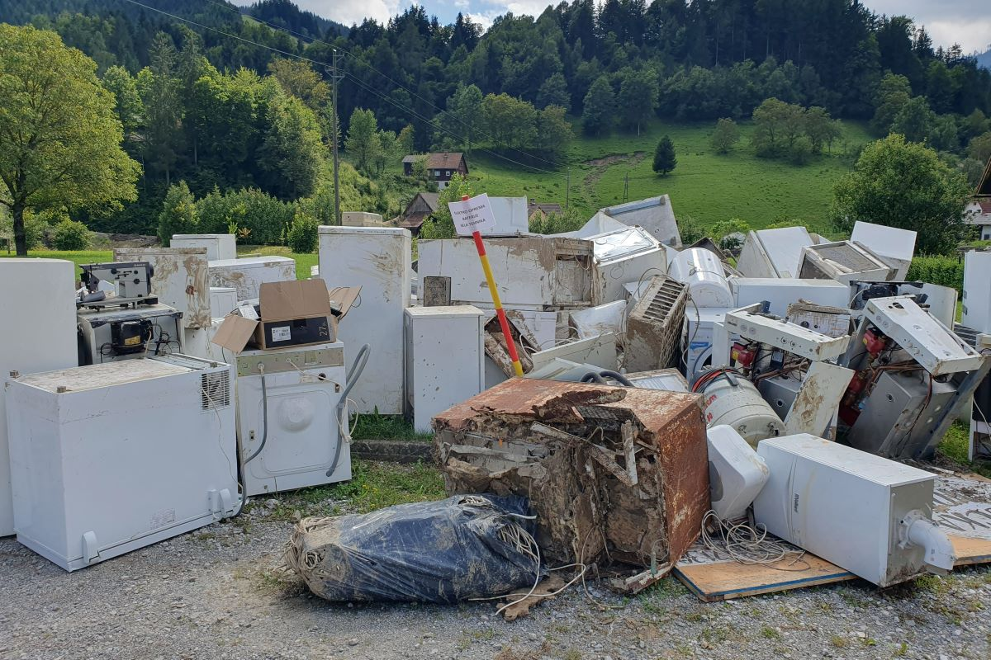
Flooding in Slovenia 2023
Cleaning: A lot of volunteer work:
LCIF Leadership Training, Bologna, september 2023

Slide 17
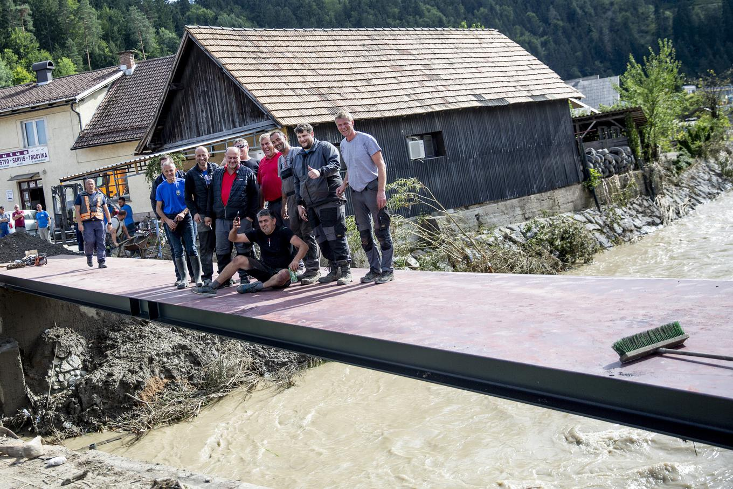
Flooding in Slovenia 2023
LCIF Leadership Training, Bologna, september 2023

Slide 18
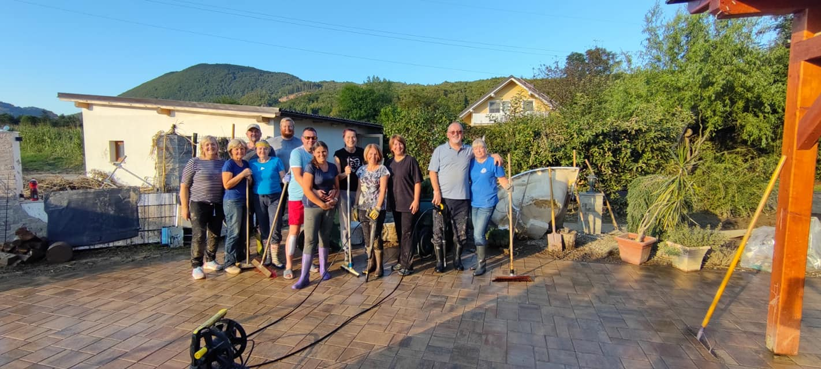
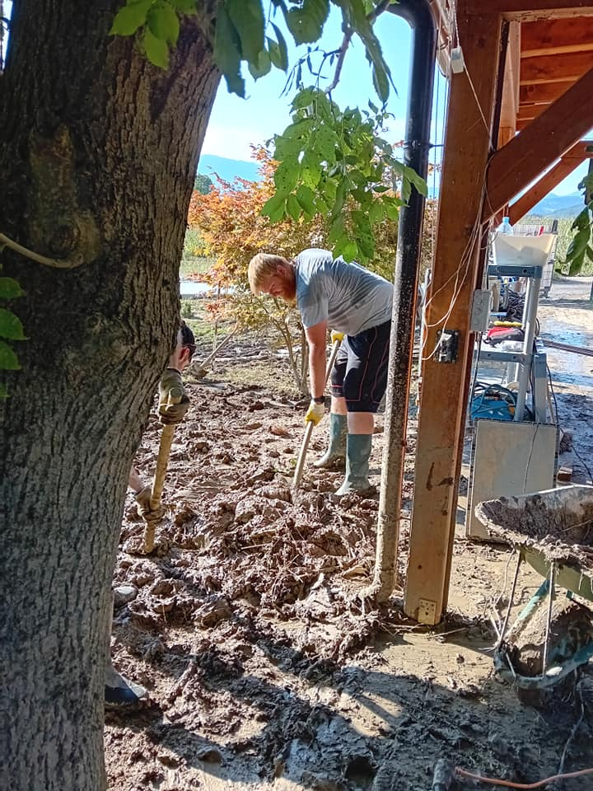
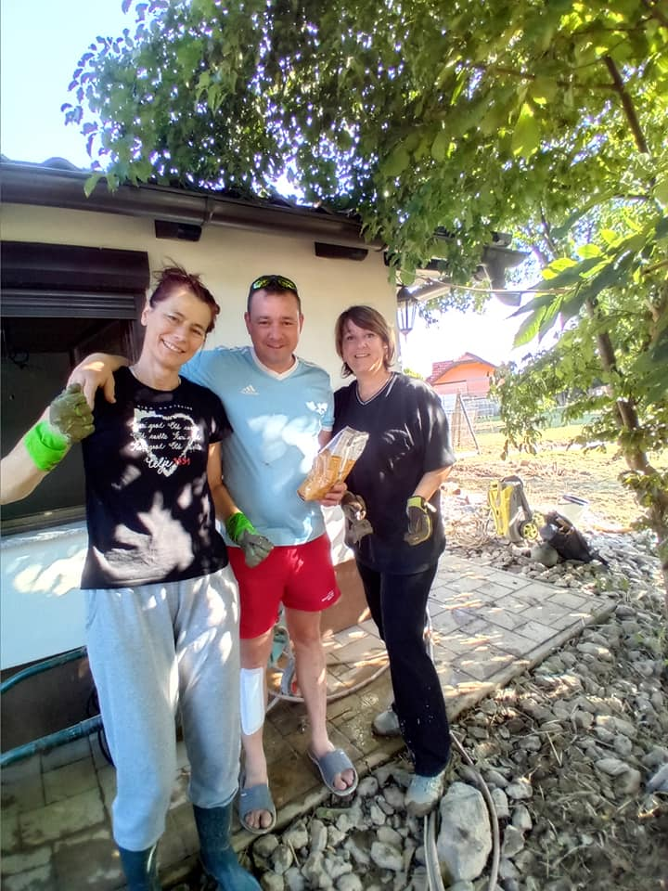
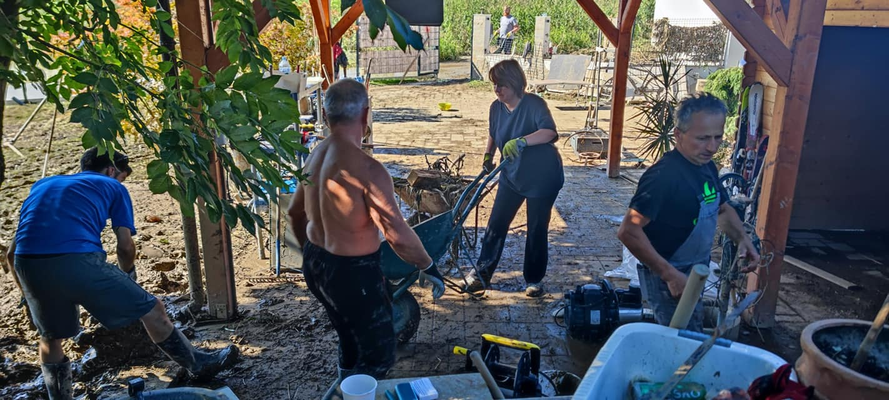
ALERT
seja kabineta guvernerke ZLKS

Slide 19
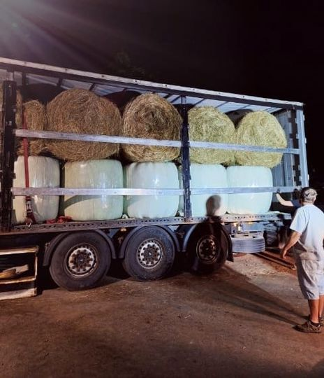
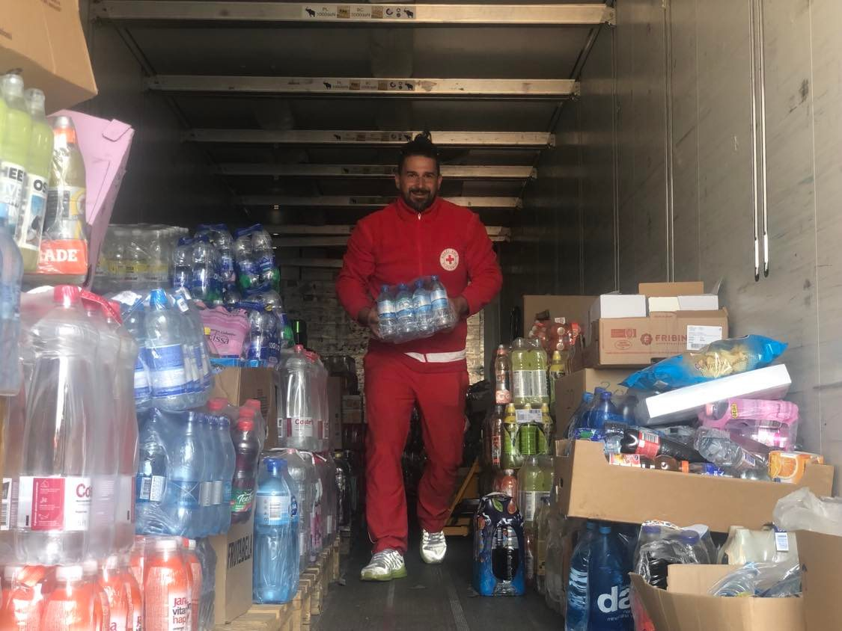
Flooding in Slovenia 2023
August 8: Lions Clubs International Community Recovery Grant in Slovenia application prepared
August 12th : LCIF Community Recovery Grant approved.
25 computers for affected school in Ljubno town donated.
Very fast and generous reaction from
German Lions foundation
and
Austrian multidistrict
LCIF Leadership Training, Bologna, september 2023

Slide 20
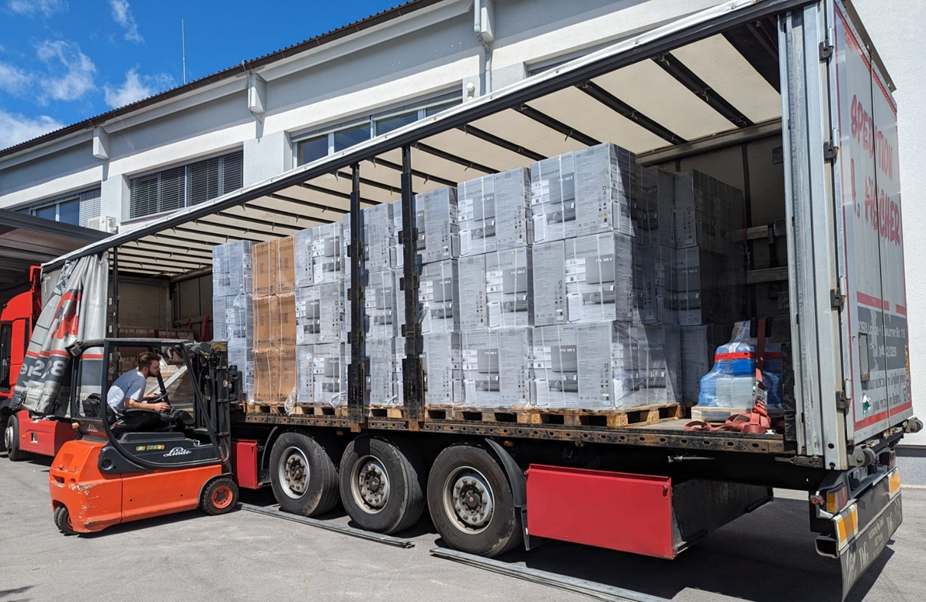
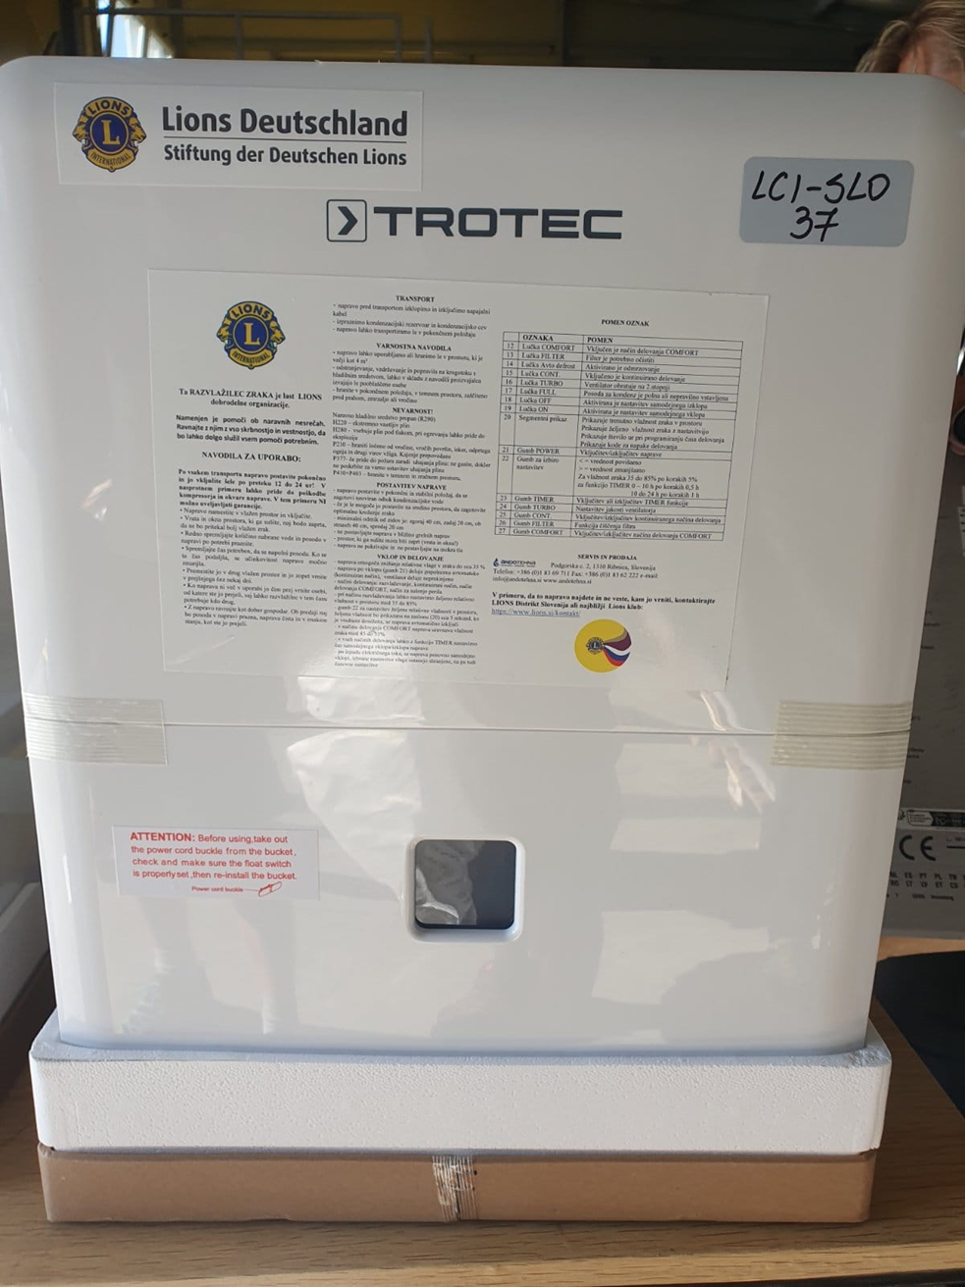
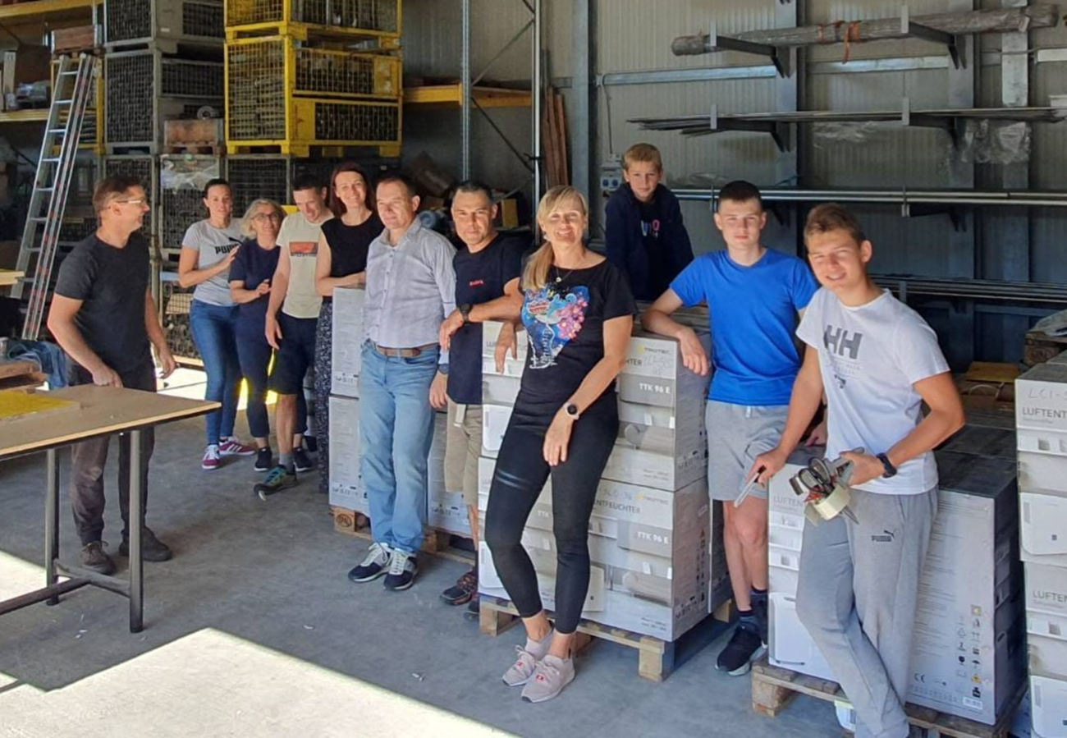
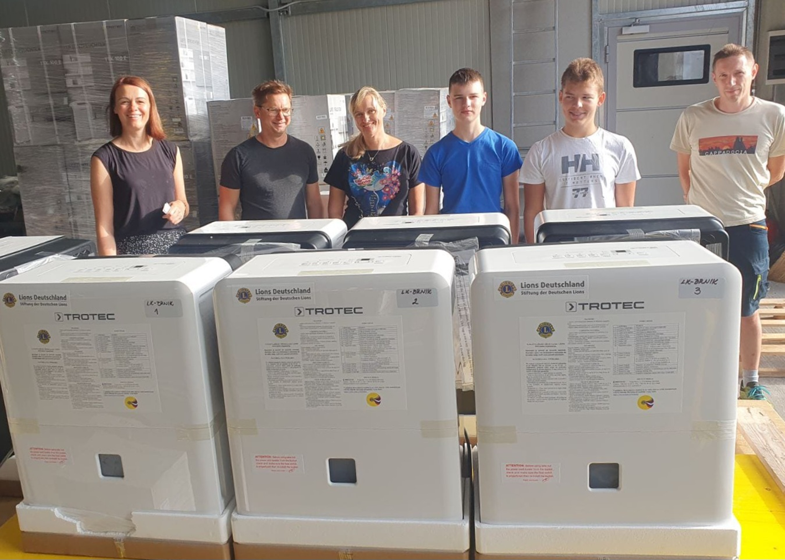
Flooding in Slovenia 2023
Dehumidifiers:
LCIF Leadership Training, Bologna, september 2023

Slide 21
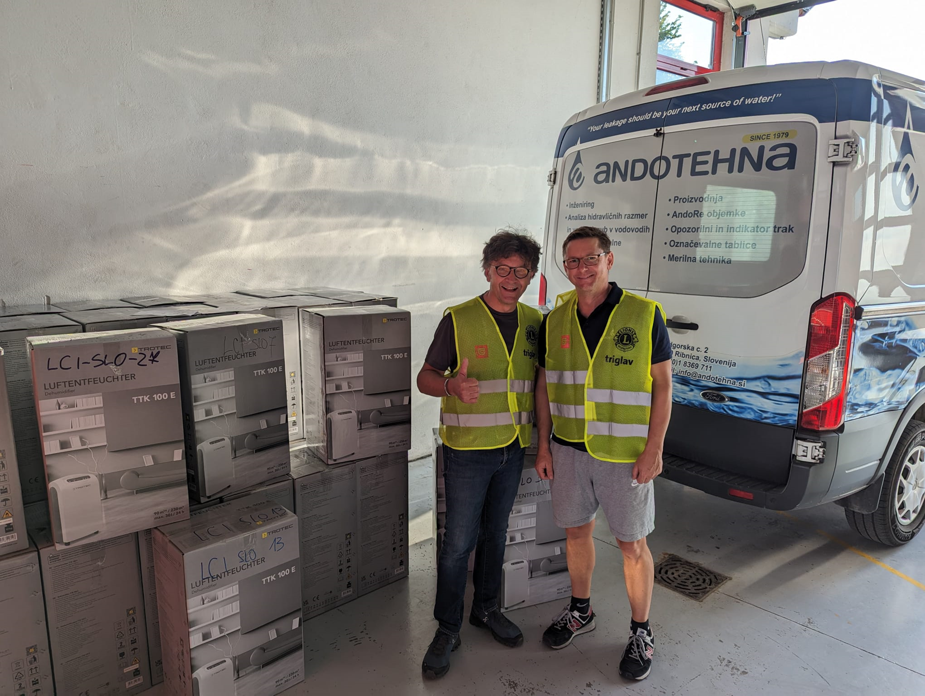
Flooding in Slovenia 2023
LCIF Leadership Training, Bologna, september 2023

Slide 22
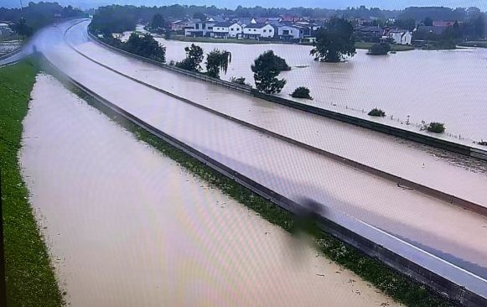
Flooding in Slovenia 2023
Current activities
District task group established for delivering help on August 22.
Focus on adaptation of unhabitable residential buildings.(Winter is approaching).
Working on weekly level. decision is based on identified needs by local Lions clubs, situation of peoples and received pro-formas for adaptation/home appliances.
The needs are much higher than funds we currently have.
We help the people with building materials they needed, based on proformas for adaptation, and buying furniture and the home appliances they lost in the floodings (refrigerators, washing machines, kitchen appliances…)
LCIF Leadership Training, Bologna, september 2023

Slide 23
DEEDS. NOT WORDS.
We serve
Thank You

