Slide 1
Grant Story: LCIF and Türkiye

Slide 2
DISASTER OF THE CENTURY:
February 2023 South East Anatolia Earthquakes
and
LIONS RESPONSE

Slide 3
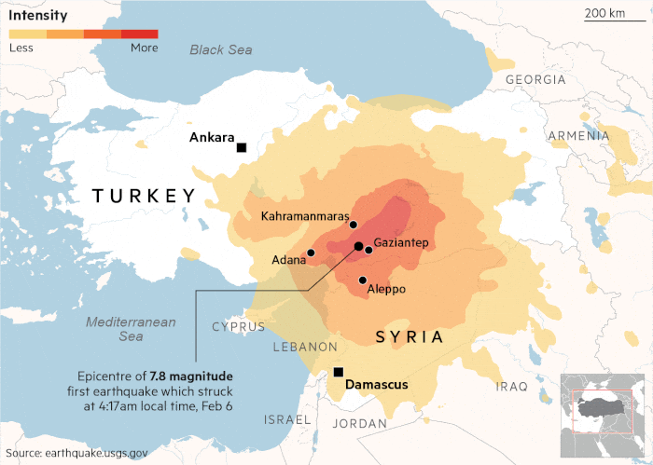
INTENSITY MAP
LESS
MORE
On February 6, 2023 at 4:17am and 1:24 pm Turkish time two consecutif earthquakes of magnitude Mw 7.8 & Mw 7.5 occurred with epicenters in Kahramanmaras City and a Mw 6.4 earthquake occurs on February 20, 2023 at 8:04 pm in Antakya…
Antakya
Epicenter of 6.4 magnitude earthquake hit Defne district of Hatay province…

Slide 4
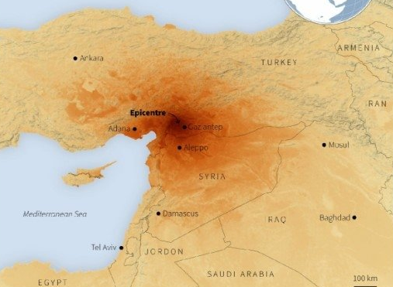
Disaster of the Century
Black Sea
The size of disaster that no country in the world can be prepared for on its own...
The effect of 3 consecutive earthquakes were the largest to strike the region in over 500 years and it is described as the 3rd worst and the most destructive and damaging disaster in the world to date.
TURKIYE
Kahramanmaraş
Mersin
Adana
Gaziantep
Aleppo
Antakya
SYRIA
CYPRUS
LEBANON
Mediterranean Sea
IRAQ
ISRAEL
JORDAN
EGYPT
SAUDI ARABIA

Slide 5
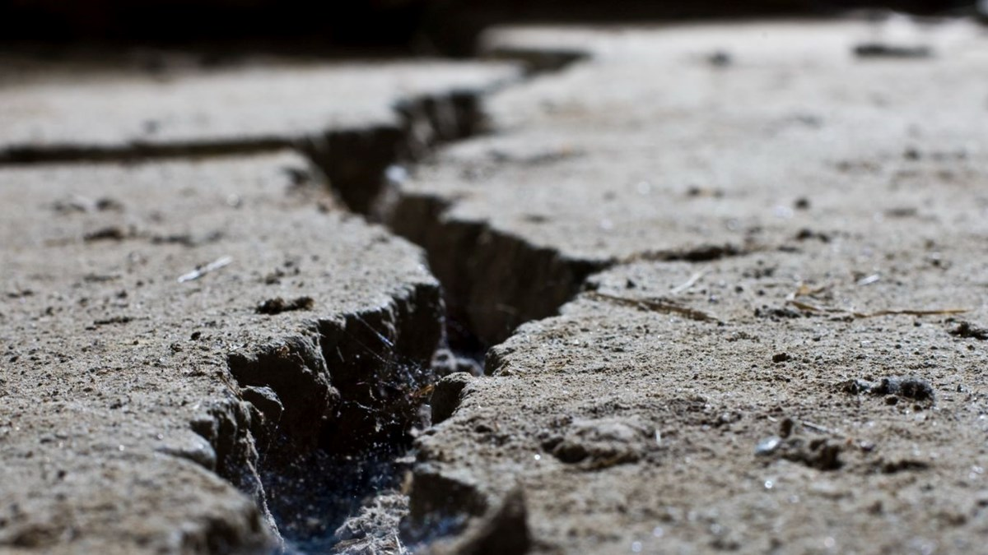
February 6, 2023 – Monday Earthquakes
Earthquakes felt in an area of about 350,000 km² (140,000 sq mi), and 15 million people affected…
According to Official Figures more than;
50,000 deaths…
120,000 injured…
360,000 demolished and heavily damaged buildings…
1.5 million uninhabitable housing…
4,5 million in total and 2,5 million permanent migration…
$160 Billion; cost of the destruction caused by the earthquake.

Slide 6
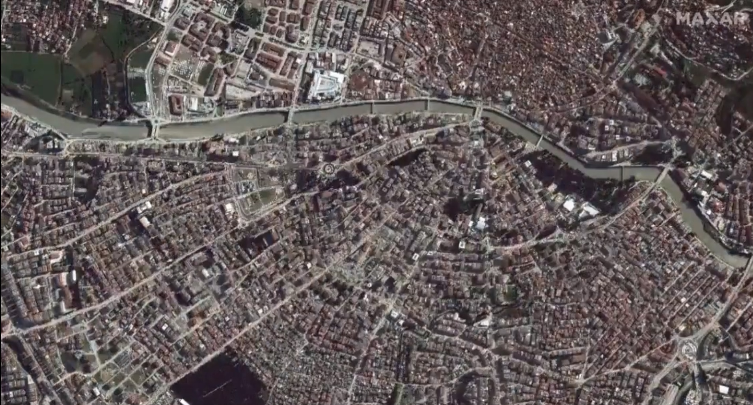
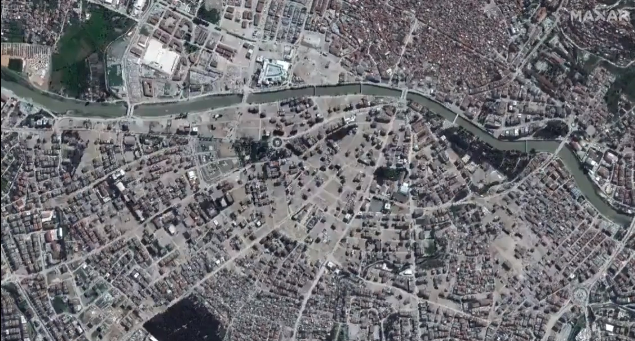
"The earthquakes damaged structures spanning centuries and cultures, from Roman forts to historic mosques to holy churches to a number of Christian denominations,"
Bénédicte de Montlaur, president and CEO of the World Monuments Fund, tells. "We have no doubt that the heritage lost in these tragic events will take years to repair and that we will need a large international mobilization to support the local efforts."
February 6, 2023 - Monday
February 5, 2023 - Sunday
More than 10 main cities were severely damaged in the February 6 earthquakes. But one of them has almost completely disappeared; Antakya, the ancient city known as ‘the city where the civilizations met’...
Holy city of Antakya (Antioch): Ghost City
Mosaic of Jewish, Christian & Muslim Cultures
Antakya: City of Civilizations

Slide 7
Lions Response
After February 2023 Southeast Anatolia Earthquakes

Slide 8
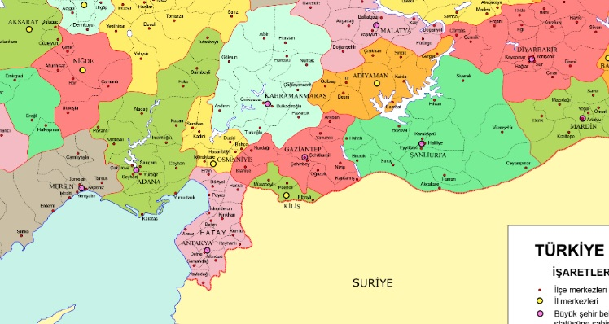
Lions in the Region
ELAZIG
DIYARBAKIR
1
KAHRAMANMARAS
MARDIN
GAZIANTEP
2
SANLIURFA
OSMANIYE
MERSIN
ADANA
9 + 1
11 + 4
KILIS
In the earthquake region and neighbourhood provinces 25 Lions and 6 Leo Clubs are serving to their society...
ANTAKYA
Lions Club exist
No Lions Club
Branch Club exist
3 + 1
Syria

Slide 9
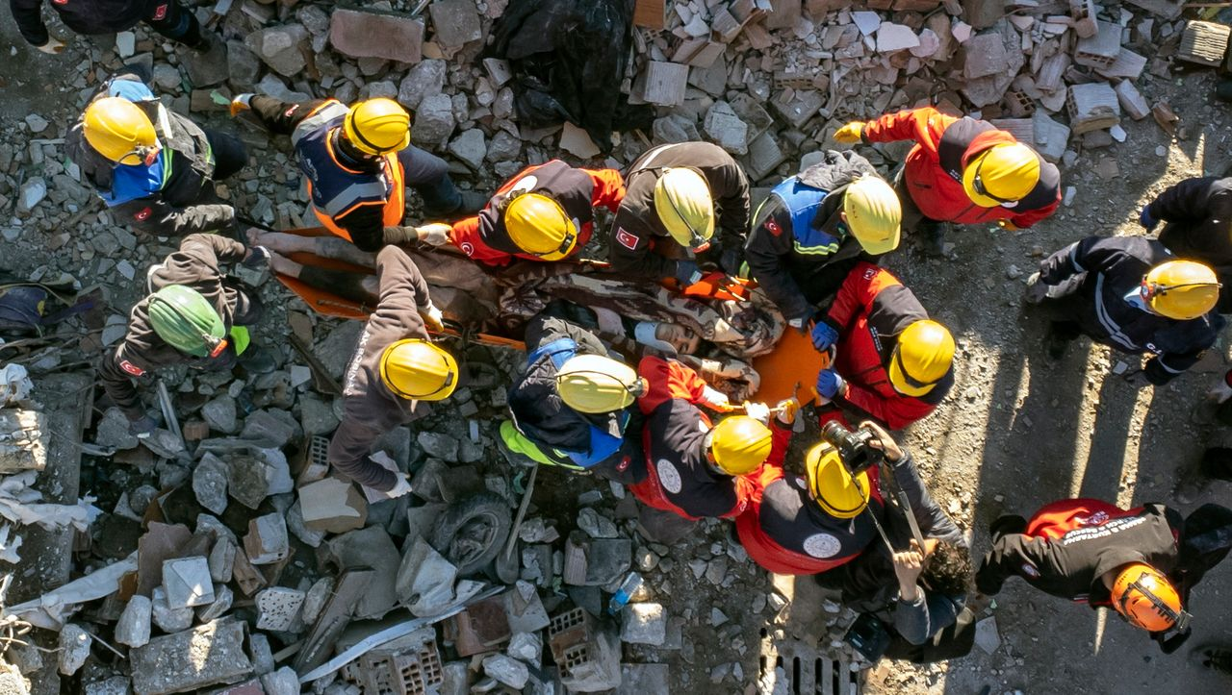
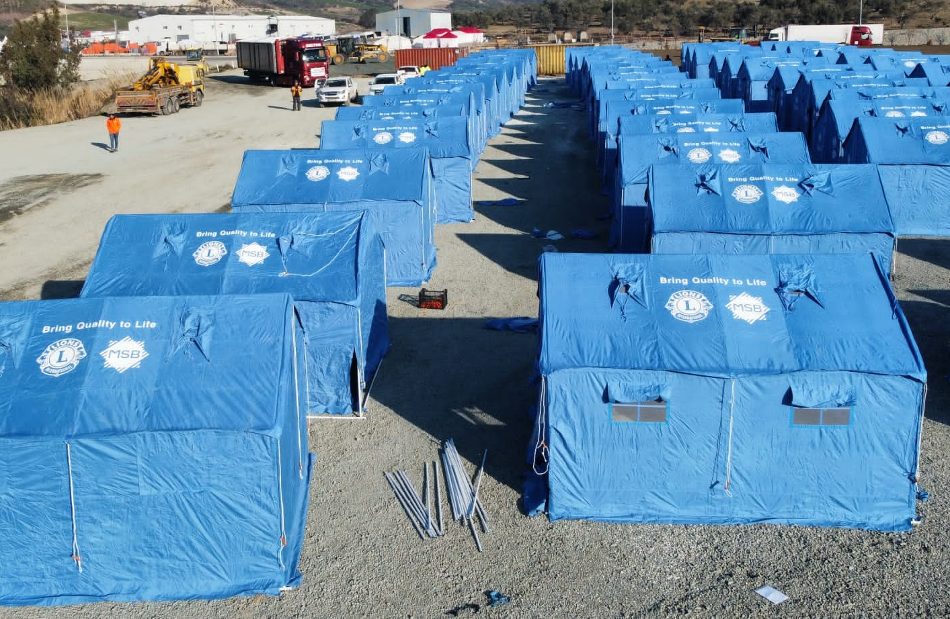
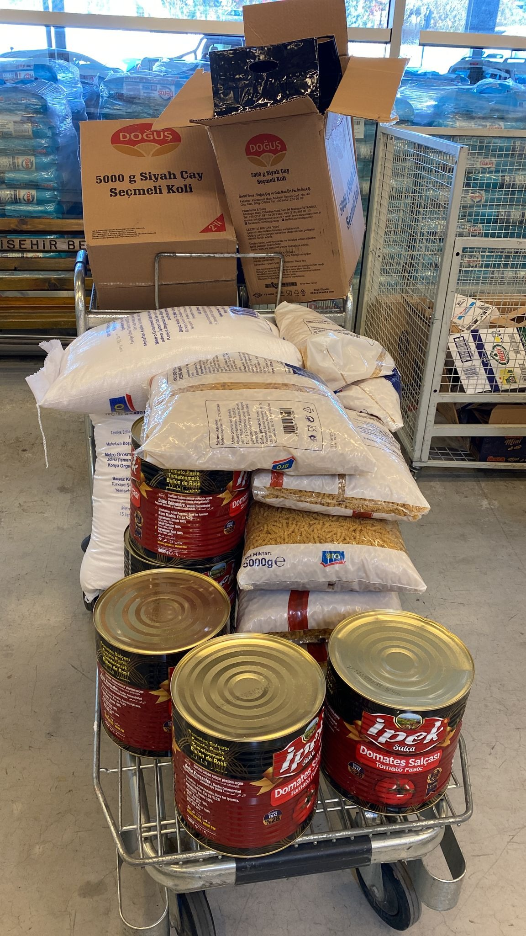
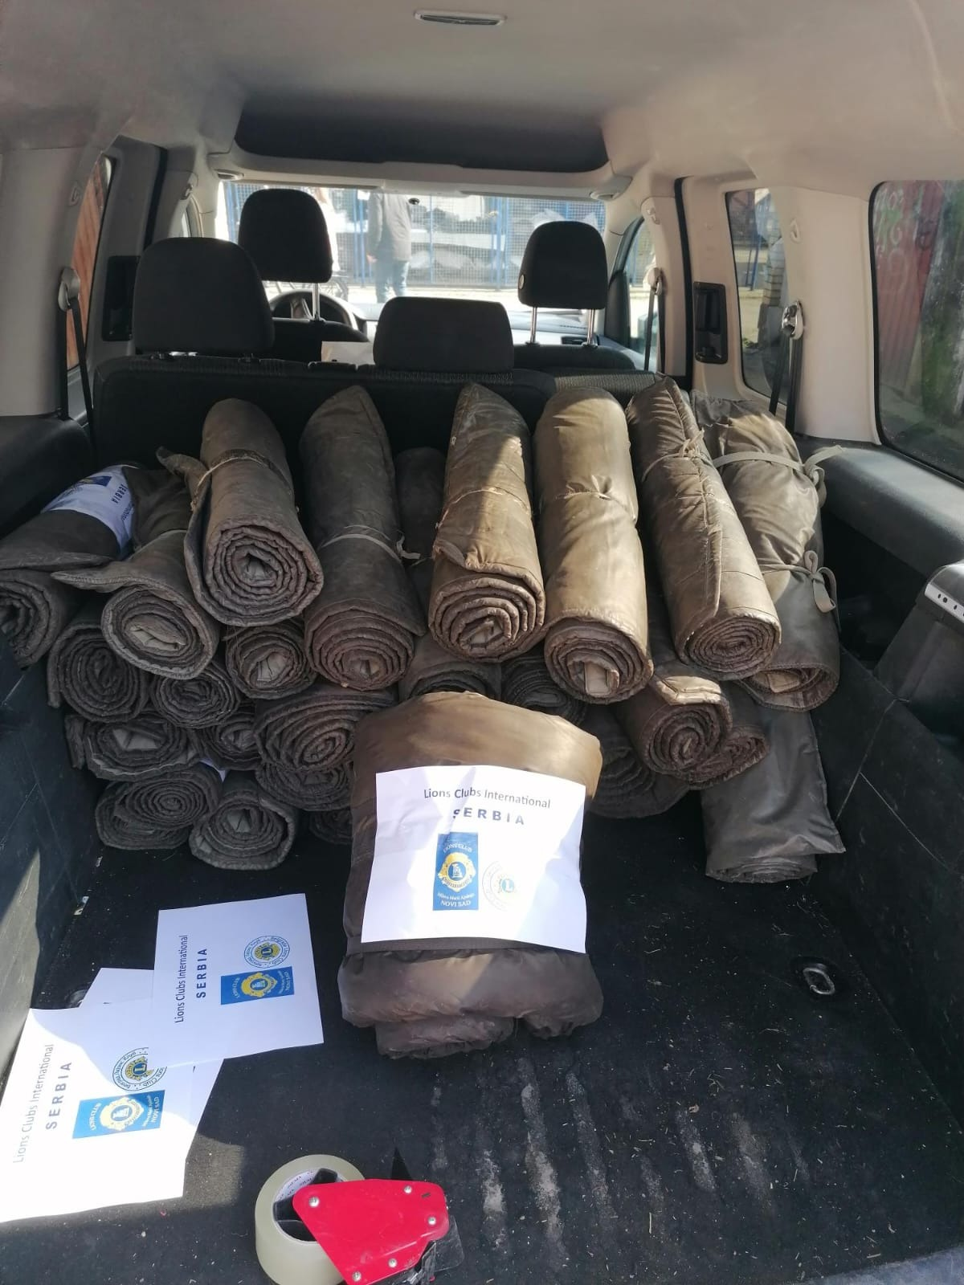
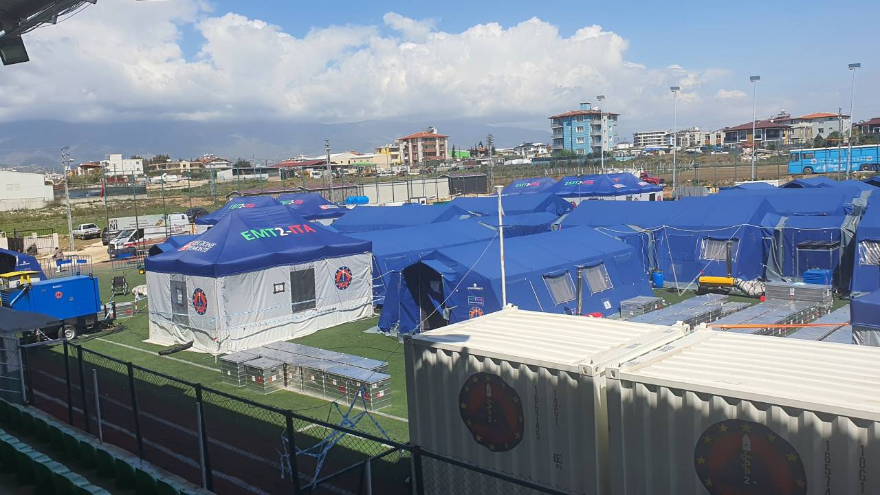
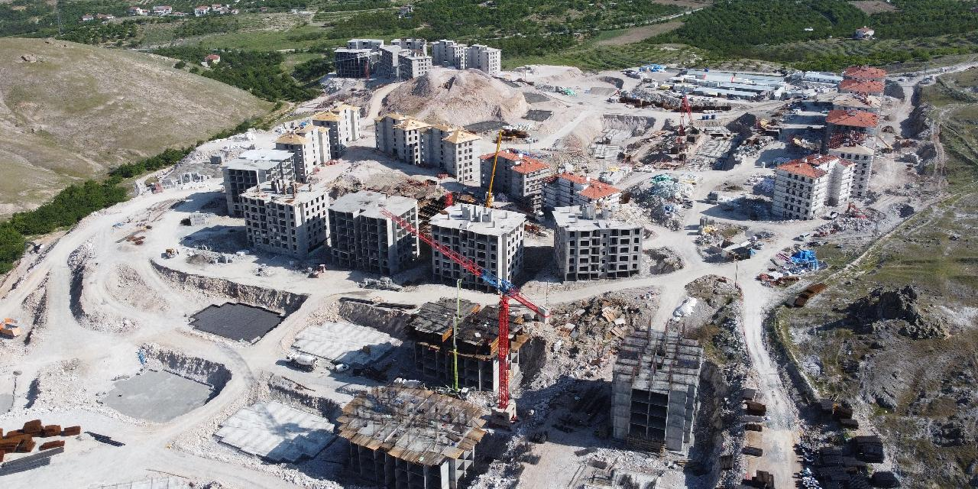
POST-DISASTER PHASES
Rescue and First Aid
Recovery
Reconstruction

Slide 10
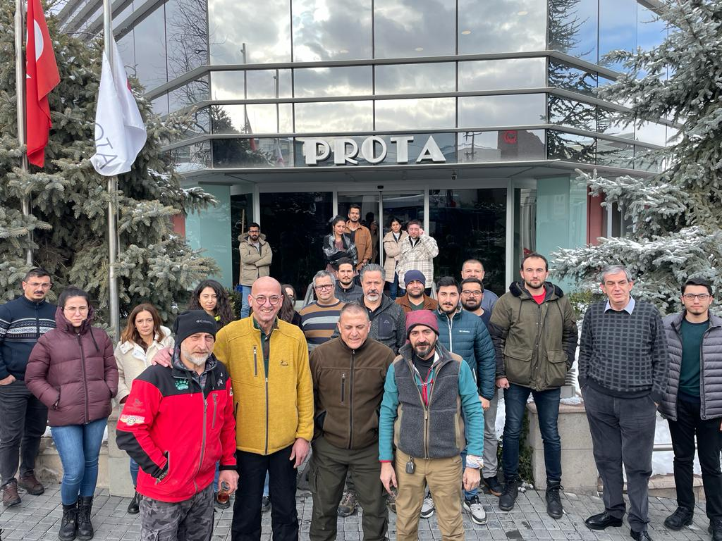
RESCUE AND FIRST AID PHASE
All efforts aimed to save a large number of human lives, to provide treatment for the injured, to meet the vital needs such as shelter, tents, nutrition, evacuation, protection, heating, security and psychological support, etc.
At this stage, the contributions of NGOs such as Lions International are enormous.
On the day of the earthquake, a pioneer team of 8 person ‘’Lions Off-Road Team’’, with 4 vehicles, delivered first aid and emergency supplies, generators, cutters, ropes, etc. set off rescue equipment.
LIONS IN RESCUE

Slide 11
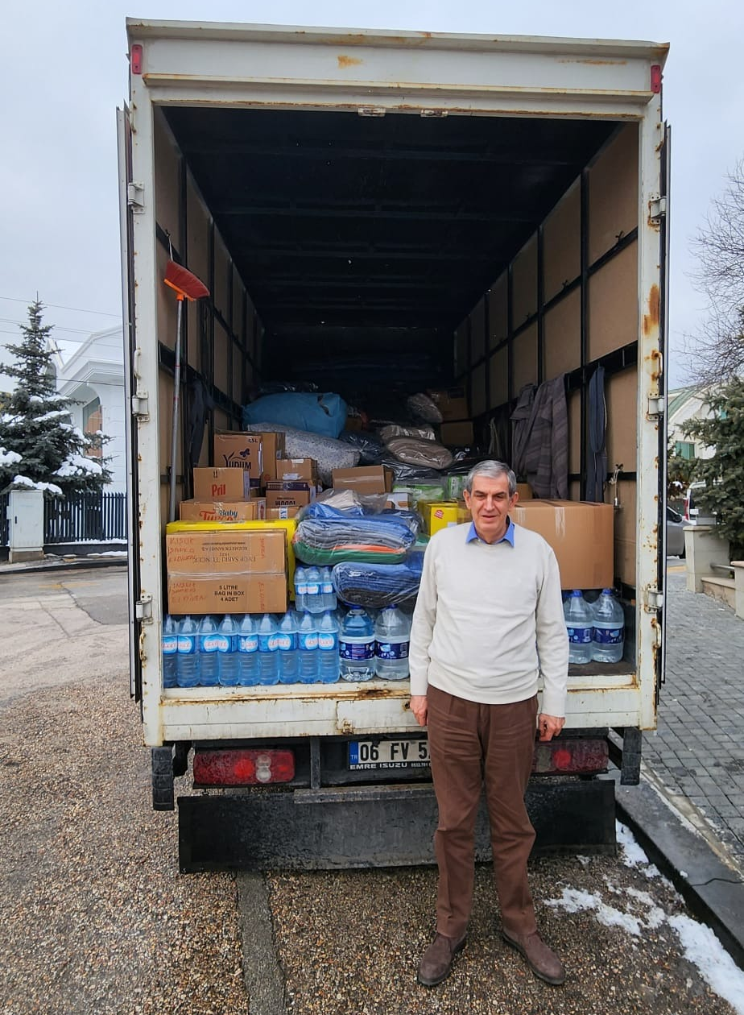
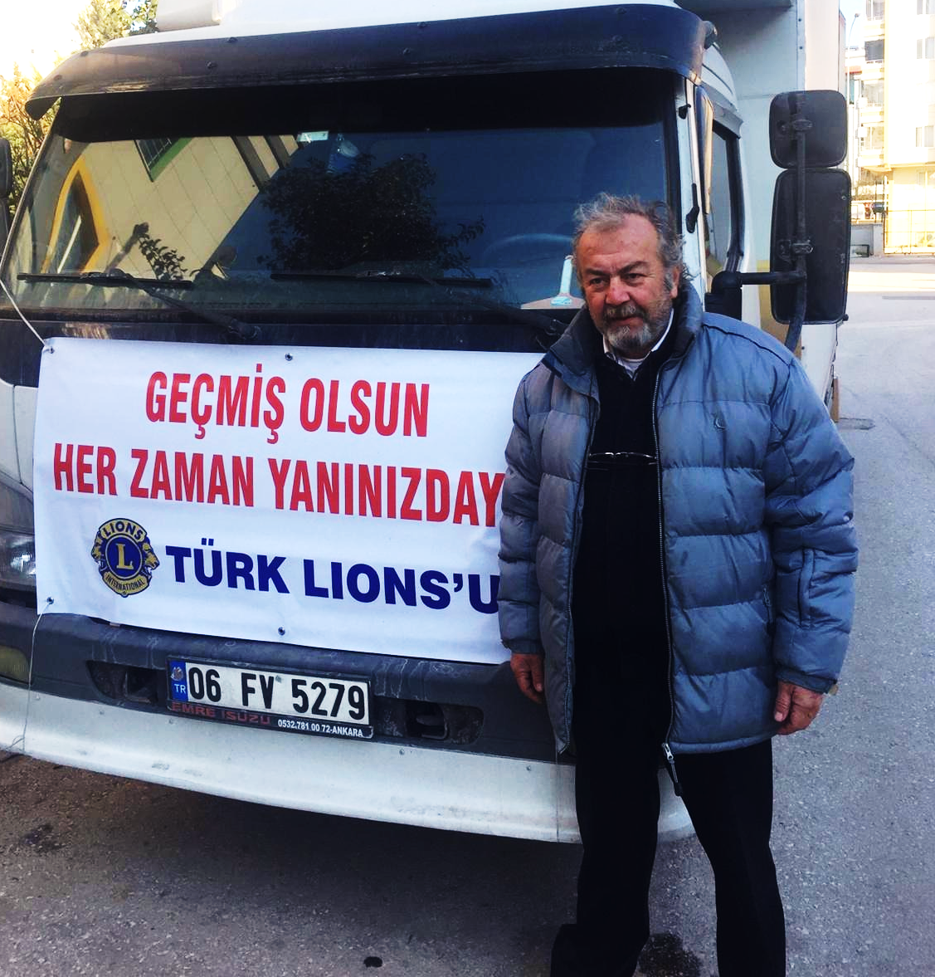
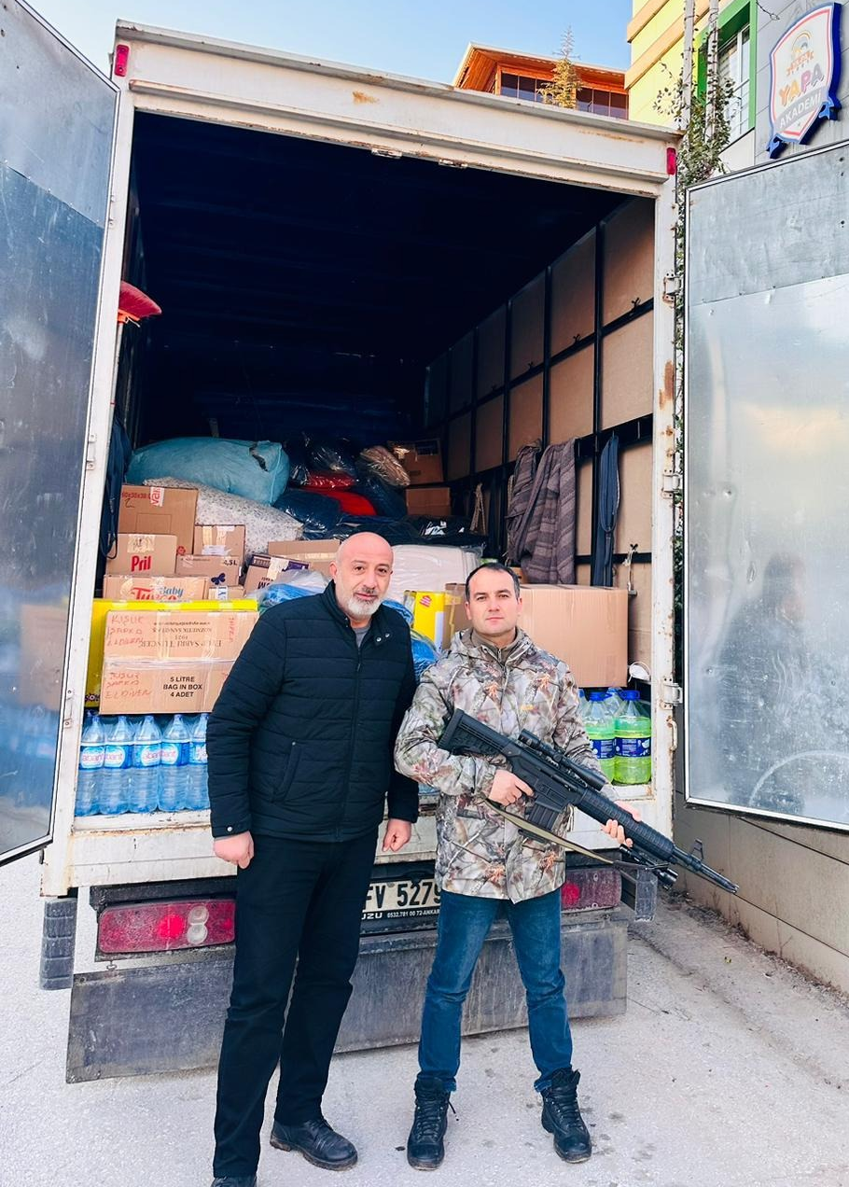
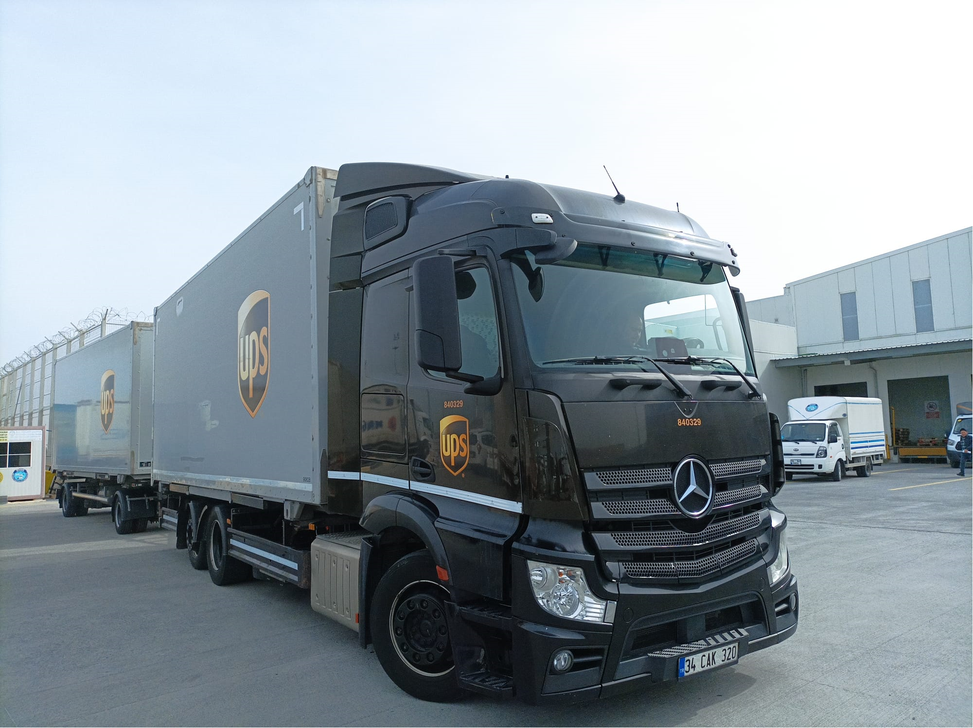
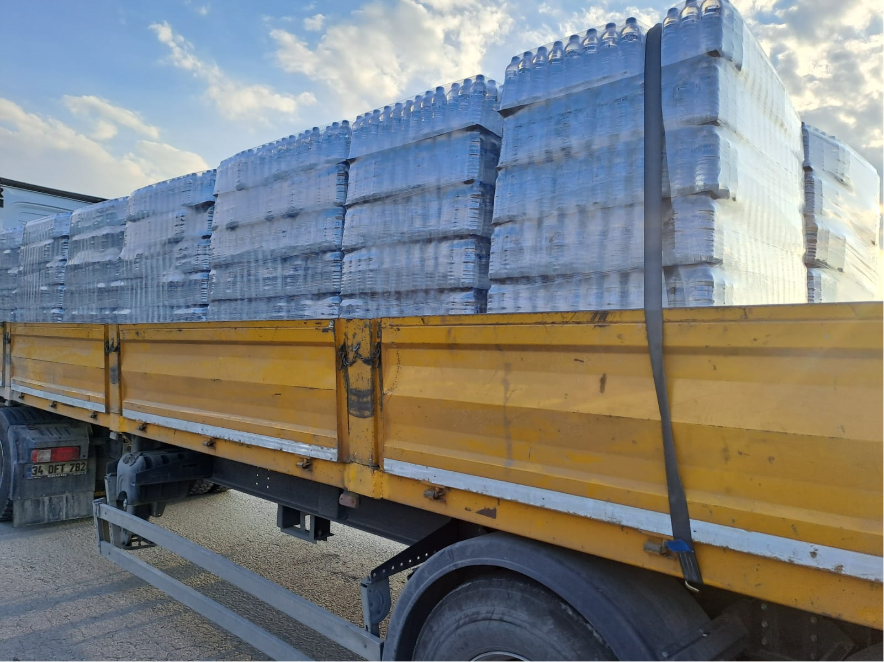
Rescue and First Aid
Thanks to Turkish Volunteers
Lions International Community with Turkish Lions and Leos provided great support in the first response in meeting first aid needs. First truck which was prepared according to the information obtained from the Lions Off-road Team in the disaster region, served just 24 hours after the earthquake...
According to the data we have from our field team, various emergency supplies were sent to Adana, Antakya, Kahramanmaraş, Osmaniye, Adıyaman, Gaziantep and Mersin Cities by MD.118 Lions and Leo Clubs with 13 trucks and TIR vehicles.
LIONS ON ROADS

Slide 12
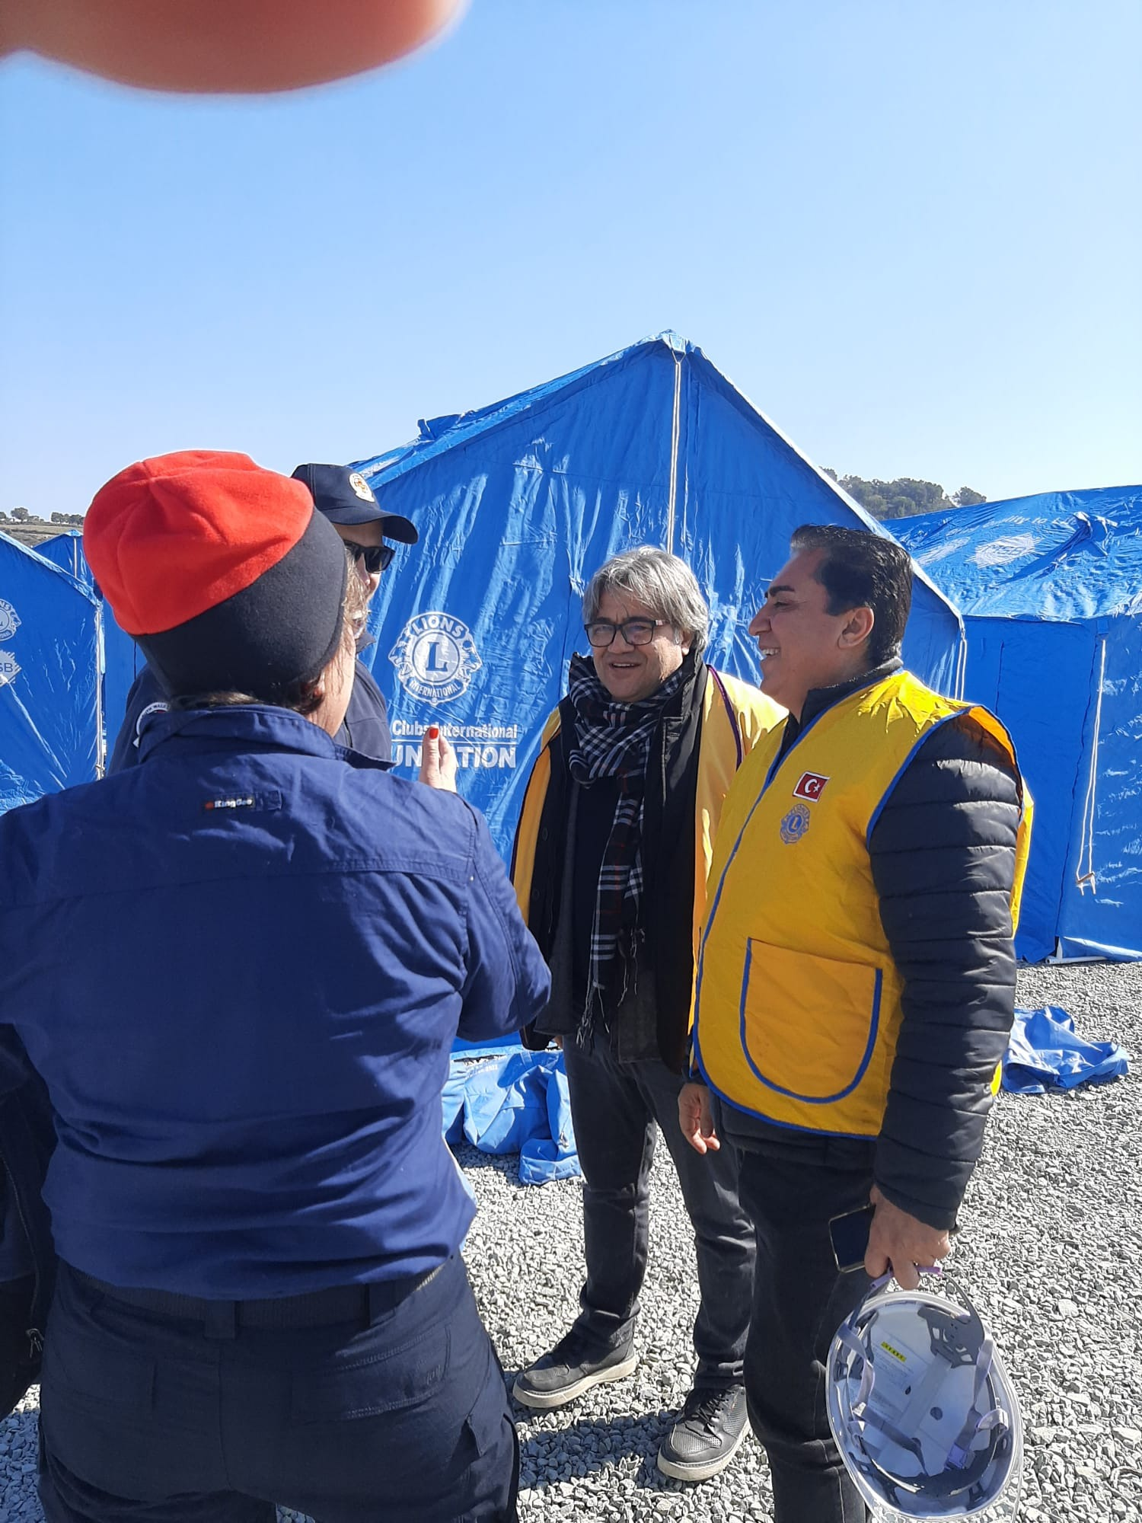
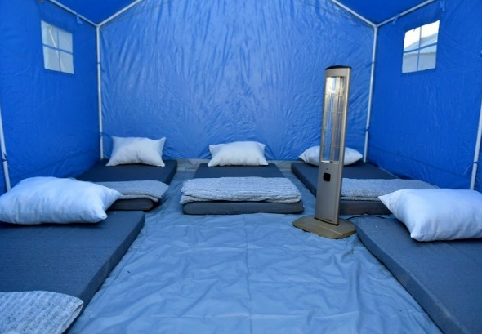
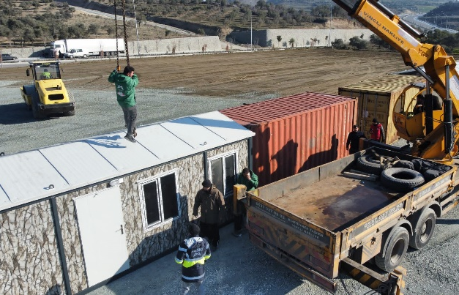
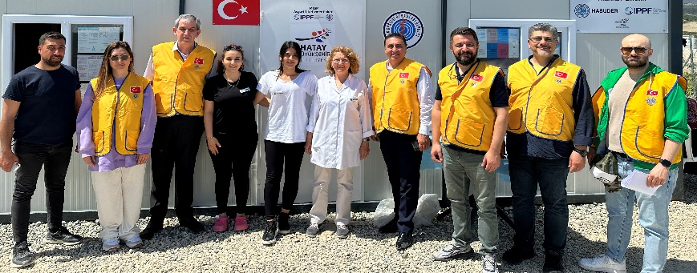
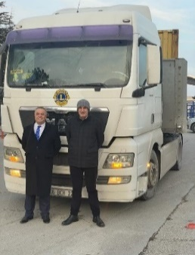
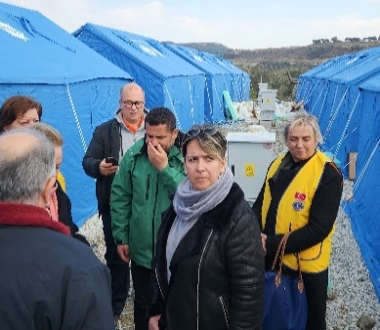
Rescue and First Aid
By the official institution of MSB in Sweden, through PDG Nilgun and PCC Leif Niord; 300 tents, 1500 blankets and 600 scarves/berets were sent to Ankara on February 12.
The plane was welcomed by PCC Danyal Kubin, IPDG Muzaffer Cetin and Burak Ozcan.
This material was directed to the Mersin Metropolitan Municipality ‘’Lions Tent Village’’ area, which is being established in Antakya with the collaboration and intense effort of Lions and Leos.
LIONS ON SITE

Slide 13
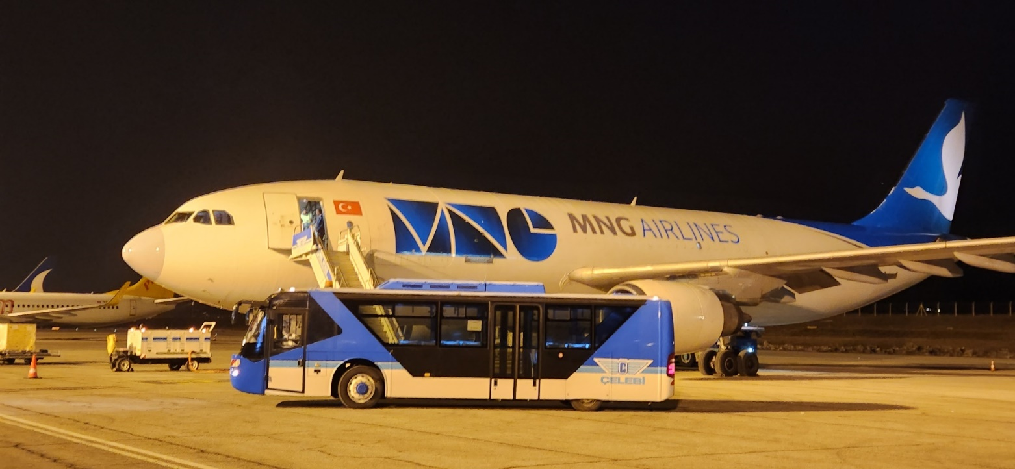
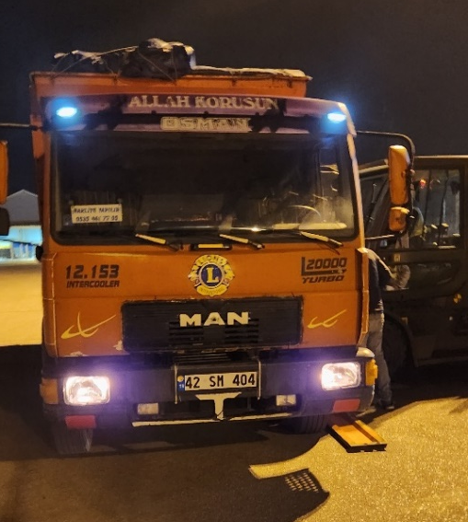
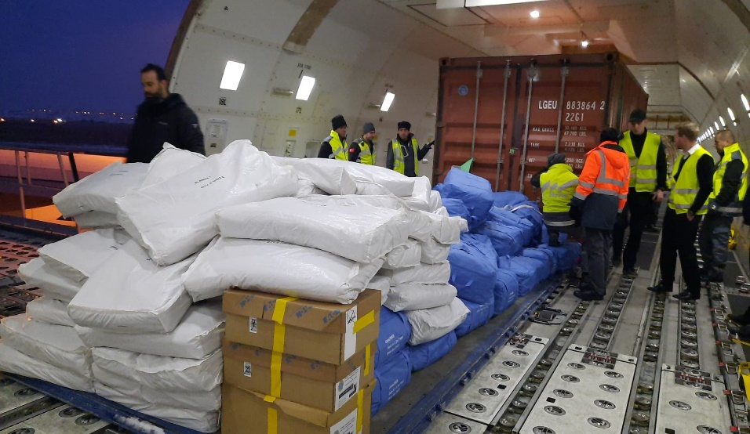
Rescue and First Aid
Thanks to Sweeden Friends
On the early morning of 17 Feb. the second aid plane from Sweden, our Swedish friends landed in Ankara with complementary materials..
These were;
25 alpha type large tents of 48 m2,
230 foam mattresses
190 beds, ,
6 45 kVA generators,
300 sheets and bedspreads,
390 large cans,
450 pillows and pillowcases, etc.
Tons of cargo arrived and was sent to our tent village in Antakya with 3 TIR trucks and 1 truck.
LIONS AT AIRPORT

Slide 14
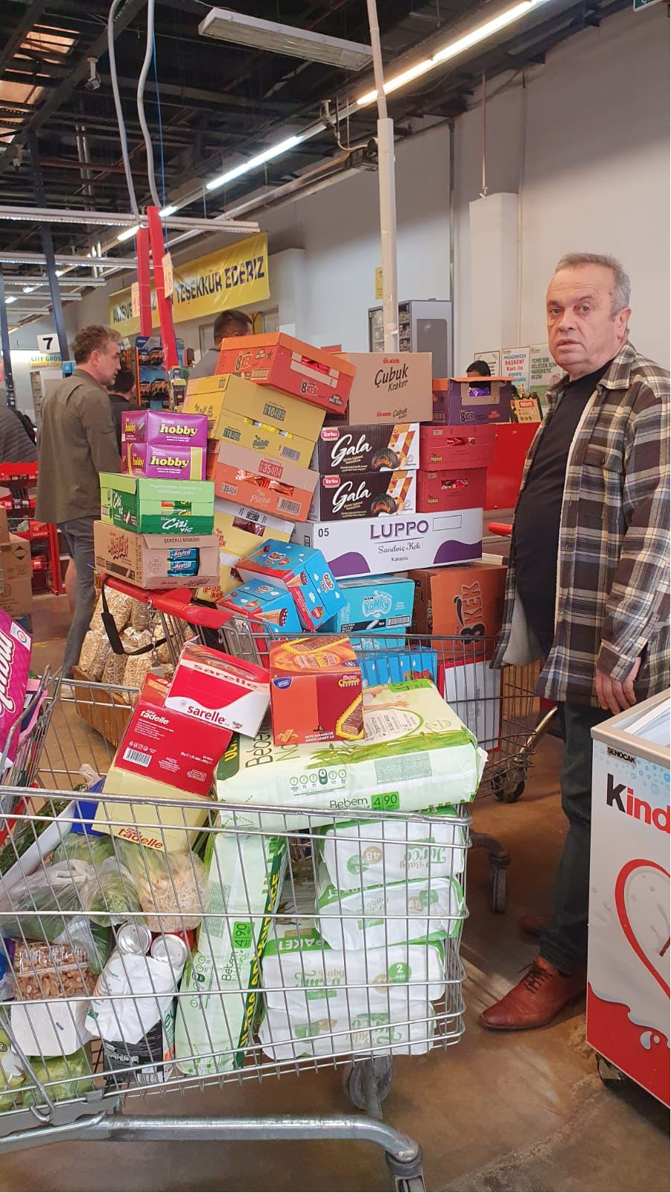
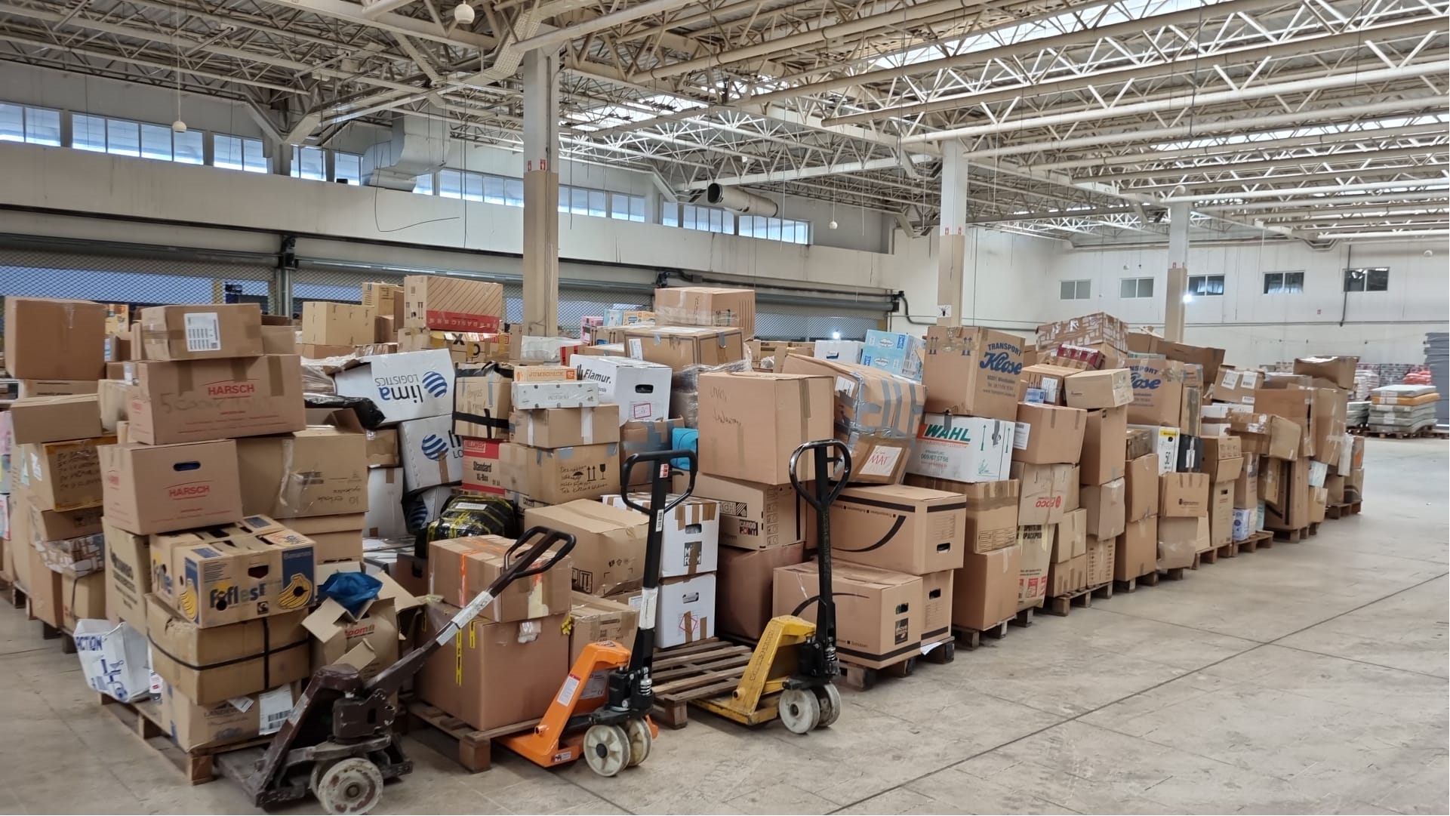
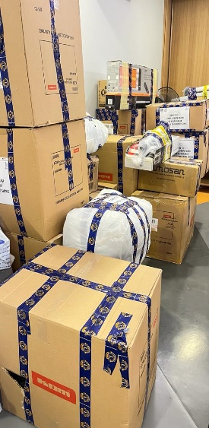
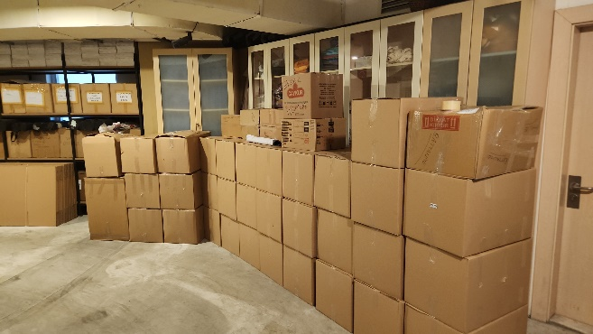
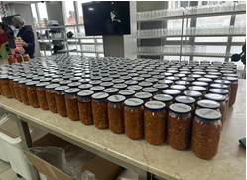
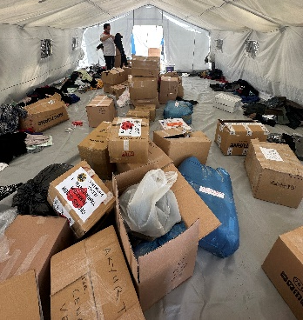
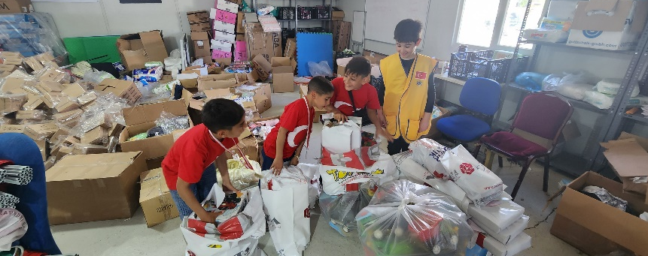
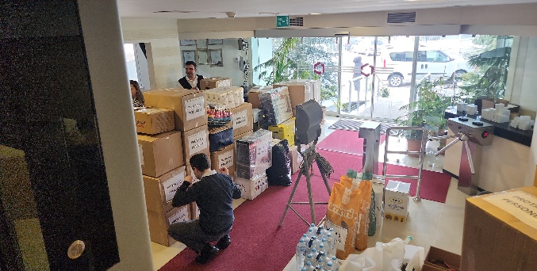
Rescue and First Aid
Thanks to International Lions Community
Hundreds of tons of first aid supplies have been sent to the earthquake zone, with the efforts of Lions and Leos.
Generally, these materials include; feminine hygiene items, diapers, clothing, bedding and quilts, sleeping bags, reading and textbooks, generators, heaters, insulation materials, water, food and drink, cardboard cups and plates, canned and frozen foods, toys, pulses, sugar and similar materials...
All materials were distributed on the field by the Lions and Leos to the victims.
LIONS IN STORAGE

Slide 15
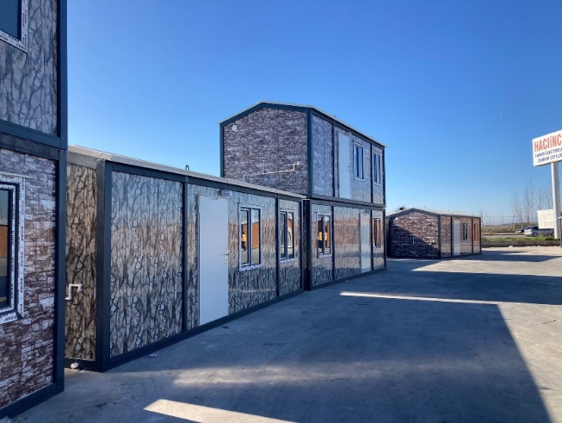
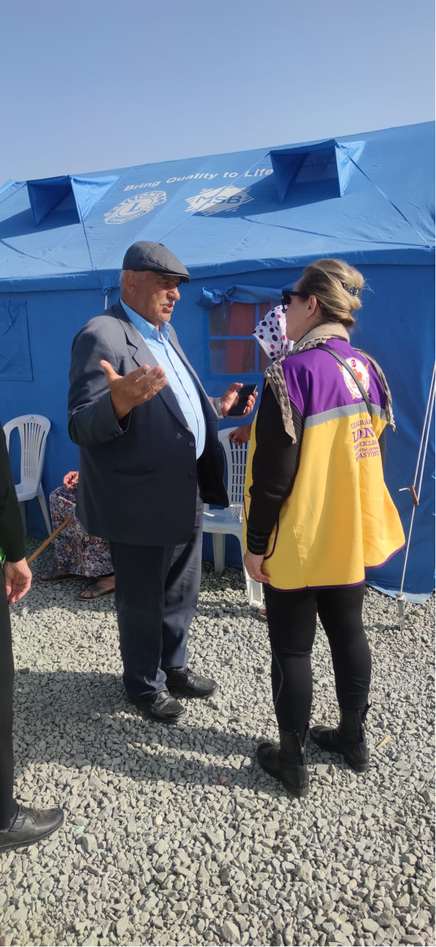
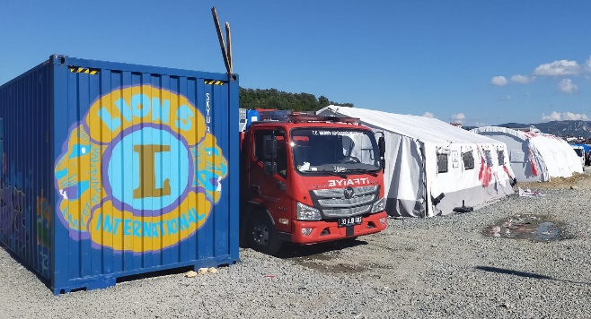
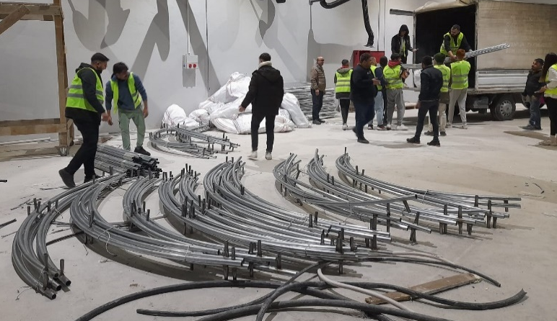
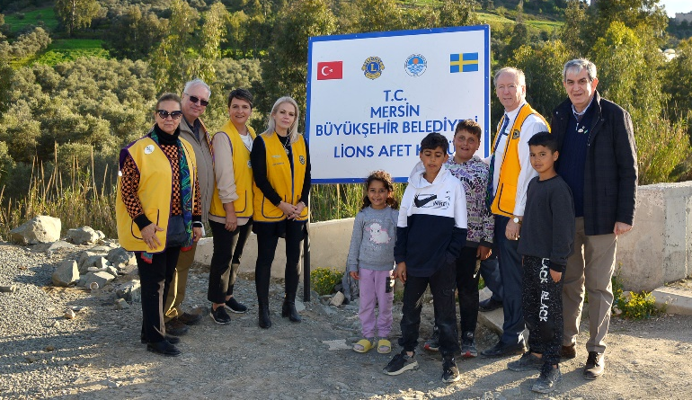
Rescue and First Aid
Leo and Lions were work voluntarily in the Lions Tent Village, which was established and operated jointly with Mersin Metropolitan Municipality in the Antakya earthquake region. We set up Swedish Tents quickly on the area.
10 containers provided by 118-R Antalya Lions Clubs, serve as an Office for staff and storage of the Village.
The Lions Tent Camp consists of
230 medium size and 5 large size social tents,
6 kitchens, storage and
WC-shower containers.
Around 1100 earthquake victims were living in the village.
LIONS AT WORK

Slide 16
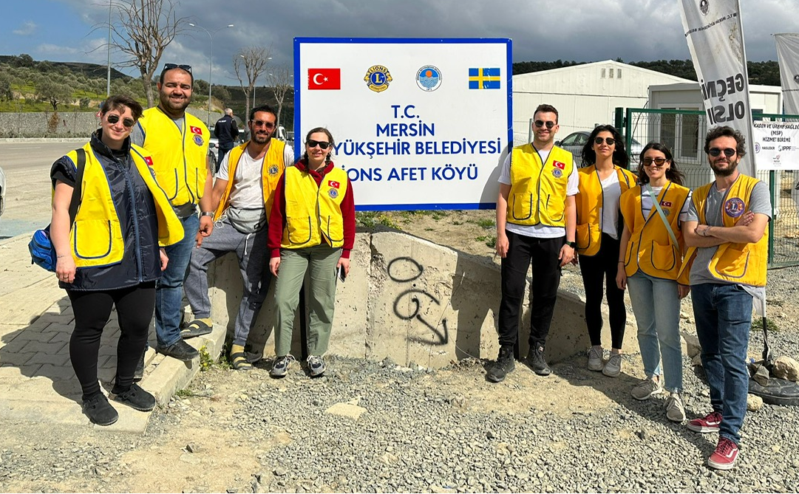
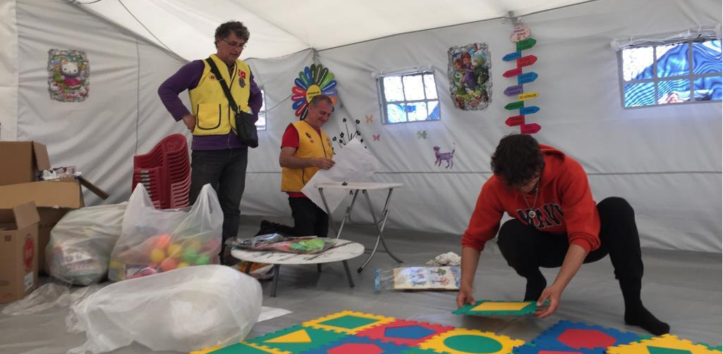
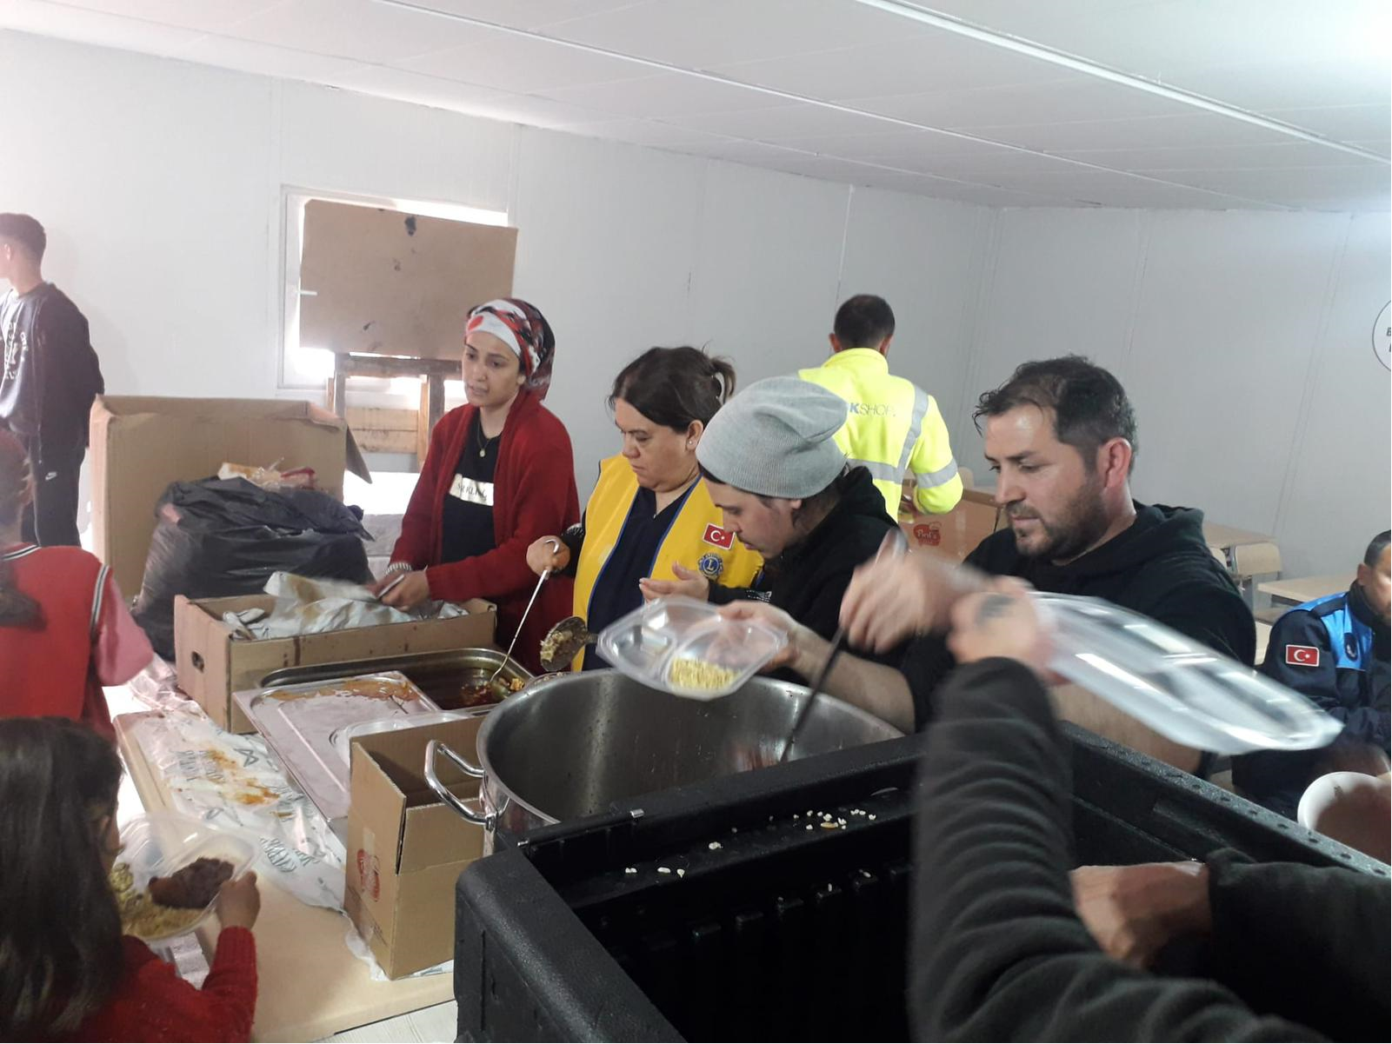
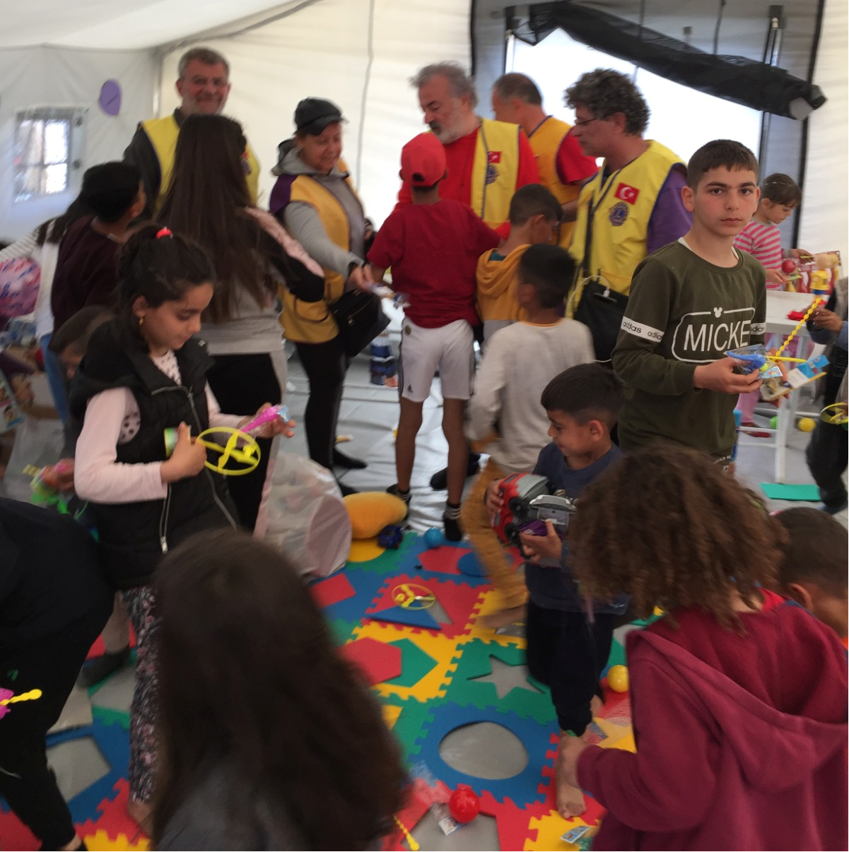
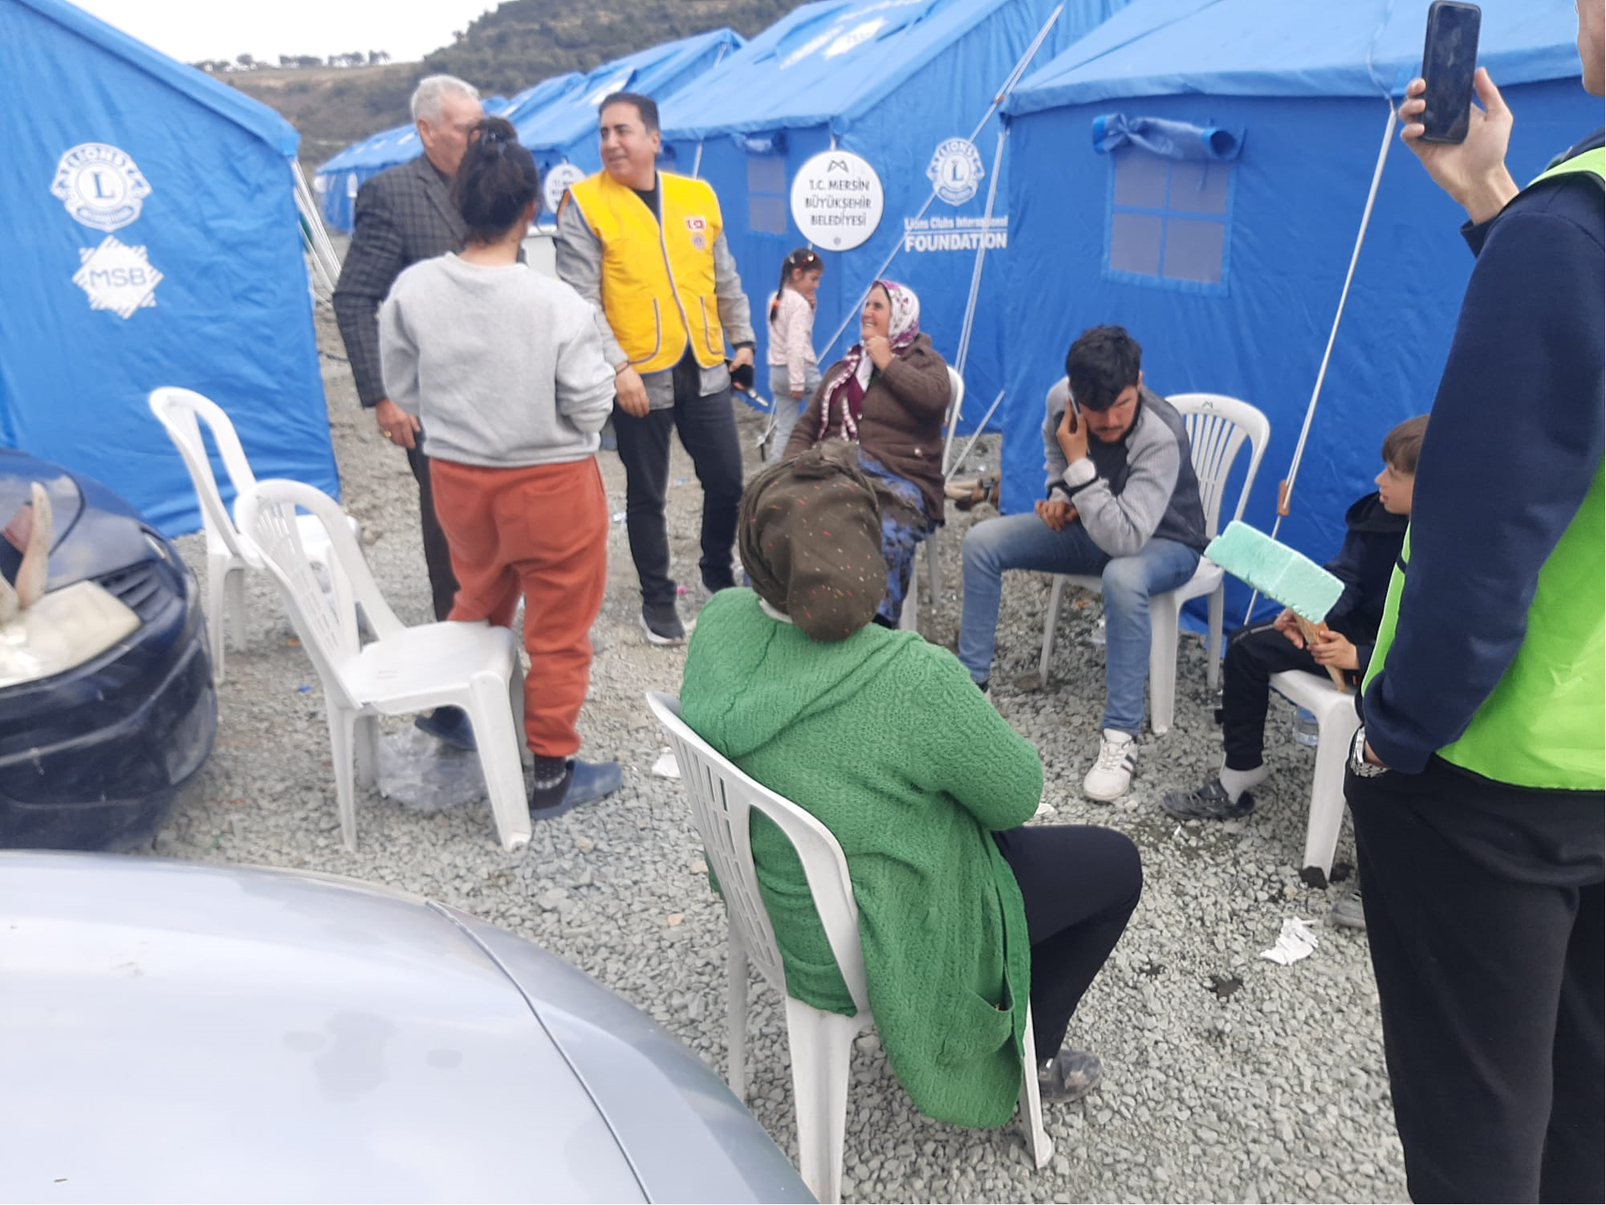
Rescue and First Aid
Thanks to All Volunteers
Leo and Lions served in rotation at the Lions Disaster Village. Leos have created a miracle in the Tent Village, all works are done with Lions; they took care of the earthquake victims closely;
Entertainment for children, a library
a playground,
health cabin,
playing games room.
They organized the repair works of the village. They reported the deficiencies to the Lions Disaster Commitee and ensured that they were supplied.
LIONS AT SERVICE

Slide 17
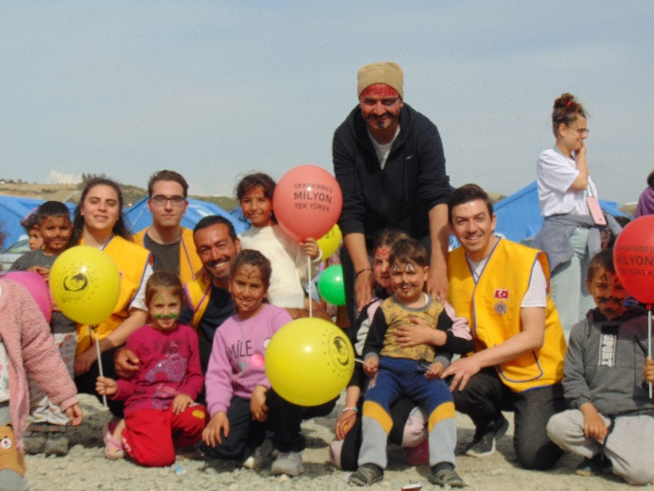
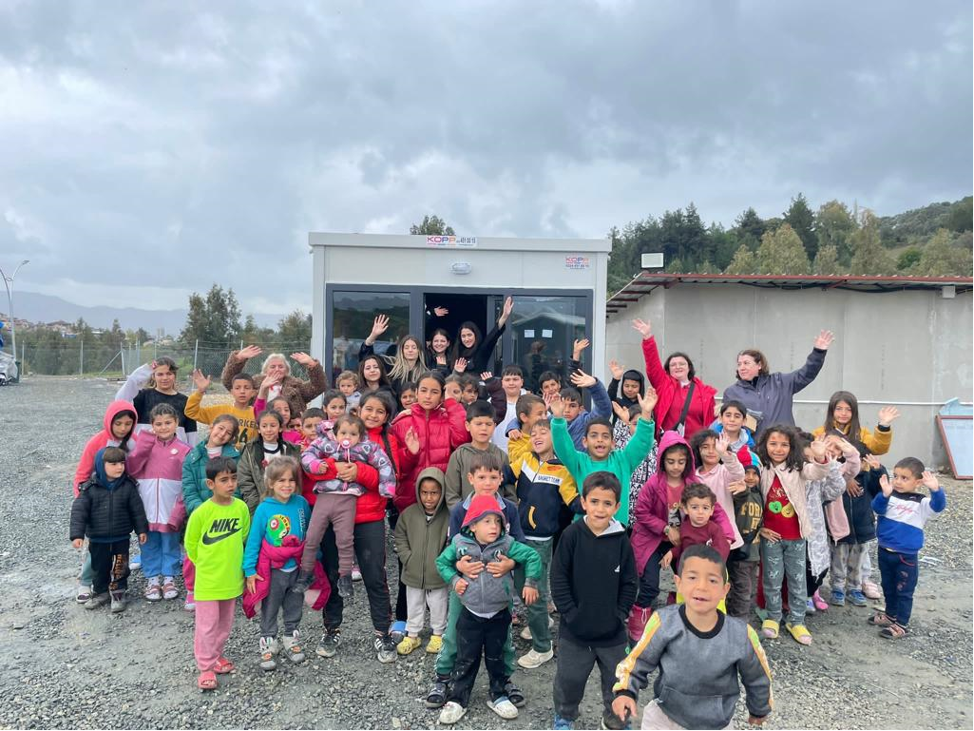
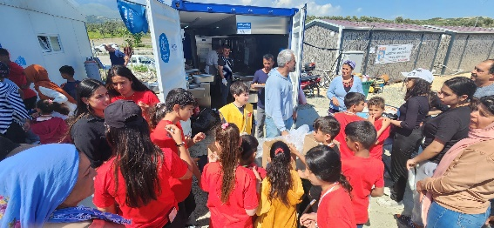
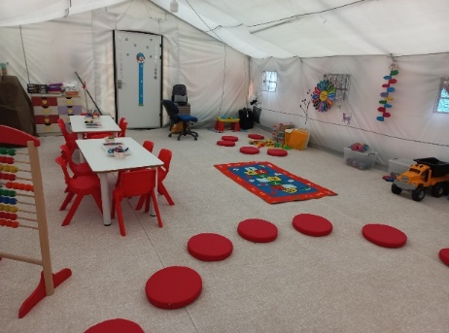
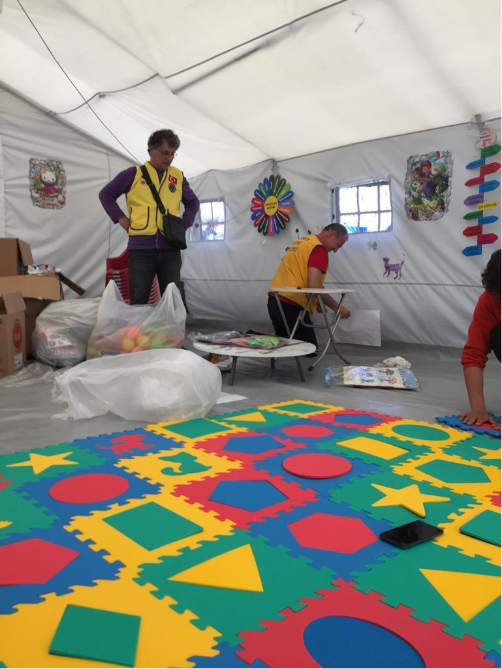
Rescue and First Aid
Thanks to Lions International
First aid phase is the most important phase after the earthquake especially for the children.
Turkish Lions and Leo Clubs have given special attention to children.
In this context, entertainments were organized, toys were provided, birthday parties were held, excursions were organized, nursery, nursing home, library and playgrounds were organized. Leos undertook important role about the children’s rehabilitation process.
LIONS WITH CHILDREN

Slide 18
Rescue and First Aid
Thanks to Lion Leaders
During this time, our village was visited by important guests: CHP, Chairperson Kemal Kilicdaroglu, Istanbul Metropolitan Mayor Ekrem Imamoglu, Mersin Metropolitan Mayor Vahap Secer, International President Brian Sheehan and his wife Lori, PID Hayri Ulgen....
MD.118 CC Tuba Tengiz Yılmaz and 118-U DG Aysegul Tas and her cabinet members frequently visited the village to assess their needs and gave morale being together with the earthquake victims.
Mayor of Mersin, Mayor of Istanbul, CHP Leader Kilicdaroglu
LIONS AS HOST
Lori and Brian with childrens

Slide 19
RECOVERY PHASE
One of the areas where Lions International takes quick action and most effective one is the Recovery Phase.
A satisfactory amount of funding has been developed through the LCIF and with the intense participation of the international community. With this fund a container village consisting of 670 containers was established in the city of Adiyaman together with Mersin Metropolitan Municipality and some other international NGO’s.
167 of 670 containers were provided by Lions and LCIF. And 50 other containers were provided to the earthquake victims in Mersin.

Slide 20
Recovery Phase
Thanks to Lions International Community
Adıyaman Container City is planned to accommodate approximately 3000 victims and allocated by AFAD (Desaster & Emergency Management).
The 167 Lions containers in the yellow painted area as well as the sports fields and children's playgrounds painted as pink color on the map were built with LCIF funds.

Slide 21
Recovery Phase
Thanks to our Foundation, LCIF
Some of the containers donated by Turkish Lions and Leos, were used for the Staff’s office units, and the rest were used for living.
During the establishment of the Adıyaman Container City, IP Brian and Lori Sheehan visited the village and supervise the works with the Committee.

Slide 22
Recovery Phase
Thanks to Turkish Lions and Volunteers
Lions contribution in the container village of Adiyaman is not limited to the establishment of the first offices and the procurement of 167 containers.
With the help of LCIF funds, the Lions also built the container village's basketball courts, indoor and outdoor playgrounds, and kindergardens.
Especially indoor children's playgrounds and nursery containers are worth seeing. They were made by a very special company and donated through Lions.

Slide 23
Recovery Phase
Thanks to Friendly Countries’ Lions
The streets in the village have been named as Sweden, Germany, Italia, Türkiye and France streets.
The plaque of that countries, LCIF and the Lions logo were hung on the fronts of all the containers.
The mission of Lions in the village has been completed and handed over to AFAD for the operation.

Slide 24
Container Inventory List
Internal Migration…
More than 2 million people left the earthquake zone permanently. Now they need support at least as much as those in the earthquake zone. For this reason, 50 containers were sent to Mersin city.

Slide 25
Internal Migration in Türkiye
Migration to neighboring provinces that were not damaged after the earthquake. Mersin, Diyarbakır and Antalya are important cities of attraction in this respect. Especially Mersin has become the most preferred city in terms of providing employment opportunities.
According to the official statements, the fact that the city has received more than 250,000 new immigrants is created many new problems in the economy and social life.
Mersin City Center

Slide 26
In a Year Permanent Project
LIONS SOCIAL CENTERS
RECONSTRUCTION PHASE

Slide 27
Project: Lions Social Service Centers
Post-earthquake permanent projects main target :
Building Lions Social Service Centers in cities in the earthquake zone...
MERSIN
ADANA
GAZIANTEP
ANTAKYA
The main objective of the project, is ‘’to ensure that Lions become partners in the buildings’ operation after putting it into service’’. We don't want to go...

Slide 28
General Approach
The main objectives of the Social Service Centers are:
1- Rehabilitation of children, who are the most easily and most affected group by disasters, in kindergarten and nursery.
2- Opening courses for women, who are the part of the society who face the most problems, to acquire a profession.
3- Women's handicrafts production various handicrafts, carpets, covers, ornaments, etc. in workshops.
4- Ensuring the sustainability of the project and placing shops where women can contribute to their families by earning income by selling what they produce in the workshops.
Childrens First

Slide 29
Partnership Conditions
The partnership terms between the municipalities and the Lions Foundation will generally be as follows:
The project will be realised with the District 118-U ‘’Lions Education and Service Foundation’’ to ensure continuity.
A 25-year protocol will be signed between the Municipalities and the Foundation.
The protocol will be approved by the highest governing body of the provinces and by the municipal council.
All operating expenses (water, gas, internet, electricity, security, etc) of the building will be paid for 25 years by the municipality.
The building will also function as the Lions Center.
Construction costs will be paid by the LCIF fund.
The LCIF logo and inscription commemorating its contributions will be placed on a brass plate at the entrance.

Slide 30
Plot and Roof Plan
FARM AND GARDEN
ROOM NAME | AREA (m²)
ELECTRICAL ROOM | 12.00
WATER TANK | 28.00
HEATING ROOM | 13.00
MAIN STORAGE | 30.00
HALL | 16.00
TOTAL NET AREA | 99.00
TOTAL GROSS AREA
FLOOR | AREA (m²)
ENTRANCE FLOOR | 773.56
UPPER FLOOR | 793.85
TERRACE FLOOR | 131.15
TOTAL GROSS AREA | 1698.56

Slide 31
Entrance Floor (Kindergarten)
ROOM NAME | AREA (m²)
NURSERY ROOM 5-6 AGE | 36.00
NURSERY ROOM 5-6 AGE | 36.00
PREPARATION | 18.00
WC-LAV. | 11.00
NURSERY ROOM 4-5 AGE | 36.00
NURSERY ROOM 4-5 AGE | 36.00
PREPARATION | 18.00
WC-LAV. | 11.00
NURSERY ROOM 3-4 AGE | 36.00
PREPARATION | 7.00
WC-LAV. | 5.00
NURSERY ROOM 3-4 AGE | 36.00
PREPARATION | 7.00
WC-LAV. | 5.00
SLEEPING ROOM | 51.00
ENTRANCE HALL | 36.00
KINDERGARTEN HALL | 68.00
NURSES ROOM | 18.00
WINTER GARDEN / PLAY GROUND | 32.00
HEALTH ROOM | 5.60
SOCIOLOGIST ROOM | 11.00
WC-LAV. | 2.20
WC-LAV. | 2.20
STORAGE | 10.00
CAFE | 55.00
WC-LAV. | 3.00
STORE | 35.00
MARKET | 60.00
TOTAL NET AREA | 687.00

Slide 32
Upper Floor (Social Center)
ROOM NAME | AREA (m²)
COURSE / WORKSHOP ROOM | 55.00
COURSE / WORKSHOP ROOM | 37.00
COURSE / WORKSHOP ROOM | 37.00
COURSE / WORKSHOP ROOM | 55.00
TRAINER'S ROOM | 23.00
WAITING HALL | 19.00
WAITING HALL | 19.00
MAIN HALL | 69.00
CHILDREN'S ENTRANCE HALL | 32.00
CHILDREN'S DINING & MULTIPURPOSE HALL | 57.00
MAIN KITCHEN | 23.00
WASHING | 11.00
STORAGE | 14.00
ADULT'S DINING & MULTIPURPOSE HALL | 159.00
ENTRANCE HALL | 17.00
WC-LAV. | 12.00
WC-LAV. | 12.00
STIRAGE | 7.00
LIONS SECRETARY | 12.00
ADMINISTRATION CORR. | 13.00
KINDERGARTEN MANAGER | 14.00
FINANCE & ACCOUNTANT | 12.00
LIONS NGO ROOM | 9.00
TECHNICAL MANAGER | 16.00
TOTAL NET AREA | 734.00

Slide 33
Kindergarten and Nursery
REGION’S MOST MODERN AND SUSTAINABLE, MULTIPURPOSE SOCIAL CENTERS
Kindergarten and Nursery
6 classes for differnet age groups
Sleeping room for 3-4 age group
Preparatory rooms
Library and social areas
Closed winter play ground
Sociologist and health rooms
120 children capacity
Private dining hall for 50 children
Special management rooms
Garden and open air playground
Vegetable field, poultry and livestock production area

Slide 34
Social and Training Center
REGION’S MOST MODERN AND SUSTAINABLE, MULTIPURPOSE SOCIAL CENTERS
Social and Training Center
Dining Hall for 120 adult
Multi-purpose hall for 150 people
4 training rooms
Board meeting room
Opportunity to gather in the winter garden
Separate service for adults
Use of transformable rooms
Separate entrances for children and adults
Private management units for Lions
Shared main kitchen for both
Storage and depot rooms
Possibility to do activities on the open terrace
Facilities for Lions and Leos activities

Slide 35
Türkiye and Turkish Lions / Leos Thanks
Lions International, LCIF and International Lions Community
DISASTER RELIEF COMMITTEE
CC Tuba Tengiz Yılmaz - DG Ayşegül Taş - VCC Ender Sakintuna - PID Nesim Levi - PID Hayri Ülgen - PID Oya Sebük - FVDG Erol Aydın - SVDG Cengiz Kurt - PCC Danyal Kubin - IPDG Muzaffer Çetin – PDG Bülent Şen - PDG Nilgün Niord - PDG Teoman Akçalı - PDG Can Canver - PDG Nazım Geyikçi - PDG Neşe Başak Güner - PDG Fuat Topdemir - PDG Canan Banu Dündar - PDG Hüsamettin Ocak – Leo MDP Orhun Tugay Kocaoğlu - Leo DP Bensu Simge Büyükvural
Danyal Kubin, ID

