Slide 1

Lions Clubs International Foundation:
Supporting the Global Community
IPIP Douglas X. Alexander
LCIF Chairperson

Slide 2

WELCOME!
Douglas X. Alexander
Immediate Past International President
LCIF Chairperson
Notes:
[CHAIRPERSON ALEXANDER]
Hello Lions! Thank you for joining us today to talk about one of my favorite parts of our organization. Lions Clubs International Foundation – or LCIF.

Slide 3
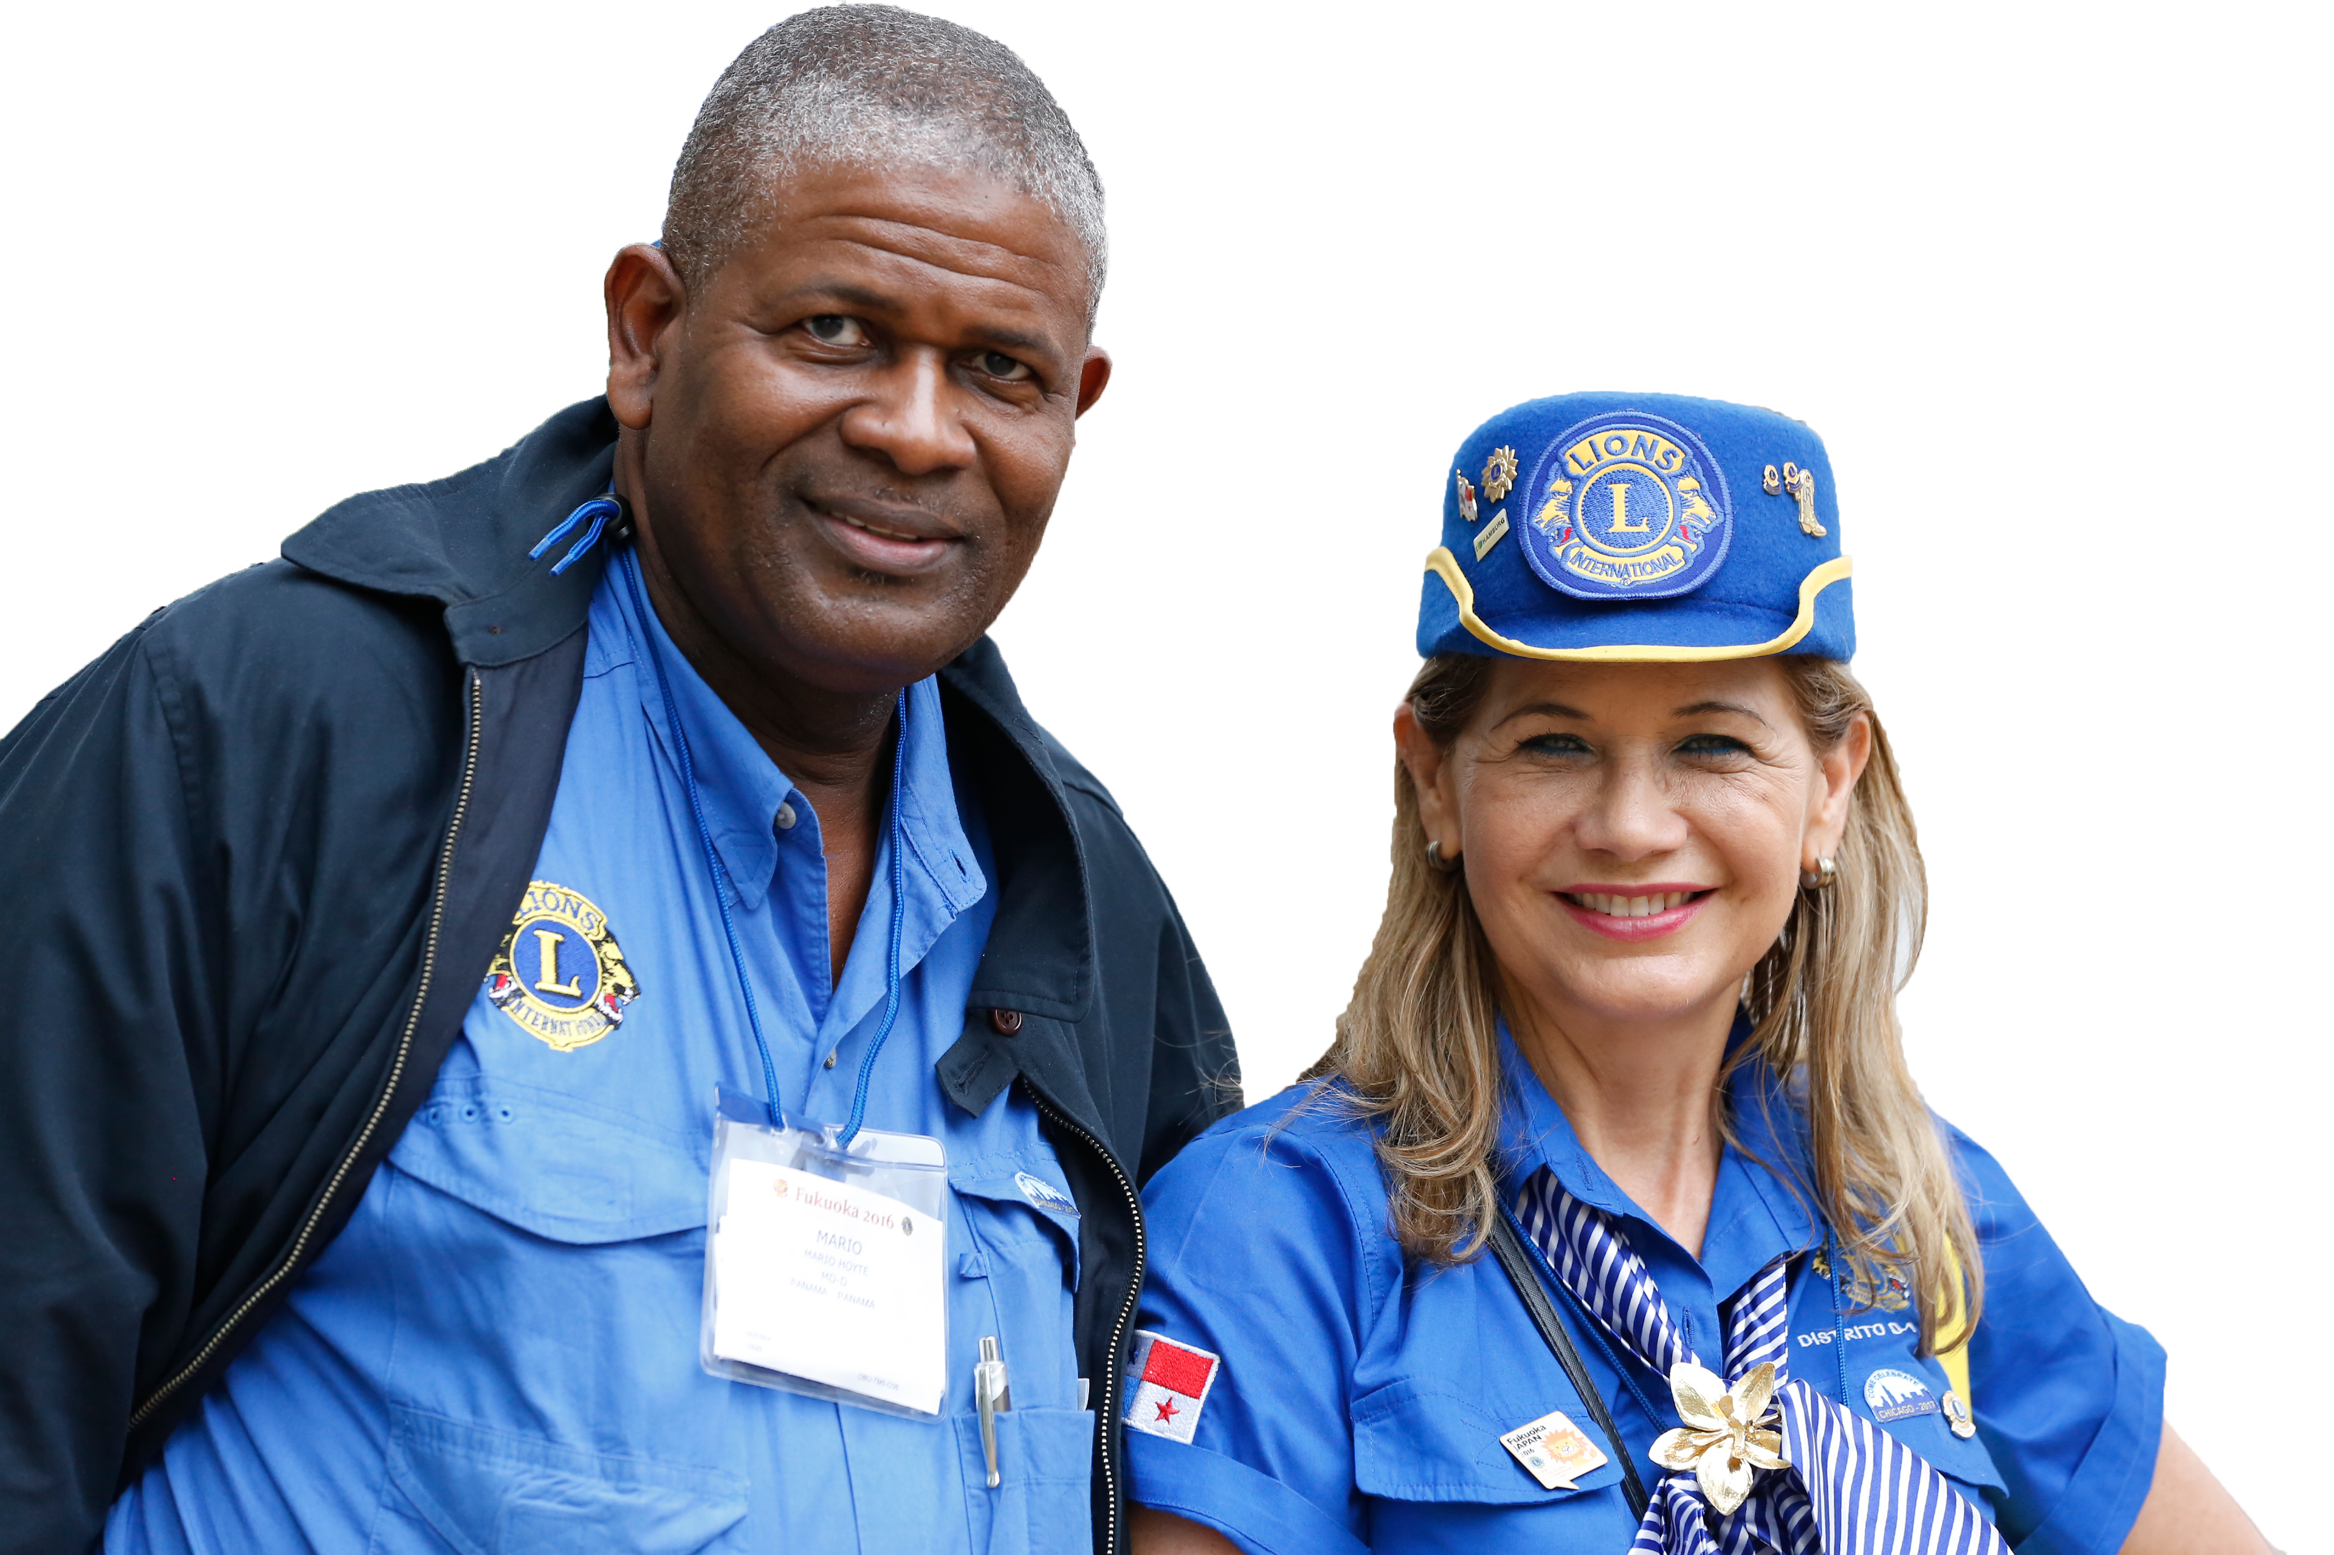
THE FOUNDATION
OF SERVICE
Notes:
[CHAIRPERSON ALEXANDER]
LCIF plays a very important role in our global service as Lions. How? LCIF encourages Lions in one region to show their global friendship and help out Lions in another region during a time of need. As humanitarians, we are each guided by kindness to serve not only those in our own communities, but also people in need around the world. Through LCIF, we can make possible what may be beyond the capacity of a single club or district. Foundation grants enable us to complete large-scale projects that individuals and clubs can't do alone.
In fact, LCIF is the only Lions foundation to empower the service of Lions worldwide and remains committed to magnifying YOUR service while strengthening our humanitarian mission.

Slide 4

Since
1968
US$1.2
billion
Notes:
[CHAIRPERSON ALEXANDER]
LCIF was founded in 1968 to take the work of Lions to new heights by tackling global problems and assisting Lions with both large- and small- scale humanitarian projects. Since its founding, LCIF has awarded more than one point two billion U.S. dollars in grants to Lions, filling our organization's history with high-impact projects, meaningful partnerships, and the kindness and service of Lions.

Slide 5
Constitutional Area VII
US$26,621,082
MD 201: $13,523,543
MD 202: $3,654,125
MD 307: $8,864,139
Region 203: $579,275
Notes:
[CHAIRPERSON ALEXANDER]
Here in Constitutional Area VII you can see that LCIF has supported grants totaling over $26 million dollars.
A tremendous amount of service was enabled through these grants.
But it takes the generosity of our Lions to make these grants happen.
Let’s take a moment to celebrate LCIF's recent fundraising successes made possible by Lions and other supporters like YOU.

Slide 6

INCREASING
Service Impact
FIGHTING
Diabetes
EXPANDING
Global Causes
Notes:
[CHAIRPERSON ALEXANDER]
At the International Lions Convention in Las Vegas, Nevada in 2018, LCIF announced the most ambitions fundraising effort in Lions' history - Campaign 100. The campaign goal was to raise three hundred million U.S. dollars to expand Lions' commitment to communities and empower our service for years and decades to come by:
Increasing our service impact in the areas of vision, youth, disaster relief, and humanitarian causes;
Fighting diabetes and improving the quality of life for those diagnosed;
And expanding our global causes to include hunger, childhood cancer, and environment

Slide 7
OUR GOALS
Responding to the needs of the world
Hundreds of Millions
Lives Changed
US$300M
Raised Through
Campaign 100
100%
Lion Participation
Notes:
[CHAIRPERSON ALEXANDER]
Our goals were high for this campaign, but we knew that through this achievement, hundreds of millions of lives would be changed for the better.

Slide 8


Celebrating Campaign 100
Notes:
[CHAIRPERSON ALEXANDER]
At the 104th International Lions Convention in Montreal, Canada, LCIF announced that it had not only reached but exceeded the campaign goals, making history for our organization.

Slide 9

CELEBRATING CAMPAIGN 100
Dr. Jitsuhiro Yamada
Past International President
Campaign 100 International Chairperson
Notes:
[CHAIRPERSON ALEXANDER]
Now I would like to introduce Past International President Dr. Jitsuhiro Yamada, Campaign 100 International Chairperson to talk more about our accomplishments!
[PIP YAMADA]
Thank you, Chairperson Doug. Lions, I am honored to be with you today as we celebrate the success of Campaign 100 and look towards our foundation’s bright future.

Slide 10

US$325
MILLION
Notes:
[PIP YAMADA]
It was our sincere pleasure to announce at the Convention that LCIF had not only met but surpassed our US three hundred million dollar goal. As you heard in the video, in total, we raised three hundred and twenty five million US dollars!
This amazing accomplishment was made possible by YOU and your fellow Lions and others around the globe.

Slide 11
New grant programs in Childhood Cancer and Hunger
Mobilized the Refugees and Displaced Persons fund
Increased ability to quickly award grants in times of disaster and during global crises
Continued support for the world’s youth
Innovative grant projects to protect and restore our environment
Lives changed for the better – many even saved - because of Lions’ service
Campaign 100 Achievements
Notes:
[PIP YAMADA]
But the impact of Campaign 100 goes beyond dollars raised…
Throughout the course of the campaign, the impact of Campaign 100 was felt globally in a number of ways.
The new grant programs in Childhood Cancer and Hunger improved quality of life for those in need.
LCIF mobilized the Refugees and Displaced Persons fund to provide safety and security for those fleeing their homes during immensely challenging times. This was most recently evident through nearly one point eight million dollars in grants to Lions in Ukraine and other surrounding countries helping Ukraine families who fled the country after Russia's invasion in March.
Campaign 100 also increased LCIF's ability to quickly award grants in times of disaster and during global crises like the COVID-19 pandemic
The campaign offered continued support for the world’s youth through Lions Quest programming and grants.
LCIF also initiated innovative grant projects to protect and restore our environment to improve the well-being of all communities.
And, lives changed for the better – many even saved - because of Lions’ service in vision, diabetes and other humanitarian efforts globally.
All of this was made possible because of the support of LCIF and Campaign 100.

Slide 12
ありがとうございます
감사합니다
謝謝您！
KIITOS
MERCI
THANK YOU!
GRAZIE
TACK
GRACIAS
MUITO OBRIGADO
DANKE
Notes:
[PIP YAMADA]
As we close this chapter on Campaign 100, I want to again thank all of you in this room and around the world for supporting OUR foundation. We are ensuring that our service is magnified through the power of each grant awarded and each [dollar] donated.
With that, I would like to turn the presentation back over to Chairperson Doug.

Slide 13

What's Next?
Notes:
[CHAIRPERSON ALEXANDER]
Thank you, Dr. Yamada.
Lions, we should all be very proud of what we achieved together throughout the campaign.
But, we know that the world will continue to need Lions in the years and decades to come.

Slide 14

The calls to serve a world in need continue to grow.
LCIF empowers Lions to ALWAYS ANSWER!
14
Notes:
[CHAIRPERSON ALEXANDER]
It is only through the continued support of LCIF that we can ensure that the foundation will always be able to support us in our service through life-changing – even life-saving – grants and programs.

Slide 15

OUR WORLD
IN NEED
Julie Boonprasarn
Senior Grants Specialist
Notes:
[CHAIRPERSON ALEXANDER]
Now I would like to introduce [JULIE BOONPRASARN] to walk us through a few examples of how the world needs Lions, and how LCIF magnifies the impact of Lions service across the globe.
[JULIE BOONPRASARN]
Thank you, Chairperson Alexander! My name is Julie Boonprasarn and I’m the Senior Grants Specialist for Constitutional Area Four, Europe. I review and manage the grant applications for LCIF funding from the Lions of Europe.
Let’s look at how LCIF is meeting the needs of the world and magnifying the service of Lions.

Slide 16
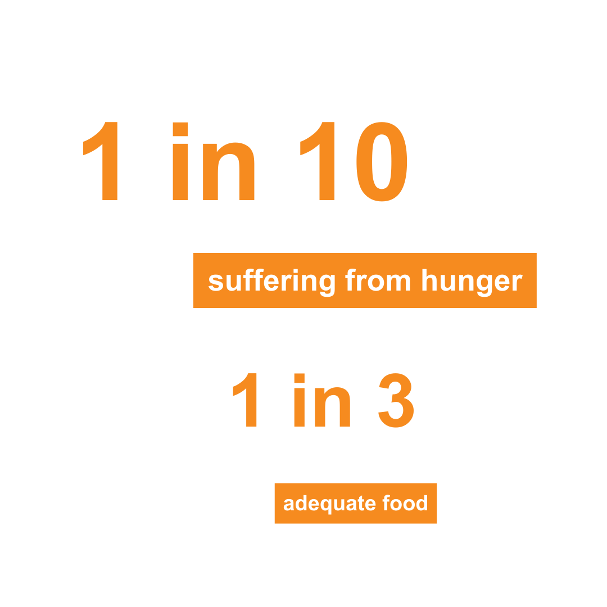
United Nations Sustainable Goals Report 2022
Notes:
[JULIE BOONPRASARN]
We have pulled a few recent statistics from the United Nations 2022 update on the Sustainable Development Goals to show how great the needs of the world continue to be. For example...
According to the report, one in ten people worldwide are currently suffering from hunger; and one in three people in the world lack regular access to adequate food.

Slide 17
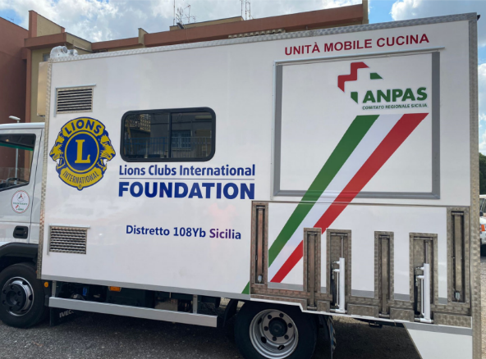
Hunger Grants
Community Impact
Grants (DCG)
Lions in Italy purchased a transport vehicle to deliver meals from the local food bank to families in need.
Notes:
[JULIE BOONPRASARN]
No one can truly understand the devastating physical and emotional impact of hunger unless they experience it. Through the LCIF Hunger Grant Program, Lions support school-based feeding programs, food banks, feeding centers, and similar facilities that provide food to people when they need it most.
Another opportunity for grant funds is through the District and Club Community Impact grants -- or DCGs. District and clubs qualifying for the program have the option to use earned funds to carry out local projects and access those funds through the submission of a District and Club Community Impact Grant Application or use them as part of the local matching funds component.
Here is an example of how Lions are rising to the challenge of combating hunger in their community. In Sicily, Italy, Lions worked with Banco Alimentare Sicily to expand their cooked food program. The food truck is designed to cook 200 meals an hour, allowing an additional 1,000 people to be served annually through its outreach programs. Lions have established an agreement with Banco Alimentare Sicily to volunteer with the food bank and will have access to the food truck for Lion organized meal distribution events. Lions received a nearly seventy-seven-thousand-dollar Hunger grant from Lions Clubs International Foundation (LCIF). With the funds, Lions purchased a truck can continue being a dependable part of their community.

Slide 18
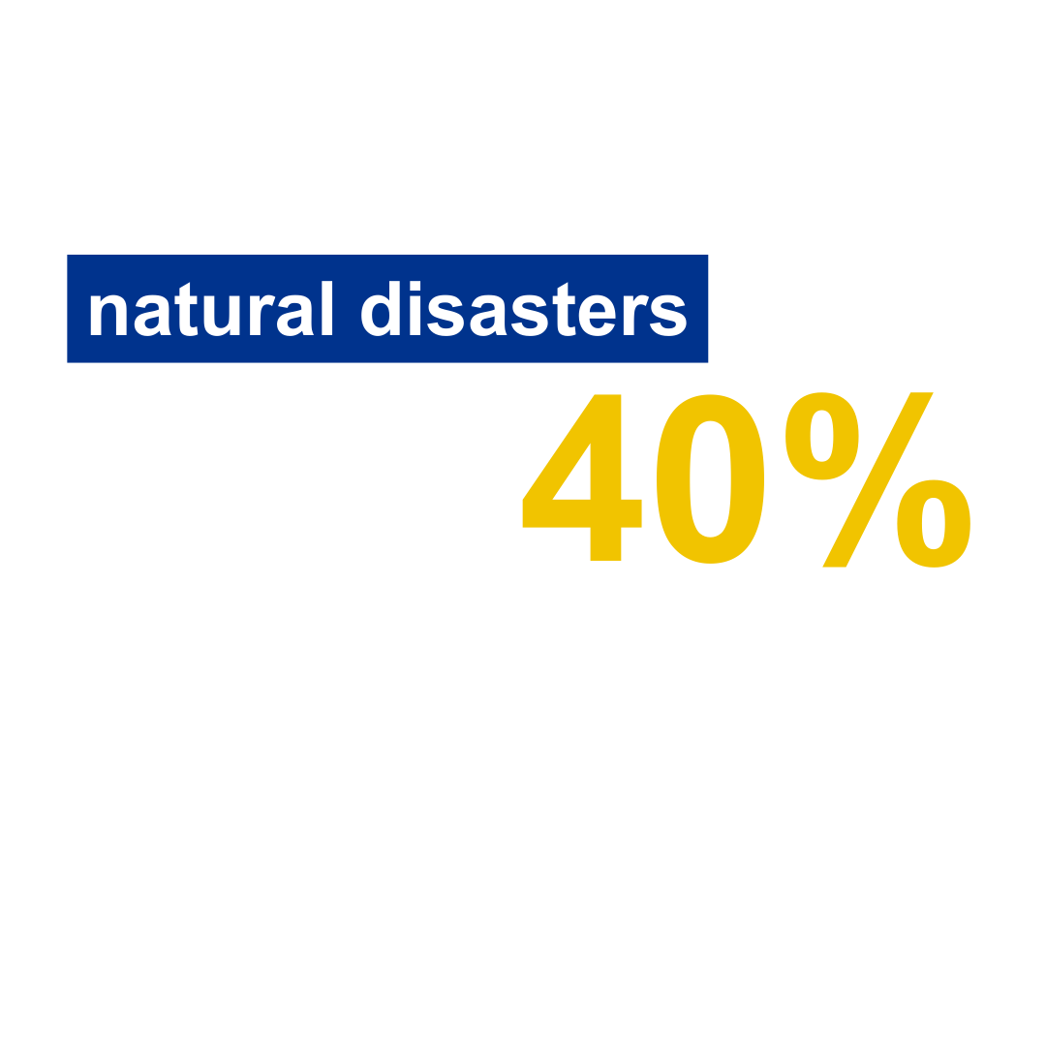
United Nations Sustainable Goals Report 2022
Notes:
[JULIE BOONPRASARN]
The United Nations Sustainable Goal Report also paints a grim picture of natural disasters - which we have been all too familiar with lately with flooding, fires, and tornadoes – and predicts that medium- to large-scale disasters will increase by 40% within by 2030.

Slide 19
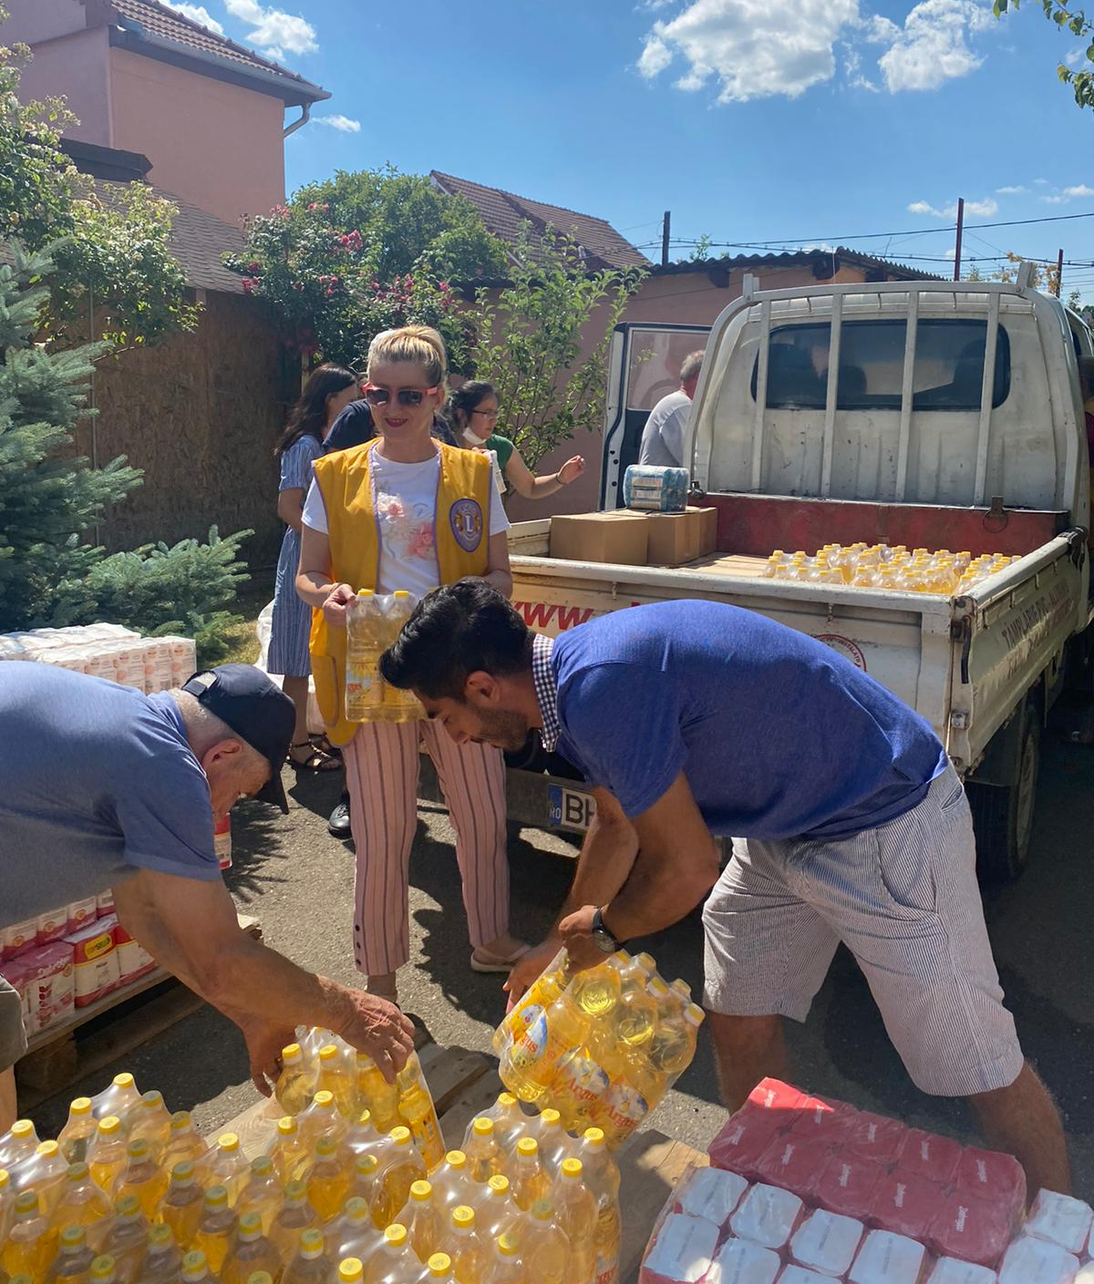
Disaster Relief Grants
  Emergency Grants
  Community Recovery Grants
  Disaster Preparedness Grants
Lions in District 124 quickly responded to the needs of their community after floods displaced over 500 people and damaged 60 homes
Notes:
[JULIE BOONPRASARN]
Whenever and wherever disaster strikes, Lions are often among the first to offer aid. LCIF is ready to support their efforts with funding assistance through global disaster relief programs.
With a disaster grant, Lions can do even more for communities devastated by hurricanes, floods, fires and other major events. As a foundation, we are proud to offer a variety of grant options to support various stages of disaster relief operations including disaster preparedness. To date, LCIF has awarded more than a hundred and forty million U.S. dollars in grants for disaster relief.
One recent example is...
When devastating floods displaced hundreds in Satu Mare County and Bihor County in Romania, LCIF quickly responded and awarded US$10,000 in disaster relief grant funding.
LCIF immediately awarded a US$10,000 grant to the Lions in district 108-A Italy to help the Lions distribute boots, shelf-stable food, and blankets for 400 flood victims.

Slide 20
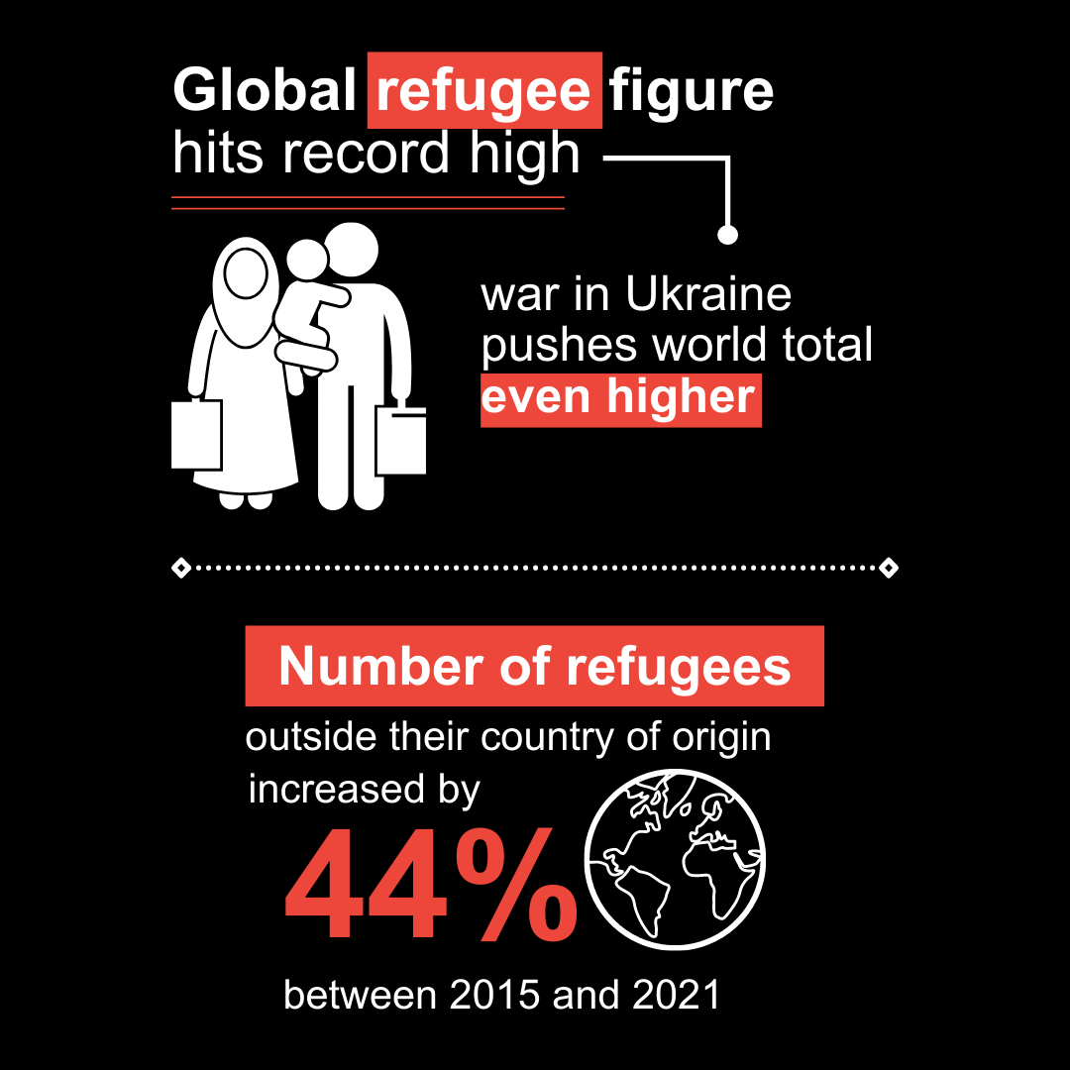
United Nations Sustainable Goals Report 2022
Notes:
[JULIE BOONPRASARN]
As you know, conflicts throughout the world are increasing. With that comes citizens seeking refuge from the crises in and around their home. The war in Ukraine has pushed the already record number of refugees even higher. As of last year, the United Nations reported the number of refugees living outside their country of origin increase by 44% in just six years.

Slide 21

Refugee Assistance Grants
Lions in District 121 packed and distributed food and hygiene products refugees to feel welcomed during their stay in Poland.
Notes:
[JULIE BOONPRASARN]
Often refugees flee to safety with limited personal belongings and funds. In March 2022- shortly after the war in Ukraine began, LCIF began a dedicated refugee assistance grant program aimed at providing immediate relief items to refugees fleeing to nearby countries. To date LCIF has awarded nearly two million US dollars for Ukraine refugee relief efforts.
For example, In Poland, Lions are managing more than eighty assistance projects throughout the country - many funded by LCIF grant funds. Projects include supplying medications and first aid supplies directly to the border intake facilities, food, clothing, bedding, and furniture to refugee safe houses. With more than 4 million refugees fleeing into Poland, the Lions have truly embodied what it means to serve their communities magnified by funds from LCIF.
The project in Poland and many others in the countries surrounding Ukraine were made possible by the Refugees and Displaced Persons Fund, which has received donations from people and organizations around the world that support the service of Lions in these difficult times. If you want to support the Refugees and Displaced Persons Fund, visit lions clubs dot org slash humanitarian resettlement.

Slide 22
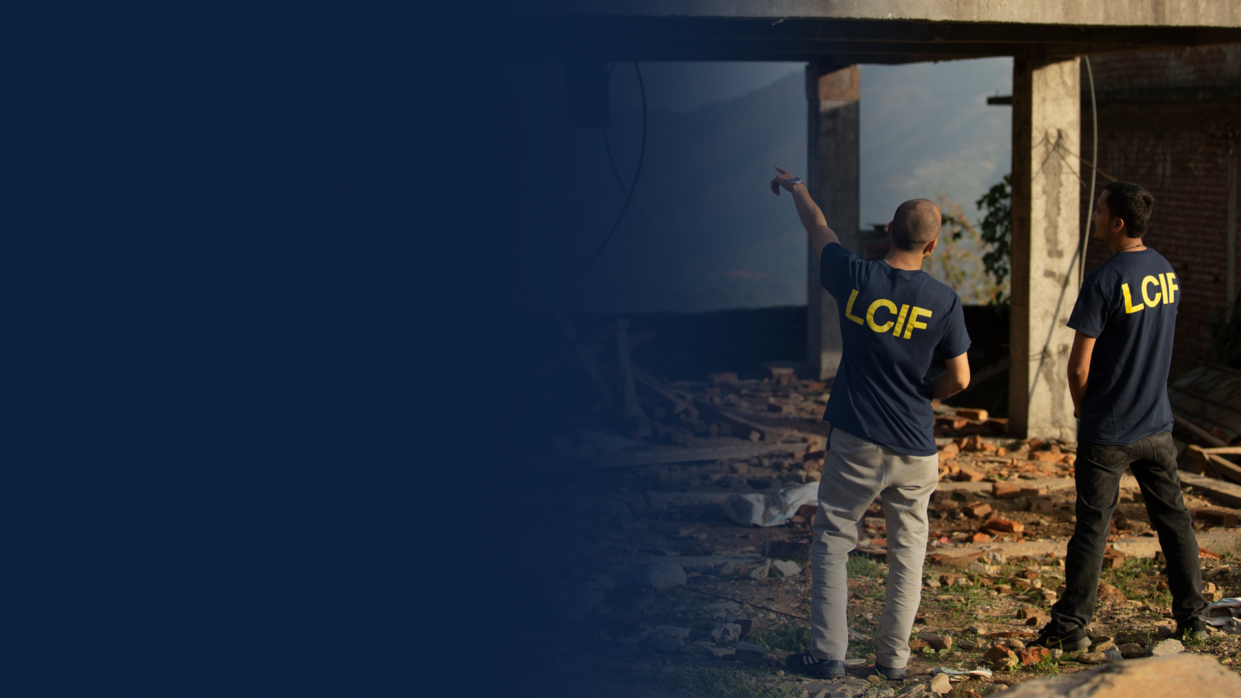
LCIF Impact
MAGNIFIES the service impact of Lions
GRANTS = BIGGER PROJECTS & sustainable solutions
GLOBAL reach
Notes:
[JULIE BOONPRASARN]
These are just a few examples of how important the foundation is the continued service of Lions.
To sum up:
LCIF grant funding magnifies the service impact of Lions.
Grants can help Lions take on bigger projects that create more sustainable solutions and better lives for the people you serve
LCIF is YOUR global foundation, providing grant opportunities for Lions everywhere

Slide 23

How can YOU help?
23
Notes:
[JULIE BOONPRASARN]
There are several ways that we – that YOU – as a Lion, can help ensure the future of our foundation's ability to continue empowering our service through these grant programs.
Allow me to introduce PCC Lou Onley who served as an LCIF Area Leader here in Australia during Campaign 100. Lou is going to speak on the various ways each of us can support the Foundation.

Slide 24
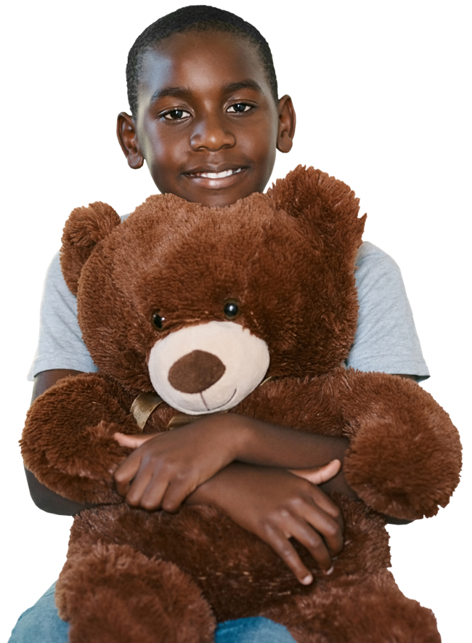
SUPPORTING
YOUR FOUNDATION
PID Robert Rettby
PID Bent Jespersen
Lion Claudia Balduzzi
LCIF CAIV Area Leaders
Notes:
[LOU ONLEY]
Thank you, Jeff [Introduce self]
As we transition out of Campaign 100, we must remember to continue to support the Foundation through our service by both doing AND giving.

Slide 25
Supporting our Foundation by Doing AND Giving
RAISE AWARENESS
PROMOTE
LCIF GRANT OPPORTUNITIES
BUILD ON THE SUCCESS OF CAMPAIGN 100
Notes:
[LOU ONLEY]
YOU are one of our foundation's strongest resources, not only because of your personal donations, but also as ambassadors for the foundation, encouraging members of your clubs to support the foundation in a variety of ways, including raising awareness of LCIF, promoting LCIF grant opportunities, and the importance of continuing to support LCIF financially.

Slide 26




RAISE AWARENESS
Share LCIF stories with fellow Lions and others.
Notes:
[LOU ONLEY]
Behind every LCIF grant, there is a story filled with inspiration, impact and kindness. To help raise awareness of LCIF’s work, I encourage you to share your personal LCIF empowered stories with not only your fellow Lions, but also within your communities and around the world.
We need Lions and others to understand why LCIF is so important to our mission of service.
Read and share the stories of service made possible by LCIF on LCIF: Stories of Pride at lcifpride.org, as well as through local media outlets, social media and sharing back with the LCIF team.
There are so many ways you can help share the impact of LCIF with others. These are just a few examples.

Slide 27

PROMOTE
GRANT OPPORTUNITIES
Increase awareness and visibility of LCIF grants and programs.
  MAGNIFY YOUR DONATION: LCIF GRANTS
  Saturday, September 24 | 9:00 am to 10:15 am
  TULLY 2
Notes:
[LOU ONLEY]
Promote LCIF grant opportunities to Lions and educate them on the grant application process, and grant implementation.
Remind Lions that there is a team of dedicated staff at LCIF who are there to help with the process. Email LCIFGlobalGrants@lionsclubs.org with questions.
The LCIF website is also an excellent resource of information. Visit lionsclubs.org/grants toolkit to explore whether there is a grant program for your club, district, or multiple district – now or in the future.
Remember to share these resources with your fellow Lions.
You can learn more about LCIF grants opportunities here at the ANZI Forum by attend LCIF Grant Seminar tomorrow morning at 9:00 AM with Ben Furtransky, LCIF’s Department Manager for Global Grants.

Slide 28

BUILD ON
CAMPAIGN 100 SUCCESS
Financial donations are key to keeping our foundation strong!
Notes:
[LOU ONLEY]
There is no doubt that we made history through Campaign 100. And we should all be proud of what we were able to accomplish together.
We must build on this momentum to ensure our foundation’s ability empower our service for generations to come.

Slide 29

100%
of donations
support those
in need
Notes:
[LOU ONLEY]
The grant funding mentioned in the examples we shared today is only possible through continued support of LCIF from Lions, Leos, Lions clubs, partners and friends of the foundation.
Our world continues to need Lions. And Lions need funding from our global foundation to magnify the impact of their service.
With 100% of donations going towards grants and programs, LCIF empowers the compassionate service of Lions and those who need our help.
This means that every donation, no matter the amount, is making a difference in our communities, both locally and globally.
There are several ways that you can personally support the foundation, or encourage others to contribute to LCIF

Slide 30

WAYS TO GIVE
Personal donation
or pledge
Online or in-person fundraising event
Planned giving
  lcif.org/waystogive
Notes:
[LOU ONLEY]
Several options for giving to are available. Visit lionsclubs.org/waystogive to learn more.
First, consider making a personal donation or pledge. Or, work with your club or district to launch an online or in-person fundraising event. Facebook is an excellent way to host a fundraiser that not only encourages donations to LCIF, but also increases the visibility of the impact of our foundation with your family, friends, and community.
LCIF is also truly honored when thoughtful Lions include us in their planned giving. There are many options, and our staff can help you find one that works for you.
Learn more during the Planned giving seminar...

Slide 31



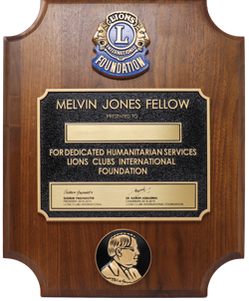


RECOGNITION
Lions Share
Melvin Jones Fellowship
PMJF
Notes:
[LOU ONLEY]
Without the generous donations of our donors, our foundation would be unable to provide the incredible levels of support that are empowering the service of Lions everywhere. And, LCIF offers special recognition for our donors through a variety of ways.
One of our most popular recognition programs is the Melvin Jones Fellowship.
Becoming a Melvin Jones Fellow is a distinct honor of a Lion – an honor bestowed upon you as a donor to our great foundation or as a gift from your fellow Lions to recognize your service. Or, perhaps a combination of the two. Melvin Jones Fellows are creating a better future for our world.
Another popular recognition program is the Lions Share program that recognizes those individuals who give annually to the foundation in one of three levels.

Slide 32







RECOGNITION
Club Giving Patches
100% Contributing Member Patch
Notes:
[LOU ONLEY]
LCIF also offers a variety of awards for clubs.
Clubs can be recognized for their total per-member average giving on an annual basis – this is inclusive of all of their fundraising, not just member giving! Clubs will receive the patch annually when they obtain the following levels: $50, $100, $250, $500, and $1,000.
Clubs receive a 100 Percent Member Support banner patch and chevron the first time every member donates a minimum of US$50 within a fiscal year. Clubs receive a chevron for each subsequent year they achieve 100% member support.
You can learn more about LCIF's recognition programs on our website.
Now I would like to turn the presentation back over to Chairperson Alexander for closing remarks before we open it up for questions.

Slide 33

THANK
YOU!
Notes:
[CHAIRPERSON ALEXANDER]
Thank you, [staff name].
Although those benefitting from your support may never know of your generosity, Lions Clubs International Foundation and our beneficiaries are grateful for your support.
That concludes today's seminar. Thank you all for joining us and learning more about our global foundation, LCIF.
Please be sure to attend the other LCIF seminars scheduled during the forum...
Open it up for questions….

