Slide 1
PID PHILIPPE GERONDAL
LCI Representative to UNHCR
Chairperson of the Refugee Relief Committee
PID Philippe Gerondal Past LCIF Trustee

Slide 2
Refugee Relief Committee
PID Philippe Gerondal Past LCIF Trustee

Slide 3
Speakers
PID Philippe Gerondal: LCI Representative to UNHCR, Chairperson of the Refugee Relief Committee
PID Robert Rettby : Chairperson Tast Force Ukraine
PDG D134 Ukraine : Valentin Kravchenko
PDG D121 Poland : Katarzyna Gebert
PID Philippe Gerondal Past LCIF Trustee

Slide 4
LCI-LCIF serving the Refugees
Programmes and projects around the world in favour of political, climatic and economic refugees
(ex : fight against hunger in the world).
Partnerships with UNHCR: e.g. Lebanon.
Refugee Steering Committee to help refugees from Syria : in operation in 2016 and 2017.
More than 1.4 million USD were distributed in grants.
The Refugee Relief Committee : Created by the European Council at the Montreux Forum in 2017.
Informing on refugee issues in Europe, mobilising Lions, coordinating actions.
Programmes and projects to help the Ukrainian Refugees.
PID Philippe Gerondal Past LCIF Trustee

Slide 5
LCIF always responds with urgency to disasters
Lions are immediately in the field,
The Executive Committee makes emergency decisions,
The administration develops programs and projects quicky.
PID Philippe Gerondal Past LCIF Trustee

Slide 6
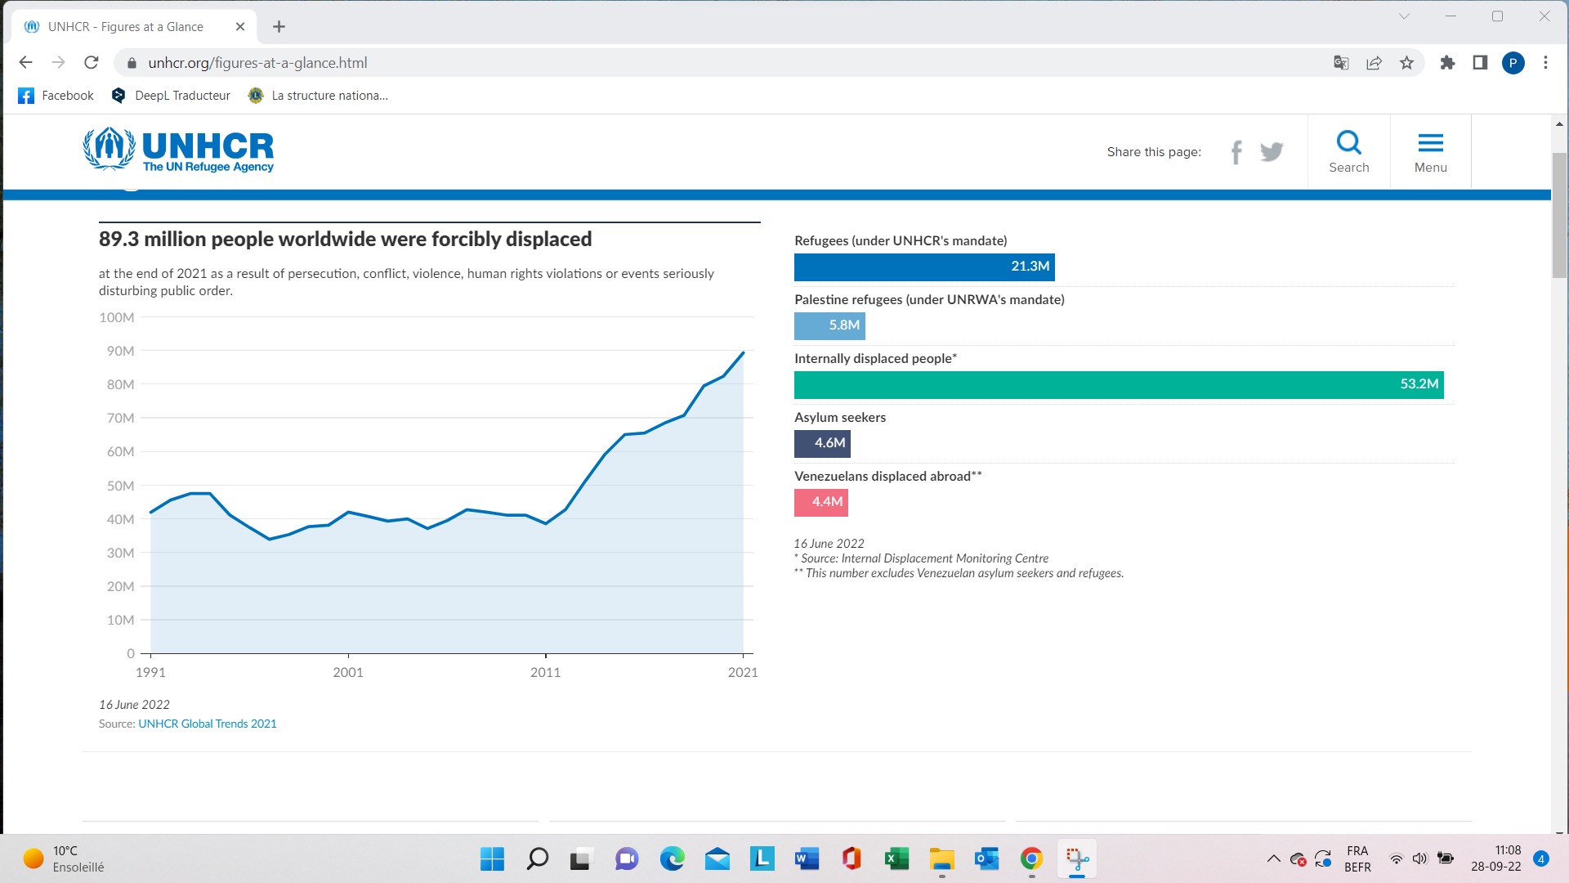
PID Philippe Gerondal Past LCIF Trustee

Slide 7
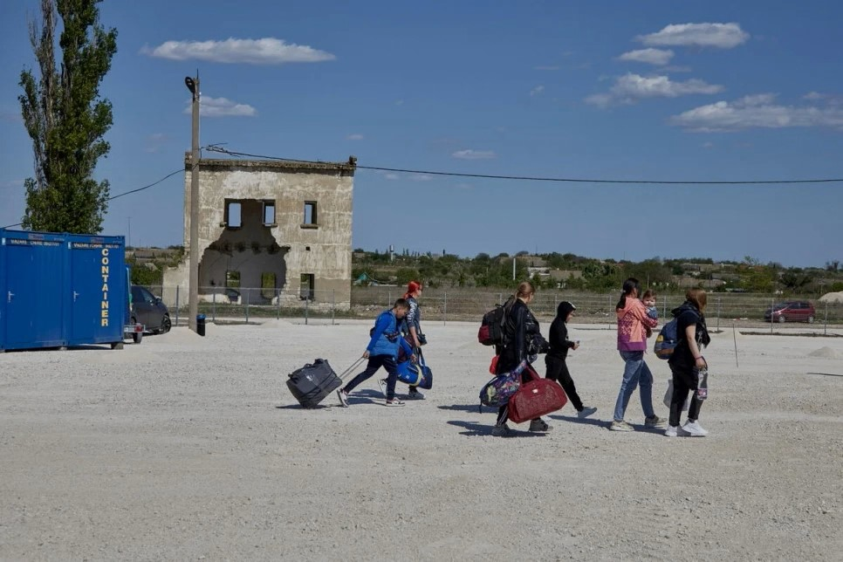
The tragedy of Ukrainian refugees.
PID Philippe Gerondal Past LCIF Trustee

Slide 8
Ukrainian Refugees
Total of Refugees
> 7,2 million
Countries featured in the refugee Response Plan :
Hungary, Romania, Slovakia, Poland, Republic of Moldova
1,688,047
Other neighboring countries :
Russian Federation, Belarus
2,708,608
Other European Countries :
3,011,837
Total of people internally displaced in Ukraine
> 6,900 million.
PID Philippe Gerondal Past LCIF Trustee

Slide 9
LCIF APRROACH TO THE UKRAINE REFUGEE CRISIS
War versus natural disaster :
Extended period,
Need and complexity can change quickly,
Many variables.
Strategy for serving the refugee crisis :
Immediate safety is the priority,
Support Lions’ service,
Steward donations effectively,
Plan for the long-term.
PID Philippe Gerondal Past LCIF Trustee

Slide 10
LCI/LCIF and the Ukrainian Issue
Establishment of the Refugees and Displaced Persons fund :
Has already received US$7.6 million in donations.
Awarded 51 grants to Districts that directly serve refugees in Ukraine or in another Country. This includes emergency aid (food, clothing, hygiene supplies, sleeping bags, medicine, etc.)
EuropeGlobalGrants @lionsclubs.org
Ukraine Task Force: Identification of needs, mobilisation of necessary assistance, coordination of relief efforts.
LCIF-GAT synergy
PID Philippe Gerondal Past LCIF Trustee

Slide 11
Refugee Assistance Grant
Revised to include more ways to help:
Immediate needs,
Transitional needs,
Integration needs,
Possibly in the future - Reconstruction.
PID Philippe Gerondal Past LCIF Trustee

Slide 12
Grants for urgent needs
US$20,000 :
Available to countries with 100 or more displaced Ukrainian refugees,
Lions action includes distribution of basic need items,
Small size allows for change in priorities,
Can be spent quickly and renewed.
Quick application process
PID Philippe Gerondal Past LCIF Trustee

Slide 13
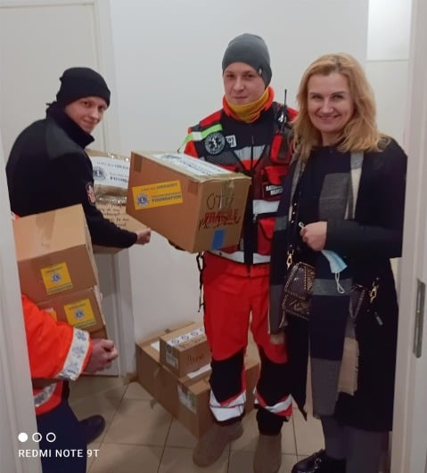
Types of assistance provided to refugees
Ex. :
- medical equipment,
- relief pack : food, water, hygiene and sanitarian supplies,
- sleeping bags, blankets,
- support to bomb shelters,
- suction pumps and consumables to treat bombing victims.
PID Philippe Gerondal Past LCIF Trustee

Slide 14
Grants for Transitional Needs
US$20,000 + :
Available to countries with 100 or more displaced Ukrainian refugees,
Lions action includes distribution of household items and needs for a mid-long term stay in host country,
Fills gaps in services governments and other NGOs can’t fill.
Quick application process
PID Philippe Gerondal Past LCIF Trustee

Slide 15
Grants for Integration Needs
US$20,000 + :
Available to countries with 100 or more displaced Ukrainian refugees,
Lions action includes lions-led projects for adult language learning, group therapy, and vocational training
Supports projects that can make the lives of refugees easier.
Quick application process
PID Philippe Gerondal Past LCIF Trustee

Slide 16
Designated grants at the multiple district level : Working with LCIF
US$100,000 – 1,000,000,
Serve unique needs,
1-year unless otherwise specified,
Detailed report within 45 days of completion,
Reports must be approved by the MD council of Governors before submission to LCIF.
PID Philippe Gerondal Past LCIF Trustee

Slide 17
Other grants
Ex : Matching Grants
District and Club Community Impact Grants
ETC
PID Philippe Gerondal Past LCIF Trustee

Slide 18
Benefits of donating money and acting through LCIF
The Clubs and Districts decide on all the aid granted by submitting their grant applications.
US$1 donated to LCIF = US$1 distributed (100%) for projects
Efficiency of volunteer efforts
Safety and financial transparency
Building priority for Lions globally
Publicly organized efforts
Impact
Wider perspective
PID Philippe Gerondal Past LCIF Trustee

Slide 19
Remember : LCIF is our Foundation :
we created it, we are administrating it and financing it.
We may trust it.
PID Philippe Gerondal Past LCIF Trustee

Slide 20
The future
Lions never give up in helping victims
(we stay in the field after the media have left)
After emergency assistance :
Relief and Reconstruction Program to be Defined
Existing Grants
WE WILL SERVE UNTIL THE NEEDS CEASE!
PID Philippe Gerondal Past LCIF Trustee

Slide 21
Keeping update
Facebook
LCIF Website : Ukraine page
https://www.lionsclubs.org/en/resources-for-members/resource-center/humanitarian-crisis-ukraine
LCIF Ukraine donation page :
https://www.lionsclubs.org/en/donate?utm_source=ukraine-response-lp&utm_medium=link&utm_campaign=humanitarian-resettlement
PID Philippe Gerondal Past LCIF Trustee

Slide 22
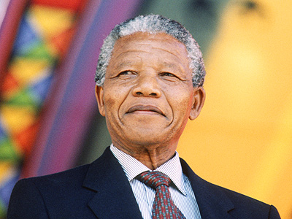
Man’s goodness can be hidden, but can never be extinguished
PID Philippe Gerondal Past LCIF Trustee

