Slide 1
Lions Ukraine Task Force lcifday.eu
Europa Forum Zagre

Slide 2
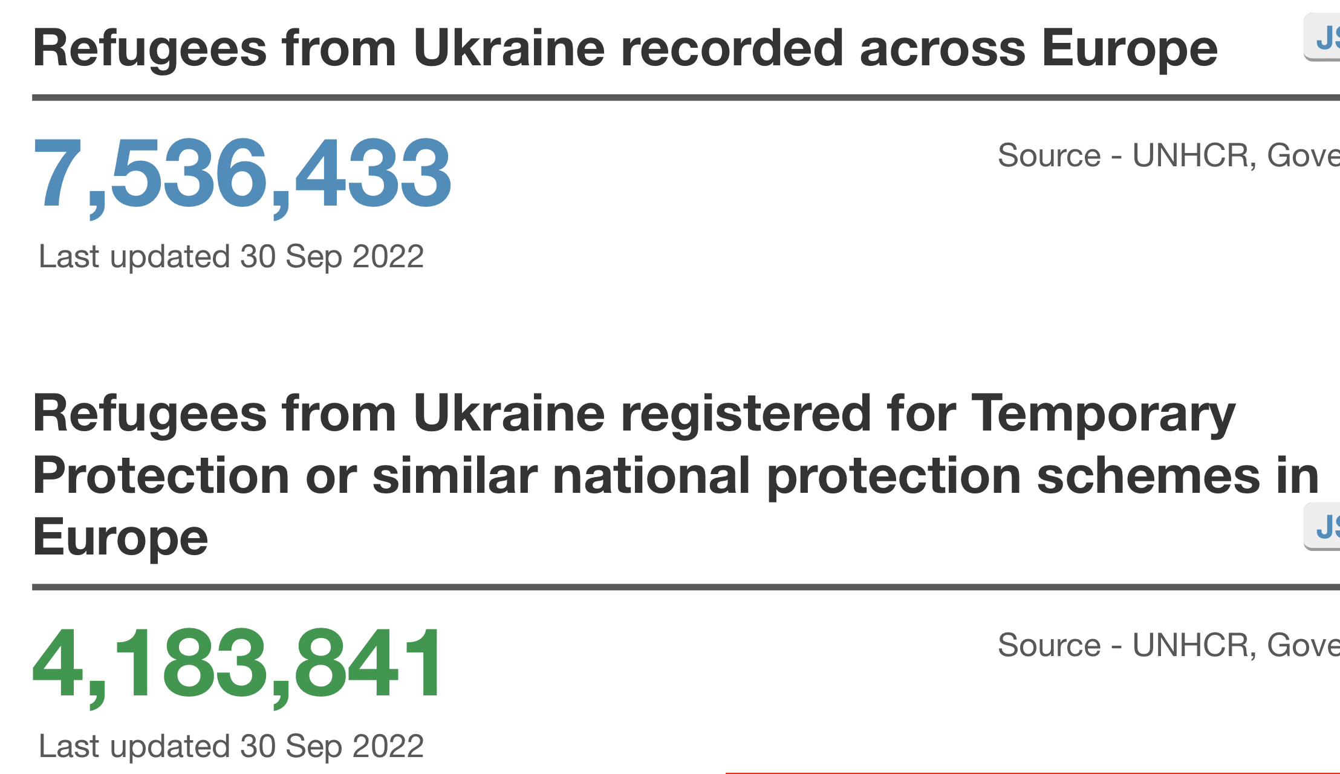

Slide 3
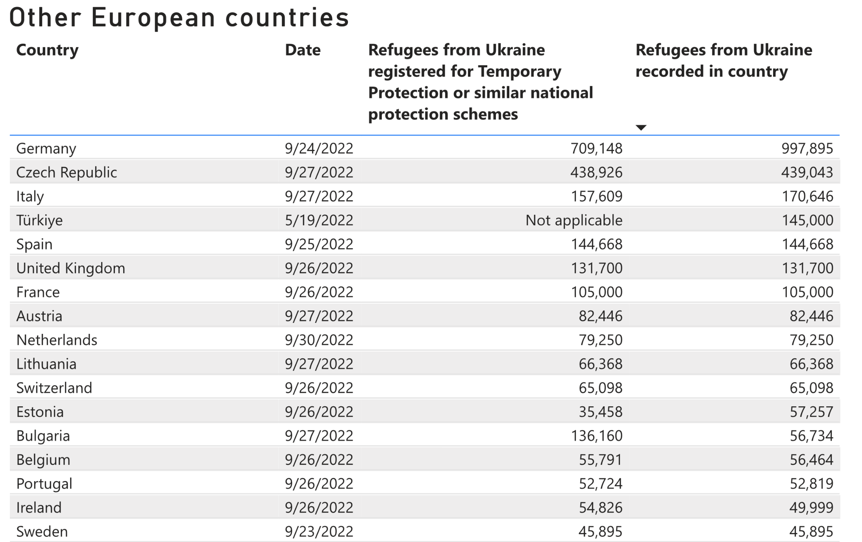

Slide 4
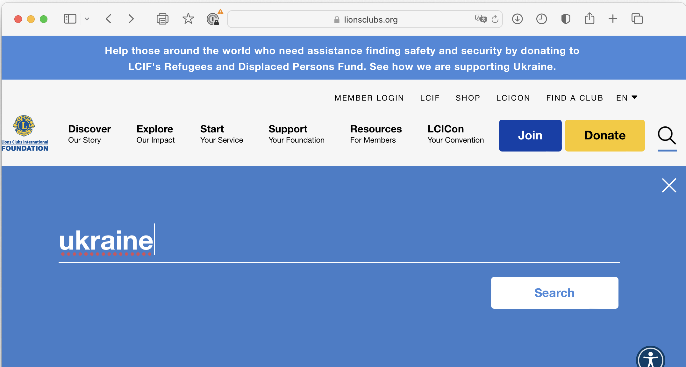
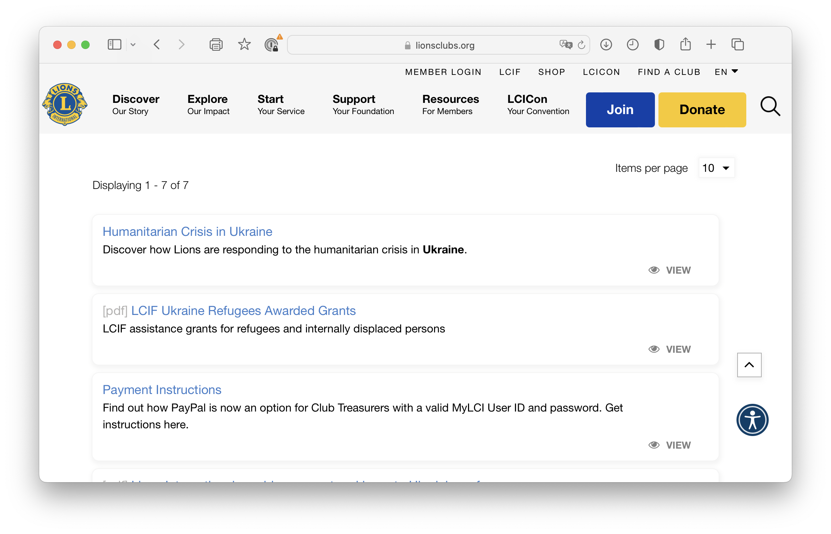

Slide 5
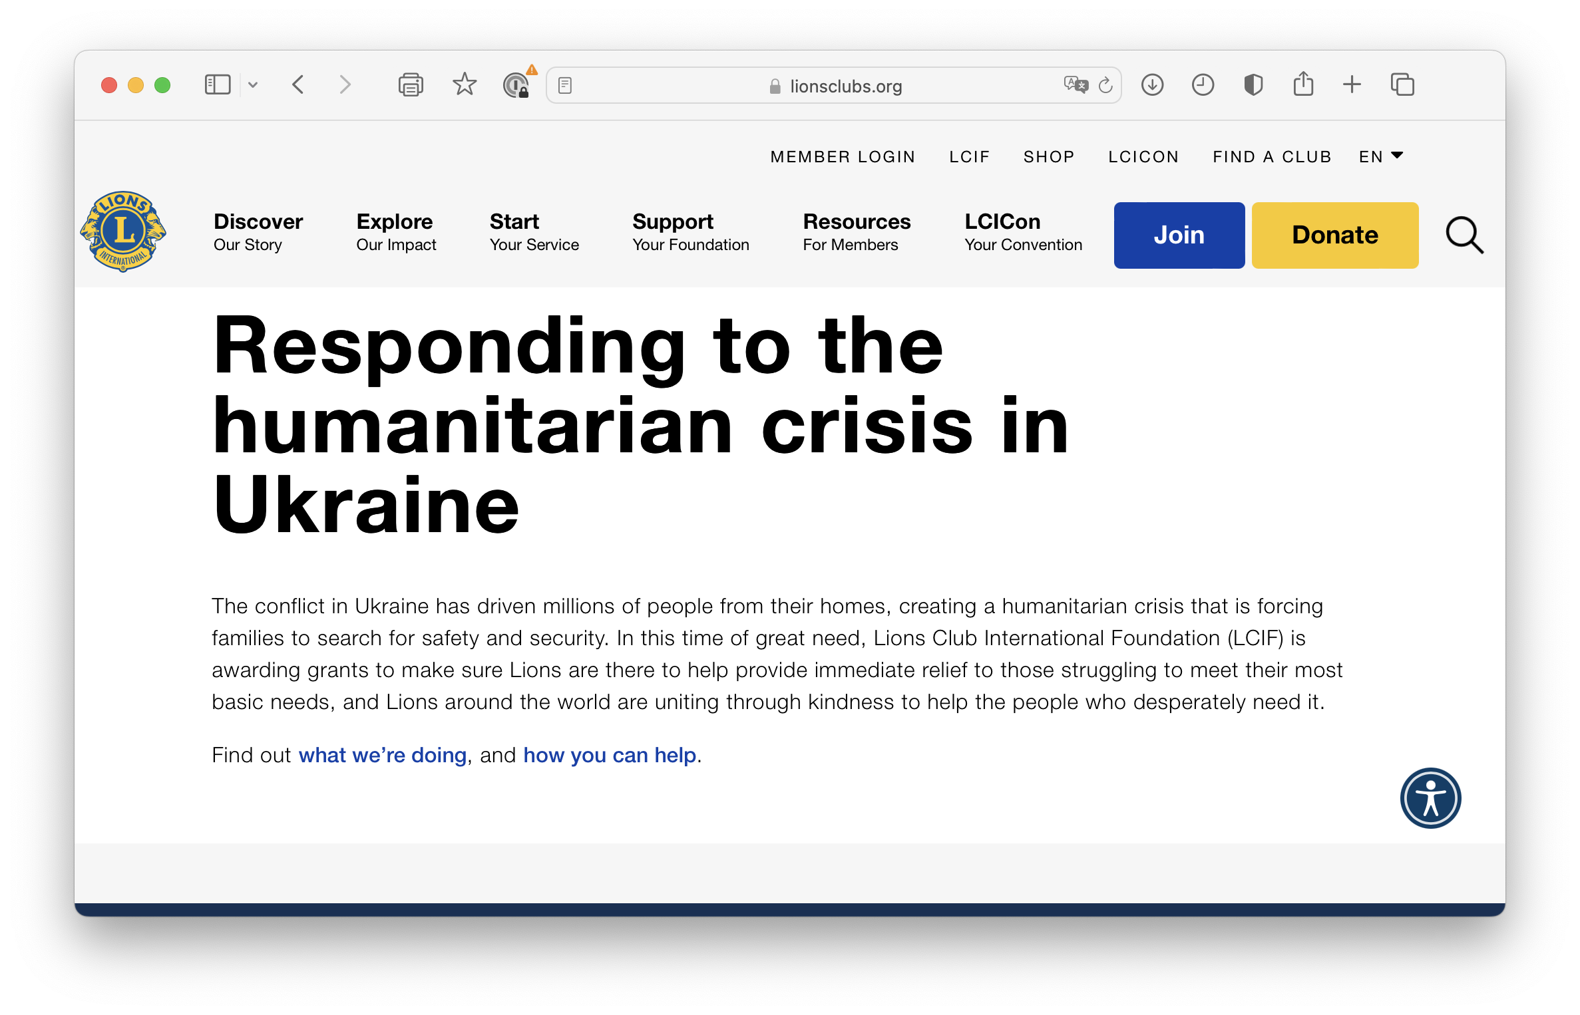
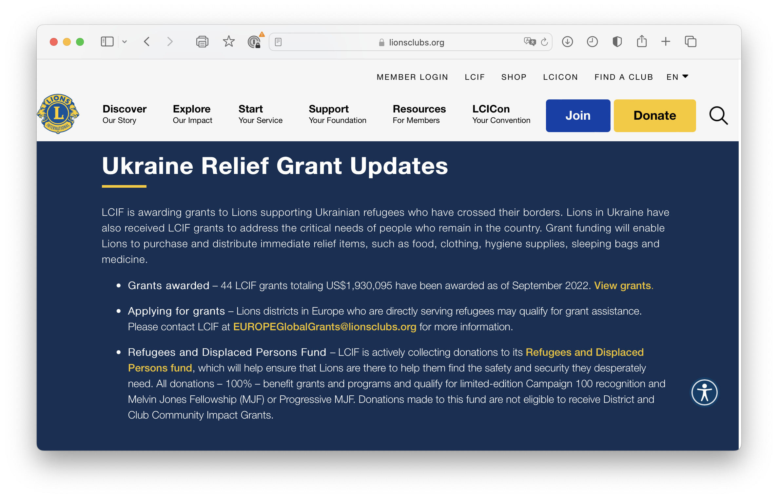

Slide 9
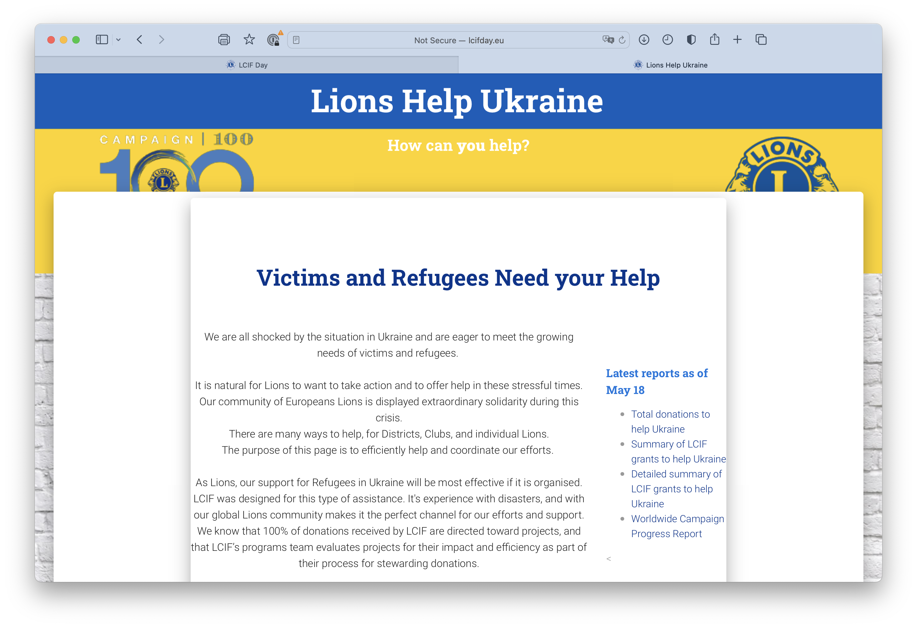

Slide 11
Ukraine European Task Force
Identify needs
Identify funds available (Individuals, Clubs, Districts and MDs)
Match needs and funds
Encourage to coordinate nationally (USD 100’000+ projects)
Encourage to benefit from the expertise and experience of LCIF
Keep a comprehensive list of all CA4 help, regularly updated

Slide 12
Why LCIF ?
Coordinated and efficient actions
Experienced assessment, monitoring and evaluation
Reactive assessment and approval processes
Complies with messages from IP and LCIF Chairperson
Counts toward LCIF goals
Large national projects (100’000+ USD)
Large projects are more efficient than micro-supports
Impacts the Goodwill of Lions International (LCI + LCIF)
How: Straight forward process

Slide 13
Members of the Ukraine European Task Force
GAT ALs: Niels Schnecker and Miklos Horvath (area 4c)
LCIF ALs: Philipe Gerondal (LCI /UNHCR), Kasia Gebert (Area 4c)
BoT: CA4 Trustee Sandro Castellana
Robert: LCIF CAL and facilitator of the Task Force
IPCP and Trustee Gudrun, and GAT CAL Elisabeth Haderer:
Informed and invited, as available

Slide 14
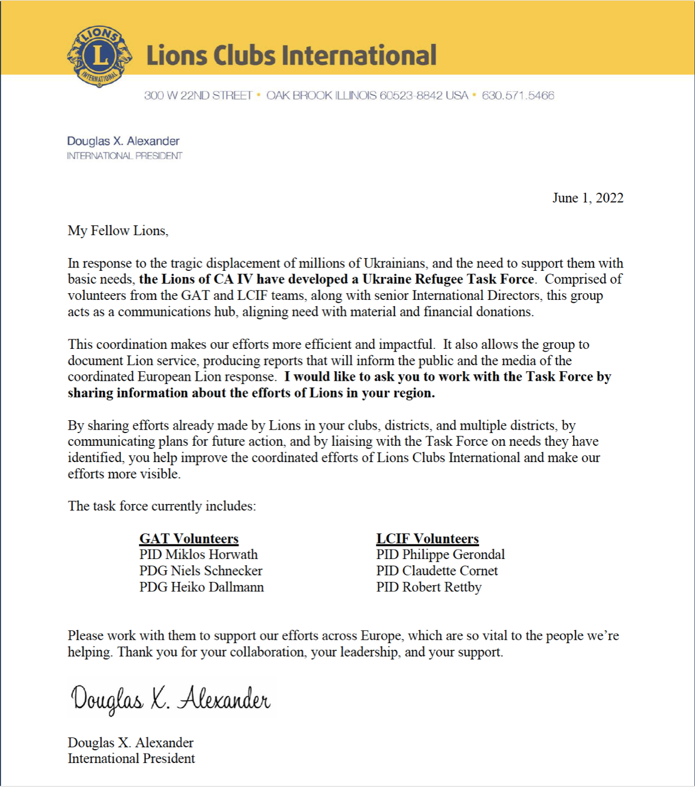
Endorsed by IP Douglas
Was presented in Montreal
Will be presented in Zagreb
Request from all CA4 Leaders
Feedback and suggestions
Inform
Ask for reports

Slide 15
QUESTIONS?
Notes:
Let’s pause here for questions from our District Coordinators, or to hear comments from them on this idea so far. We want to hear your thoughts.

