Slide 1
Winter is coming to Ukraine
Part 2
100% transparent
100% Lions
Controlled
100% Lions
visibility
LCIF approved project
MJF/PMJF
recognition
HelpforUkraine
1

Slide 2
HelpforUkraine
Part 1
THE HISTORY
October 2022
Winter 2022 there was a huge need for portable generators!
Schools and kindergartens in Ukraine were left without power so, as a reaction to bombardments of the civilian infrastructure, a Lion in Finland decided to try, with the help of other Nordic Lions Clubs, to collect funds and donate 100 generators.
The call to action was launched and the project simplicity, its transparency corroborated with the huge need for this service, made Lions from Finland, Sweden, Norway, Denmark, Iceland, Germany, Netherlands, France, Ukraine, Switzerland, Estonia, Belgium and Poland to join in this great humanitarian service!
Astonishing results:
Over 2260 portable generators donated to schools and kindergartens!
Within 3 months over 1,5 million Euros collected!
13 European countries participating!
Over 300.000 children in Ukraine got light and heat!
Read the full story: Winter is coming to Ukraine
2
2

Slide 3
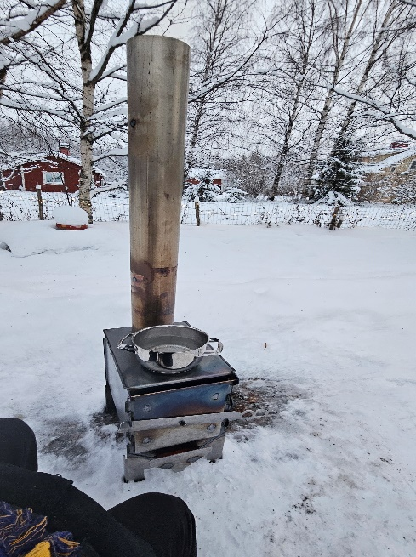
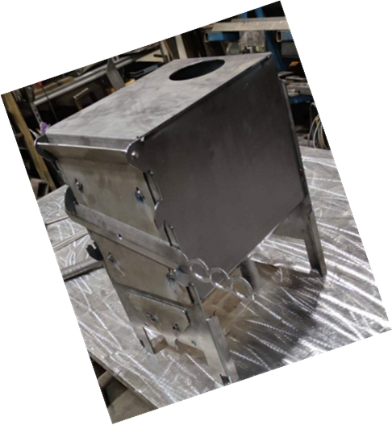
HelpforUkraine
Part 2
THE NEED
November 2023
Winter 2023 there is a huge need for stoves!
Since the beginning of the armed conflict in Ukraine it has been complicated for the families and households in South East Ukraine to warm the houses and cook the food. As this Winter the gas or diesel fuels are scarce, people need to use wood. So, our wood stoves are the answer to the needs of so many families, in order to keep warm and to feed themselves properly.
We call LIONS to action again!
Let us gather our forces once again, in an even bigger project:
WINTER IS COMING TO UKRAINE 2.0!
We call LIONS to action
so we can build and deliver wood running stoves to the households of South-East Ukraine!
3
3

Slide 4
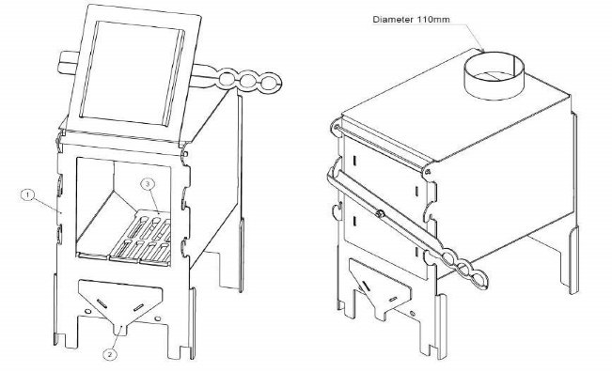
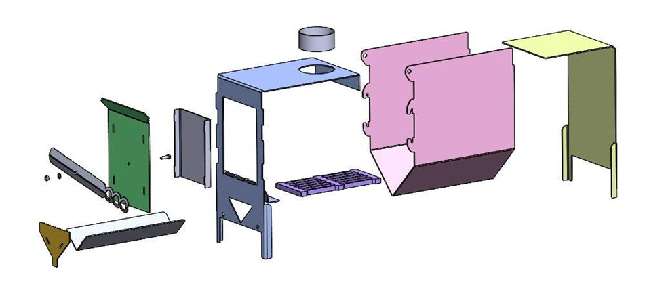
HelpforUkraine
Our LIONS stoves
THE PRODUCT
We have evaluated several products on the market and decided that we are able to manufacture our own Lions stove by developing the best option on the market !
This special designed LIONS stove meets all the requirements:
highly effective, made of stainless steel, perfect for heating;
big surface to cook food;
ash box to collect ashes and to control the draft in the stove;
engraved LIONS logo on the cooking surface;
instruction manual included, both in English and Ukrainian;
cost effective in every aspect: manufacture, transport, maintenance and use.
Here you can see a video about the stove production: Production Video
4
4

Slide 5
HelpforUkraine
Our LIONS guarantees
100%
THE FACTS
Controlled by LIONS
We are proud to have Lions involved in all processes from the raw materials to production, and from the factory in Finland to the homes of the families in Ukraine!
100%
Financial transparent
The cost is only 150€ per piece, VAT included
For that you get:
a high-quality stove made in Finland,
transport to Kharkiv, Pavlograd, Zaporizhia
delivery to families in need!
100%
LIONS visibility
Our stove will have a huge LIONS Logo, laser engraved on the cooking surface, so user will be reminded every day that we, LIONS, helped!
5
5

Slide 6
HelpforUkraine
Lions Clubs International Foundation
LCIF PROJECT
Great news!
Part 1 of the project with the portable generators was a huge success in 2023 and maybe the most amazing project of international collaboration between the Lions Clubs in Europé. Also, maximum percentage of Lions control and financial transparency resulted after audited and approved by PID Daniel Isenrich. All these details and many more resulted after many discussions determined an marvelous result:
LCIF has approved this project to be an LCIF project!
What does it mean?
6
6

Slide 7
HelpforUkraine
How to join?
Just DECIDE the number of stoves and DONATE!
JOIN US
DIRECT DONATIONS:
SWIFT code OKOYFIHH,
Account no. FI85 5006 0420 0551 57
Okobank Alavieska, Keskustie 7, 85200 Alavieska, FINLAND.
Account holder: LC Ylivieska Finland
OR
LOCAL FOUNDRAISING:
Some of the Countries decided to fundraise local and than transfer lump sums.
Ask your Country Coordinator who is happy to support you!
ATTENTION LIONS!
In the “Subject” field on the payment write down the ID and the name of the Lion or the Lions Club or the Lions District or the Multi District!
*We are collecting funds and send amounts and statistics to LCIF twice a month.
Join and make it your project, too!
7
7

Slide 8
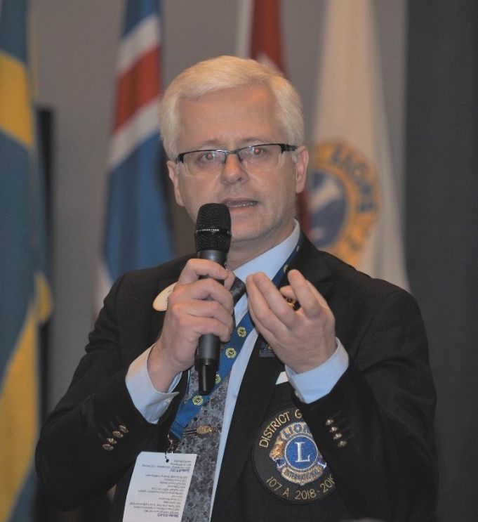
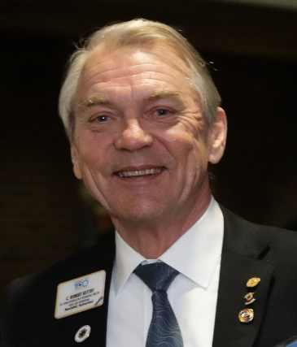
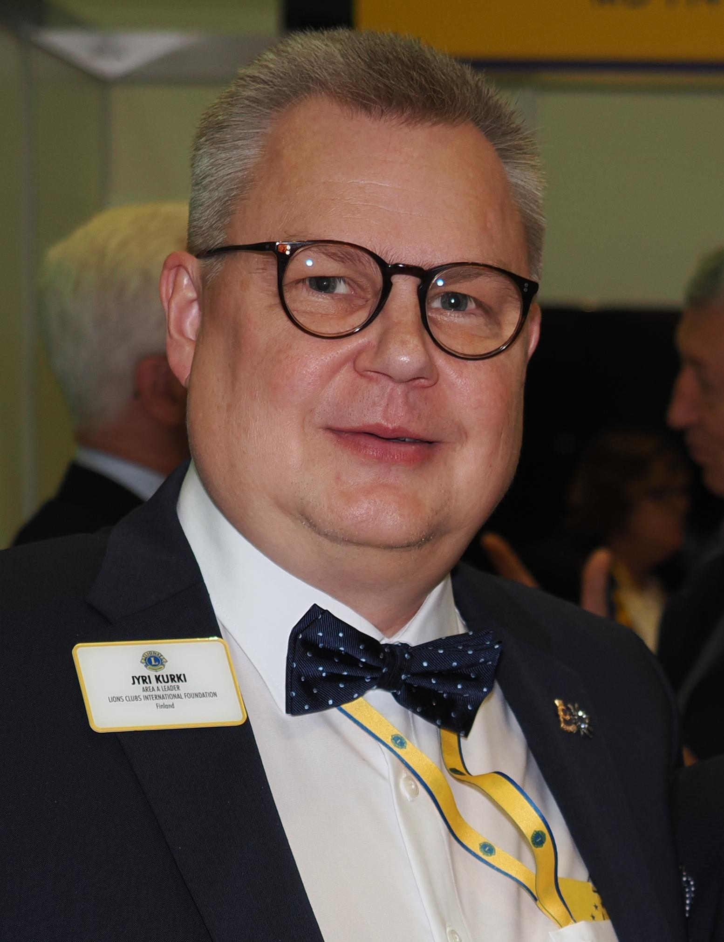
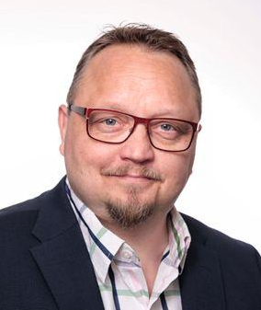
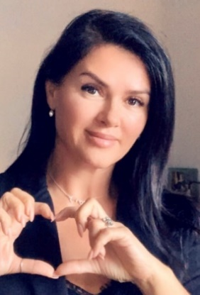
Project team
Project Leader
PDG Björn Hägerstrand
Project Advisor
PID Robert Rettby
LCIF Coord Jyri Kurki
Production Coord
PDG Petri Lappi
Financial & Coord
Finland PCC Heikki Hemmilä
Marketing & Coord Romania Anamaria Zechiu
Looking forward to serve together!
8
8

