Slide 1

Welcome leaders in Lions’ service!
1
Notes:
Opening words by Constitutional Area Leaders (and participants as desired).

Slide 2

Today’s goals:
Review CA IV’s fundraising: some congratulations are in order.
Strategic discussion: important messages and activities for this year.
Set district goals: and enter them into an online spreadsheet.
Review new recognition: incoming for the new year.
2
Notes:
There are 4 goals for our meeting today:
We want to review our CA’s fundraising performance to-date. We have had the third historic fundraising year in a row in CA IV. Some congratulations and thanks are in order.
We will also examine some trends in the donation data to see if there are insights that will help us carry this momentum into the coming year and beyond.
We will ask you as leaders to go through a goal setting exercise for the districts in your area, and to confirm those goals by entering them into an online repository.
Finally, we will review some changes to LCIF’s recognitions that will go into effect this year.

Slide 3

CA IV’s 2022-2023 fundraising performance:
Thank you, and congratulations!
Notes:
Let’s start by reviewing CA IV’s fundraising numbers. Before I go any farther, I want to start by congratulating and thanking you all.
The total fundraising numbers for this year continue to be counted, and that includes any donations made during this convention, but when this report was made, CA IV had the best percent to goal of any CA in Lionism. We had reached 166% of our goal on June 30th.
CA I will have a strong push at convention, but there is very good chance that we will finish the year as the CA with the highest percentage of goal achieved. If we finish with the highest percentage of goal achieved, it will be the first time that has happened for CA IV.

Slide 4

CA IV 2022-2023 total donation history
Fiscal Year | Donation Total | % of Donations Designated
2017-2018 | US$ 4,154,252 | 60%
2018-2019 | US$ 4,766,076 | 68%
2019-2020 | US$ 4,679,792 | 42%
2020-2021 | US$10,458,505 | 71%
2021-2022 | US$12,084,541 | 84%
*2022-2023 | US$ 9,996,289 | 81%
*Donations recorded as of June 30, 2023
10-year avg | 1 standard deviation | 2 standard deviations
US$ 6,142,201 | US$ 8,920,503 | US$11,698,805
4
Notes:
This slide shows us the year-to-year fundraising totals for CA IV during Campaign 100, as well as fundraising progress as of June 30th of 2023.
You can see a jump in fundraising numbers starting in the 2020-2021 year. That is partially the result of LCIF’s MOU with MD111 and the matching funds that come with that agreement, but as you will see, CA IV’s philanthropy made a shift during this time as well.
CA IV had its third-highest historical fundraising total for the CA as of June of this year, and I think we will get pretty close to the second-highest total (2020-2021) when the year closes.
The table in the bottom right includes some notes on historical donation trends for CAIV. You will note that total donations this year have exceeded the standard deviation in our donation 10-year average. That makes this a very relevant year for the CA, statistically speaking.

Slide 5
*CA IV history: donations sent to LCIF
Fiscal Year | *Donations to Oak Brook | Per Member Average | % Designated
2017-2018 | US$ 4,154,252 | US$ 16.80 | 60%
2018-2019 | US$ 4,766,076 | US$ 19.50 | 68%
2019-2020 | US$ 4,679,792 | US$ 19.59 | 42%
2020-2021 | US$ 5,766,870 | US$ 24.93 | 48%
2021-2022 | US$ 8,270,341 | US$ 36.46 | 77%
**2022-2023 | US$ 5,904,477 | US$ 26.34 | 67%
*SDL projects removed.
**Processed donations through 30 June 2023.
10-year average PMA | 1 standard deviation | 2 standard deviations
US$ 21.56 | US$ 27.39 | US$ 33.21
5
Notes:
This slide only shows donations that have come to LCIF: it excludes money from the SDL agreement. You can see from this slide that:
CA IV’s per member average exclusive from the German MOU increased significantly in the 2020-2021 year.
Last year, the final year of Campaign 100 and the year the refugee crisis from the Ukraine war began, was the CA’s best year from a per member average perspective.
You will also note that CA IV’s per member average is historically already the second highest for the CA. If we end up seeing one dollar and four cents more per member arrive at LCIF before the close of the financial year, we will have surpassed the one level of standard deviation from our 10-year average. So this has been a great year for all of Europe, not just Germany.
It is worth noting the percent of total donations that arrived designated.

Slide 6
Designated donations to LCIF
Fiscal Year | Donation Total | Donations for refugees from the war in Ukraine | Donations for the earthquake in Turkey & Syria | Donations totals for major regional crisis | % of donations for major regional crisis
2021-2022 | US$ 8,270,341 | US$ 4,423,888 |  | US$ 4,423,888 | 53%
*2022-2023 | US$ 5,904,477 | US$ 888,446 | US$ 2,032,647 | US$ 2,921,093 | 49%
*Donations recorded as of June 30, 2023
6
Notes:
For the purposes of considering the impact of regional crisis on engagement, this slide shows the percentage of donations that were designated for Turkey or Ukraine.
Some of these donations may already have been planned for LCIF and were sent with designations because of the crisis.
Some of these donations may have been inspired exclusively by the crisis, in which case, we can be proud that we were able to build trust in our foundation amongst our Lions and their communities during these challenging times.

Slide 7
Discussion:
Building on the CA’s momentum.
Notes:
For the purpose of beginning the strategic planning process, the next two pages have a series of reflection questions on them. They are not the only questions relevant to our task this year, but they may be a good start.
Individual activity: 5 minutes
Please begin this exercise by review those pages by yourself, and deciding which questions, if any are the most significant to your regions’ fundraising efforts for the current year. If you feel that the questions don’t accurately capture the most important questions for your region, please feel free to add other questions that you may feel are the most important.
Group activity- ask participants to get into groups by Area: 30 minutes;
For the next 30 minutes please work together in your groups to agree upon the most important three questions for your area, and consider answers, or things to reflect up that will help you find the answers.
Reporting out: 30 minutes
Ask a representative from each group to present their questions and their thoughts and answers. 3 minutes per group plus 1-2 minutes of questions or comments from other participants.

Slide 8
Reflection Questions
  What approaches to inspiring donations were successful during recent major regional crisis?
  How can trust built during the recent refugee crisis and earthquake be transferred from situational to universal?
  Are there additional messages and strategies that can be implemented based on our increased engagement that will help us continue to grow?
8
Notes:
Content Slide Option 4

Slide 9
Reflection Questions
  What will you do to celebrate fundraising success and LCIF service in your regions?
  How will you develop your strategy around fundraising events this year?
9
Notes:
Content Slide Option 4

Slide 10
Area Discussion:
District Goal Setting
Notes:
Thank you all for your continuing work to find ways to improve engagement with our Lions.
In this next section, we are going to ask you to take ownership of goal assignments for the districts in your Areas.
Fundraising goals have been identified by Area, but we are aware that within Areas some regions may have greater or lower potential. Now that you have all had the chance to become acquainted with your Areas, we would like to ask you to meet in your Area Groups to discuss what the goals for each district should be.
Each single district; district; or undistracted region with membership contributing to your Area’s fundraising goals is listed.
The membership of each region, and its fundraising performance through the first 10 days of June are indicated for each district. If you would like additional context, there are some slides at the end of this section reminding you of how to access the fundraising dashboard, incase you would like to see more nuanced numbers year-to-year.
You will also notice that there is a link to an online document that will allow you to enter the district-by-district fundraising numbers for your Area. These will be double-checked to ensure the fundraising totals for each area are met.
If you cannot enter each district’s fundraising goals by today, please plan to enter them by the end of July.

Slide 11
Area Goals
11
Notes:
You will notice that the PMA for CA IV is US$ .1 higher than a standard deviation from the average performance of the district, but please note that both the average and the standard deviation are likely to change once this year’s final numbers are documented.

Slide 12

District | Membership | Total % of Goal | District Goal In Dollars | 2023-2024 Goal | 2022-2023 Fundraising
101 M | 1176 |  |  |  | $17,972
101 N | 888 |  |  |  | $24,442
101 O | 1241 |  |  |  | $30,426
101 S | 2157 |  |  |  | $79,775
101 V | 1697 |  |  |  | $12,208
104 A | 1196 |  |  |  | $17,028
104 B | 1642 |  |  |  | $23,300
104 C | 1476 |  |  |  | $46,266
104 D | 1653 |  |  |  | $26,664
104 E | 1932 |  |  |  | $50,132
106 A | 1224 |  |  |  | $18,547
106 B | 2407 |  |  |  | $23,494
106 C | 1246 |  |  |  | $9,919

Slide 13
District | Membership | Total % of Goal | District Goal In Dollars | 2023-2024 Goal | 2022-2023 Fundraising
107 A | 1907 |  |  |  | $12,698
107 B | 814 |  |  |  | $24,902
107 C | 1835 |  |  |  | $13,737
107 D | 1248 |  |  |  | $12,842
107 E | 1446 |  |  |  | $10,016
107 F | 1369 |  |  |  | $10,319
107 G | 1039 |  |  |  | $9,611
107 H | 1014 |  |  |  | $6,825
107 I | 925 |  |  |  | $3,015
107 K | 944 |  |  |  | $6,008
107 L | 829 |  |  |  | $8,455
107 M | 1361 |  |  |  | $44,458
107 N | 1442 |  |  |  | $17,465
107 O | 961 |  |  |  | $10,048

Slide 14
District | Membership | Total % of Goal | District Goal In Dollars | 2023-2024 Goal | 2022-2023 Fundraising
109 A | 1270 |  |  |  | $41,315
109 B | 738 |  |  |  | $61,679
120 | 1123 |  |  |  | $3,675
131 | 733 |  |  |  | $400
REP OF LATVIA | 33 |  |  |  | $0

Slide 15
Area B total goal: US$523,006.61
District | Membership | Total % of Goal | District Goal In Dollars | 2023-2024 Goal | 2022-2023 Fundraising
102 E | 3301 |  |  |  | $5,273
102 C | 2991 |  |  |  | $3,500
102 W | 4034 |  |  |  | $51,055
111 N | 3434 |  |  |  | $5,973
111BN | 2351 |  |  |  | $1,000
111BO | 1669 |  |  |  | $200
111BS | 3522 |  |  |  | $385
111MN | 4199 |  |  |  | $840
111MS | 4052 |  |  |  | $550
111NB | 1997 |  |  |  | $2,000
111NH | 3045 |  |  |  | $0
111NW | 2456 |  |  |  | $100
111OM | 1844 |  |  |  | $0

Slide 16
Area B total goal: US$523,006.61
District | Membership | Total % of Goal | District Goal In Dollars | 2023-2024 Goal | 2022-2023 Fundraising
111ON | 2075 |  |  |  | $600
111OS | 1685 |  |  |  | $100
111RN | 2375 |  |  |  | $1,200
111RS | 2576 |  |  |  | $2,050
111SM | 3512 |  |  |  | $100
111SN | 1961 |  |  |  | $0
111SW | 1563 |  |  |  | $100
111WL | 3760 |  |  |  | $200
111WR | 3220 |  |  |  | $100
114 M | 3335 |  |  |  | $110,048
114 O | 2269 |  |  |  | $63,912
114 W | 3011 |  |  |  | $120,349

Slide 17
Area C total goal: US$263,109.09
District | Membership | Total % of Goal | District Goal In Dollars | 2023-2024 Goal | 2022-2023 Fundraising
119 | 832 |  |  |  | $91
121 | 934 |  |  |  | $32,524
122 | 414 |  |  |  | $2,050
123 | 170 |  |  |  | $0
124 | 1617 |  |  |  | $24,017
126 | 1153 |  |  |  | $4,424
129 | 1437 |  |  |  | $31,643
130 | 693 |  |  |  | $5,240
132 | 471 |  |  |  | $2,060
134 | 676 |  |  |  | $0
ALBANIA | 55 |  |  |  | $0
ARMENIA | 48 |  |  |  | $0

Slide 18
Area C total goal: US$263,109.09
District | Membership | Total % of Goal | District Goal In Dollars | 2023-2024 Goal | 2022-2023 Fundraising
BELARUS REP. | 41 |  |  |  | $0
BOSNIA & HERZEGOVINA | 87 |  |  |  | $2,000
BULGARIA | 193 |  |  |  | $0
REP OF GEORGIA | 210 |  |  |  | $0
REP OF KYRGYZSTAN | 10 |  |  |  | $0
REP OF TAJIKISTAN | 0
REPUBLIC OF KOSOVO | 86 |  |  |  | $0
REPUBLIC OF MONTENEGRO | 46 |  |  |  | $650
SERBIA | 54 |  |  |  | $0
REP OF MOLDOVA | 91 |  |  |  | $0
SLOVAK REPUBLIC | 225

Slide 19
Area D total goal: US$819,748.61
District | Membership | Total % of Goal | District Goal In Dollars | 2023-2024 Goal | 2022-2023 Fundraising
105 A | 1284 |  |  |  | $116,998
105 N | 1072 |  |  |  | $98,788
105CE | 1521 |  |  |  | $87,372
105CN | 1057 |  |  |  | $77,438
105CW | 1722 |  |  |  | $127,751
105SC | 1081 |  |  |  | $96,765
105SE | 1145 |  |  |  | $65,651
105SW | 1023 |  |  |  | $57,628
110AN | 1236 |  |  |  | $23,908
110AZ | 1888 |  |  |  | $19,416
110BN | 1651 |  |  |  | $17,896
110BZ | 1828 |  |  |  | $17,930

Slide 20
Area D total goal: US$819,748.61
District | Membership | Total % of Goal | District Goal In Dollars | 2023-2024 Goal | 2022-2023 Fundraising
110CO | 1785 |  |  |  | $19,386
110CW | 1680 |  |  |  | $19,075
118 E | 823 |  |  |  | $3,911
118 K | 600 |  |  |  | $2,104
118 R | 1210 |  |  |  | $2,556
118 T | 526 |  |  |  | $4,676
118 U | 1034 |  |  |  | $1,786
118 Y | 1292 |  |  |  | $8,229
128 | 693 |  |  |  | $13,227
133 | 1949 |  |  |  | $99,962
Gibraltar | 18 |  |  |  | $2,000

Slide 21
Area E total goal: US$848,924.34
District | Membership | Total % of Goal | District Goal In Dollars | 2023-2024 Goal | 2022-2023 Fundraising
103 C | 1444 |  |  |  | $38,265
103 E | 2344 |  |  |  | $85,717
103 N | 2018 |  |  |  | $46,969
103 S | 2136 |  |  |  | $58,243
103 W | 1637 |  |  |  | $18,608
103CC | 1270 |  |  |  | $33,615
D103CE | 1364 |  |  |  | $37,121
103CS | 2094 |  |  |  | $89,024
103CW | 1471 |  |  |  | $52,931
103IE | 869 |  |  |  | $21,494
103IP | 674 |  |  |  | $24,571

Slide 22
Area E total goal: US$848,924.34
District | Membership | Total % of Goal | District Goal In Dollars | 2023-2024 Goal | 2022-2023 Fundraising
103IW | 1328 |  |  |  | $36,399
103NIE | 1508 |  |  |  | $42,635
103SE | 1295 |  |  |  | $60,000
103SW | 1597 |  |  |  | $83,689
112 A | 1947 |  |  |  | $110,895
112 B | 1838 |  |  |  | $105,875
112 C | 905 |  |  |  | $53,729
112 D | 2203 |  |  |  | $61,843
113 | 867 |  |  |  | $35,000
Prince of Monaco | 35 |  |  |  | $0
Principat D'Andorra | 31 |  |  |  | $0

Slide 23
Area E total goal: US$1,271,916.02
District | Membership | Total % of Goal | District Goal In Dollars | 2023-2024 Goal | 2022-2023 Fundraising
108 A | 3170 |  |  |  | $57,980
108 L | 3223 |  |  |  | $115,728
108 LA | 2970 |  |  |  | $102,763
108 YA | 3552 |  |  |  | $61,882
108 YB | 3633 |  |  |  | $130,264
108AB | 2683 |  |  |  | $79,347
108IA1 | 2048 |  |  |  | $117,975
108IA2 | 1834 |  |  |  | $119,986
108IA3 | 1909 |  |  |  | $77,549
108IB1 | 2558 |  |  |  | $94,975
108IB2 | 1397 |  |  |  | $113,230
108IB3 | 1726 |  |  |  | $46,171
108IB4 | 1118 |  |  |  | $97,434
108TA1 | 1855 |  |  |  | $67,102

Slide 24
Area E total goal: US$1,271,916.02
District | Membership | Total % of Goal | District Goal In Dollars | 2023-2024 Goal | 2022-2023 Fundraising
108TA2 | 1436 |  |  |  | $82,523
108TA3 | 1443 |  |  |  | $64,598
108TB | 2356 |  |  |  | $119,866
115CN | 1190 |  |  |  | $13,933
115CS | 1195 |  |  |  | $9,618
116 A | 649 |  |  |  | $11,322
116 B | 850 |  |  |  | $66,070
117 A | 974 |  |  |  | $5,649
117 B | 995 |  |  |  | $10,551
UNDISTRICTED CYPRUS | 482 |  |  |  | $3,580
MALTA | 112 |  |  |  | $1,337
REP OF SAN MARINO | 39 |  |  |  | $2,659

Slide 25
Enter your results here: https://lionsclubs.box.com/s/e4u4y49r8mglfqtqc5kwoscgsb6nhp2c
You will also receive an email with this link.

Slide 26


Accessing the Dashboard
Logging in to the Dashboard:
USERNAME:
RTR
PASSWORD:
real&time
https://dashboard.lionsclubs.org/reports/mobilereport/
CTRL + D to bookmark this page
Notes:
Now it is time to discuss the Drilldown Dashboard. Please open your laptops if you have them, and log into this site:
The Drilldown Dashboard is a fundamental tool to see cash per fiscal year, Per Member Average, and donation processing in real time. It updates every 4 hours.
You can see the login details are:
Username: RTR
Password: real&time
I recommend bookmarking this website, and saving the username and password for your convenience.
If you are using a tablet, I recommend using firefox or chrome, and making sure they are updated on your device. I don’t recommend using your phone for this.

Slide 27
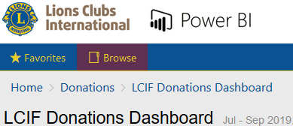
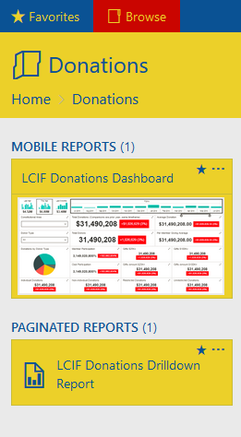
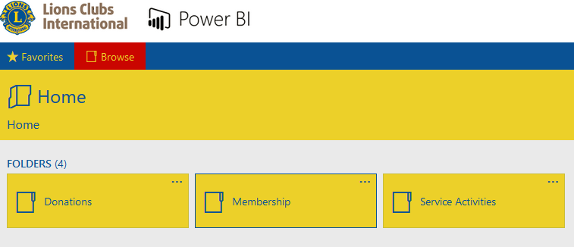
Accessing the Dashboard
Notes:
I will go slow so we can do this together: You may need to wait a bit, so someone please let me know when you reach the necessary page.
Click “Home,”
Then “Donations,”
Then “LCIF Donations Drilldown Report”
When you get to the blue screen try not to click anything yet.

Slide 28
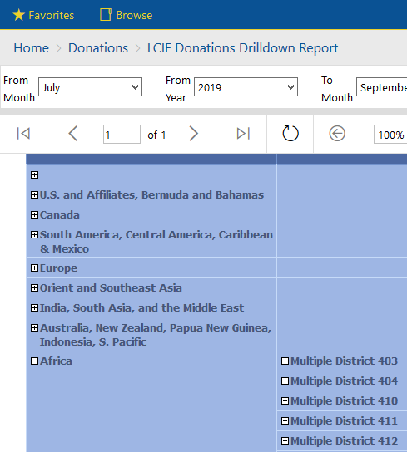
Accessing the Dashboard
Notes:
From here you should be able to see our Constitutional Areas
You can drill down to more date to find by clicking on the “plus” sign next to a continent
Clicking the plus sign next to Multiple Districts will reveal their districts.
If you scroll down below Multiple Districts you will find a category listed as “Undistricted.” This is misnamed. If you click on the plus sign, you will find our CA’s Single Districts.
If you continue to click on plus signs, you can drill down all the way to the club level.

Slide 29
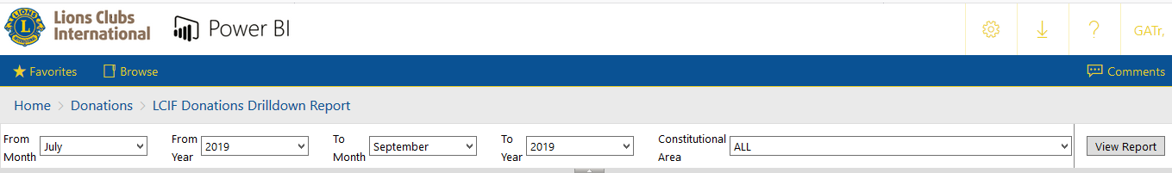
Accessing the Dashboard
Notes:
Now this tool also has historical data. It will default to performance in the current financial year, but if you adjust the months and the year at the top, and then click “View Report” you will find data for the section of time you have denotated.

Slide 30
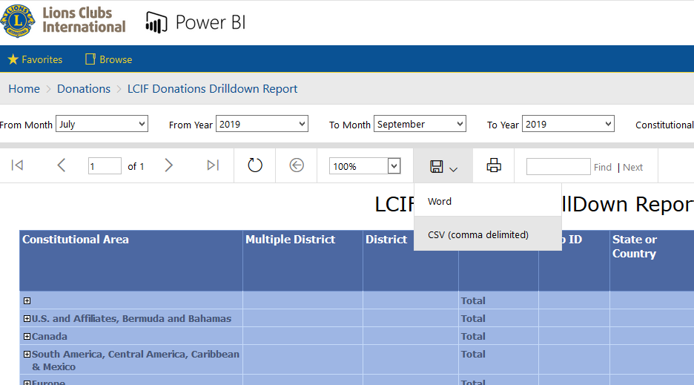
Dashboard: Exporting Data
Notes:
If you find the dashboard cumbersome to view, you can also export it to Excel by clicking on the floppy disk icon, and selecting CSV

Slide 31
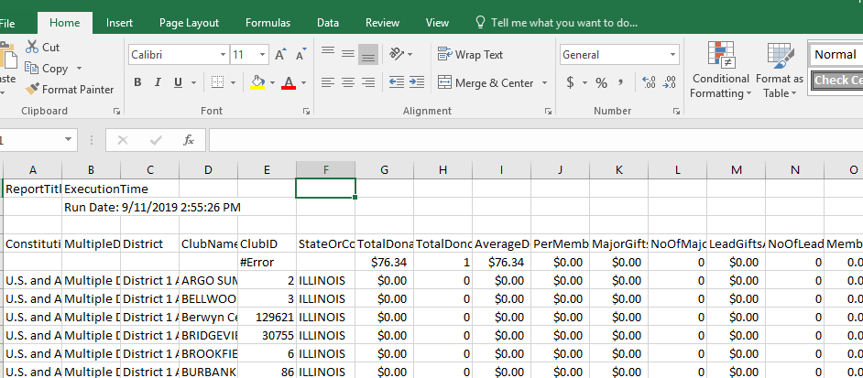
Dashboard: Exporting Data
Notes:
Whatever you are viewing will automatically open as an excel document. Again, it may take some time.

Slide 32
New Recognition
Notes:
There are some board-approved changes to LCIF recognition this year. Recognition has used in different ways across our CA, but as a final step in planning the year, we would like to make sure you are familiar with the different new additions:

Slide 33




LCIF Presidential Supporter
Program Details:
Annually fulfilled for individual donations of US$50 & above
Donations for Supporter pins also receive MJF credit
Design changes each year with new Presidential theme
Levels:
Bronze Pin: US$50
Silver Pin: US$100
Gold Pin: US$200
33
Notes:
As part of LCI and LCIF’s strategy to become more closely branded, several pieces of recognition have been rebranded to emphasize each International President’s support of LCIF. You will find that many forms of recognition will be customized with the colors and name of the International President. This is part of a larger effort to better align District Governors with LCIF’s goals and activities. The first example of these newly branded recognition forms is the “LCIF Presidential Supporter” pin, which will replace the Lions Share pin.
You will notice that the increments for the varying pin levels are the same: US$50; US$100; US$200. But the pins are branded differently to emphasize the International President’s support of LCIF.
These pins will be made available to our volunteers during our upcoming trainings, as Lions Share pins were in the past.

Slide 34
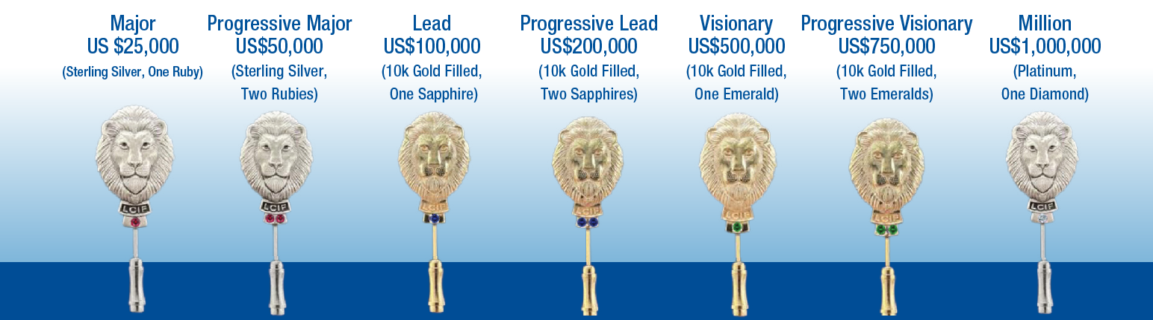
Lead and Major Gifts
34
Notes:
Lead and Major gifts were introduced by LCIF during Campaign 100 as a way to help support fundraising. Now that Campaign 100 is over, a new, post Campaign 100 form of recognition is available to Lions who do not have a Campaign 100 pledge balance.
These lapel pins were designed personally by LCIF’s Development Committee Chairperson, PIP Dr. Yamada.

Slide 35





Club giving patches
Program Details:
Annually awarded to clubs that achieved set Per Member Average Level during a fiscal year:
Copper: $50 PMA
Silver: $100 PMA
Gold: $250 PMA
Platinum: $500 PMA
Diamond: $1,000 PMA
35
Notes:
Club giving patches will replace Per Member Average patches, and will once again be branded with the President’s name and colors. Results will be calculated at the close of each financial year. Clubs qualifing for these banner patches will receive them automatically.

Slide 36

LCIF Presidential Award for Goal Achievement
Program Details: Awarded to District Governors and LCIF District Coordinators from districts that achieve 100% of their fiscal year LCIF fundraising goal, as defined by LCIF Development.
36
Notes:
The Campaign 100 Presidential medal was introduced during the campaign to show Presidential support for the campaign. Now that the campaign is over, it was decided that a new medal for District Governors and District Coordinators will demonstrate that support.
These medals will be presented to teams of District Coordinators and District Governors who achieve their annual LCIF District fundraising goals.

Slide 37



Thank you!
Let’s have another great year!
37
Notes:
(Closing words by Constitutional Area Leaders)

