Slide 1
Supporting Disaster Relief
Notes:
You have created your fundraising plan for the year and I bet you are wondering what is in it for your team and you.

Slide 2
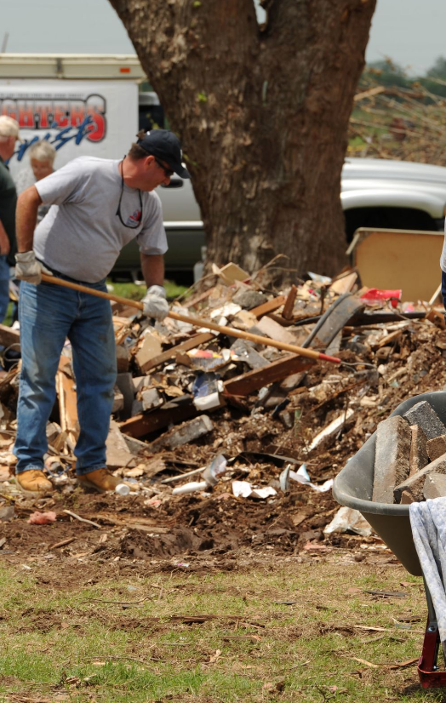
The Power of LCIF Disaster Grant Programs
Every year, disasters affect millions of people globally, and the impact on affected communities is devastating. The LCIF General Disaster Fund provides critical support for victims and helps rebuild lives.
Notes:
LCIF's Disaster Relief and Major Catastrophe grants allow us the opportunity to support communities at critical moments. Donations to these events can be very powerful, but some nuances behind supporting communities experiencing disasters are important for us all to know. As LCIF volunteers, the Lions in our district may come to us with questions. As part of our duties to educate Lions about LCIF, understanding the stages of a disaster and how LCIF supports disaster relief is critical.

Slide 3
LCIF donations support Lion projects:
All projects:
Identify critical needs or gaps in service
Are informed by connection to the community
Require a detailed project plan
Ensure the safety of implementing Lions
Ensure dignity for the community receiving the grant
Notes:
Donations to LCIF support Lions’ hands-on relief projects. They are not intended to go directly to governments or to other NGOs.
LCIF requires a project plan and reviews that plan for efficiency, sustainability, and impact. Our Programs team offers advice based on their experience with projects around the world. Studies show that local design and implementation help assure a standard of quality because having local people design the projects means they:
Identify critical needs or gaps in service- by ensuring that our projects don’t duplicate the efforts of other NGOs or of local governments
Are informed by connection to the community- this includes local leadership; it includes contextual knowledge: for example, they know how a community looked and functioned before disaster struck. This community knowledge also includes an understanding of the needs and desires being discussed by local people.
Require a detailed project plan- LCIF releases grants for defined purposes and defined needs that can be measured. Donations are never sent to Lions or the project committee without detailed plans.
Ensure the safety of Lions- we will not fund projects that require risk by our Lions during implementation. This is always an important consideration, but its relevance is particularly highlighted during a disaster.
Ensure dignity for the community- We are all Lions. Projects funded from donations belong to our entire global community, including those receiving grants. LCIF takes on the role of thanking donors for contributing to projects through the MJF and PMJF programs. Part of the purpose of these recognition programs is to eliminate a sense of debt or obligation to specific people that grant recipients may otherwise develop.
These points are all true of any program, including disaster-related grants.

Slide 4
Stages of a disaster:
Disaster Planning
First Response
Disaster Management
Disaster Recovery
Rebuilding
Notes:
When we think about supporting communities experiencing disaster, it is important to be aware of the stages of need communities experience.
These needs are in sections for the sake of defining trends, but transitions between these stages can be gradual. This sometimes means that multiple stages of need can exist simultaneously.
LCIF projects in all these stages adhere to the guidelines previously stated:
Identifying critical needs or gaps in service
Connected to the community
Addressing distinct needs
Ensuring dignity for the community receiving the grant

Slide 5
Disaster Planning
Develop strategies and procedures for future relief efforts
Educate community through public relations and outreach
LCIF Disaster Preparedness Grant
Stage
0
Notes:
Disaster planning involves developing strategies and procedures to prepare for, respond to, and recover from natural disasters. It consists of anticipating potential disasters, analyzing their potential impact, and establishing protocols to mitigate risks and ensure the safety of individuals and assets. Disaster planning typically includes:
Creating emergency response plans.
Conducting drills and simulations.
Stockpiling essential supplies.
Collaborating with relevant response agencies.
The goal is to minimize the adverse effects of a disaster, protect lives and property, and facilitate a speedy recovery.
LCIF offers Lion Districts the opportunity to apply for a Disaster Preparedness grant to support districts interested in partnering with local authorities and other community organizations to plan and prepare for future relief efforts.

Slide 6
First Response
Immediate aftermath
In the news cycle
Important services are disrupted
Damage assessments made
Search & rescue operations
Stage
1
Notes:
During a natural disaster, the emergency response involves quick damage assessments, search and rescue operations, medical aid, temporary shelter, and coordination among agencies. Long-term recovery efforts follow once immediate needs are addressed.
The First Response stage of disaster recovery occurs during and in the immediate aftermath. Not all disasters make it to the news cycle, but if they do, you are most likely to see this first stage- it is where you will see footage of destruction and people in the most distress, which makes for compelling news footage. It is also the stage in which the lives of people affected can be at the highest risk.
Local services and NGOs may be struggling to organize. Utilities and logistics may be dysfunctional. The community is experiencing tragedy in real-time. This is also the stage at which donors are most likely to respond: because of news footage; in our digital world, because of social media pleas for assistance; and because of direct emails, sometimes from fellow Lions.
Unless the Lions are employed as first responders, these are all the responsibility of local government and trained emergency personnel.

Slide 7
Critical Needs
LCIF does not accept in-kind donations
Immediate needs:
Food
Water
Medicine
Hygiene
Blankets
LCIF Emergency Grant
Stage
2
Notes:
The Critical Needs stage is generally where volunteers, community members, and NGOs arrive to help ensure the people are cared for. This stage can often be in tandem with the first response stage. At this stage essential needs are of the highest priority: food, water, medicine, hygiene and blankets.
LCIF does not accept in-kind donations for disasters, nor do we support the costs associated with transporting these goods to disaster areas. Often the Lions who are organizing the in-country relief efforts live far from the ports where the goods can be received and have to pay large fees to get them out of customs, which becomes more of a burden than help to the Lions implementing the aid work. Oftentimes, the items that Lions in other countries want to send are available in the affected country or are not items that are suited to that particular region.
Sending local Lions cash grants to purchase agreed-upon necessary items allows the Lions in affected areas to spend more time helping people and helping local economies that might be affected. Very often, the cost of necessary items is cheaper in the country of the disaster, particularly when you consider the cost of shipping. They are more suited to local environments as well.
The Emergency Grant addresses these needs:
LCIF does its best to approve Emergency Grants within 24 hours of the submission of applications by District Governors.

Slide 8
Stabilization
Efforts to bring the affected community back to normal
Needs might include:
Cleanup and debris removal
Repairs to homes and facilities providing vital services
Education needs
LCIF Community Recovery grant & Matching grant
Stage
3
Notes:
Once critical needs are addressed, and a degree of basic safety is established, priorities for serving a disaster typically shift to stabilizing the lives of people most deeply impacted and working on getting them back into their homes. These needs come in the form of cleaning up houses, removing debris, and making repairs to homes and facilities providing vital services. The community may also have education needs.
People may be trying to locate family members. They may be looking to find work to support their families. They may be registering for local benefits and services in cases where work is not available. Many begin to experience grief and loss in the stillness and waiting that this stage can produce.
LCIF’s Community Recovery grants can fund projects at this stage, as can matching grants- with money from these grants coming from donations earmarked for the disaster.

Slide 9
Rebuilding
Long-term recovery of the community
Needs include:
Reconstruction of facilities providing vital services
Equipment replacement
LCIF Matching Grant, Major Catastrophe Grant, Earmarked donations
Stage
4
Notes:
Stage 4 begins as the community and the institutions supporting it are able to begin considering long-term recovery and rebuilding. When Major Catastrophe and earmarked funds are available, it is not unusual for grants to be approved to rebuild housing or repairs for important community structures like hospitals or schools. Important equipment for hospitals and other important institutions may also need to be replaced.
LCIF is always anxious for this stage to begin and is proud of the opportunity to support communities as they become places that support and nurture families and friendships again. Earmarked disaster relief donations can be spent on all the stages of disaster relief outlined in this talk, but this stage is where earmarked donations often run out. Once Major Catastrophe and earmarked funds are gone, Matching grants, made available from undesignated donations, can fund these projects as long as the project complies with the regulations and criteria of the Matching grant program.

Slide 10
Major Catastrophes:
Large-scale disasters – Türkiye earthquake, 2021 European Floods
Covers all stages of disaster relief except the first stage
Lions projects might include:
Distributing immediate needs
Providing temporary shelters
Rebuilding homes
Lions cannot apply. Awarded at the discretion of the International President and the LCIF Chairperson
Notes:
Major Catastrophe grants are an essential way that LCIF can address large disasters. Some of the most recent Major Catastrophe grants issued in CA IV have been for the Türkiye earthquake last year and the Flooding in Northern Europe in 2021.
Major Catastrophe grants are intended to cover all stages of disaster relief resulting from a large natural disaster. However, they do not fund first response efforts, such as search and rescue and other situations more appropriately done by the government or established first response agencies.
As noted, Lion projects for Major Catastrophe grants can include:
Distributing immediate needs
Providing temporary shelters
Rebuilding homes
Lions cannot apply for this grant. It is awarded at the discretion of the International President and the LCIF Chairperson. The Programs team may reach out to Lions and District leaders experiencing a disaster to assess whether a Major Catastrophe grant would be appropriate.

Slide 11
Lessons: variables to service
Local governments
Always the very first responders
Have priority for resources
Must create a safe environment
Changes to regulations may affect timelines for rebuilding
The environment
Weather and additional disasters
Damaged infrastructure
Local economies
Local Lions
Relationship to the affected area
Specialized knowledge
Notes:
Every disaster is unique, so Lion projects in service of their communities are customized according to their unique context.
Because the Lions of Europe donate in such powerful ways to disasters it is important for all of us to be aware of the lessons we have learned, and how the foundation supports Lion projects when disaster strikes. This is a list of some of the variables to service in these scenarios:
First, national and municipal governments are always the first to respond to a disaster through their own disaster services. In that role they have the priority for resources. That includes local supplies and logistics. This priority can slow the import of goods and materials for other purposes.
Many governments need help at the start of a disaster, when services are overwhelmed, and may experience unexpected challenges. They often have professionals and plans to help with the stabilizing work that defines stage two.
As we have said, LCIF grants are approved for projects for which there is a gap in service. It is once safety and services have been established that Lions are able to recognize opportunities for projects. So, Lions’ abilities to plan projects is local government-dependent. Local governments also impact the Rebuilding process because disasters cause a reevaluation of building standards. Before rebuilding can begin, studies may be conducted and debated. Sometimes new infrastructure is installed before rebuilding can take place. The government’s ability to implement these plans can affect the timeline for rebuilding. Sometimes for years.
The environment around a disaster area creates several variables to Lions’ ability to serve their communities. Puerto Rico has been a tragic example of this, experiencing annual hurricanes that consistently force the island to suffer through stages of critical needs because of flooding and wind damage. It is only after those needs are addressed that Lions can return to addressing needs in stage 2 and 3 again. Sometimes these disasters can create setbacks in ongoing projects and activities.
Weather is not the only environmental variable. Damaged infrastructure can determine how and when projects can be implemented. Rubble needs to be cleared, and roads need to be operational before projects can begin. This is a local government issue as well, but it is related to the physical ability for Lions to implement projects. Local economies may also play a role. If there are disruptions to the labor force, if important supplies become difficult to obtain, or if local currencies are devalued, this can affect the local Lions ability to respond.
Finally, our Lions are a variable to service. This includes whether Lions live in the areas affected, and their relationship to local governments. We know from experience that Lions that become a part of service “clusters” with other NGOs and local governments are well placed to coordinate and plan impactful projects. Frequently there is so much need that Lions are forced to choose the type of service they wish to pursue. They don’t have the resources to meet every need. At those times, projects may be determined by expertise in types of service. As an example, ID Daniel Kubin in Turkey is an architect with a specialty in seismology. His expertise has been invaluable in planning and coordinating projects to serve the recent devastating earthquake in that country. There may be other times when Lions have specific medical expertise or connections that guide their ability to be most impactful.

Slide 12
Common areas of confusion:
The majority of LCIF Disaster grantmaking goes to small disasters affecting 100 or more people
Hurricane Katrina changed the way LCIF manages disaster relief donations
LCIF does not establish a designated fund for any disaster
Donors can inform LCIF of which disaster they prefer their funds to go to. LCIF will “earmark” those funds and honor that preference as best we can.
We want to avoid any disaster being overfunded or underfunded
This approach allows LCIF to direct funds toward disasters with the most need for as long as the need exists
Donations for disaster relief do not qualify for DCG credits
Notes:
It is important for us to understand the difference between "earmarked" funds and designated funds when discussing donations for specific disasters. There was a time when LCIF created a designated fund for every major natural disaster, which meant that donations made in the name of that disaster were locked and could only be spent on recovery efforts for that specific disaster. However, this led to extensive administrative challenges in tracking those donations.
Hurricane Katrina posed a new challenge as many people needed extensive support, and rebuilding efforts were necessary to make the city habitable again. Over 65,000 families moved away within a year, and 10 years after the storm, the city's population had declined by 80%. The Lions who remained pursued rebuilding efforts with the donations available, but eventually, the request for grants ended before the designated donations were spent in their entirety.
Designating a donation is a technical accounting term that follows specific rules about how donations can be spent. In the absence of projects directly related to Hurricane Katrina, LCIF was forced to contact donors, asking if donations made toward Katrina years ago could be directed to other disaster-related efforts or if the donors would prefer to receive the money back. These were difficult conversations for many reasons.
After difficult conversations with donors, LCIF ceased setting up separate designated accounts for specific disasters. Instead, if a donation comes in with a note informing LCIF of the preference towards a specific disaster, LCIF will "earmark" that donation and track how much has been sent for that specific disaster. Although LCIF will make every effort to award all the earmarked funds to the assigned disaster, if Lions cannot utilize donations earmarked for their disaster, LCIF can redeploy those funds to other areas of need. This practice manages auditing risk for the foundation and allows the foundation to support need in our Lions community efficiently.
It is important to note that all donations must be used for the purpose for which they were intended. Therefore, donations to disaster relief must be used for disaster relief and nothing else, which is why they are not eligible for the District and Club Community Impact Grant Program.

Slide 13
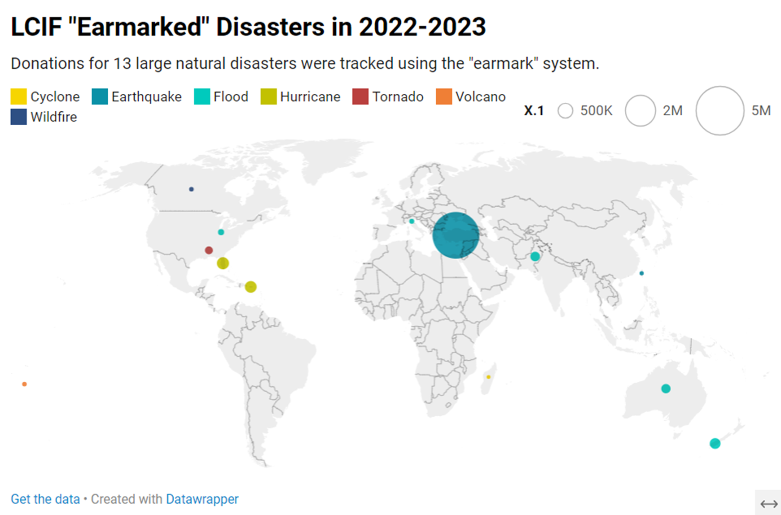
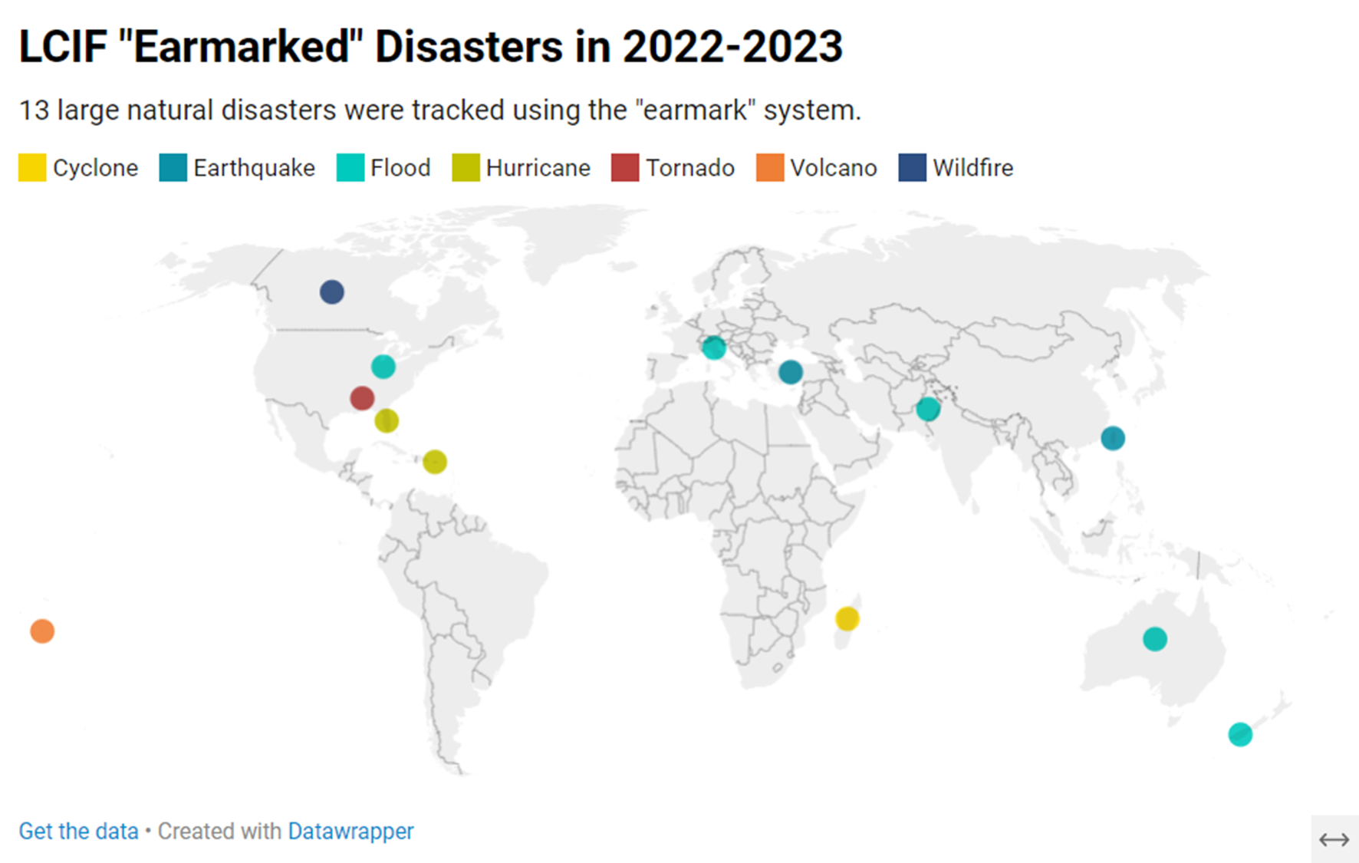
13
Notes:
In 2022-2023, LCIF tracked donations that were sent earmarked for specific disasters, a total of 13 in all. Some of which, such as the Turkiye/Syria Earthquake, received close to 5 million in earmarked funding, while others received very little.
In areas that received small amounts of earmarked donations, LCIF was able to supplement it through grants out of the General Disaster fund.
If you are from a district that donated to these disasters, thank you very much. Your donations helped Lions living through these disasters know they were in our thoughts. That is extremely meaningful.

Slide 14
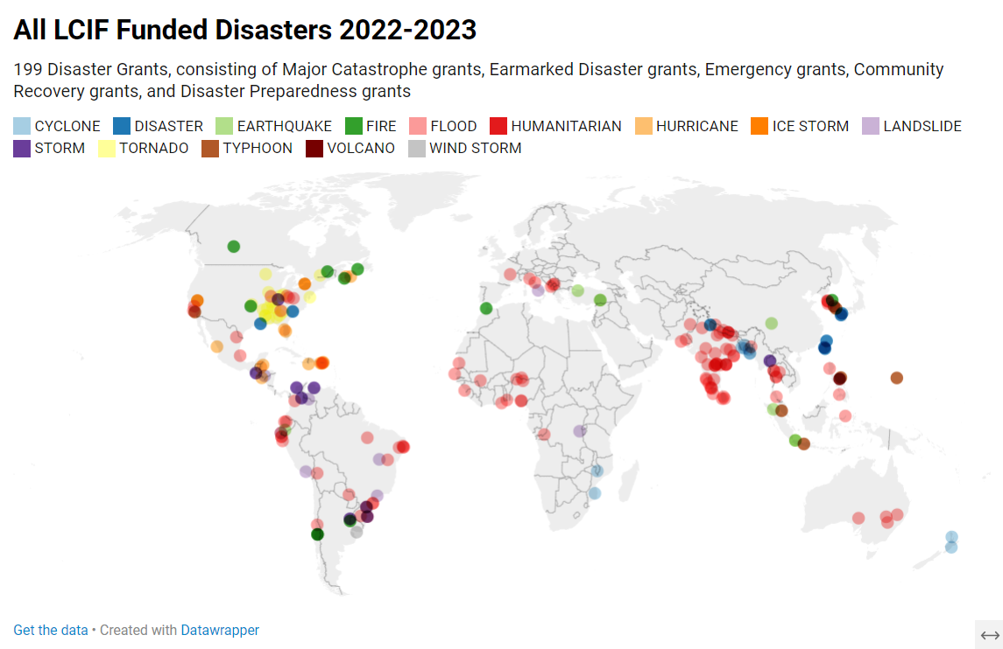
14
Notes:
It is important to note that LCIF issued 199 disaster grants in 2022-2023, and that 94% of those disasters received no earmarked donations. Some disaster’s earmarked donations totaled less than the amount awarded through LCIF’s Emergency grant program.
Most of these disasters never made international news, but they still had enormous effects on the people who had to live through them. Through donations to the General Disaster fund, LCIF was able to support clubs’ relief efforts worldwide.
If you or your district made undesignated disaster relief donations last year, you helped the Lions of Japan prepare for future typhoons, helped the Lions of Brazil through floods and landslides, the Lions of Africa through cyclones, floods, landslides, and wildfires.
Here in Europe, your undesignated disaster donations helped with floods in Italy, Albania, and Kosovo, as well as efforts towards the Türkiye earthquake.

Slide 15
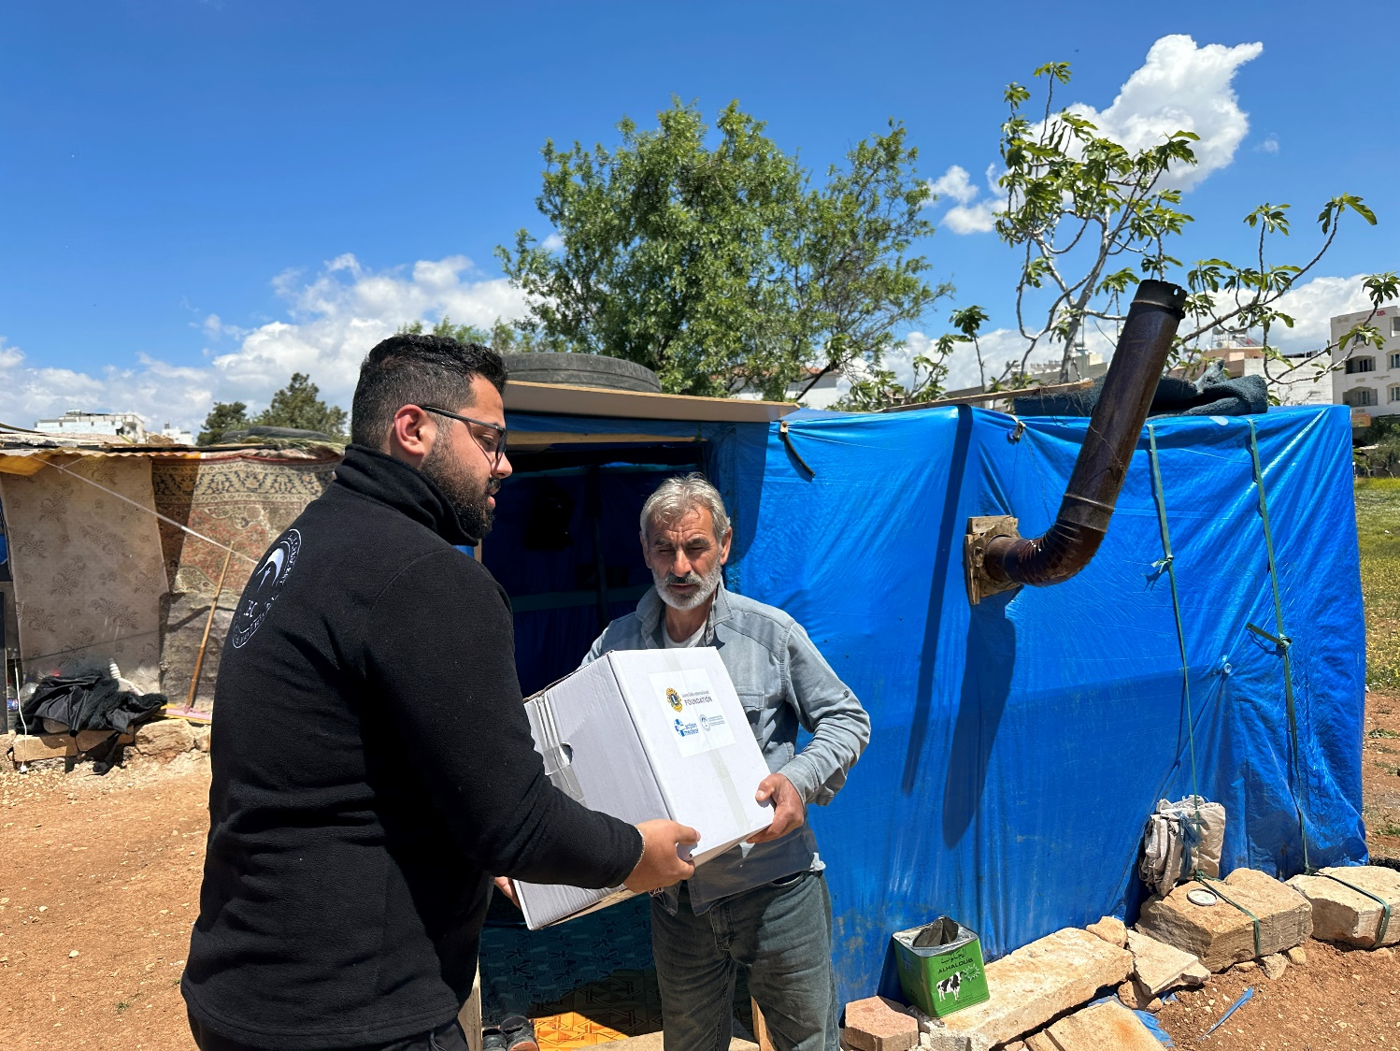
CA IV donations to Turkey Syria Earthquake: US$2,596,918
US$3.52
MILLION
Raised to date
Notes:
Finally, as we consider the amazing work we have empowered over the last year, we should salute CA IV’s efforts in supporting some of the most significant disasters in our recent history, and in the CA’s proximity.
Including donations from LCIF’s agreement with Germany, Lions of Europe have donated US$2.6 Million to support recovery efforts for the earthquake in Turkey and Syria in February of this year: 63% of donations coming to LCIF and 74% of total donations to the disaster have been from CA IV.

Slide 16
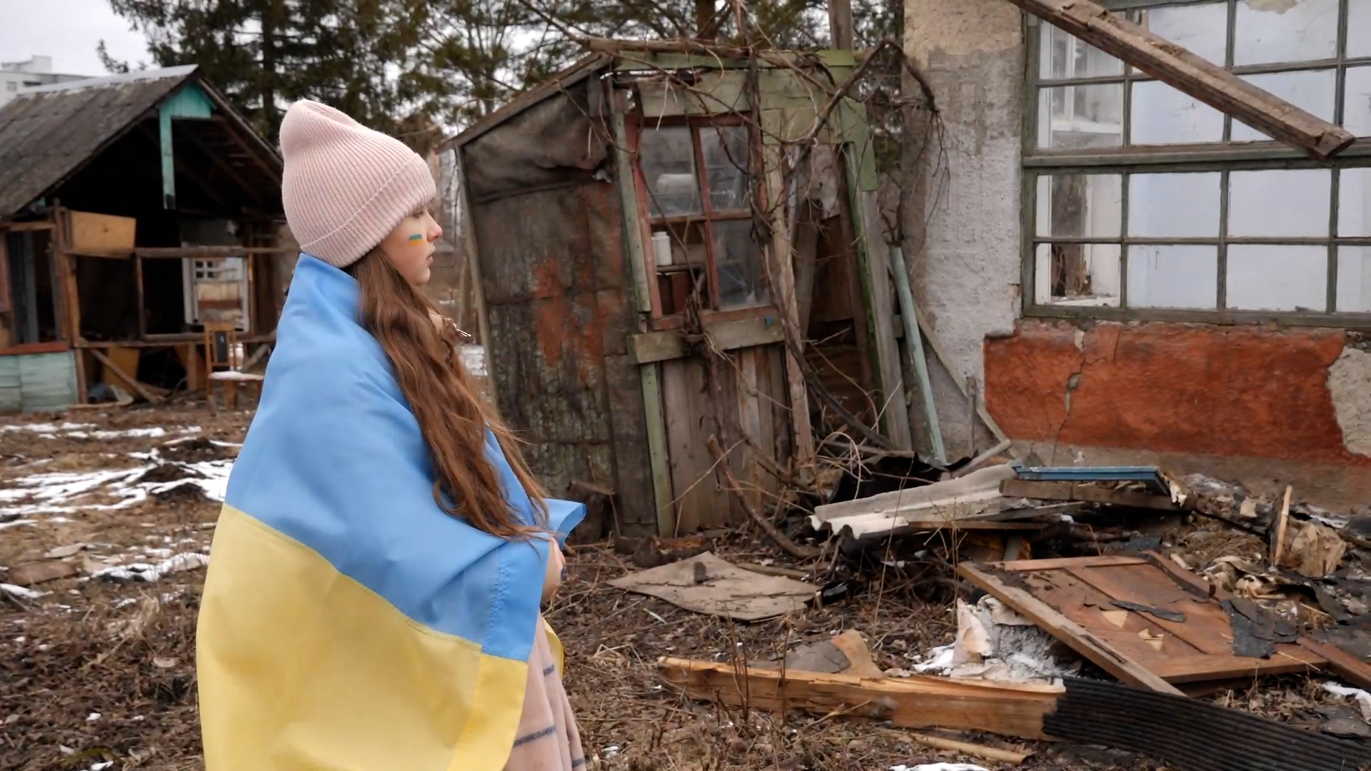
CA IV donations to Ukraine: US$5,339,010
US$4.57
MILLION
Refugee Assistance Grants Awarded
Notes:
The people of Ukraine experiencing war are another group continuously in our hearts. Donations for Ukraine do not technically get earmarked for Disaster Relief, as LCIF prioritizes natural disasters over man-made ones. Instead, they are earmarked withing the Refugees and Displaced Persons and projects are awarded Refugee Assistance Grants.
You can see here that CA IV has donated over US$5.3 million dollars for efforts supporting Ukraine. As is the case with many man-made disasters, critical and stabilization needs persist for a long time. While we hope to see this conflict move someday to the Rebuilding stage, we don’t know when that will be. We know donations to this cause will be needed until the war ends and Ukraine is rebuilt. I know that as Europeans, we believe in our opportunity to support the people of Ukraine in their time of need.

Slide 17
Grant Awards By Constitutional Area FY2022-2023 (US$)
17
Notes:
Yesterday we discussed that the 2022-2023 was CA IV’s best fundraising year in terms of progress to annual fundraising goal, of all the CAs in Lionism. I want to point out another statstic in which the CA was first. That is in grants awarded. This is because of the crisis in Ukraine and in the Turkey/Syria earthquake. But I’d also like to point out that CA IV was the top recipient of COVID grants when that disaster struck, and that many Lions from CA IV were surprised when LCIF issued a Major catastrophe grant for the 2021 flooding in Northern Europe. We heard from so many Lions in Europe that they thought that LCIF was for other Lions, but not for them.
LCIF is here for all our Lions. We are here to support service through our community, wherever we know we can make an impact. Last year, our community- in CA IV- made the case for changing the world one grant at a time, in Europe. The project plans submitted were valid. The only determinant of approval was a need and a good application. I hope we will remember, and inform our districts, that LCIF is here to support all our Lions.
On September 8th, at 11:11 pm local time, and 12:11 pm here in Oslo, LCIF approved a Major Catastrophe grant of US$100,000 for the Lions of Morocco, in addition to a recent US$10,000 Emergency grant for the recent earthquake in the High Atlas mountains. A message from LCIF’s Executive administrator, Rebecca Daou confirmed last night that further funding will be available once needs and a plan of action are determined. You all know that the queue to process is donations is 2-3 weeks long. These promises and commitments have been made without knowledge of a single dollar of donations earmarked for this disaster. That is true of every disaster.

Slide 18
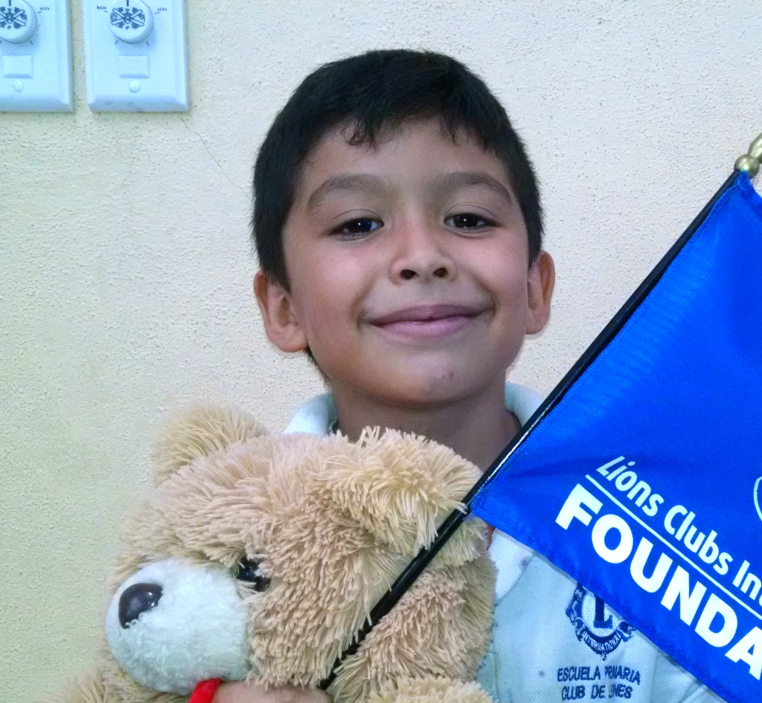
100%
of donations
support those in need
18
3
Notes:
Inspiring people to give in critical times of need is an important part of CA IV’s philanthropic culture. We respond passionately to people in need in times of disaster. This approach to response is different from a lot of CAs and it is something we should be aware of. Particularly because we know the need always exists. As we’ve said, climate change has a lot to do with that.
Between July 1, and August 21st of this year (52 days), LCIF has awarded more than 45 disaster relief grants totaling more than US$485,000.
These grants have gone to Lions serving devastating natural disasters that have recently struck across the globe, including:
Ravaging wildfires in Canada, Greece, Tunisia and the United States
Catastrophic flooding in Bangladesh, Colombia, India, Japan, Korea, Mexico, Slovenia and the United States
Destructive hurricanes and typhoons in Bangladesh, Brazil, China and Philippines
LCIF is unique in that 100% of donations do toward projects. Thank all of you for the work you to in supporting our fellow Lions and the world in these important times.

Slide 19
Grant Story: LCIF and Ukraine

