Slide 1

LCIF Global Grants
Changes to LCIF Grant Programs and Introduction to the New Vision Grant
1
1

Slide 2



LCIF Grant Program Updates
LCIF is updating all our grant programs. These changes aim to streamline processes and improve effectiveness.
2
Notes:
I want to end by reminding you to be an ambassador for LCIF. We empower so much service around the world for our fellow Lions. We enable them to change lives in their communities through our grants and programs.
Encourage others to join you in supporting our work. Tell the story of our global foundation. Remind your fellow Lions that this support will ensure our ability to empower service for years to come.
Take every opportunity to share your reasons for giving to LCIF and remind others of the difference we make together.
Your generosity feeds the hungry, prevents blindness, cares for those experiencing disaster, and more. Your generosity is transformative, reaching one person at a time to change millions of lives collectively. We invite you to join us in this work by donating today.

Slide 3






EXCITING UPDATES
At the January 2024 Board of Trustees Meeting, the Trustees voted to increase the request maximum for Hunger and Matching Grants to US$150,000.
3
Notes:
At the January Board of Trustees Meeting, the Trustees voted to increase the request maximum for Hunger and Matching Grants. Now Lions can request up to $150,000 for both Matching and Hunger grants instead of just $100,000. This is an update that you can now apply for.
Lions helped make this increase possible with strong fundraising efforts which led to increased financial capacity for LCIF giving. Thank you so much for helping make this happen! I’m excited by the potential to receive even more grants in the upcoming year and help Lions have an even larger impact in their communities.

Slide 4


Diabetes Grant Changes
One grant per district at any time.
Half of local matching funds must be collected before approval
Entire local matching funds must be collected within six months of approval
No longer collecting local match as you go
4
Notes:
For individuals, we now have the Presidential LCIF Supporter pins for individual donations of at least fifty US dollars.
Individuals can receive a presidential supporter pin each year and there are four levels.

Slide 5



Lions Quest Grant Changes
Eligible Program Expenses
Workshop logistics and trainer expenses
Expenses could include venue rental, supplies for workshops, audio-visual equipment rental, and trainer expenses.
Program materials
Expenses could include curriculum for teachers and students’ workbook adaptation, printing, translation, and supplemental content development.
Program facilitation and support
Expenses could include administrative allowances, special meetings, food for workshops, group transportation to and from workshops, and evaluation activities.
5
Notes:
I will begin with the District and Club Community Impact Grant.
Known as the DCG, these grants started with Campaign 100 and allow 15% of your club and district donations to LCIF to be transformed into grant funds for you to use on a local level, if your club gives at least five thousand US dollars to LCIF or your district gives at least ten thousand US dollars to LCIF in a Lion year.
So, while you are donating to LCIF to help make an impact for people in need around the world, you can also receive some of that back to help in your local community. It’s a win-win.

Slide 6
Lions Quest Grant Changes
Pre-Approval
Half of local matching funds must be collected before approval
Post-Approval
Entire local matching funds must be collected within six months of approval
Grant funds are not released until all local matching funds are collected
In-kind donations are not eligible
Budget Limit
Maximum 10% of budget for program facilitation and support
Open Grants
Only one open Lions Quest grant per district or Multiple District at any time
Notes:
Terms and titles
Grantee: the district, MD or club that submitted the application and was awarded to LCIF grant. Cannot be an individual Lion.
Grant Administrator:
unless otherwise specified, If the grantee is a district, then the DG at the time the grant is approved is the GA. If the grantee is a MD, then the MCC is the GA.
GA manages the utilization of grant funds, project activities and reporting to LCIF
Project Chairperson: GA assigns a Project Chairperson who will manage the day-to-day activities of the project.
Changes to the GA or PC must have prior LCIF approval.
Project Committee: GA, PC and other Lions and partners involved in the project’s activities.

Slide 7

Emergency Grant Changes
Minimum and Maximum.
Minimum is US$5,000. Maximum request amount increased from US$10,000 to US$15,000
Integration with Community Recovery Program
Combined into one flexible Emergency grant program. Includes expenses from both previous programs
Timelines.
Apply within 30 days of disaster occurrence
Funds should be used within 60 days of receipt
7
Notes:
For individuals, we now have the Presidential LCIF Supporter pins for individual donations of at least fifty US dollars.
Individuals can receive a presidential supporter pin each year and there are four levels.

Slide 8
Disaster Preparedness Grant Changes
Minimum and Maximum.
Minimum request amount is US$5,000. Maximum request amount increased from US$10,000 to US$15,000
Higher Match Requirement
Local matching fund requirement increased from 10% to 25%
Lions can now apply for Disaster Preparedness grants every two years
8
Notes:
For individuals, we now have the Presidential LCIF Supporter pins for individual donations of at least fifty US dollars.
Individuals can receive a presidential supporter pin each year and there are four levels.

Slide 9
Community Recovery grants will be discontinued. Expenses that were previously available under the program are now eligible for Emergency grants.
9

Slide 10
CONCLUSION OF SIGHTFIRST
195
190
Million
People had their sight preserved
Million
US dollars awarded in grants for SightFirst due to success of Campaign SightFirst II.
10

Slide 11
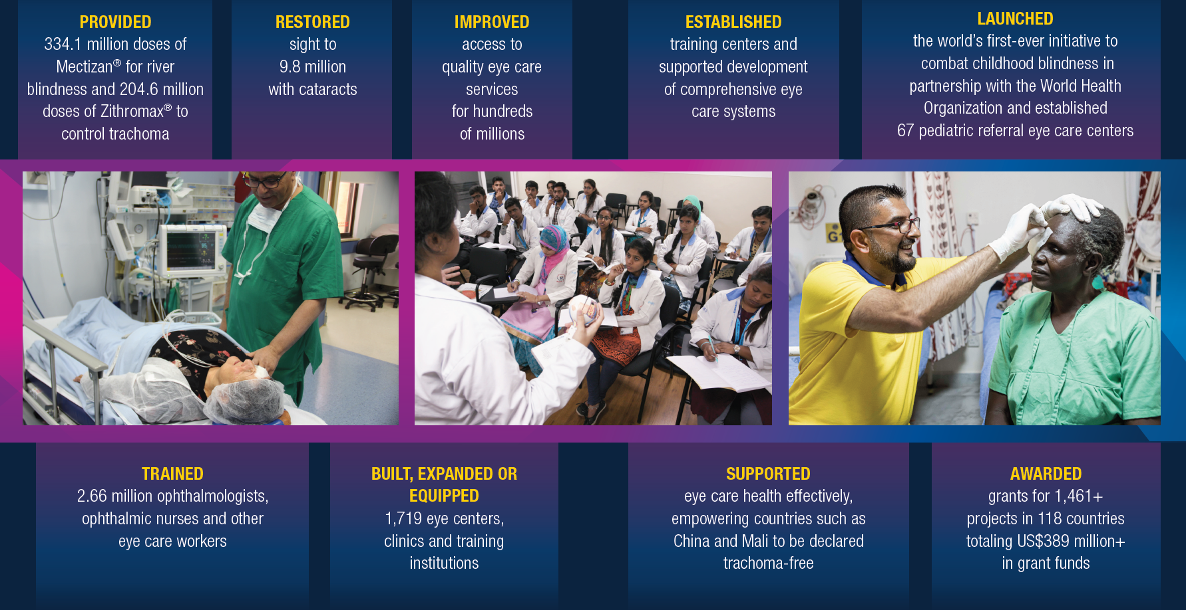

Slide 12

NEW VISION GRANT
All vision projects, including SightFirst Grants, will be consolidated under a new Vision Grant Program.
Funding is available to support:
All countries can apply
Major equipment acquisition, infrastructure renovations (no construction of new eye hospitals), training of medical professionals*, limited consumables*.
US$10,000 up to US$300,000
50/50 Match
*Developing country applicants only
12
Notes:
All vision projects, including SightFirst Grants, will be consolidated under a New Vision Grant Program in the upcoming Lion year with the Board of Trustees reviewing revisions in August.
The Board of Trustees is reviewing revisions in August.
Funding is available to support: major equipment acquisition, infrastructure renovations (not new construction) and training for medical professionals (in low-income countries).

Slide 13

NEW VISION GRANT
The Vision Grant incorporates core aspects of SightFirst criteria
Vision grant program is not disease specific (i.e. cataract surgeries)
It supports small and large-scale vision-related projects
Technical Advisors will review the grant requests
The application is being translated into all official languages and will be available on or around October 1, 2024
13
Notes:
All vision projects, including SightFirst Grants, will be consolidated under a New Vision Grant Program in the upcoming Lion year with the Board of Trustees reviewing revisions in August.
The Board of Trustees is reviewing revisions in August.
Funding is available to support: major equipment acquisition, infrastructure renovations (not new construction) and training for medical professionals (in low-income countries).

Slide 14
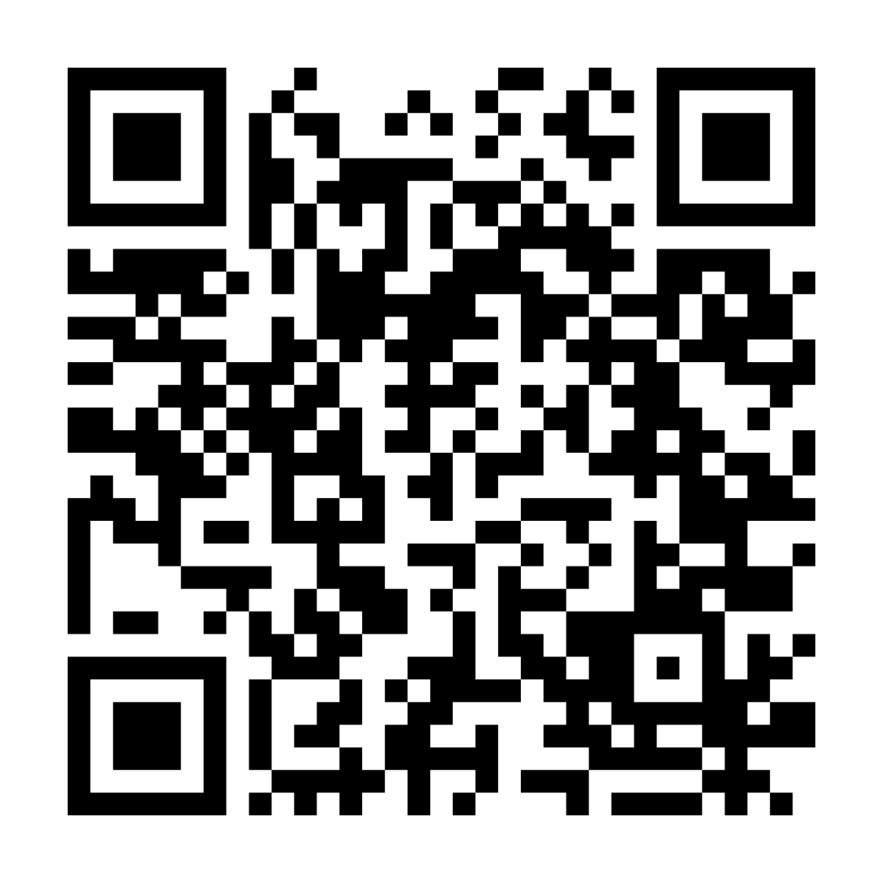
Thank You!
Scan the QR Code to access the LCIF Grants Toolkit and learn more.
14
Notes:
Thank you so much for your interest in LCIF Grants. Do not hesitate to contact us if you have any questions and thank you for everything you do. Please scan the QR code to visit the LCIF Grants Toolkit

