Slide 1

MD118 LCIF Coordinator PID Prof.Dr. Hayri ÜLGEN

Slide 2
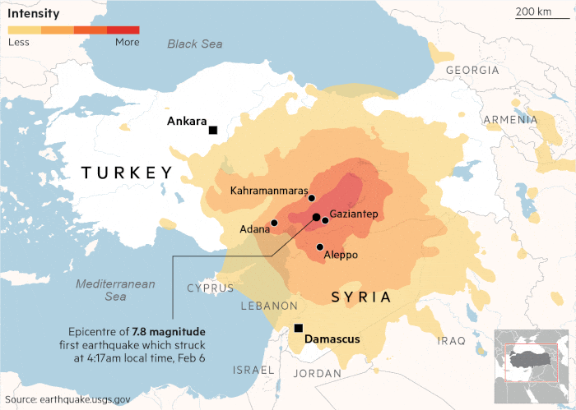
Disaster of the Century
On Feb. 6th, 2023 at 4:17 AM and 1:24 PM Türkiye faced with two earthquakes of mag. Mw 7.8 and Mw 7.5 in Kahramanmaraş
and
on Feb. 20th. At 8:04 PM third one of mag. Mw 6.4 occurred in Antakya…
3rd worst and the most destructive and damaging earthquake ever seen.
Antakya
Epicenter of 6.4 magnitude earthquake hit Defne district of Hatay province…

Slide 3
February 6, 2023 Damages of Earthquakes of Southeast Türkiye
Affected area is about 350,000 km² (140,000 sq mi), and 15 million people affected…
According to Official Figures more than;
50,000 deaths…
120,000 injured…
360,000 demolished and heavily damaged buildings…
1.5 million uninhabitable housing…
4,5 million in total and 2,5 million permanent migration…
$160 Billion; cost of the destruction caused by the earthquake.

Slide 4
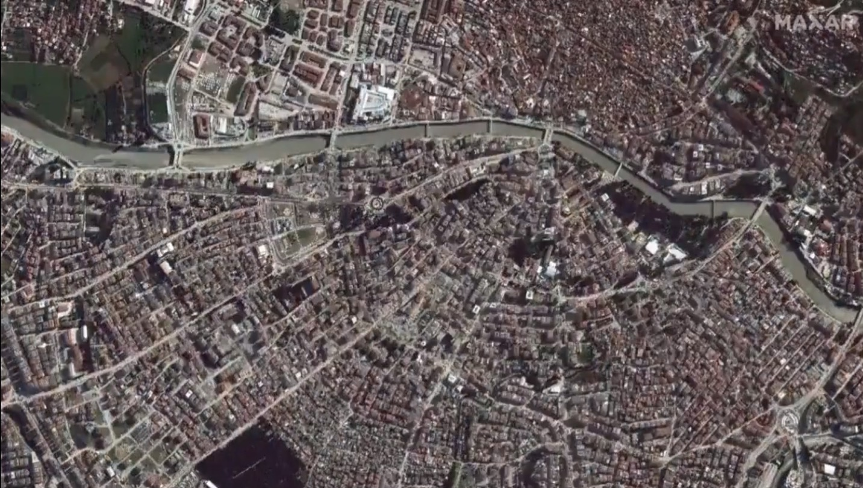
February 6, 2023 - Monday
"The earthquakes damaged structures spanning centuries and cultures, from Roman forts to historic mosques, synagogues, holy churches and a number of Christian denominations,"
Antakya (Antioch) : ˝City where the Civilizations met″ almost completely disappeared and become Gost City

Slide 5
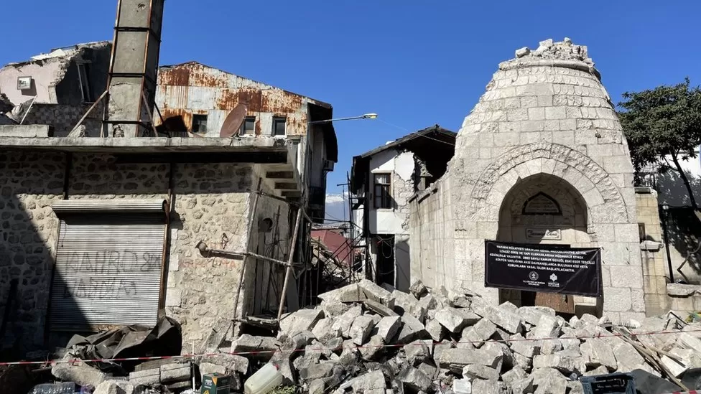

Antakya Through the International Press
Turkey earthquake: Antakya now unrecognisable to tour guide
Antakya, known in Roman and medieval times as Antioch, is an ancient city. Founded in 300 BC, it was a regional capital for the Roman Empire. It was also one of the earliest centres of Christianity and important for both Judaism and Islam.

Slide 6
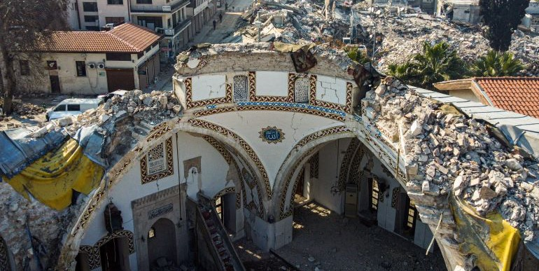

Antakya Through the International Press
Quake-hit Antakya communities seek role in saving rich heritage
Authorities are set to start restoration imminently, but some warn a rush to rebuild could threaten the city’s unique character and communities.

Slide 7
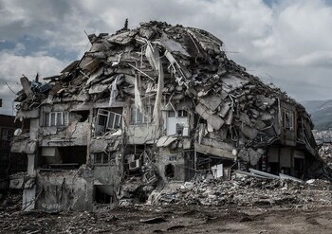

Antakya Through the International Press
Remaking Turkey: Inside the biggest rebuilding project on earth
After February’s catastrophic earthquakes, Turkey must now repair its broken cities and towns.

Slide 8
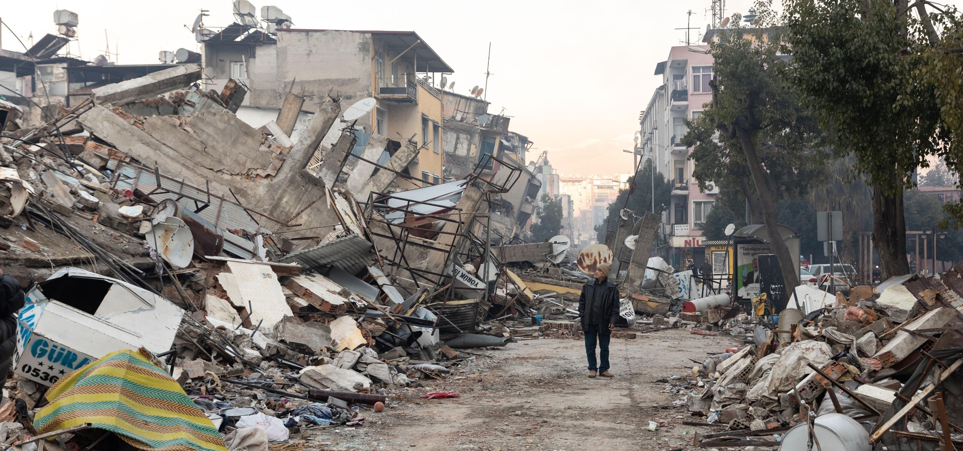

Antakya Through the International Press
Inside Antakya: Earthquake has reduced city I love to ruins
The destruction wrought by the earthquake that shook Turkey has left some parts unreachable even for rescue teams.

Slide 9
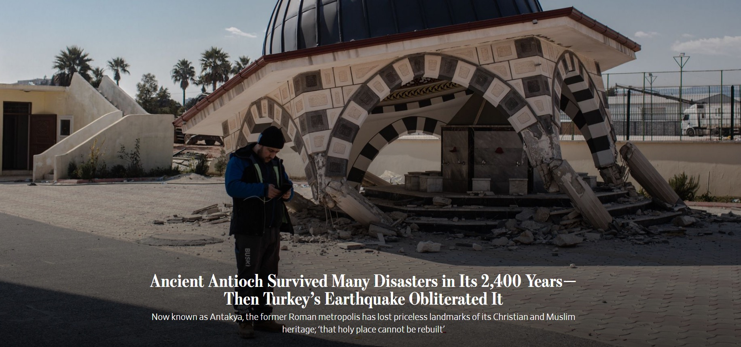

Antakya Through the International Press
Once the third largest city in the Roman Empire;

Slide 10

Antakya Through the International Press

Slide 11
Lions Response
after February 2023
Southeast Anatolia Earthquakes

Slide 12
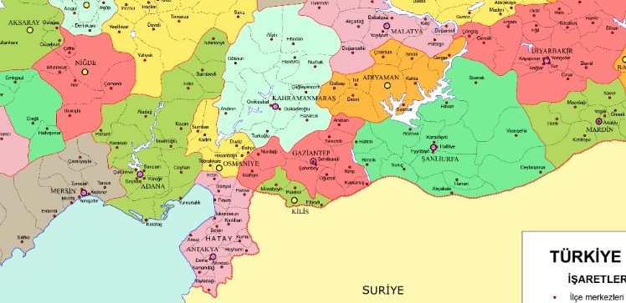

LIONS IN THE REGION
ELAZIG
DIYARBAKIR
KAHRAMANMARAS
MARDIN
GAZIANTEP
2
SANLIURFA
OSMANIYE
MERSIN
ADANA
9 + 1
11 + 4
KILIS
In the earthquake region and neighboring provinces 25 Lions and 6 Leo Clubs are serving.
ANTAKYA
Lions Club exist
No Lions Club
Branch Club exist
3 + 1
Syria

Slide 13
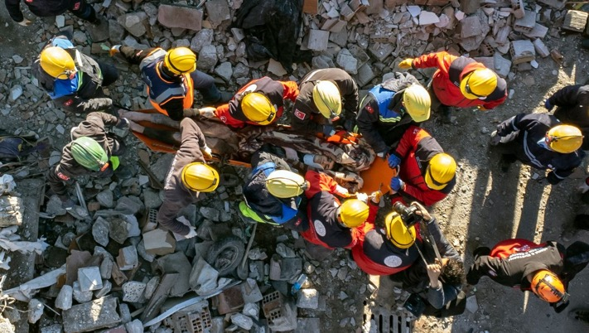
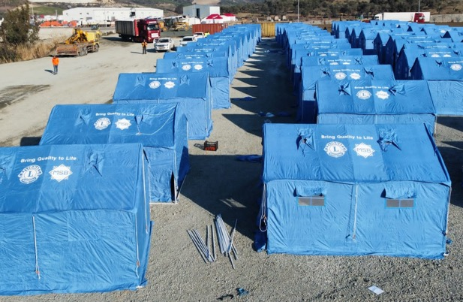
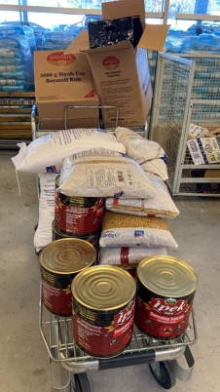
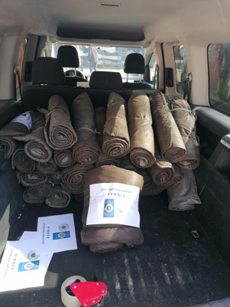
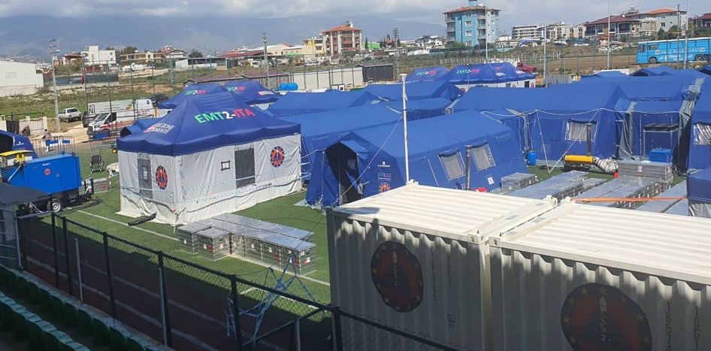
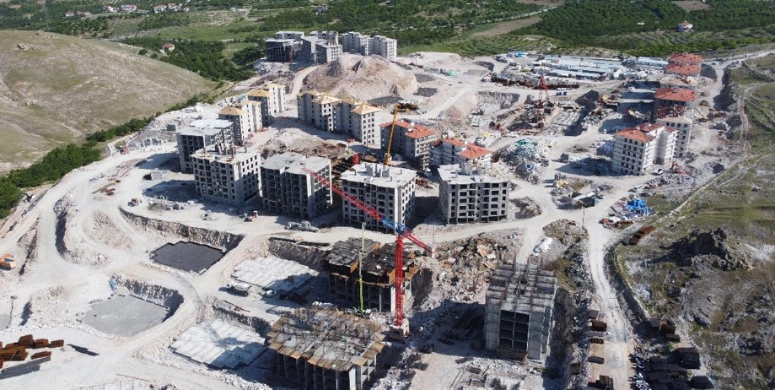
MAJOR CATASTROPHE PHASES
1. Rescue and First-Aid
2. Recovery
Reconstruction

Slide 14
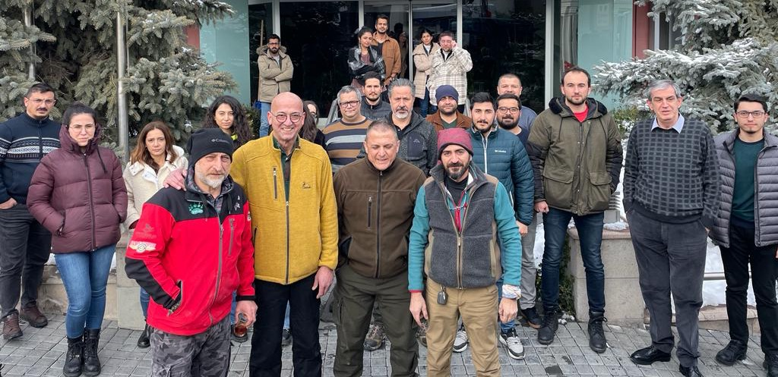
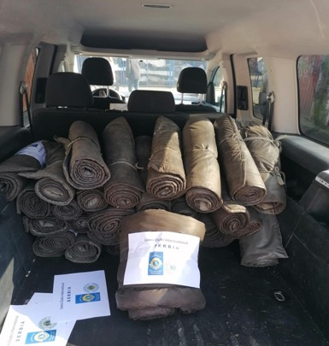
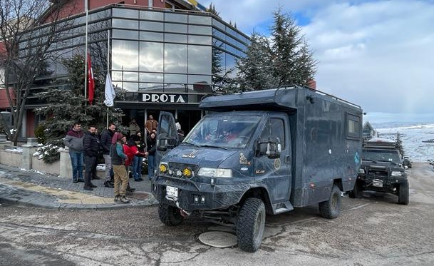
1. RESCUE AND FIRST AID PHASE
February 6th.
Same day of the earthquake;
Lions Off-Road team with 8 person & 4 Off-Road Cars, as the pioneer first-aid team, delivered rescue equipment to Earthquake Region.
MD118 formed an Earthquake Relief Committee to support and coordinate the first-aid needs

Slide 15
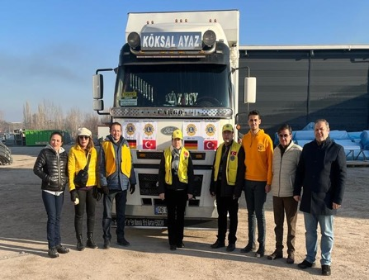
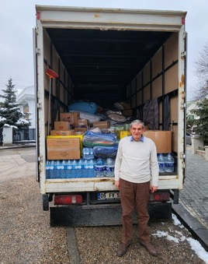
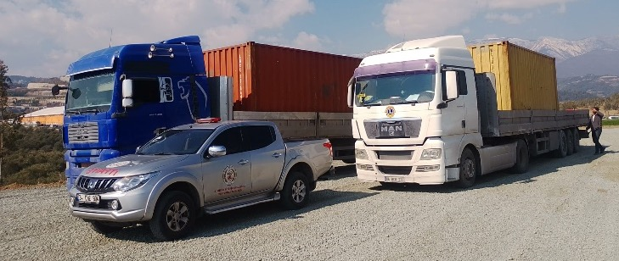
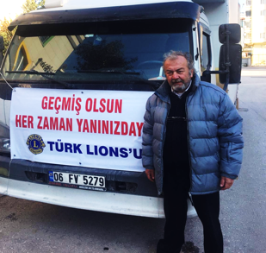
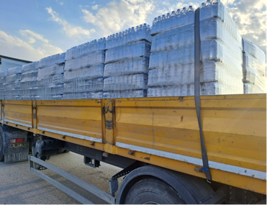
1. RESCUE AND FIRST AID PHASE
February 6th. 2023 LCI/LCIF approved a Major Catastrophe Grant of 200,000$ to be used solely for Earthquake Relief.
Lions International with Turkish Lions Districts provided great support as the first response in meeting first-aid needs.
13 trucks of Lions Districts was on the road 24 hours after the earthquake....
LIONS ON ROADS

Slide 16
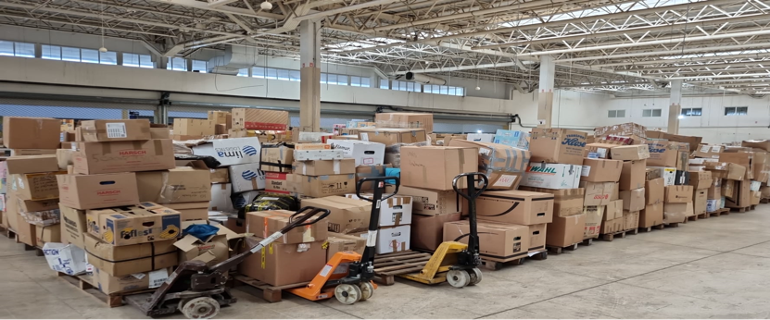
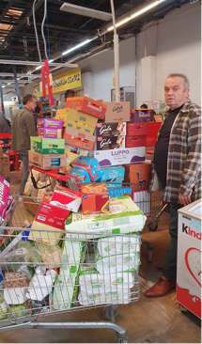
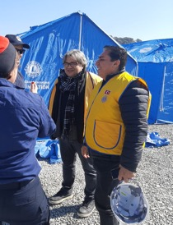
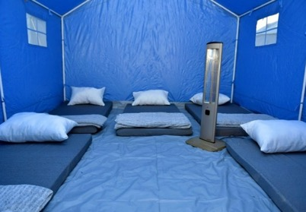
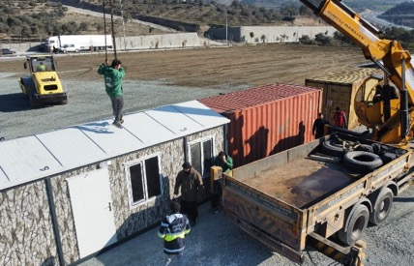


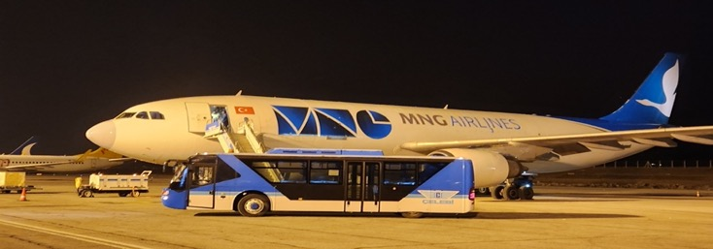
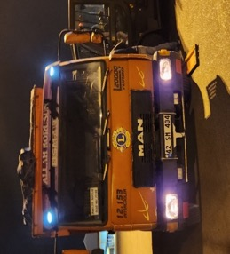
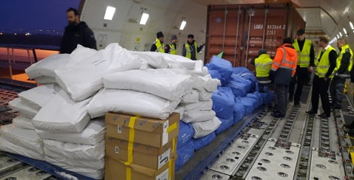
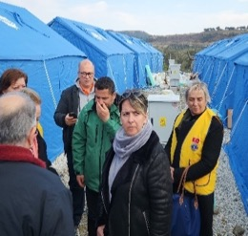
1. RESCUE AND FIRST AID PHASE
February 12th. First Cargo plane sent by Swedish Lions & MSB landed to Ankara Airport with tents, blankets, scarves and first-aid materials
And Feb.17th., a second cargo plane from Sweden came to Ankara with complementary first-aid materials and 25 large scale tents of 48 m².
We sent them to Antakya City to establish Lions Tent Village.
LIONS ON SITE

Slide 17
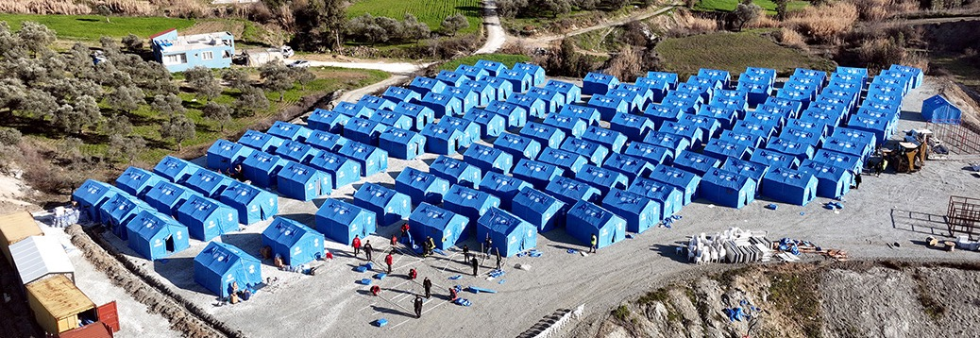
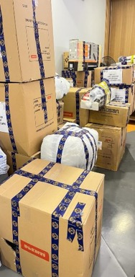
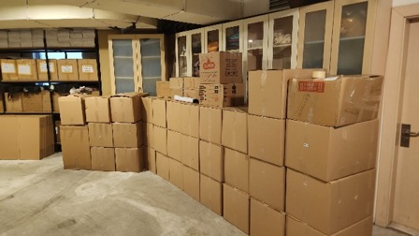
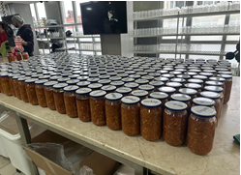
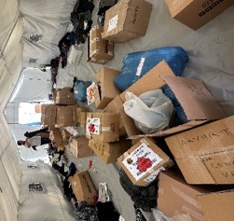
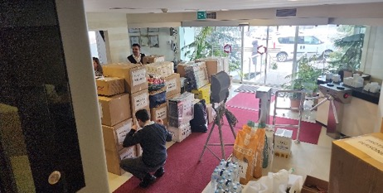
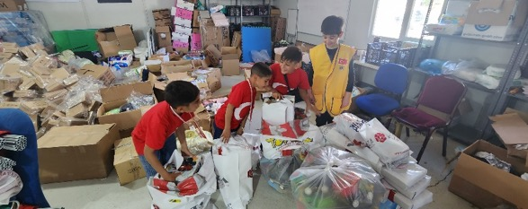
1. RESCUE AND FIRST AID PHASE
The camp formed by 230 medium size and 5 large scale (45m2) social tents, 10 Service Containers, 6 kitchens, storage and wc-shower containers.
Around 1100 earthquake victims were lived in the Lions village.
Hundreds of tons of first-aid supplies have been sent to the earthquake region,
All materials were distributed on the field by the Lions and Leos.

Slide 18
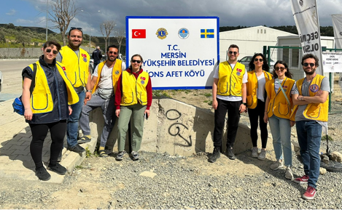
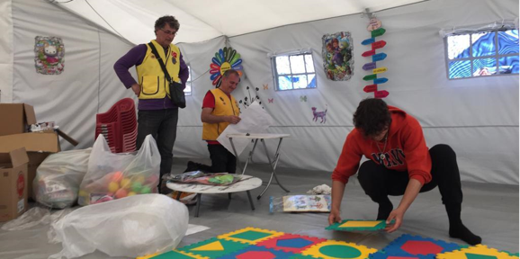
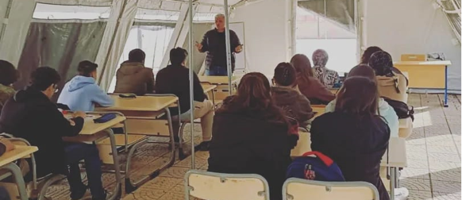
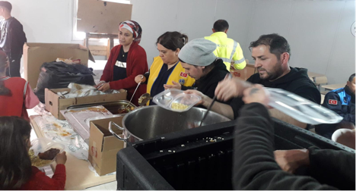
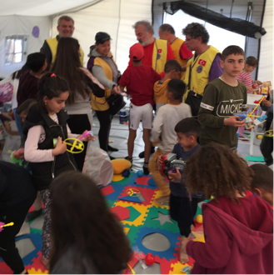
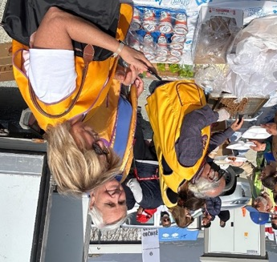
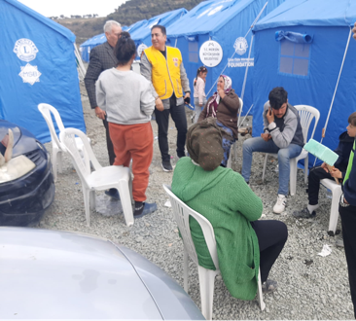

1. RESCUE AND FIRST AID PHASE
Leo and Lions
served in rotation in the Lions Village.
Lions and Leos took care of the victims closely, made up for their deficiencies, organized entertainment for children, built a library and a playground, install a health cabin and a playing rooms.
LEOS&LIONS AT SERVICE

Slide 19
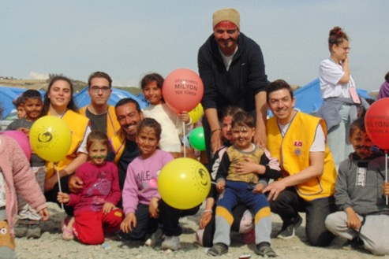
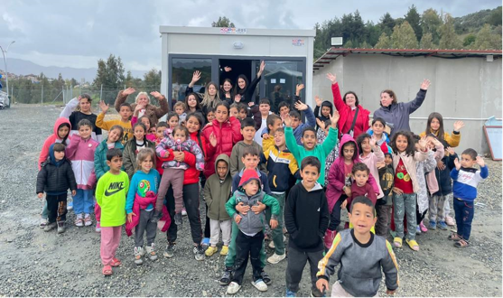
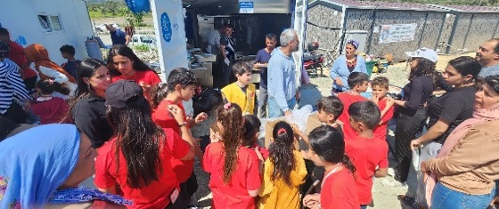
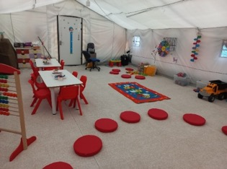
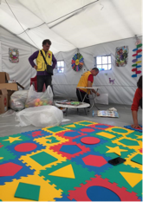



1. RESCUE AND FIRST AID PHASE
First aid was the most important phase especially for the children. Turkish Lions and Leos have given special attention to children.
* Entertainments and birthday parties were organized,
* Toys were provided,
* Nursery, library and playgrounds were organized.
LIONS WITH CHILDREN

Slide 20








1. RESCUE AND FIRST AID PHASE
During this time
Lions Village was visited by IP Brian Sheehan and his wife Lori...,
MD118 CC/DGs and cabinet members frequently visited the village to assess their needs and gave morale being together with the earthquake victims.
Mayor of Mersin, Mayor of Istanbul, CHP Leader Kilicdaroglu

Slide 21


2. COMMUNITY RECOVERY PHASE
A large amount of funding has been developed through LCIF with the participation of the International Lions Community
1. CAT 22288/MD118 of $200,000 for 40 Container Houses.
2. DES 22692/MD118 $360,045 MD103 Designated Donation of MD103 France to increase equipped container houses
3. DES 22782/MD118 $92,500 for Basketball Fields and Playgrounds

Slide 22




2. COMMUNITY RECOVERY PHASE
Container Houses Village
is planned to accommodate approximately 3000 people is allocated by AFAD (Disaster &Emergency Management Presidency) .
167 Lions containers
Sports fields and children's playgrounds
built with LCIF and other countries funds.

Slide 23







2. COMMUNITY RECOVERY PHASE
Some of the containers donated by Turkish Lions and Leos, used for office units, and the rest used for living.
During the establishment of the container city, IP Brian Sheehan and his wife Lori, members of the MD118 Earthquake Relief Committee and local Lions visited the village and supervise the works.

Slide 24




2. COMMUNITY RECOVERY PHASE
IP Brian Sheehan and Lori, in Earthquake Region

Slide 25







2. COMMUNITY RECOVERY PHASE
With 92,500 USD of LCIF, we built basketball fields, indoor and outdoor playgrounds & kindergartens.
Especially indoor children's playgrounds and nursery containers were made by a very special company are donated by Turkish Lions (D.118-K).

Slide 26






2. COMMUNITY RECOVERY PHASE
The streets in the village have been named as France, Italy, Sweden, Germany, Türkiye…
The plaque of that countries, LCIF and the Lions logos were hung on all containers. The mission of Lions in the village has been completed and handed over to AFAD (Disaster &Emergency Management Presidency) for the operation.

Slide 27

CONTAINER INVENTORY LIST
Internal Migration…
More than 2 million people left the earthquake region
For this reason, 50 containers were sent to neighbor city of Mersin.

Slide 28

INTERNAL MIGRATION IN TÜRKİYE
Migration to neighboring provinces that were not damaged after the earthquake. Mersin, Diyarbakır and Antalya are important neighbor cities. Mersin became the most preferred city with providing employment opportunities
According to the official statements, MERSİN city has received more than 250,000 survivors. New migration is created social & economic problems in the city’s social life.

Slide 29
3. DISASTER RECONSTRUCTION PHASE
Permanent Project
LIONS SOCIAL CENTERS
FOR EARTHQUAKE SURVİVORS

Slide 30


3. DISASTER RECONSTRUCTION PHASE
Post-earthquake permanent projects main target;
Building 3 Lions Social Centers in the earthquake region to serve earthquake survivors...
A Project of 3,823,211.- USD
Approved by LCIF as a Designated Grant DES 23248/ MD118
MERSIN
ADANA
GAZIANTEP
ANTAKYA

Slide 31

3. DISASTER RECONSTRUCTION PHASE
Main objectives of the project
1- Rehabilitation of children, who are the most easily and most affected group by disasters, in kindergarten and nursery.
2- Opening courses for women to acquire a profession.
3- Supporting the handmade production of women (Handicrafts, carpets, covers, ornaments, etc.) in workshops of Centers
4- Ensuring the sustainability of the project and placing shops where women can contribute to their families by earning income by selling their production.
Childrens First

Slide 32



PARTNERSHIPS
Partnership Terms between the municipalities and the Local Lions
A 25-year protocol will be signed between the Municipality and the Lions District.
The protocol will be approved by the highest governing body and by the municipal council.
All operating expenses (water, gas, internet, electricity, security, etc) of the building will be paid for 25 years by the local municipality.
The building will also function as the Lions Service Center.
Construction costs will be paid by the LCIF fund.
LCIF logo and contributions plate will be placed at the entrance.

Slide 33


GARDEN AND ROOF PLAN
ROOM NAME | AREA (m²)
ELECTRICAL ROOM | 12.00
WATER TANK | 28.00
HEATING ROOM | 13.00
MAIN STORAGE | 30.00
HALL | 16.00
TOTAL NET AREA | 99.00
TOTAL GROSS AREA
FLOOR | AREA (m²)
ENTRANCE FLOOR | 773.56
UPPER FLOOR | 793.85
TERRACE FLOOR | 131.15
TOTAL GROSS AREA | 1698.56
FARM AND GARDEN

Slide 34

ENTRANCE FLOOR PLAN (Kindergarten)
ROOM NAME | AREA (m²)
NURSERY ROOM 5-6 AGE | 36.00
NURSERY ROOM 5-6 AGE | 36.00
PREPARATION | 18.00
WC-LAV. | 11.00
NURSERY ROOM 4-5 AGE | 36.00
NURSERY ROOM 4-5 AGE | 36.00
PREPARATION | 18.00
WC-LAV. | 11.00
NURSERY ROOM 3-4 AGE | 36.00
PREPARATION | 7.00
WC-LAV. | 5.00
NURSERY ROOM 3-4 AGE | 36.00
PREPARATION | 7.00
WC-LAV. | 5.00
SLEEPING ROOM | 51.00
ENTRANCE HALL | 36.00
KINDERGARTEN HALL | 68.00
NURSES ROOM | 18.00
WINTER GARDEN / PLAY GROUND | 32.00
HEALTH ROOM | 5.60
SOCIOLOGIST ROOM | 11.00
WC-LAV. | 2.20
WC-LAV. | 2.20
STORAGE | 10.00
CAFE | 55.00
WC-LAV. | 3.00
STORE | 35.00
MARKET | 60.00
TOTAL NET AREA | 687.00

Slide 35

UPPER FLOOR (Social Center)
ROOM NAME | AREA (m²)
COURSE / WORKSHOP ROOM | 55.00
COURSE / WORKSHOP ROOM | 37.00
COURSE / WORKSHOP ROOM | 37.00
COURSE / WORKSHOP ROOM | 55.00
TRAINER'S ROOM | 23.00
WAITING HALL | 19.00
WAITING HALL | 19.00
MAIN HALL | 69.00
CHILDREN'S ENTRANCE HALL | 32.00
CHILDREN'S DINING & MULTIPURPOSE HALL | 57.00
MAIN KITCHEN | 23.00
WASHING | 11.00
STORAGE | 14.00
ADULT'S DINING & MULTIPURPOSE HALL | 159.00
ENTRANCE HALL | 17.00
WC-LAV. | 12.00
WC-LAV. | 12.00
STIRAGE | 7.00
LIONS SECRETARY | 12.00
ADMINISTRATION CORR. | 13.00
KINDERGARTEN MANAGER | 14.00
FINANCE & ACCOUNTANT | 12.00
LIONS NGO ROOM | 9.00
TECHNICAL MANAGER | 16.00
TOTAL NET AREA | 734.00

Slide 36



KINDERGARTEN AND NURSERY
Kindergarten and Nursery
6 classes for differnet age groups
Sleeping room for 3-4 age group
Preparatory rooms
Library and social areas
Closed winter play ground
Sociologist and health rooms
120 children capacity
Private dining hall for 50 children
Special management rooms
Garden and open air playground
Vegetable field, poultry and livestock production area

Slide 37



SOCIAL AND TRAINING CENTER
Separate service for adults
Use of transformable rooms
Separate entrances for children and adults
Private management units for Lions Clubs & District
Shared main kitchen for both
Storage and depot
Possibility to do activities on the open terrace
Facilities for Lions and Leos activities
Dining Hall for 120 adult
Multi-purpose hall for 150 people
4 training rooms
Board meeting room
Opportunity to gather in the winter garden

Slide 38


LIONS SOCIAL AND TRAINING CENTER
October 17th.,2023
Lions Social Center was our Dream,
June 9th.,2024 it became true.

Slide 39


DREAM CAME TRUE with LIONS INTERNATIONAL & LCIF
REGION’S MOST MODERN AND SUSTAINABLE, MULTIPURPOSE LIONS SOCIAL CENTER

Slide 40



.... and Finally
REGION’S MOST MODERN AND SUSTAINABLE, KINDERGARDEN

Slide 41

.... and Finally
REGION’S MOST MODERN AND SUSTAINABLE, KINDERGARDEN

Slide 42


.... and Finally
REGION’S MOST MODERN AND SUSTAINABLE, MULTIPULPOSE SOCIAL CENTER

Slide 43


.... and Finally
REGION’S MOST MODERN AND SUSTAINABLE, MULTIPULPOSE SOCIAL CENTER

Slide 44


GREAT OPENİNG CEREMONY
REGION’S MOST MODERN AND SUSTAINABLE, MULTIPURPOSE SOCIAL CENTER
Chairperson Brian Sheehan ‘’ I haven’t seen such a beautiful and successful project anywhere’’

Slide 45



GREAT OPENİNG CEREMONY

Slide 46




GREAT OPENİNG CEREMONY

Slide 47

GREAT OPENİNG CEREMONY

Slide 48


GREAT OPENİNG CEREMONY

Slide 49

LIONS SOCIAL CENTER in National & Local Media

Slide 50


LIONS SOCIAL CENTER in National & Local Media

Slide 51




LIONS SOCIAL CENTER FINANCIAL DETAILS
LIONS SOCIAL CENTER in National & Local Media
Requested budget for 3 Lions Social Centers was 3,916,135.- USD
Approved Grant Amount is 3,823,211.- USD
Total Cost of Mersin / Mezitli Lions Social Center is 1,612.080.- USD (+%13,28 Budget)
Budget for Adana Lions Social Center is 1,250,000.- USD
Budget for Antakya / Defne Lions Social Center is 1,050,000.- USD
Project need additional support from the collected funds of LCIF for earthquake of Türkiye.

Slide 52
Türkiye and Turkish Lions / Leos
Thanks to
Lions International, LCIF and
International Lions Community
MD118 Disaster Relief Committee

