Slide 1
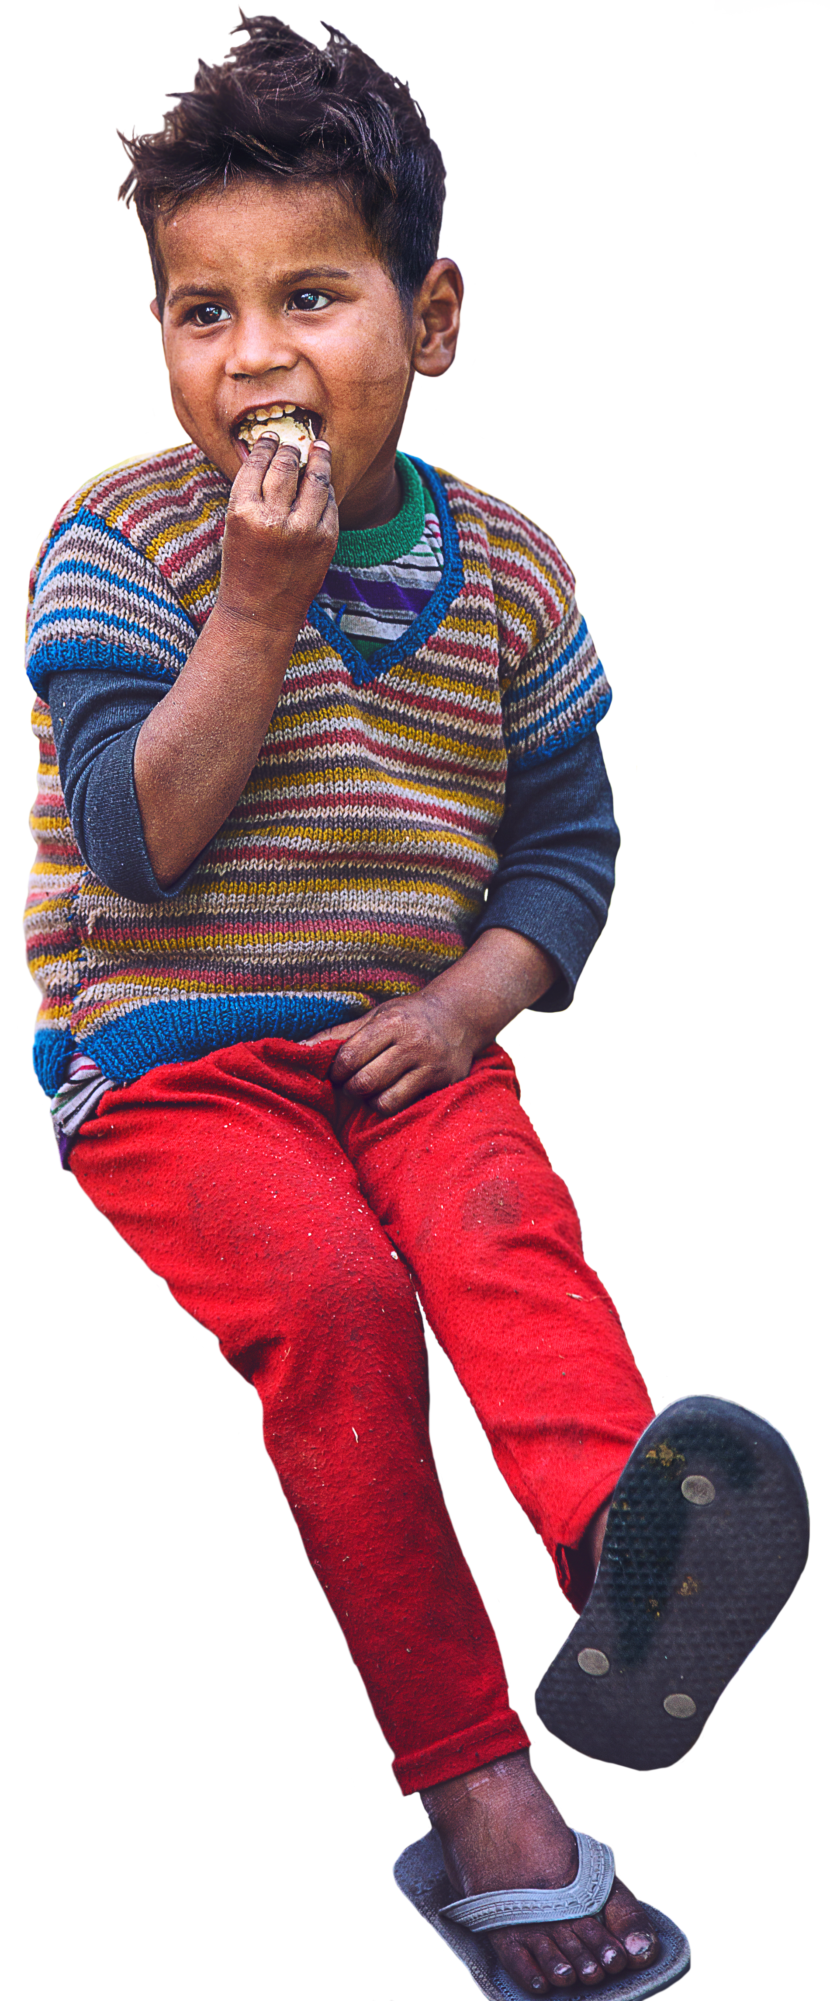
Welcome! Bienvenue !
September 14, 2024
Paul Steele
Development Manager: Europe & Africa
Notes:
Welcome to LCIF’s volunteer training. It is a great pleasure to join you today. As an organization of 1.4 millions people across 200 countries communication is critical to LCIF’s success. Thank you for joining us, and please join me in thanking our incredible team of interpreters supporting us this weekend.
As LCIF volunteers, the foundation relies on you to represent our mission in your regions, and to continue building our engagement with Lions.
I’d like to start by asking all Lions joining us for the first time as volunteers to stand up. Representing the foundation is an opportunity to learn, and to grow, and to do something amazing for the world and our community of Lions in the process. Please join me in welcoming these new members of our team!
For those of you returning to our team from last year, thank you very much for the part you played in CA IV’s success, and thank you for returning. I hope you will share your experience, and the lessons you have learned with these new members. We can learn a lot from your experience.

Slide 2
Video of LCIF Chairperson
Removed (due to large size)
Available on the full Day 1 Power Point
Notes:
VIDEO of greetings from Chairperson Patti Hill

Slide 3
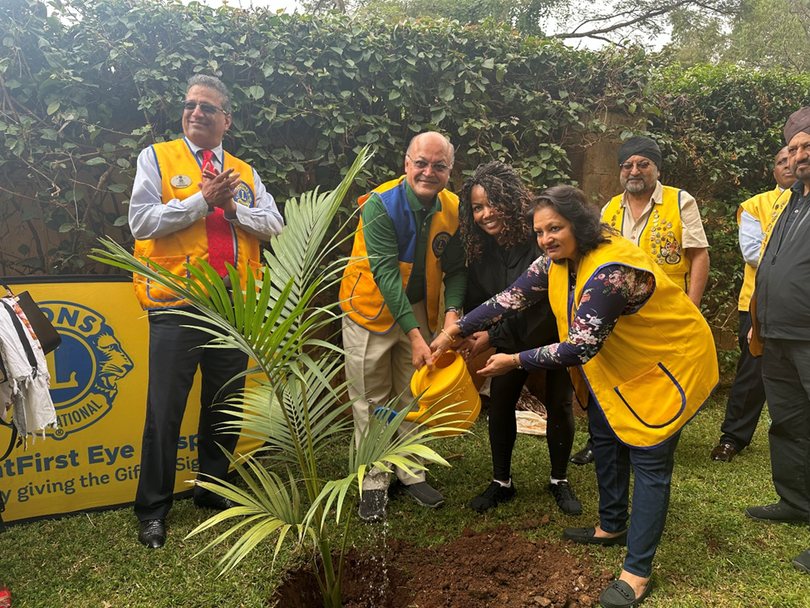
Opening remarks
CA IV Constitutional Area Leaders:
PID Bent Jespersen
PID Robert Rettby
Lion Claudia Balduzzi
ID Marcel Daniels
Trustee Sandro Castellana

Slide 4
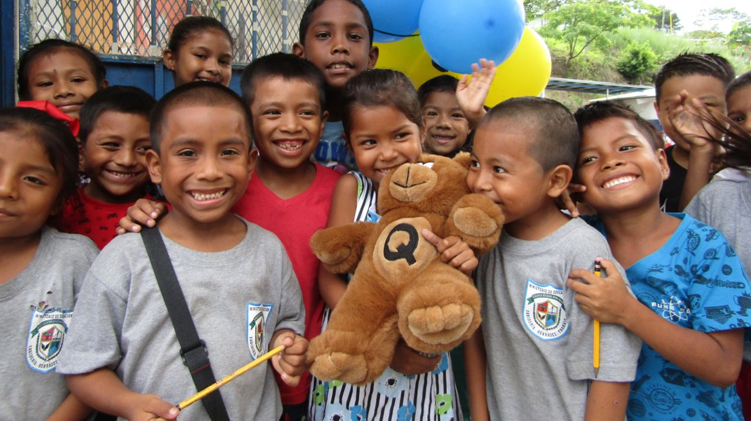
CA IV Fundraising History & Goals
Paul Steele
Development Manager: Europe & Africa
Notes:
Let’s begin by reviewing CA VIII’s journey so far:

Slide 5
Successful notes:
The best cash goal performance in LCIF: 147%
Great start: 40% increase in Q1 & 2 donations.
Strong Q4 finish: 36% of donations
4 Areas above goal:
Area A: 132%
Area B: 199%
Area D: 110%
Area F: 130%
5
Notes:
We’d achieved our cash goal by the end of Q3

Slide 6
Constitutional Area IV
FY 2023-2024 Successes:
CA with the highest percent to original goal.
Achieved stretch goal with less than US$100,000 in new expectancies.
Standouts:
Highest district donations and PMA: 108 IB2 US$197,151 471% US$141.05
Highest percent to goal: 101 O US$188,723 570% US$135.38
PMAs above US$40:
 | Goal | Funds raised | % to goal
Progress to goal | US$6,600,000 | US$9,720,150 | 148%
Progress to stretch goal | US$8,799,997 | US$9,748,376 | 111%
Notes:
Key Takeaways:
The local new cycle and connecting donations to impact is extremely important. We still want Lions to understand better, the impact of project that are not in their news cycle. Those projects can seem invisible, but they are important to the Lions to receive grants. Those projects come from undesignated funds. That is why donating undesignated is so important to supporting our Lion community.
We must engage and steward our new donors.
From new members must come new donors.

Slide 7
CA IV’s 2023-2024 fundraising performance:
Thank you, and congratulations!

Slide 8
GRANT AWARDS BY CONSTITUTIONAL AREA
FY2023-2024 (US$)
Notes:
You can see that for the second year in a row, Europe received the highest total in approved grants of any CA. US$1.67M of this was in refugee programming across 17 grants, including Winter is Coming II. To be clear, even if Winter is coming was removed CA IV would still have the second-highest grant total last year.
This is a good thing. As a community of humanitarians, LCIF exists to approve grants that serve our cause areas, and that qualify for our standards of Efficiency, Impact, and Sustainability. We understand that those grants make the world a better place, and we are proud to serve our community wherever there is a need.

Slide 9
Percent of 2023-2024 total
Constitutional Area | Total Funds Raised | % of Total Funds Raised
I | $12,476,905 | 17%
II | $1,539,784 | 2%
III | $1,721948 | 2%
IV | $9,800,630 | 13%
V | $36,806942 | 49%
VI | $8,010,994 | 11%
VII | $1,476,347 | 2%
VIII | $1,011,497 | 1%
Non-affiliated/ Other | $1,923,814 | 3%
TOTALS | $74,768,861
9
Notes:
On this slide, you’ll see a breakdown of total funds raised by Constitutional Area.
CA I, CA II, CA IV, CA VI, and CA VIII had all reached or exceeded their stretch goals.
Constitutional Area III had its best fundraising year ever, and reach its cash goal.
CA VI also had its best fundraising year, to date.
As usual, CA V led the way, contributing about $35 million to LCIF.

Slide 10
Path to $80 million in 2024-2025
CONSTITUTIONAL ​ AREA​ | 24-25 Cash Goal | 23-24 Total Funds Raised | 24-25 Total Funds Raised Goal
I​ | $7,875,000 | $12,476,905 | $13,000,000
II​ | $869,000 | $1,539,784 | $1,750,000
III​ | $1,630,000​ | $1,721948 | $2,000,000
IV​ | $7,200,000​ | $9,800,630 | $10,000,000
V​ | $29,800,000​ | $36,806942 | $36,000,000
VI​ | $5,900,000​ | $8,010,994 | $8,800,000
VII​ | $1,100,000​ | $1,476,347 | $1,600,000
VIII​ | $720,000​ | $1,011,497 | $1,200,000
NON-AFFILIATED/​ OTHER​ | $4,350,000​ | $1,923,814 | $6,000,000
TOTALS​ | $57,000,000​ | $74,768,861 | $80,000,000
10
Notes:
Our increased grant totals have inspired Chairperson Dr. Patti Hill to announce a stretch goal of US$80 Million. As we’ve said, CA V has expressed that their increase cannot be as large as other CAs. They asked other CAs to take more of a lead. It was originally proposed that
The highest increased stretch goal this year is Canada (101% of their cash goal).

Slide 11
CA IV cash donation history
Fiscal Year | Donation Total
2020-2021 | US$10,458,505
2021-2022 | US$12,084,541
2022-2023 | US$10,586,632
2023-2024 | US$ 9,720,150
10-year avg | 1 standard deviation | 2 standard deviations
US$ 7,280,846 | US$ 10,031,294 | US$12,781,740
Notes:
Based on our fundraising history, we are well positioned to reach our goal.
This slide shows that our 10-year average of cash donation history. We can see that each of the last 4 years we have surpassed our cash goal AND in three of those years we surpassed our stretch goal.
Our 10-year average of cash donations is just above our cash goal. Our stretch goal is one standard deviation away from achieving in cash alone.

Slide 12
*CA IV history: donations sent to LCIF
Fiscal Year | Per Member Average
2020-2021 | US$ 45.21
2021-2022 | US$ 53.27
2022-2023 | US$ 47.44
2023-2024 | US$43.79
10-year average PMA | 1 standard deviation | 2 standard deviations
US$ 31.01 | US$ 44.06 | US$ 57.11

Slide 13
*CA IV history: donations sent to LCIF
2023-2024 Cash Goal | 2023-2024 Stretch Goal | 10-year avg | 1 standard deviation | 2 standard deviations
US$ 7,200,000 | US$ 10,000,000 | US$ 7,280,846 | US$ 10,031,294 | US$12,781,740
CA Goal PMA | CA Goal PMA Stretch Goal | 10-year average PMA | 1 standard deviation | 2 standard deviations
US$ 32.44 | US$ 45.06 | US$ 31.01 | US$ 44.06 | US$ 57.11

Slide 14
OFFICERS | CA I | CA II | CA III | CA IV | CA V | CA VI | CA VII | CA VIII | CURRENT WORLDWIDE AVERAGE
Past International President | 58% | 100% | N/A | 100% | 80% | 100% | 0% | N/A | 79%
International Director | 100% | 100% | 100% | 100% | 100% | 100% | 100% | 100% | 100%
LCIF Trustee | 100% | 100% | 100% | 100% | 100% | 100% | 100% | 100% | 100%
Past International Director | 59% | 58% | 46% | 44% | 73% | 50% | 50% | 71% | 58%
Council Chairperson | 80% | 100% | 56% | 50% | 95% | 67% | 67% | 100% | 74%
District Governor | 81% | 83% | 65% | 47% | 77% | 69% | 69% | 50% | 65%
LCIF Multiple District Coordinator | 96% | 89% | 89% | 82% | 91% | 71% | 71% | 80% | 82%
LCIF District Coordinator | 79% | 77% | 69% | 44% | 65% | 62% | 62% | 94% | 63%
GAT Coordinator | 51% | 59% | 53% | 17% | 62% | 40% | 40% | 31% | 42%
Club President | 11% | 5% | 22% | 2% | 33% | 6% | 6% | 9% | 12%
Club LCIF Coordinator | 26% | 18% | 27% | 6% | 47% | 17% | 17% | 19% | 19%
Leadership Giving
14

