Slide 1
Fundraising Pillars
Name
Paul Steele
…
…
Development Manager: Europe & Africa
Notes:
So we are all fundraisers and this weekend’s workshop, more than our past workshops, will focus on some fundraising theory and practice as well. In the hope of giving you all a sense of perspective on the goals of fundraising and the way people have been found to give.

Slide 2
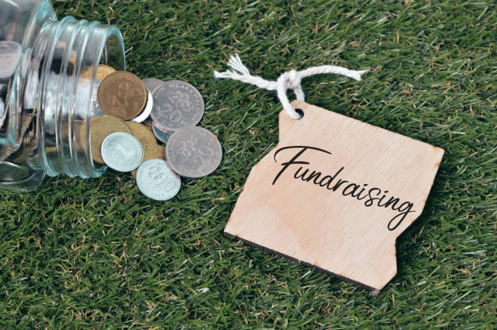
Fundraising Pillars: Why People Choose to Donate
They believe in the mission of the organization
They believe that their donation can make a difference
They want to give back to their community
Personal satisfaction, joy and fulfillment
They were asked
Spontaneous response to a need
Notes:
This first slide includes the most common reasons people donate according to academic research in fundraising. These are the top 6 starting from the most common to the least common.
It is my suspicion that you will recognize some of these reasons from your interactions with donors, as well as from our past and current trainings.
1.believe in the mission of the organization
2.believe that their donation can make a difference
3.want to give back to their community
4.Personal satisfaction, joy and fulfillment
5.They were asked
6.Spontaneous response to a need
The good news here is that non of these reasons are personal, which means if people hate us, that doesn’t mean they cannot be moved by our causes. As we’ve said, the best place for the origin of another person’s donation is from their heart.
These are the ending motivations, but before we talk about those more, we should talk about how we get here.

Slide 3
Pillars of stewardship
Learning
(Head)
Trusting
(Heart)
Engaging
(Hands)
Notes:
These are three pillars of stewardship that people must experience before they donate. The process most people go through before they donate for the reasons in the previous slide.
I’ve added nicknames to them, like head, hearts and hands. I’ve been told that Leadership uses the terms head, heart and guts as well. These terms are used in a different context.
We are going to review this journey in detail, and as we review some questions, I’d like you to answer some of the questions it includes according to yourself:

Slide 4
Learning (the head)
The first stage
What is the organization’s mission?
What needs to they meet?
Do I understand and agree with the organization’s definition of the need or problem?
How does the organization’s mission align with my values?
How is the organization addressing the causes it serves?
Are they truly having an impact?
*The strongest predictor of if a person will donate is whether they have donated to your organization already in the past.
Notes:
The bad news is how many people don’t know this.
The good news is that we have reviewed these questions a lot in our trainings.
This is the initial stage of a relationship with an organization. Once these questions are answered, people may donate. That is really powerful. As a matter of fact, the most accurate predictor of someone’s willingness to donate, is a previous donation. But if you want them to keep coming back, you also need to move to stage two.
Before we move on, consider how you answer the bottom questions for yourself (5-10 minutes)
Now share you discussion with your group (5 minutes)

Slide 5
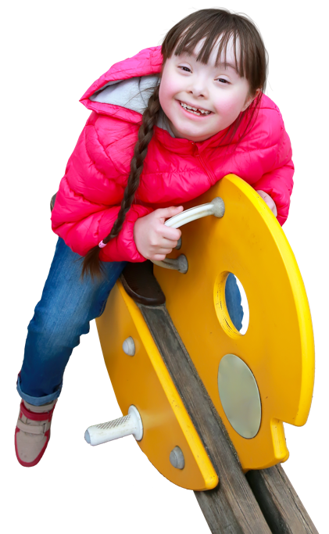
Trusting (the heart)
Do I believe in the organization’s approach and future?
How does the organization’s approach align with my values?
How does the organization compare with others that I can support?
What do I hear about the organization from others?
Do I like and trust the leadership?
How does the organization make me feel?
Am I respected?
Who else is involved with the organization?
Notes:
Building trust is done through the heart. Recognition is often important, here, for people who have donated.
Which of these questions are important to you? (5-10 minutes)
Share your answers with the group

Slide 6
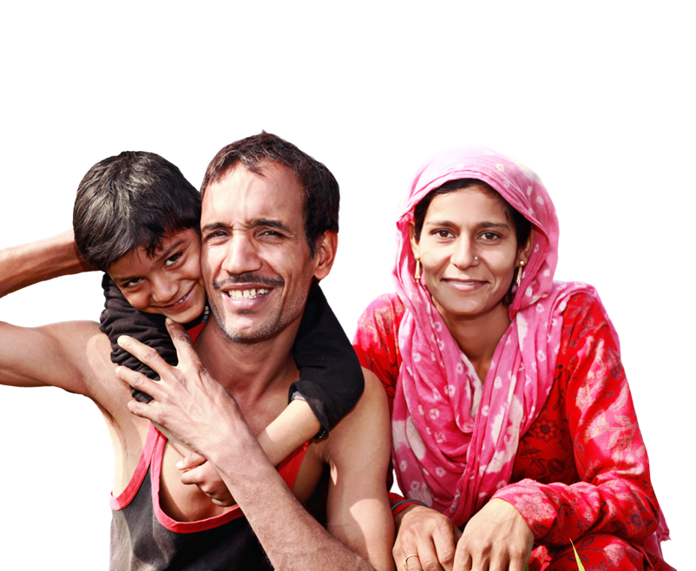
Engaging (the hands)
How do I want to be involved with the organization?
Can my membership be valuable?
Do I feel like a part of the solution to the causes the organization serves?
How can I dedicate myself?
Notes:
Everyone here is engaged, already, so it may be worth asking yourself, when and how these questions were answered for you.
Discuss your answers with the group.

Slide 7
Pillars of stewardship
Learning
(Head)
Trusting
(Heart)
Engaging
(Hands)
Notes:
The purpose of this brief discussion and series of exercise was to explore the path people take toward engagement and donations with organizations, and to experience that for yourself.
As you considered this journey, I hope you thought about what it might take to help guide others on the journey as well.
We will discuss the reasons people donate again but thank you for this time of reflection.

Slide 8
Consolidation
Was it easy for you to answer these questions for yourself?
Were there any ideas that surprised you in this section?
Did these stages make you think of anyone in particular, or any events from your time as an LCIF Volunteer?
Did these pillars inspire any additional questions for yourself?

