Slide 1
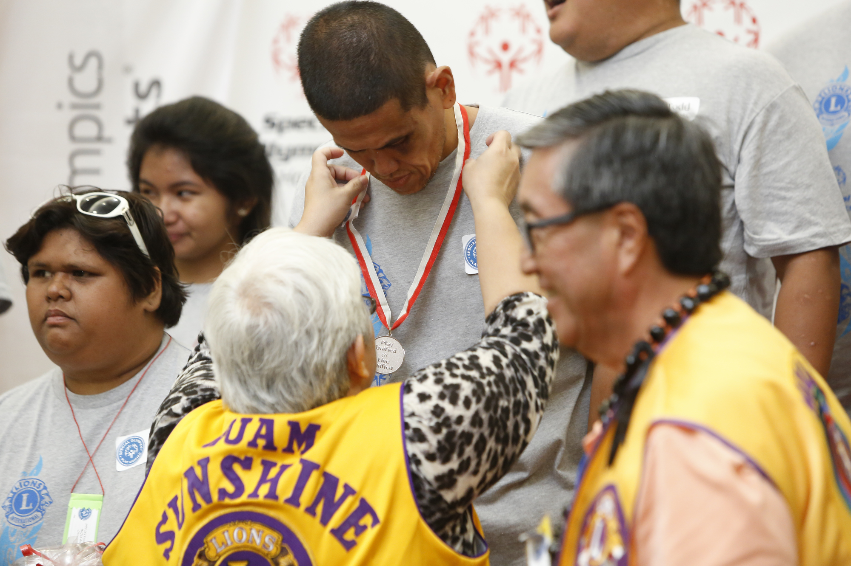
Heroes in our story of service:
PID Robert Rettby
MD102 CA IV LCIF Constitutional Area Leader
Notes:
Lion International is a service organization. the call to make the world a better place is in our mission; it is at the core of expectations.
There can be an expectation that the good resulting from the work that Lions do, or that we support through donations is enough thanks to those that are dedicating themselves through time and donations; but it is important to help our current donors, and our future donors understand the importance of their choice.
LCIF exists so that Lions around the world can support one another in a community of service. We are all aware of the ways LCIF grants have contributed to our own region, and we have said in the past, that the purpose of the MJF was designed to salute philanthropic efforts of our Lions. No matter where you are in the world, when you see someone wearing a Melvin Jones Fellowship pin or a Progressive Melvin Jones Fellowship Pin, you know that you are a part of the same circle of people who live their values and support changing the world by supporting one another’s local service projects. The same is true of the Presidential Supporter pins.

Slide 2
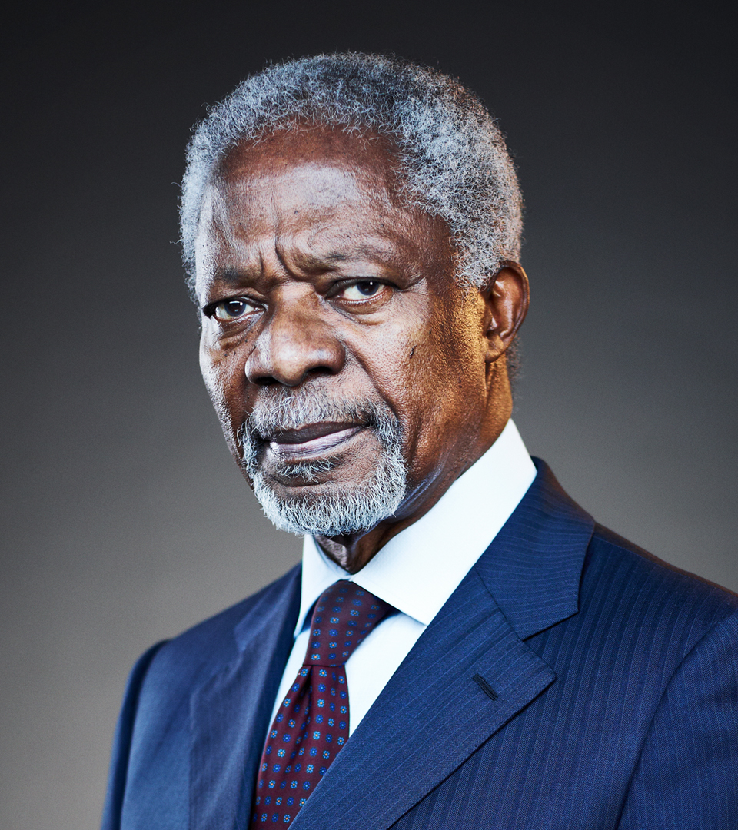
Heroes in our story of service:
To live is to choose. But to choose well, you must
know who you are, and what you stand for, where
you want to go, and why you want to get there.
~Kofi Annan
Notes:
Aside from saying “thank you” to donors for their contributions, LCIF’s recognition serves the purpose of insulating grant recipients from the sense that they may be beholden to specific individual Lions or groups of Lions. This is a question of dignity. By allowing LCIF to provide thanks for donations, and by allowing LCIF to provide objective project evaluation, the dignity of our grant recipients is protected, as can be the integrity of a project that is not beholden to outside influence.
This relates back to something that is important to donor cultivation. As people learn about our work and approach, we want them to develop trust, and to choose LCIF. By cultivating trust through education of LCIF’s grant approach, we ensure that our members understand the value and benefits that our foundation brings to their humanitarian experience. That is how donors experience satisfaction from their careful choice to donate.
There are organizations that rely on an approach to soliciting donations that does not rely on education:

Slide 3
Heroes in our story of service:
Questions to consider:
What do you learn about the problem this organization is trying to solve, and the organization’s expertise?
Who are the “heroes” of this story?
Who speaks in this video?
What is the relationship between the people helping and those receiving help?
What emotions is this video trying to inspire?
Notes:
You are going to see an example of a marketing video from an organization that is using a more common approach to raise donations.
The name of the organization has been removed. We are not hear to disparage other people’s work, but you will find some important differences about who we are as an organization.
As you watch the video I’d like you to consider the questions above:

Slide 4
Video removed
Notes:
VIDEO

Slide 5
Heroes in our story of service:
Questions to consider:
What do you learn about the problem this organization is trying to solve, and the organization’s expertise?
Who are the “heroes” of this story?
Who speaks in this video?
What is the relationship between the people helping and those receiving help?
What emotions is this video trying to inspire?
Notes:
Let’s take some time to reflect on the questions.
Then we are going to watch a second video, and let’s discuss the same questions.

Slide 6
Video removed (due to large size)
Available on the full Day 2 Power Point
Notes:
VIDEO

Slide 7
Heroes in our story of service:
Questions to consider:
What do you learn about the problem this organization is trying to solve, and the organization’s expertise?
Who are the “heroes” of this story?
Who speaks in this video?
What is the relationship between the people helping and those receiving help?
What emotions is this video trying to inspire?
Notes:
Okay, please reflect individually, and then in groups.

Slide 8
Heroes in our story of service:
Compare and contrast:
List some difference you noticed between the two videos.
Which video is more effective as a piece of marketing?
From which video showed you more about is organization?
What does the second video tell you about LCIF?
Which type of video is more common for NGOs trying to encourage donations?

Slide 9
Heroes in our story of service:
How we are different:
Empowerment & dignity in service implemented by local Lions.
Service defines our circle of Lions.
LCIF supports need in every corner of our community.
Our stewardship approach requires education and avoids stigmatizing grant recipients.
Notes:
That discrepancy is the point:
Our greatest strength is the fact that service is implemented by local people: our fellow Lions. In that way, empowerment is prioritized in our grants process. There is dignity in that approach.
That approach to service defines who we are, and it defines our circle of service across Lion communities.
We know this because almost everyone in this room has been involved with a project!
So, our imagery supports empowerment of local people changing the world for the better in their own community.
The story is more complicated that is why we need a team of fundraisers to help tell it: you can’t condense it into a 1-minute video.

Slide 10
Heroes in our story of service:
Two types of heroes:
Implementing Lions are heroes in their own service stories.
Donors are heroes in our community of philanthropy:
They empower service around the world.
They represent our values LCIF’s service in their communities.
They can share their own path to:
Learning
Trusting
Engaging
Notes:
Providing this separation creates space for two types of heroes:
By allowing for this space, we protect the dignity of our Donating Lions by providing a space for them to be thanked, so that they do not feel the need to move into the heroic space that should be occupied by local heroes.
Done correctly, it is easy not to notice the space created for these two types of heroes, but it is important for us all to acknowledge how LCIF operates this way and why.
Building an understanding of LCIF’s approach to service amongst our members and the public also:
Helps them learn more about service and Lionism.
This is why I always say I hope that nobody is recruited into Lions International without knowing the type of organization they are becoming a part of.
Our separation of these roles protects the dignity of our donors as well: by allowing them to have a space where they feel proud of their contributions without over-stepping into communities where they are not members.

Slide 11
Heroes in our story of service:
Consolidation:
How do you discuss issues of localized service and its implications for dignity in LCIF’s grant making process with Lions in your district?
Would discussing this approach help people understand LCIF’s unique value to service and our community?
What are the best ways to tell this story?
Notes:
Here are some final questions to consider.
Note: LCIF’s videos show Lions taking action in their own community. The first video shows a savior coming to a community. Often videos like the first, use a familiar sense of pity to inspire donations. It is very effective, but LCIF’s grants are for local implementation of projects. Projects are managed by people just like us: because we have all been involved with projects ourselves.
We often talk about how we are united around the world by a sense of humanitarian community. LCIF does a lot to ensure that the people receiving grant money are the heroes of their own stories of service.
Donor are heroic as well, but we celebrate them in a different context, through recognition. They send LCIF to steward so that we can direct it toward projects that align with our values, and so that local people can become local heroes.
The approach to marketing you saw in the second video is more difficult. The video was longer and showed more about our cause areas. It was meant to inspire pride rather than pity. It demonstrated how we serve our communities and why.
We have a team of fundraisers because we want you to engage with the clubs and Lions in your district. It is not the most efficient way to inspire donations, but we want to invest in leadership of you as our volunteers, and to make sure that our Lions become truly knowledgeable about the type of service LCIF supports with donations. That message is complex, and getting it right is how we steward donations better- through the donation pillars we reviewed earlier.
This is an important difference in the way LCIF operates vis-à-vis other foundations and charities. It is important that we understand the reason for that difference as we tell people about our work. It is not the easiest path, but it is intentional, and it is intended to protect the dignity of the people receiving funds for their local projects.

