Slide 1
Intrinsic and extrinsic motivation
Lion Claudia Balduzzi
MD108 LCIF Constitutional Area Leader
Notes:
Let’s begin by reviewing CA VIII’s journey so far:
A feeling from outside versus a feeling from within

Slide 2
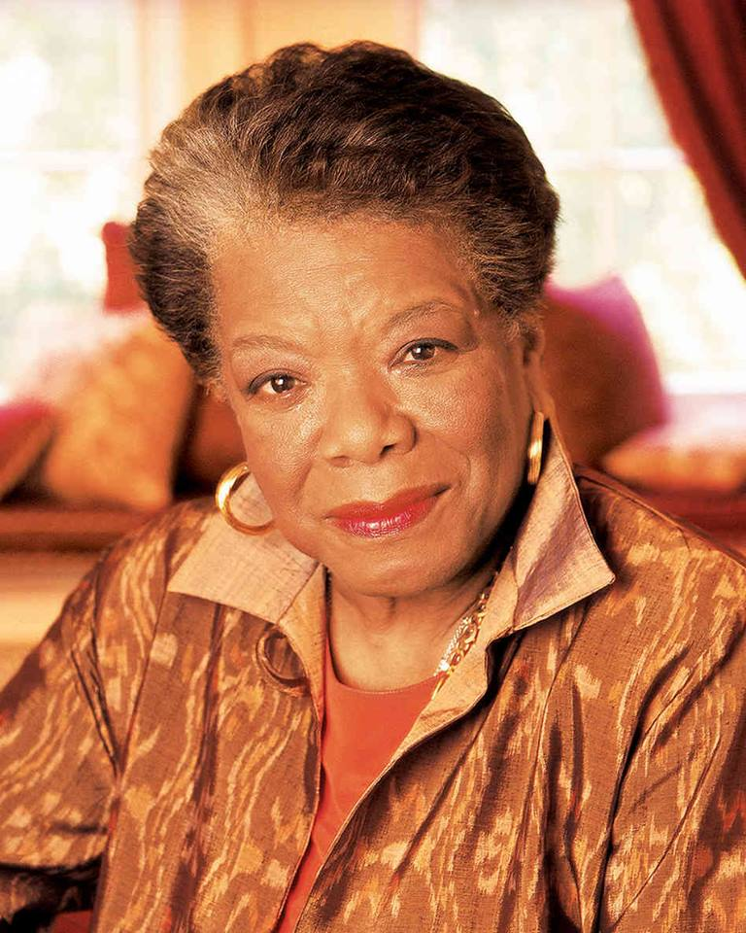
Intrinsic and extrinsic recognition
“People will forget what you said. People will forget what you did. But they will never forget how you make them feel”
~Maya Angelou
Notes:
We have discussed mechanisms by which both implementors and donors can play a role Lions International’s service. We’ve also talked about the education that is needed to help donors understand their roles and become satisfied with them.
Recognition is part of how we do that.
It is important that we talk about formal structures that are in place for thanking donors and discuss additional methods that might be available to us.

Slide 3
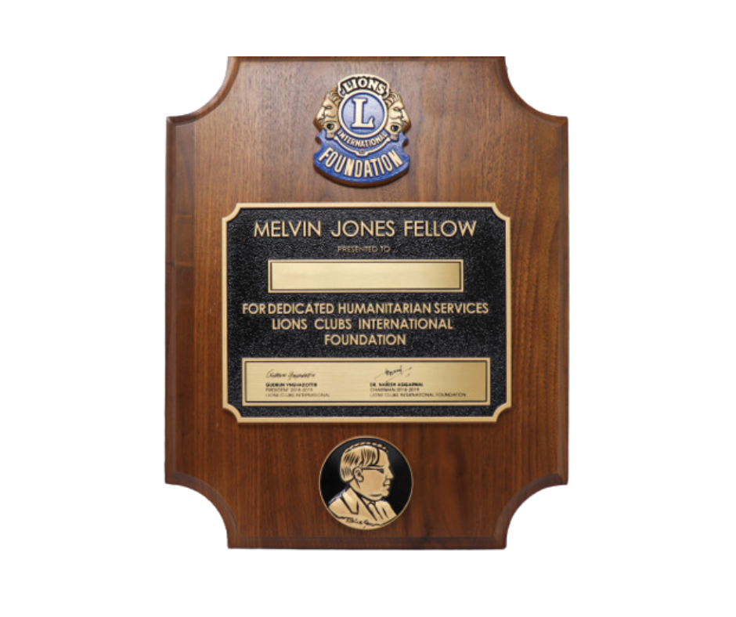
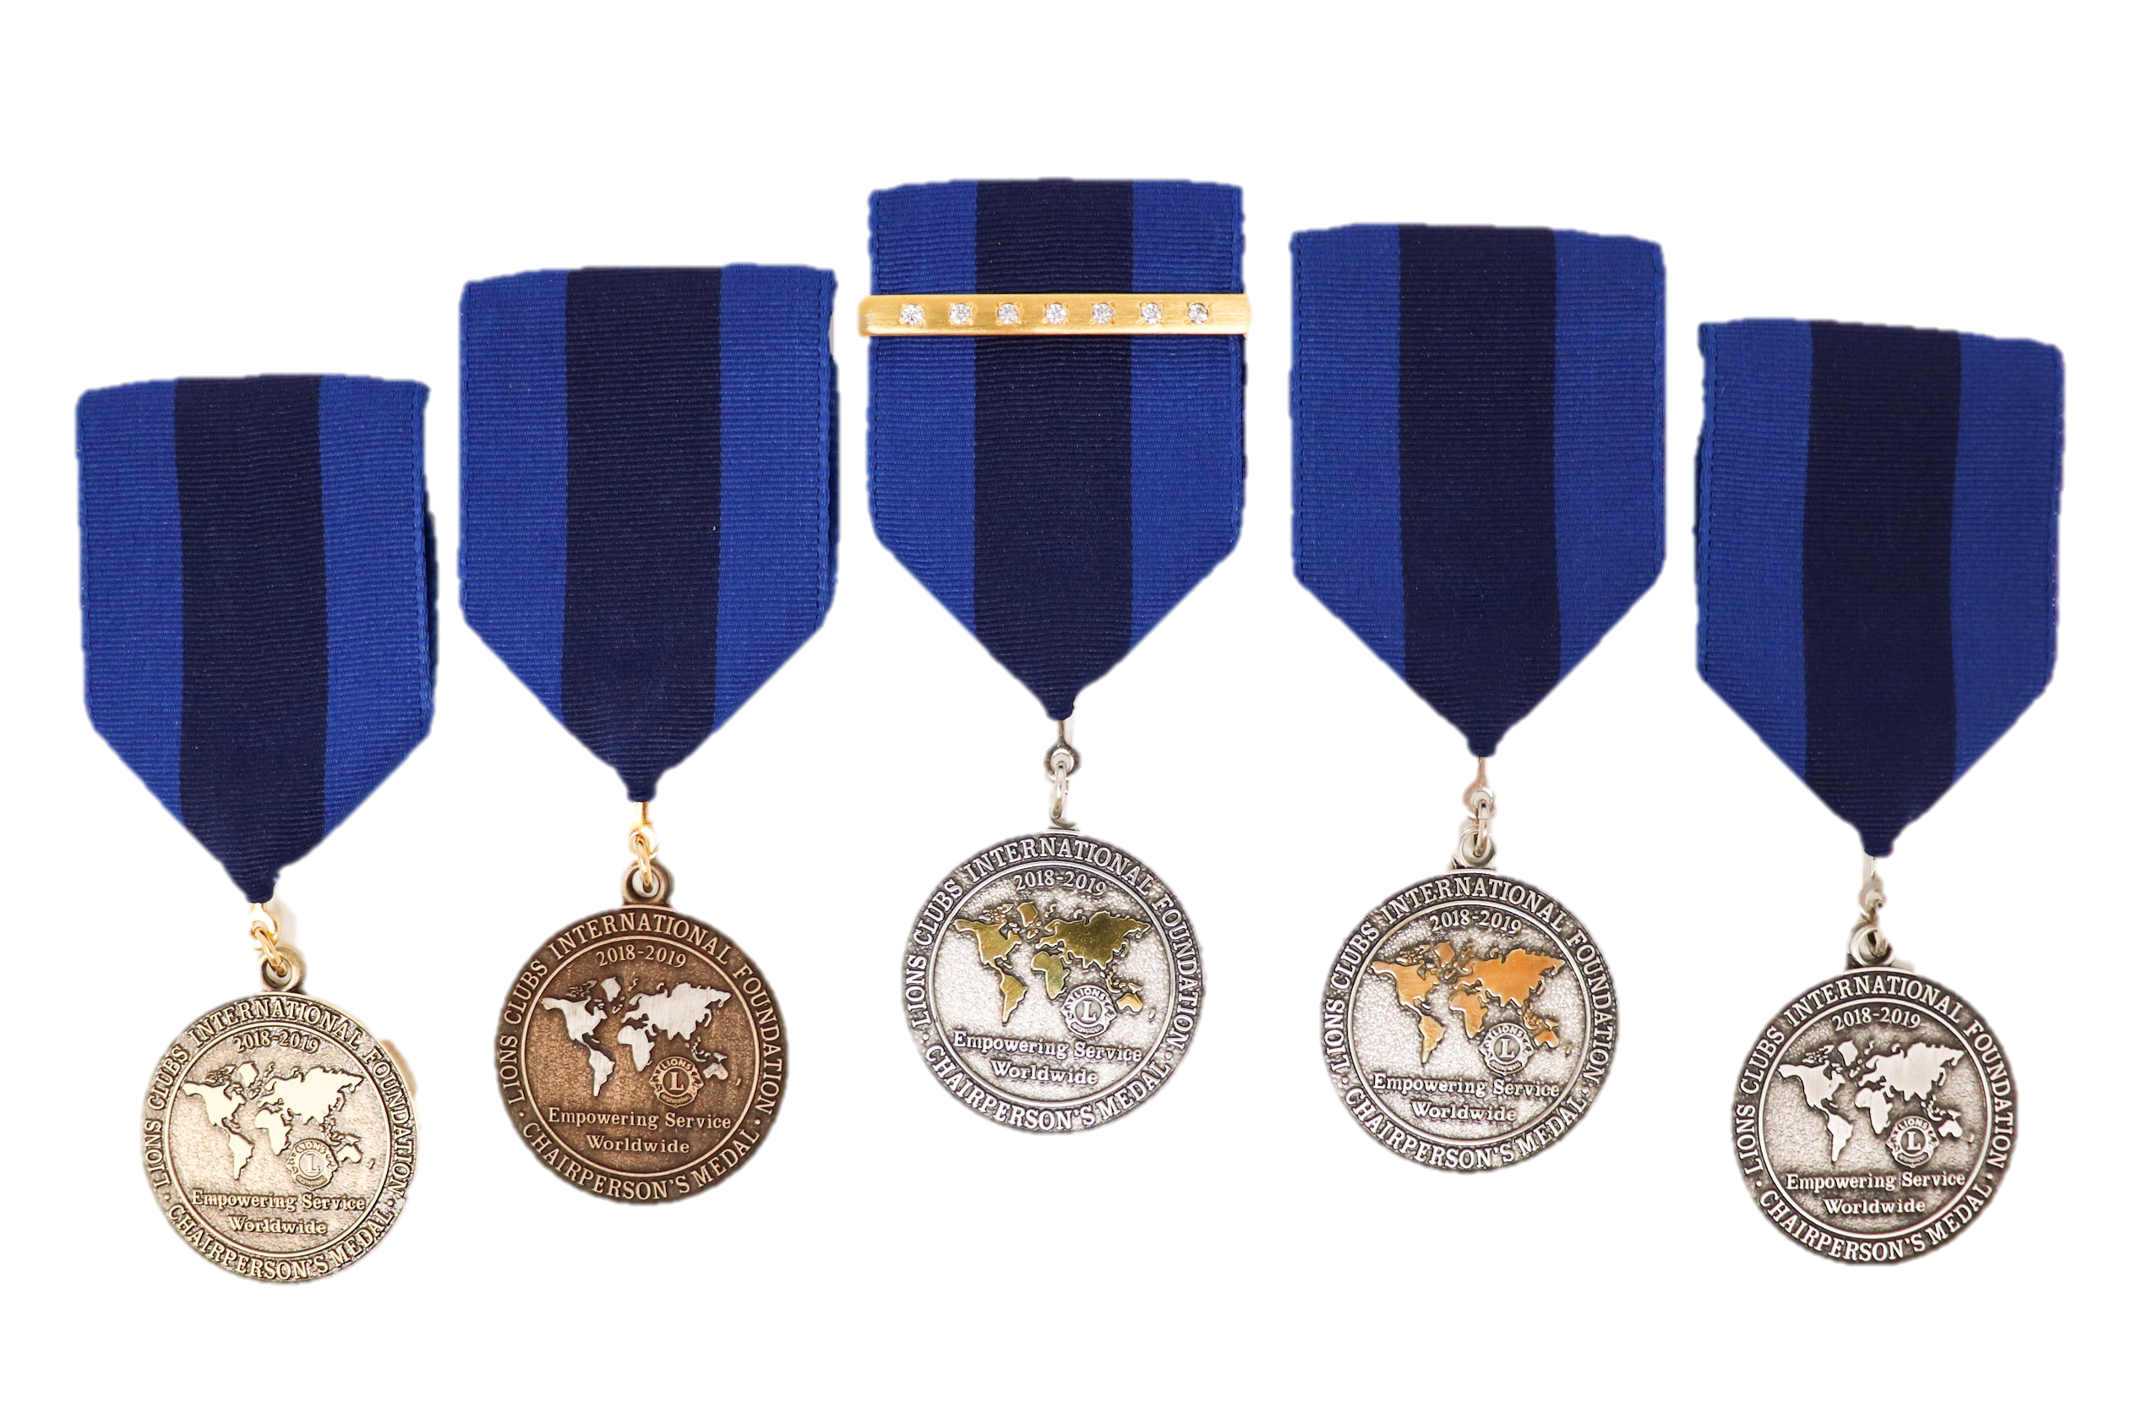
LCIF Presidential Goal Achievement Award
DCG/Impact Grants
LCIF Presidential Goal Achievement Award
Notes:
All is a review of our extrinsic recognition: those pieces of recognition that donors received from external sources.
Let’s review some other ways that people can feel recognized.

Slide 4
Informal extrinsic recognition
Is received from outside sources.
Can be less formal, or come from the district or MD:
Special seating or events at conventions or forums.
Presenting recognition formally.
Meetings with, or communications from executive officers.
Lists of donors sent monthly in WhatsApp groups.
Notes:
There are ways that recognition can become extrinsic, but less formal as well. Districts and Multiple District may implement some of these to assist in fundraising and stewardship opportunities.

Slide 5
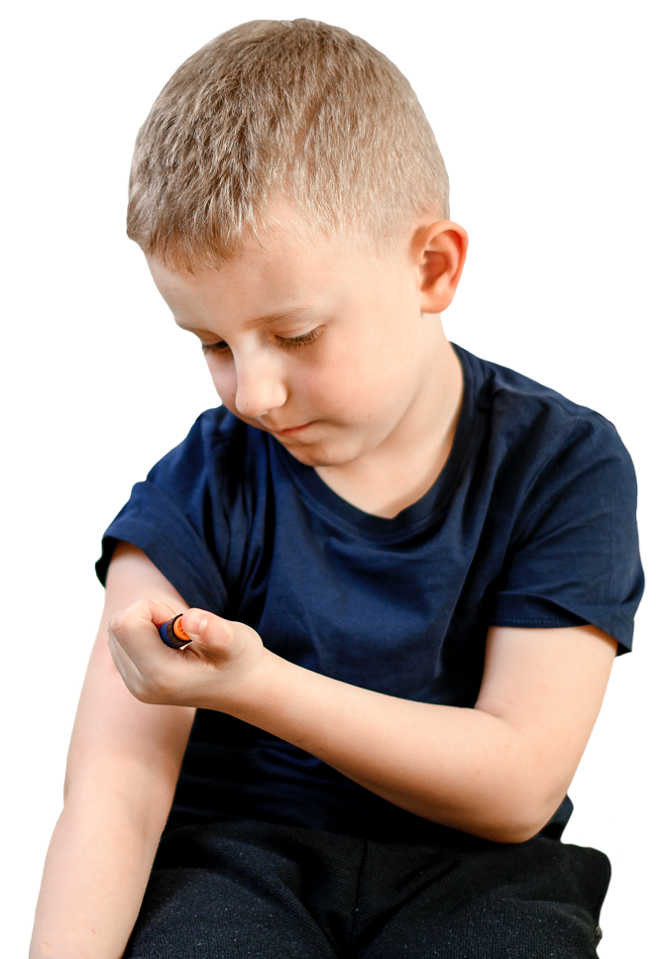
Intrinsic recognitions
Donating has been found to:
Increase energy.
Activate brain response.
Reduce
responses to pain
blood pressure,
blood glucose,
inflammatory markers
*Achieving excellence in Fundraising, 5th Edition, 2022
Notes:
In fundraising we also have a concept of “Intrinsic Recognition” that includes rewarding feelings that donors get for themselves because of their choice to donate, and to support a cause. Lions International is full of a lot of Lions who really enjoy receiving their MJFs and PMJFs, but if we are not working at the same time to remind our donors of the roles they plan in our circle of humanitarianism, and the principles that their donations represent, they miss out on some of the most rewarding parts of philanthropy.
In supporting LCIF, our community of philanthropy and our heroes in Lions Service, it is important that we ensure that donors know in their hearts that their donations are impactful.
To do that, it is important that we remind them. Especially if donations are made:
For recognition
To support specific projects
As part of a perceived obligation to a club, district or multiple district
Look at the great things donating does for your health!

Slide 6
Intrinsic recognitions
Levels of happiness:
Material
Ego gratification
Generativity
Transcendence
*Robert Spitzer:
https://www.magiscenter.com/4-levels-of-happiness
Notes:
And if you don’t believe a study conducted by professional fundraisers, we can refer to philosophical levels of happiness as identified by Dr. Robert Spitzer:
This list has been developed through a study of at least 12 different moral ecologies, including:
Greek,
Hebraic
Christian
Enlightenment
Here are the levels: the first two are a more extrinsic, the second two are intrinsic
Material- cars, cloths – maybe pins
Ego gratification- winning victories; achieving statue; attaining control– getting elected, representing Lions, winning a grant, bigger pins
Generativity- the pleasure one receives from giving back to one’s own community. - to experience this level and the next, donors have to understand the nature of philanthropy through LCIF, and their role.
Transcendence- connection to a universal truth, unconditional love, having a sense of purpose and place in the world, justice and beauty.
These are moments when we have discovered a connection to these things in our own life, and we want to be faithful to it in our daily life.
To experience this, donors must understand what they are a part of.
If we think about this for ourselves, we may find that it is typical for people to climb this ladder: to start off focused on the material and move to the ego and on to generativity and transcendence. To help people climb this ladder, we need to begin by meeting them where their interest is, and build more education and trust. That is why we need a team of volunteers and 5-minute videos!
It can be so important when people donate:
For recognition
To support specific projects
As part of a perceived obligation to a club, district or multiple district
But, if we don’t consider how to connect people with the higher levels of happiness that are associated with giving, we are not helping them grow in philanthropy, and we are robbing them of the inner benefits, AND HEALTH benefits that we’ve discussed.

Slide 7
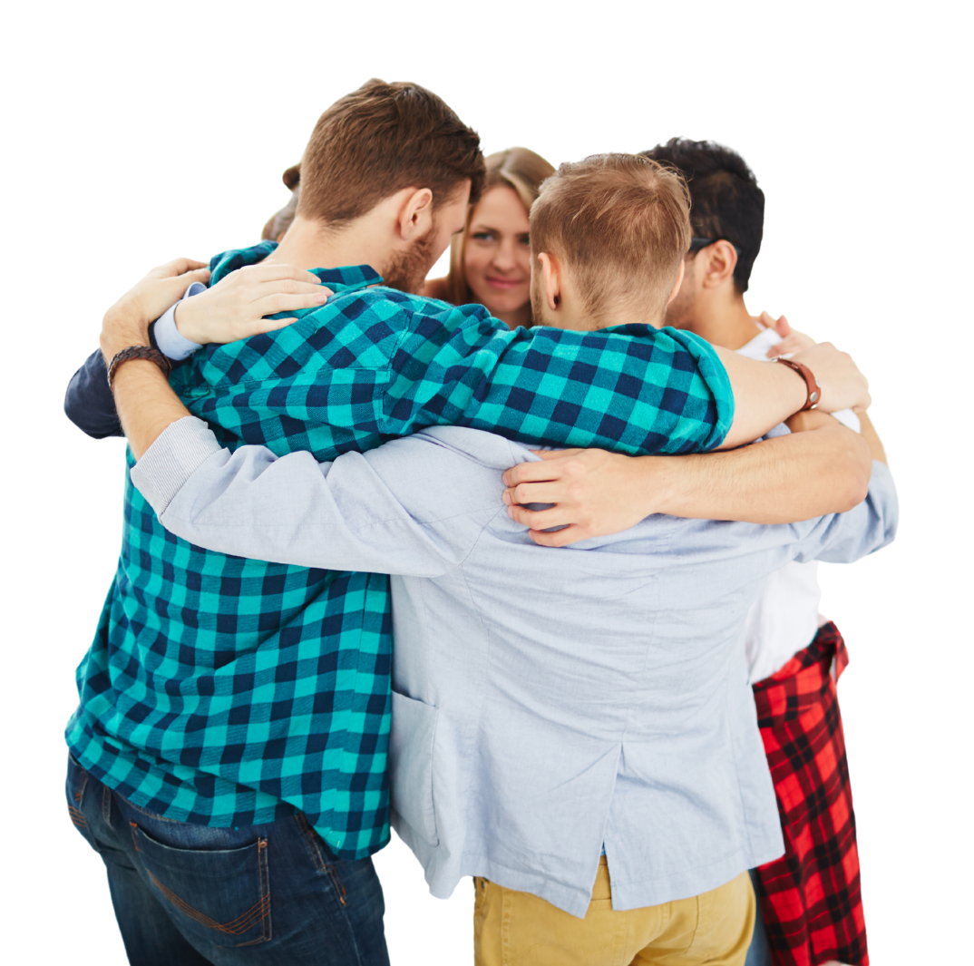
Intrinsic recognitions
How can we support intrinsic recognition in the hearts of our members?
A phone call, email, or card of thanks.
Sending articles, you encounter that highlight a cause someone may care about, or a project and its impact.
Notes:
Not everyone makes the journey into intrinsic recognition. Conditions outside their Lions meetings sometimes need to be right too, but if we promote the opportunity for the journey, we can make it more likely that people find it when they are ready, and we make it more likely that they will have these experiences.
These are a couple of ways we can help to facilitate that feeling for people in themselves. There are other opportunities, too, but it is often a human connection that brings about this consciousness.
And it is easy to forget to do this. We all have a lot of priorities, and it can feel ironic that scheduling time to:
Call people to personally thank them.
To send them an article about causes they are interested in.
Can be so important to helping people find more joy and power in what they do when they give to support our community.

Slide 8
Recognition dream board
What types of new recognition would support donating in your districts, multiple districts or areas?
Who needs to be recognized?
What approach to philanthropy do you want to recognize?
Feel free to fanasize about new intrinsic and extrinsic approaches that might work for your Lions.

