Slide 1

LCIF Grant Approval Process
LCIF Coordinators Training 2024, Berlin

Slide 2

Global Grants Team
2
Notes:
Supporting our Lions in implementing grant projects, is the work of LCIF’s Global Grants Division. This team is based in the Lions International Headquarters in Oak Brook, USA.

Slide 3


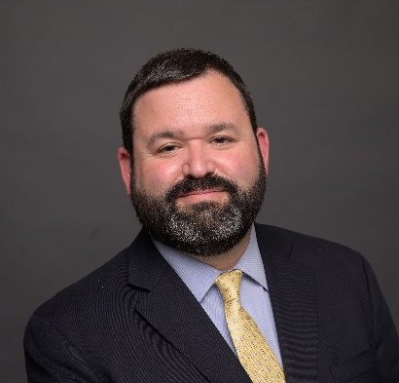
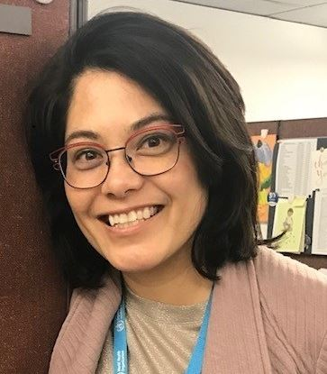
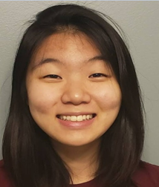
Global Grants Team CAIV
KaSondra Byrd
Division Manager
Ben Futransky
Department Manager
Julie Boonprasarn
Specialist
Elaine Sine
Specialist

Slide 4
Primary Responsibilities
RECEIVE APPLICATIONS
Review project
Guide Lions
Determine eligibility
PROJECT MONITORING
Disburse funds
Review reports
Monitor progress
COMMUNICATE OUTCOMES
Testimonials
Success Stories
Share with Lions/donors
Notes:
The Global Grants Team is responsible for reviewing grant applications, presenting them for consideration to the Board of Trustees and other leadership for approval, and guiding Lions in implementing approved grant projects. We also monitor the progress and success of each project and communicate outcomes with other Lions and our partners.

Slide 5


LCIF Grant Process
5
5
Notes:
Headline + Text Option 6

Slide 6
Grant Lifecycle
How an Application is Approved
Most grants follow a similar approval process.
Grant application submitted to Global Grants Department
Application is summarized and presented to Board of Trustees for their final approval
Staff and Technical Advisors review application
Staff asks Lions for additional information
6
Notes:
The very first step of any project is to you identify and understand the specific needs or problems of the community you want to serve using the grant. This is called a Needs Assessment. For example, you notice that the local public school does not have enough female toilets for girls. How many female students are there? How many toilets are currently available? How many additional toilets do you need? Think about urgent and impactful needs.
Remember that all LCIF-funded projects must address an unmet humanitarian need. LCIF exists to support Lions doing charitable services for people who need help the most.
Once you’ve selected your project and you’ve got at least two Lions clubs within your district on board, pull up that application and start completing it, at least in draft form. Familiarize yourself with the criteria and ask for any clarifications, if needed.
Once you submit your application, regardless of grant type, it goes to staff for review. We’re checking to make sure all the application questions are answered, the budget is complete, your meeting minutes are included, the project is eligible, etc. You and I may go back and forth a bit trying to clarify details and fill in any blanks. Then, staff submits your application for approval.

Slide 7









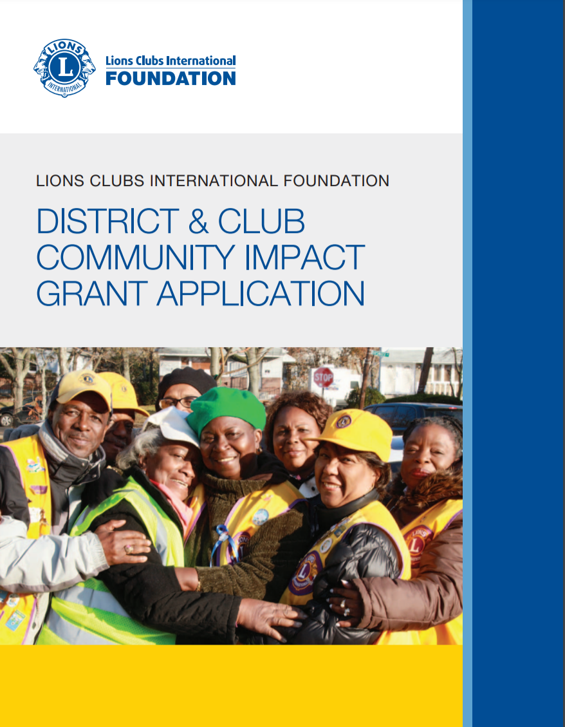
GRANT APPROVALS
Approved at Board Meeting
LCIF Chairperson Approval
Notes:
KaSondra has already provided an overview of all of LCIF’s grant programs. However, the application timelines are different based on grant program. Not all of our grant programs are approved during the three annual Board of Trustees meetings.
It’s helpful to know the different review processes for the various grant programs. Each grant application will indicate how the grant is approved, but here is a visual overview.

Slide 8

APPROVED AT BOARD MEETINGS
Completed narrative
Budget
Cabinet/Council approval via meeting minutes
District Governor/Council Chairperson Endorsement
Proof of local match
Pro-forma invoices or quotes
Items Required for Submission
Childhood Cancer
Diabetes
Hunger
Grant Deadlines
October 1 || February 1 || May 1
Matching
Lions Quest
Vision
Notes:
Grants requiring approval during the Board of Trustees meetings are Childhood Cancer, Diabetes, Hunger, Lions Quest, Matching, and SightFirst. These grants are awarded to the District or Multiple District. Single club projects are not eligible.
All applications are unique and requires specific information. However, each of the grants require the following items for submission.
These grants require a completed narrative
A thorough Budget indicating total project costs and the amount being contributed by each Lions Club and partners. Please break this down for us as it confirms that there are no single club projects.
Cabinet/Council approval via meeting minutes.
District Governor/Council Chairperson Endorsement
Proof of local match – this can be confirmed via bank statements. AT LEAST HALF OF THE LIONS PORTION OF THE LOCAL MATCH, MUST BE COLLECTED PRIOR TO BOARD REVIEW. That is a key element to keep in mind.
Pro-forma invoices or quotes – every budget item must have a matching quote.
Must be submitted by specific grant deadline.

Slide 9
APPROVED BY LCIF CHAIRPERSON
Submission
Overview
Accepted on a rolling basis
Quicker review process
District Governor or Club President endorsement (depending on grant program)
Different requirements based on program
Emergency
Disaster Preparedness
DCG
Leo Service
Notes:
Now on to grants approved by the LCIF Chairperson. These grants are accepted and reviewed year-round on a rolling basis.
All our Disaster grants, Emergency and Disaster Preparedness, are approved internally. Of the Disaster Grants, Emergency grants require immediate action and are typically approved within a day or two if all information is included. This is our shortest application, requiring a brief narrative, budget, and DG endorsement. Community Recovery and Disaster Preparedness are reviewed and approved quickly as well, but not as quickly as Emergency Grants.
District and Club Community Impact Grants also called DCGs and Leo Service Grants are both reviewing on a rolling basis. Both require a narrative, meeting minutes, DG or club president endorsement, pro-forma invoices, and budget. Please review the requirements carefully.
Typically, applicants are notified within a few weeks of submission. HOWEVER this is fully depended upon when the application is submitted. If you submit right before a Board meeting, it will take longer for us to review. Please just keep this in mind.

Slide 10
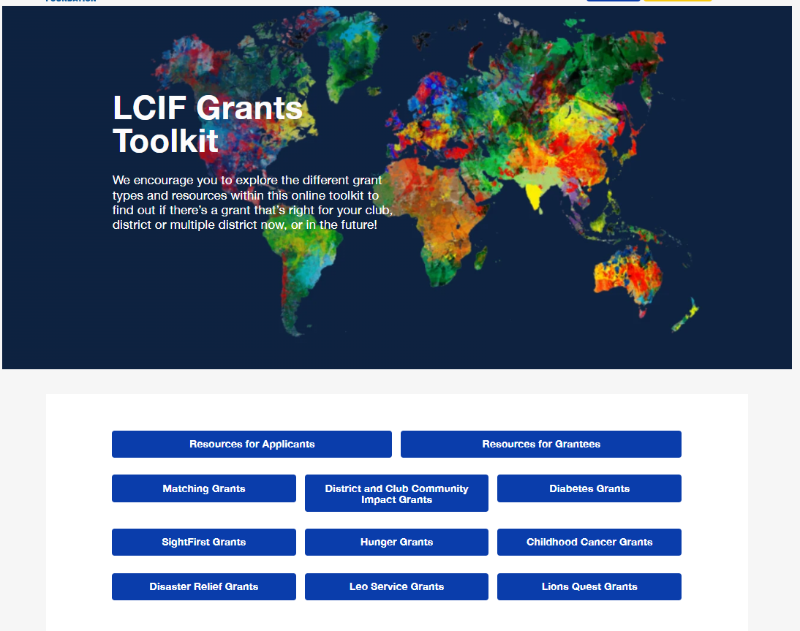
RESOURCES
Lionsclubs.org/grantstoolkit
10
Notes:
All information related to LCIF grants can be found on the LCIF grants toolkit web page. This is an image of what the toolkit page looks like. If needed, you can change the language at the top righthand side of page and that will provide applications in the selected language.
Because we offer so many grant programs, that means there is a lot of content available on the web page. I recommend taking some time to scroll through if you have never visited the web page before. At the end of the presentation we’ll show a QR code with a link to the Grants Toolkit.
This image shows all of our different grant programs. If you click on the blue box it will jump down the page to information about the selected grant. There, you can click to find the application, criteria, reporting form, and in some cases additional information.
Please note that LCIF does not have a fillable grant form for any of our grant programs. You must download the PDF and then copy the grant application questions into a Word Document. Use the same method for the reporting forms as well.
We’re often asked how long a grant application should be. There isn’t a specific length we’re looking for. Please answer ALL questions with as much detail as you think is needed to appropriately answer the question. Consider having someone unfamiliar with the project read through an application prior to submission. Keep in mind that your grant reviewer likely will not have any context for your project so having a second or third reader can help eliminate application shortcomings.

Slide 11
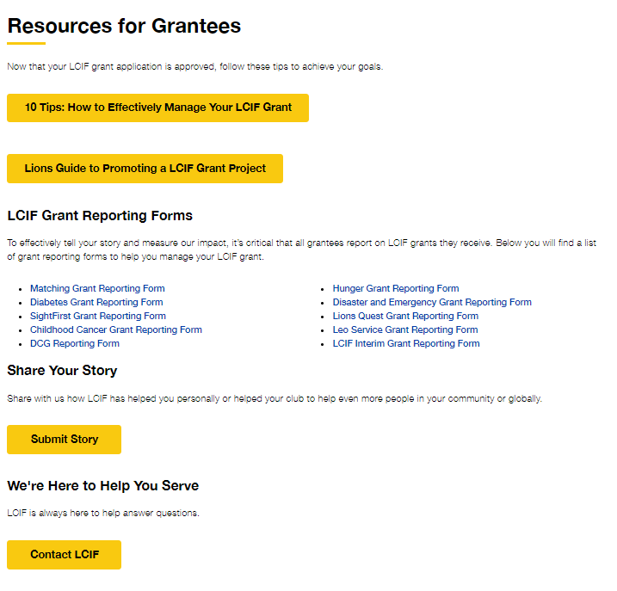
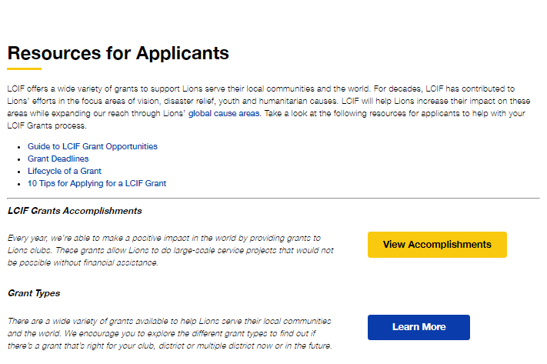
LCIF GRANTS TOOLKIT
11
Notes:
In addition to all applications and reporting forms. The LCIF Grants Toolkit also contains resources regarding how to apply for or manage a grant.
The lifecycle of a grant and 10 tips for applying for a grant may be a good place to get started.
All reporting forms can be located on the Grants Toolkit.
Once your project is completed, you can submit stories about the grant project here as well.

Slide 12

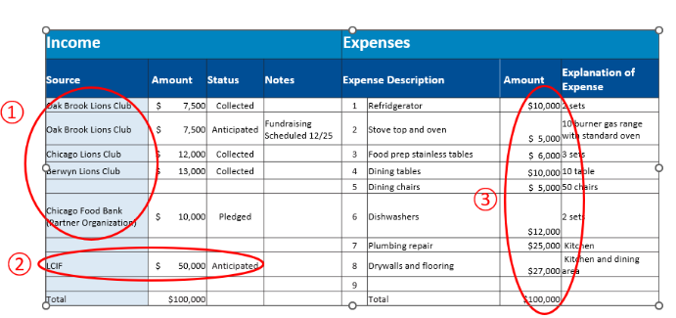
BEST PRACTICES GUIDE
12
Notes:
A new resource that is available on the Grants toolkit is the Best Practices Guide for local Lions. It helps will project development, application submission, post-approval, project implementation, promotion and final report submission. It includes helpful resources including sample budgets for Lions.

Slide 13
TIPS TO REMEMBER
Do not start project prior to approval.
Submit your application by the required deadline.
Single club projects are not eligible, with the exception of the DCG grant. All other grants require a minimum of two clubs.
Know local matching fund requirements!
Do not make any changes to the approved project without approval from LCIF.
Don’t forget your reports! Be sure to keep all receipts for reporting purposes.
Include others on your communications.
Notes:
Now that we have reviewed a large number of inspiring grant projects from all over the world, let’s talk about some tips to remember as you plan and implement your next project.
Do not start your project prior to approval. If you begin your project, it will no longer be eligible for LCIF grant funding.
Remember to submit your application by the required deadline, which is typically 90 days before the project start date or 90 days before the Board of Trustees meetings. Staff need time to translate and review each application, including DCG applications. If there is not adequate time to review the proposal, it may not be considered for approval prior to the project start date and therefore become ineligible.
With the exception of DCGs, single club projects are not eligible. Grants are intended to support projects too big for one club to undertake alone, so be sure that your application includes at least two clubs.
Don’t forget to include a narrative description explaining each of the budget expenses. This helps ensure a smoother and quicker review of the application.
Once a grant is approved, do not make any changes to your project without approval from LCIF. If grant funds are used for an ineligible expense or items that were not in original approved project, it is possible LCIF would ask to return the funds.
Don’t forget to submit a report. Final reports are required for each and every grant program. Keep all of your receipts for reporting purposes.
Take high-quality photos of your project so that we can share the story with others! This is so so so important to inspire projects around the world and share the good work that Lions of Japan are doing every day.

Slide 14

LCIF approved our grant application!
What happens next?
14
Notes:
Congratulations on your LCIF grant approval! This is an exciting opportunity to make a positive impact in your community. As the grantee, you have several key responsibilities to ensure the successful implementation of your project. Let's dive into the next steps and requirements to get your grant funded and your project underway.

Slide 15
Grant Lifecycle
After Approval
Staff monitors the project until the project is complete, and the grant money is accounted.
Grantee returns a signed grant agreement and documents for disbursement
Staff reviews the report to ensure accountability and project impact is realized
Global Grants sends the award letter and grant agreement
The Lions complete their project and submit a final report
15
Notes:
Once your grant is approved, you’ll receive and official notice of approval via email, along with some other documents: a grant agreement, a disbursement request form, a report form and some useful reference documents.
Once you return the required documents and have raised all of your local matching funds, LCIF will release your grant payment. You will then go on to equip you eye hospital, install the girls toilets at your school, or furnish your Lions Community kitchen. When it’s all done – when you have done all you were approved to do and the money is spent and the project is in use – you’ll submit your final report. That report will be reviewed just like the application, and staff may come back to you with questions or to request missing documents. Once the grant is closed, you’ll again receive official notification of that closure via email.

Slide 16

Important Terms to Remember
Seek prior LCIF approval before changing!
Grantee
The district, MD or club receiving the LCIF grant
Never an individual Lion
Grant Administrator
DG if grantee is the district / MCC if grantee is the MD
Manages utilization of grant funds and reporting to LCIF, serve as bank signatory
Project Chairperson
A Lion selected by the Grant Administrator
Manages the day-to-day activities of the project
Project Committee
Grant Administrator, Project Chairperson and other Lions and partners involved in the project
Notes:
Terms and titles
Grantee: the district, MD or club that submitted the application and was awarded to LCIF grant. Cannot be an individual Lion.
Grant Administrator:
unless otherwise specified, If the grantee is a district, then the DG at the time the grant is approved is the GA. If the grantee is a MD, then the MCC is the GA.
GA manages the utilization of grant funds, project activities and reporting to LCIF
Project Chairperson: GA assigns a Project Chairperson who will manage the day-to-day activities of the project.
Changes to the GA or PC must have prior LCIF approval.
Project Committee: GA, PC and other Lions and partners involved in the project’s activities.

Slide 17

Grant Agreement
Sign and return within 30 days
Explains the grantee’s responsibilities to LCIF in accepting this grant
Funds will not be disbursed until signed grant agreement is returned
17

Slide 18





Grant Agreement: Terms & Conditions
Purpose | Financial Account | Disbursement of Funds | Reporting
Grant used solely for the described and approved purposes by LCIF All changes require prior approval from LCIF Return unspent funds to LCIF | LCIF disburses funds to the grantee Grantee then transfers the funds into a project-specific account | Grants disbursed once banking details, local match, and cost estimates received Disbursed from LCIF via SEPA process or Wire transfer, depending on country | Final reports due 45 days after project ends Narrative of results, photos and financial documents Required…Not Optional
18
Notes:
Purpose of the Grant:
Grants are to be used solely for the described and approved purposes by LCIF. Any deviation requires prior LCIF approval.
No significant changes to budget without LCIF approval
Any unspent funds must be returned to LCIF upon project completion
Accounting and Financial Review:
Grant funds must be managed through specific bank accounts. In general, LCIF diburses funds to the grantee district/MD, who then transfers the funds into a project-specific account.
Disbursement of Funds
Grant funds are disbursed from LCIF India via the NEFT letter process once all banking details and cost estimates are received.
Grant disbursesments depend on the availability of funds in the LCIF India account, which LCIF routinely monitors to ensure there are sufficient funds awavailable.
Reporting Requirements
Regular detailed reports including narratives, financials, and photos.

Slide 19




Grant Agreement: Terms & Conditions
Recognition & Publicity | Trademark Use | Compliance and Legal | Conflict of Interest
“This project is made possible by LCIF” | Comply with LCIF trademark policies | Consequences for non-compliance LCIF has dispute resolution guidelines. Compliance with local laws and anti-corruption regulations | Neither Lions club members nor their families shall receive individual or professional benefit proprietary interest as a result of an LCIF grant Must disclose potential conflict of interest to LCIF immediately
19

Slide 20

Grant Agreement: Conflict of Interest
“
Neither Lions clubs members nor their families shall receive individual or professional benefit as a result of an LCIF grant, or have proprietary interest in projects receiving LCIF assistance.
”
20
Notes:
Neither Lions clubs members nor their families shall receive individual or professional
benefit as a result of an LCIF grant, or have proprietary interest in projects receiving LCIF assistance.
Please know that LCIF has a responsibility to its donors and the public, the Grantee must take all reasonable steps to ensure that the grant administrator, project chairperson, and any other individuals with signing authority to allow for disbursement of the grant do not have personal, financial, or professional interests that could conflict with, or appear to conflict with, the implementation of this grant. If there is or appears to be a conflict of interest, it must be disclosed to LCIF immediately.

Slide 21
My district/MD signed the Grant Agreement.
How do we request a grant disbursement?
21

Slide 22
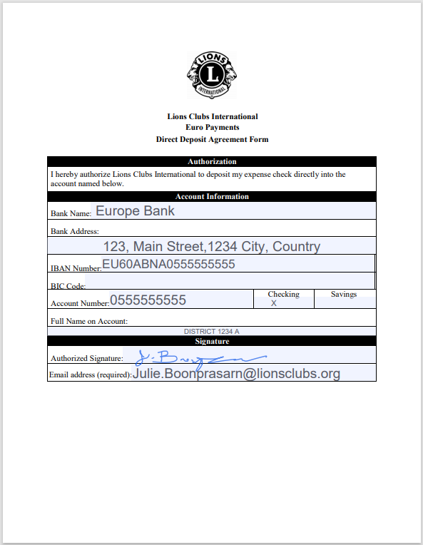
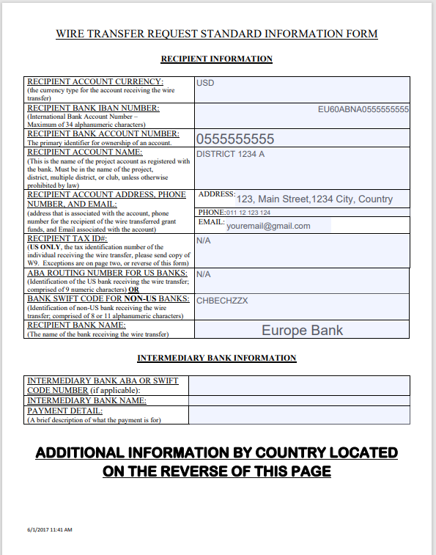
Requirements for Disbursement
USD Wire Transfer Request Form
Signed Grant Agreement
Signed by the Grant Administrator
Signed by the Project Chairperson
Provide contact details of project chairperson
Local Matching Funds
Fully collected within 6 months of the grant’s approval
Bank statement sent to LCIF for verification
Do not spend until grant disbursement arrives!
€ Banking Information
Type information. Do not handwrite!
or
Verify information before sending to LCIF!
Notes:
Local Matching Funds:
Unless otherwise specified, the full LM is due 6 months after grant approval.
A copy of bank statement must be sent to LCIF for verification.
Local matching funds cannot be utilized until LCIF grant funds are disbursed.
Signed Grant Agreement:
Bank account: Please establish a project-specific bank account with 3 signatories (GA, PC, district/MD secretary or treasurer)
Disbursement Request Form: To ensure timely and accurate disbursement of funds, Lions should carefully complete either the SEPA Euro or USD Dollar form, providing their banking information to accounting. To minimize errors, it's recommended to type the information directly into the form. Additionally, please verify the accuracy of your banking details with your financial institution before submitting the form to LCIF.

Slide 23

Grant Management Highlights
No funds until signed grant agreement and pre-disbursement documents are met
Project activities starts when funds are received
All changes require prior LCIF approval
  Budget, timeline, project committee
  May require special approvals from LCIF Chairperson, Technical Advisors
No cash payments
Duty to report to LCIF
23
Notes:
As we go through this session, keep in mind these important details when you are managing a grant

Slide 24
Our district/MD received the grant funds.
What is next?
24

Slide 25
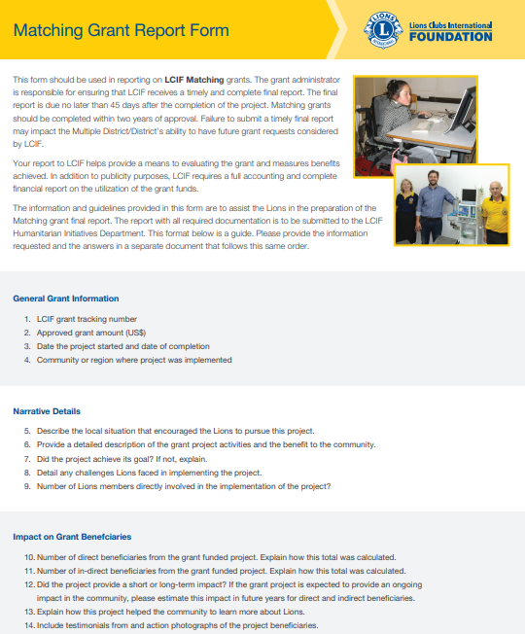
Utilization Reports to LCIF
Completed Grant Report Form
  Number of beneficiaries
  Photos
  Testimonials
Financial utilization
  Receipts
  Bank statement
Cabinet meeting minutes
25
Notes:
Shared with subsequent Grantee leadership team and secretary, and LCIF if project goes into a 2nd LY

Slide 26
Due dates for Reports
Final Report due 45 days after project ends
If grant is disbursed in multiple installments:
  Send LCIF an Interim Report after each installment is utilized, in order to receive a subsequent disbursement
Important: Every project report to LCIF must include Cabinet meeting minutes!
26
Notes:
Remember that each district of MD can only have a maximum number of grants approved at a given time, so it is critical that final reports for grants are submitted on so that LCIF can close those grant records. Delayed reporting can impact future grant disbursement and the consideration of future grant requests.

Slide 27

Promoting Your Grants
27
Notes:
Next, we are going to talk a little bit about promoting LCIF grants. It is so important to promote your grants. This is where the money goes when you donate to LCIF. These stories are what make people feel good about LCIF. Not only do grants help make an impact throughout the world, but promoting your grants can be a powerful fundraising tool.

Slide 28
PROMOTING YOUR GRANT
Promote grant through social media or press release
Take good photos
Testimonials from beneficiaries
Evoke emotion
Include a clear call to action
28
Notes:
You can promote your grant through Facebook, other social media or a press release. Throughout your project, you want to make sure to take really good photos – beneficiaries and Lions providing service. You also want to get testimonials from beneficiaries about the grant. The more you know about the project and those who benefit from it, the better the story you can tell.
When posting your project in social media, you want to evoke emotion. A captivating post will be a bright photo of Lions serving in their community, an explanation of the project, and how it was made possible (through the local Lions and LCIF).
Tag other groups, volunteers, ad even LCIF!
Make sure you have a clear call to action – such as Learn more about our foundation at LCIF.org or If you want to learn more about Lions Club of XXX, call X.

Slide 29
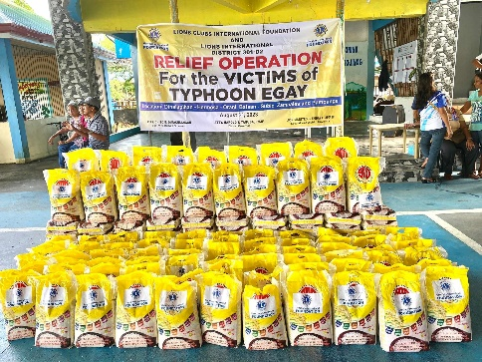
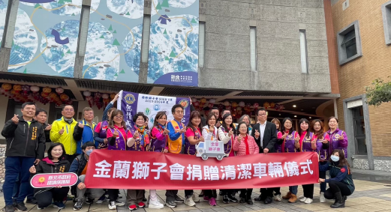
PHOTOS
29

Slide 30


PHOTOS
30

Slide 31


Share Your Grant Story
Tell your story from the front lines and share how you are changing lives through service.
lcifpride.org
31
Notes:
To help raise awareness of LCIF’s grants and all the amazing ways you are serving, I encourage you to share your stories on the Stories of Pride website.
By visiting lcifpride.org, you can share Lions' stories of service from the frontlines, and inspire your fellow Lions to consider grant funding.

Slide 32
CALL TO ACTION
  Post about your grant on Facebook and tag LCIF
  Share your grant story when you visit a club
  Share your grant stories on the Stories of PRIDE website
  TIP: If your district has not received a LCIF grant recently, how can you provide resources and encourage your district to apply?
32
Notes:
Now we are going to do an activity. You have a guide to Promoting your LCIF grant at your table. We also have a grant history report for each Multiple District at the back of the room.
I want you each to grab a guide and a copy of your grant history report.
Then, I want to challenge all of you to go home and promote your grant. We have time now to think about how you will share your story. Will you post about a grant on Facebook? Tell a grant story the next time you visit a club? Share your story on the Stories of PRIDE website?

Slide 33

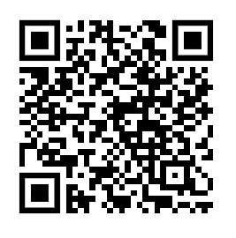
Thank You
Best Practices Guide for LCIF Grants
Notes:
The Best Practices Guide for LCIF Grants is designed to provide Lions with information on the best practices to follow at the local level to make the grant process easy to understand and navigate. Lions Clubs International Foundation (LCIF) encourages Lions to use this and other available grant resources to gain useful and practical knowledge about the LCIF grantmaking process.

