Slide 1
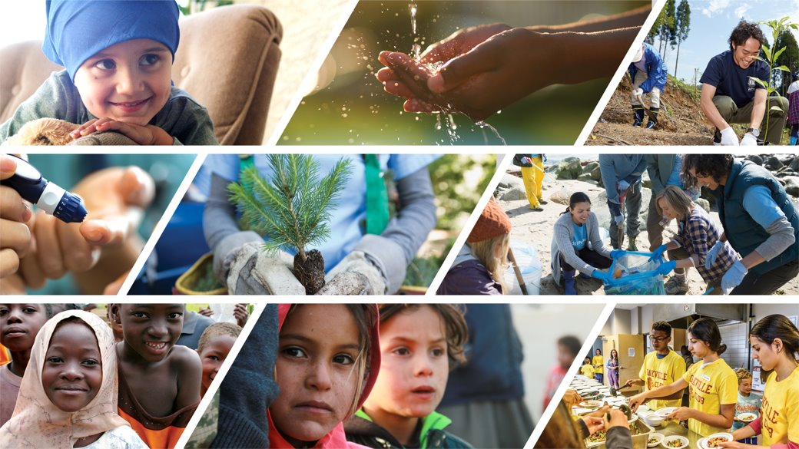
LCIF Global Grants
Grant opportunities overview and resources
1
1

Slide 2
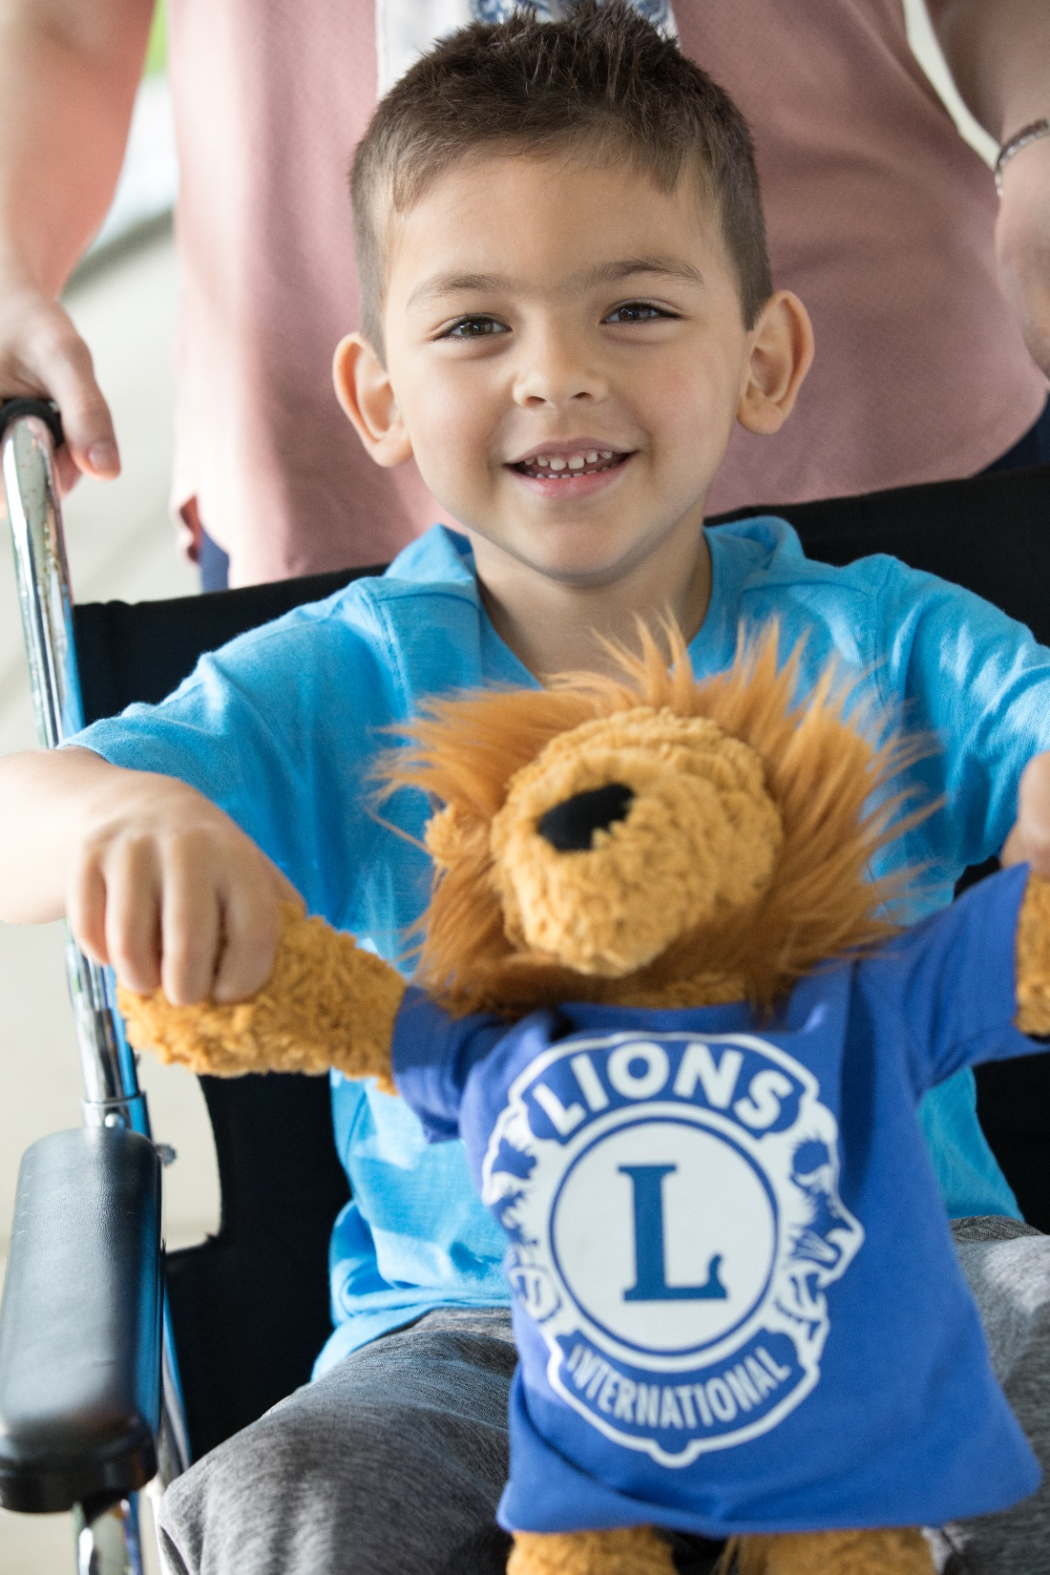

GRANTS AWARDED 2023-2024
1,580 grants
TOTALING
US$46.4M
2
Notes:
As of June 7 - 1,549 totaling $45,973,436

Slide 3
GRANT AWARDS BY CAUSE AREA
FY2023-2024 (US$)
3

Slide 4
GRANT AWARDS BY GRANT TYPE
FY2023-2024 (US$)
4

Slide 5
GRANT AWARDS BY CONSTITUTIONAL AREA
FY2023-2024 (US$)
12

Slide 6





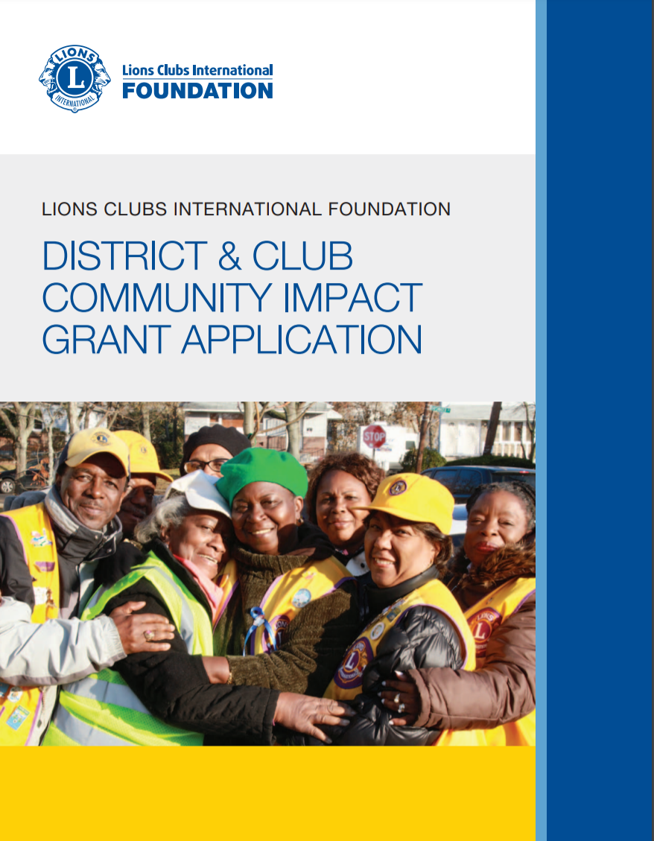
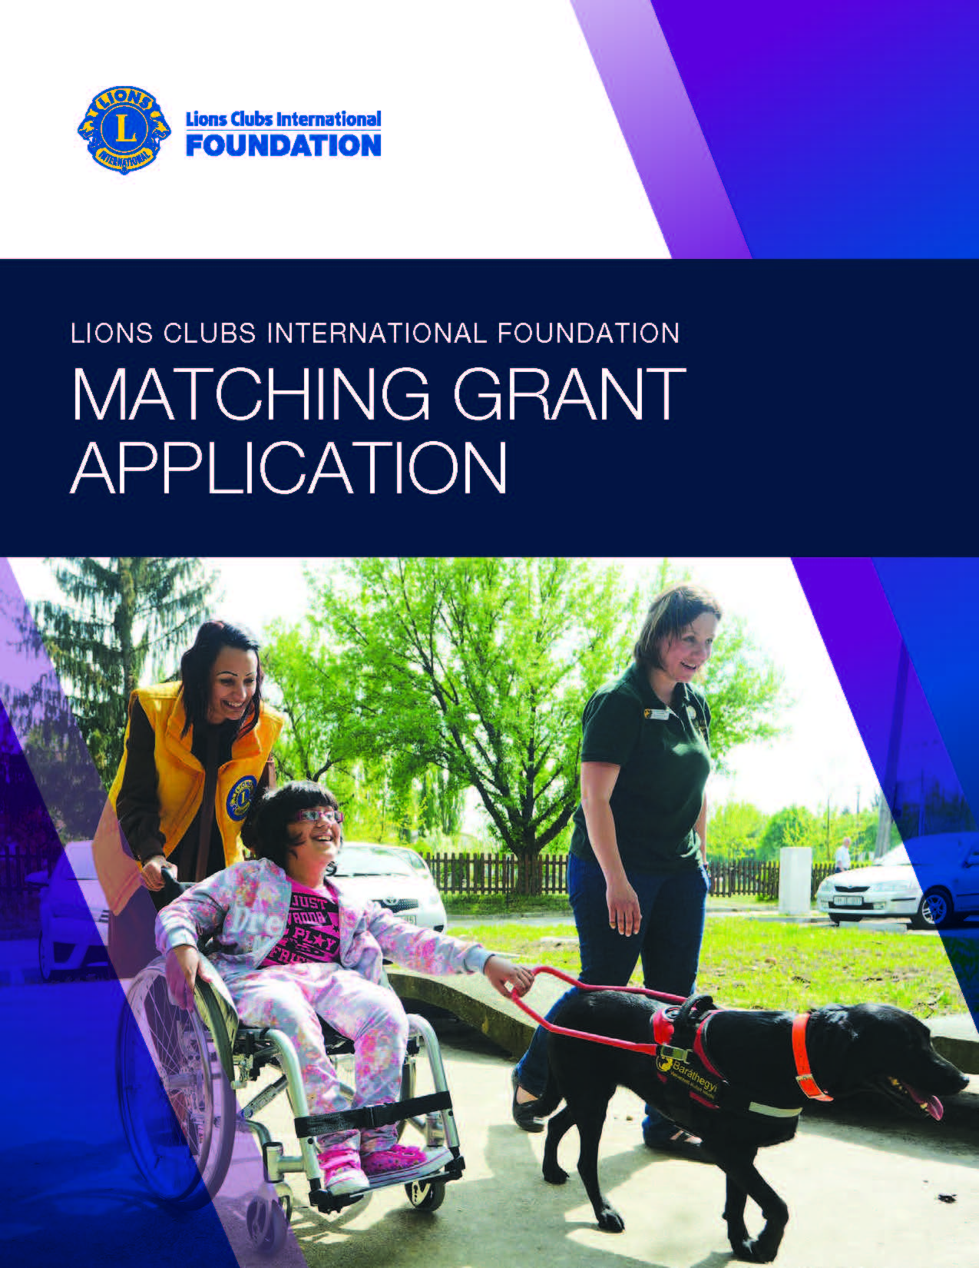



Grant Programs
Childhood Cancer
Diabetes
Disaster
Hunger
Humanitarian
Vision
Youth
15

Slide 7
Childhood Cancer Grants
US$10,000 - US$150,000
Help support and improve quality of life for children with cancer and their families
What do we fund?
  Construction and expansion of infrastructure such as family homes; child-friendly areas at child cancer treatment facilities; patient transportation, education, recreation
Applicable for districts and multiple districts
Matching funds: 25% - 50% of total project cost, depending on applicant location
15

Slide 8

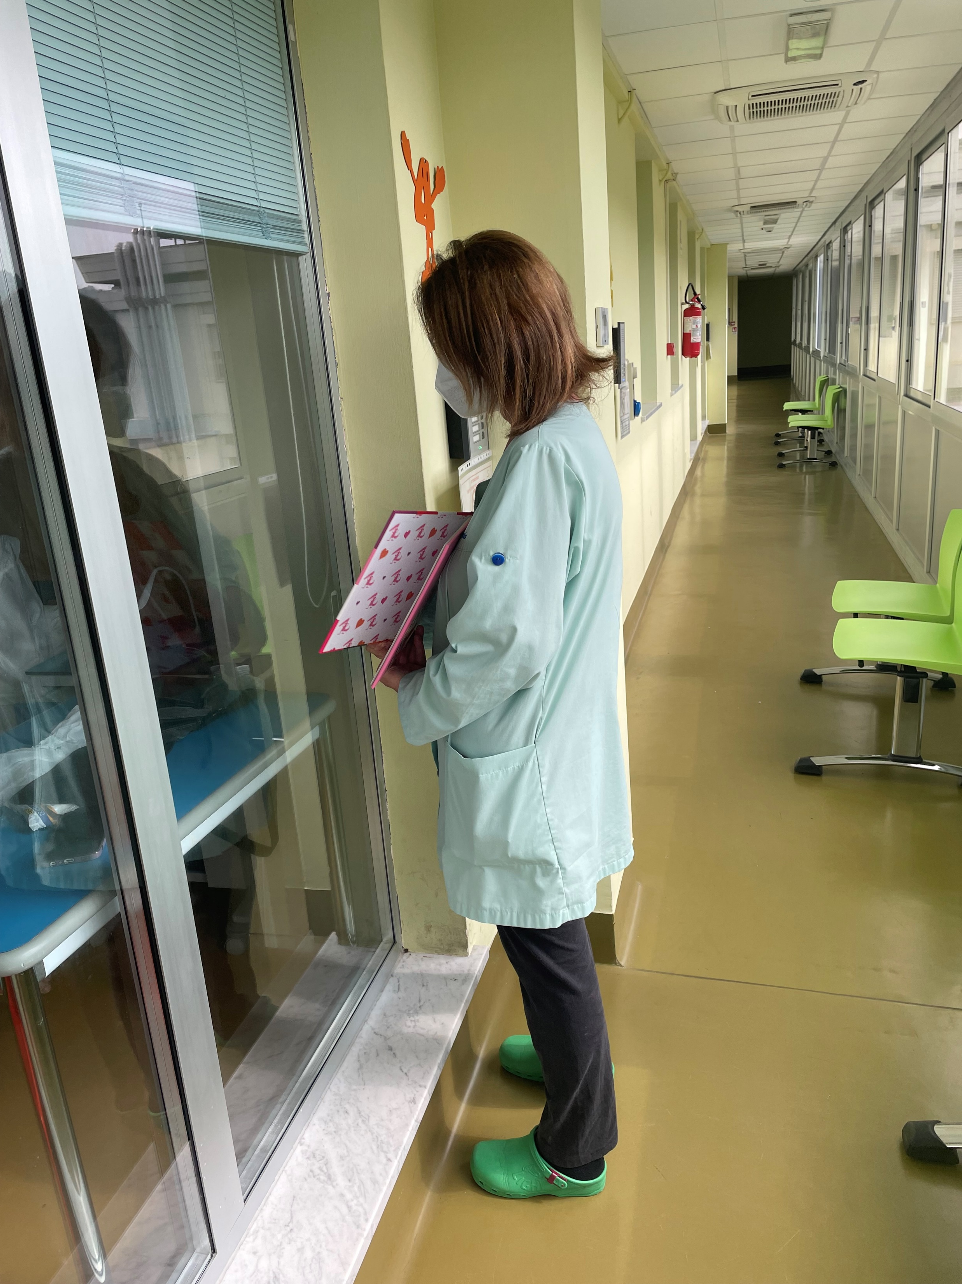
Childhood Cancer Grant
District 108Ia3 received a Childhood Cancer grant of US$150,000
Upgraded the intercom system in the Visitors’ Gallery of the Bone Marrow Transplantation Unit.
Notes:
Childhood Cancer: Lions in Multiple District 108 IA3 wanted to help families stay close to their children throughout their cancer treatment. They decided to apply for an LCIF Childhood Cancer Grant of US$150,000 to support their work with the Regina Margherita Pediatric Hospital in Italy, a leading pediatric oncology center. The Lions upgraded the intercom system in the Visitors’ Gallery of the Bone Marrow Transplantation Unit. The new system allows parents, relatives, friends, and teachers to communicate with children undergoing treatment, helping them maintain contact with the outside world. The refurbishments to the intercom system are expected to benefit over 30 families annually.

Slide 9
Diabetes Grants
Districts: US$10,000 - US$150,000
Multiple Districts: US$10,000 - US$250,000
Help reduce the prevalence of diabetes and improve the quality of life for those diagnosed
What do we fund?
  Screening initiatives and comprehensive follow-up care; enhancement of existing diabetes camps; expansion of existing health facilities to increase patient access and health personnel training
Applicable for districts and multiple districts
Matching funds: 25% of total project cost
15

Slide 10
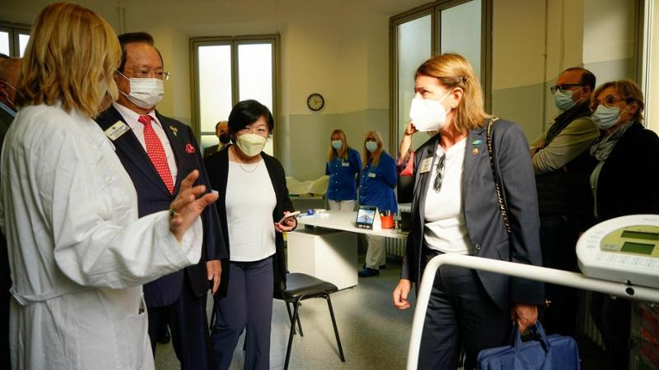
Diabetes Grant
District 108Ib3 received a Diabetes Grant of US$52,909
Expanded and equipped the diabetes center at the Broni Hospital in Italy, providing comprehensive diabetes care, including specialty services, in one location
Notes:
The Lions of District 108-IB3 proposed to expand and equip the diabetes center at the Broni Hospital in Italy. The goal was to provide comprehensive diabetes care, including specialty services, in one location. Currently, the diabetes center, which consisted of two exam rooms and a waiting room, has been expanded to four rooms and has created a gym for patients. Medical equipment, renovation, and furniture were provided by the Lions. In addition, Lions and Leos conducted screening campaigns to identify undiagnosed cases. The project improved services and benefited 5,000 people with diabetes each year.

Slide 11
Disaster Preparedness Grants
US$5,000 - US$15,000
Support partnering with local authorities and organizations to prepare for future relief efforts
What do we fund?
  Relief goods stockpiling; disaster kit assembly; preparedness education; advance support for first responders, food banks, medical facilities, shelters
Applicable for districts, once every two years
Matching funds: 25% of total project cost
15

Slide 12
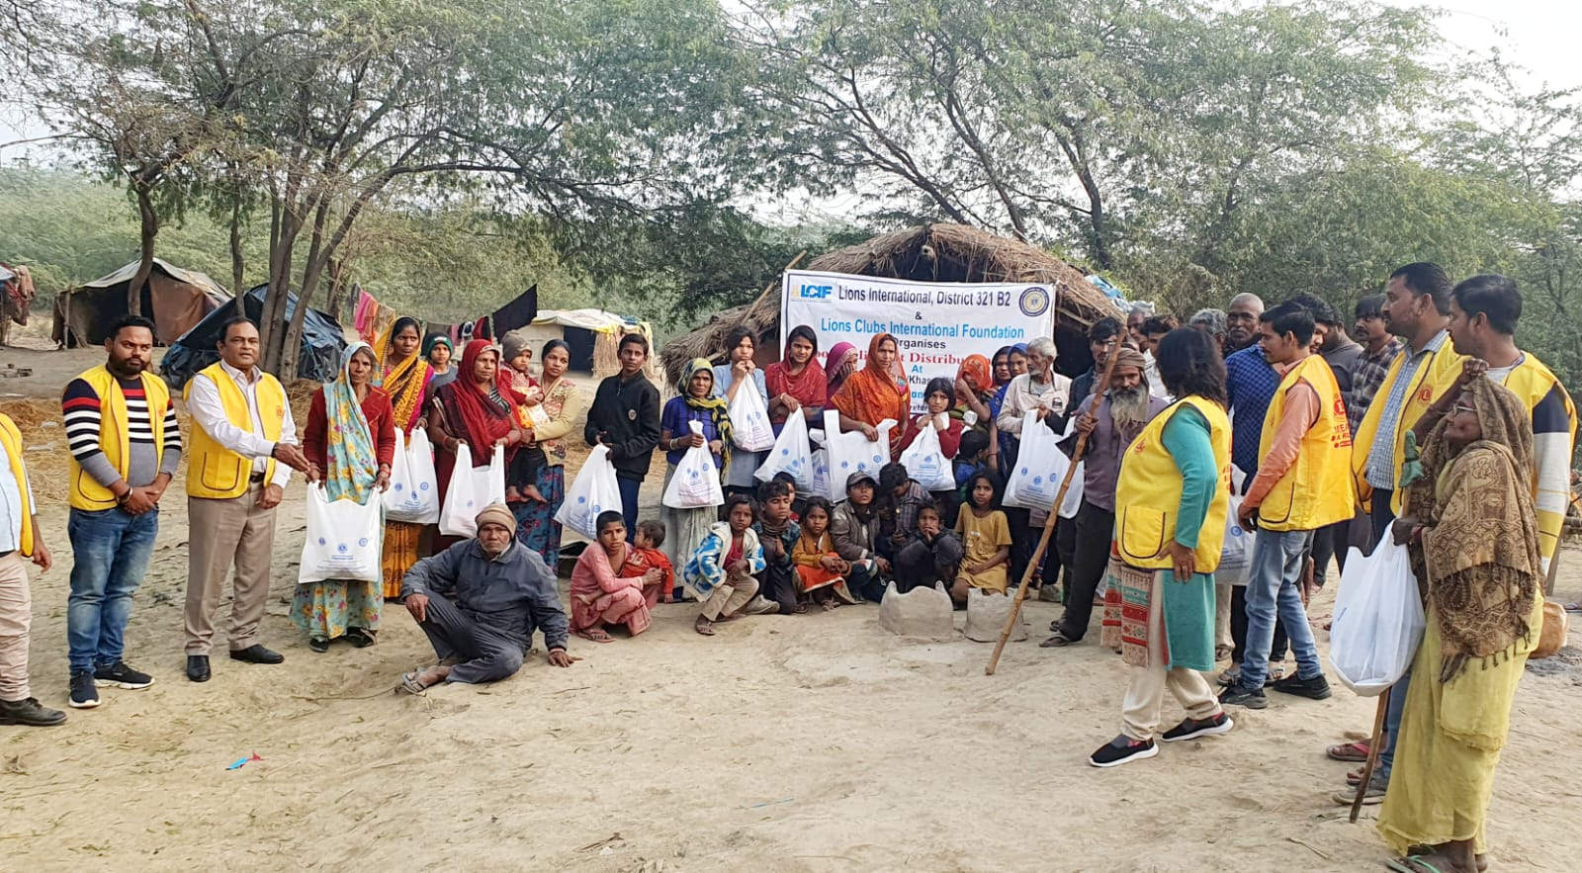
Disaster Preparedness Grant
District 321-B2 received an EMR grant of US$10,000
Lions distributed food and other immediate relief needs to victims of flood in Uttar Pradesh

Slide 13
Emergency Grants
US$5,000 – US$15,000
Help Lions provide immediate emergency assistance to victims of natural disasters, help support short-term clean-up and repairs
What do we fund?
  Distribution of water, food, clothing, medicine, blankets, and personal necessities. Make minor repairs to groups of homes and vital public facilities. Replace essential equipment lost or damaged in the disaster for vital public facilities.
One grant per district/per disaster, and the grant must be requested within 30 days of natural disaster occurrence. 60 days to implement the project.
Applicable for districts
Matching funds: Not required
15

Slide 14
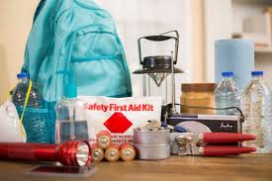
Emergency Grant
District 117 A received an EMR grant of US$10,000
Provided basic necessities such as water, sleeping bags, and cleaning supplies to those affected

Slide 15
District & Club Community Impact Grants
Awards vary; based on contributions to LCIF
What do we fund?
  Broad array of local service projects
CLUBS
  Must donate at least $5,000 to LCIF in a single fiscal year (July 1 – June 30) to qualify
DISTRICTS
  Must donate at least $10,000 to LCIF in a single fiscal year.
  Donations may come from district and/or clubs that did not otherwise qualify for a DCG
  Clubs that qualify for a DCG on their own will not count towards their district’s donations total.
DCG funds can also be applied toward matching fund requirements for other LCIF grant programs
Questions about your DCG Balance? DonorAssistance@lionsclubs.org
15

Slide 16
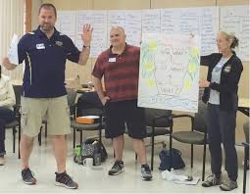
District and Club Community Impact Grant (DCG)
District 107 B received a DCG Grant of US$910
Paid registration for two teachers to attend a Lions Quest training held in Espoo, Finland on March 14-15, 2024. They estimate that 90 students benefit annually.

Slide 17
Hunger Grants
US$10,000 - US$150,000
Support Lions’ service projects focused on alleviating hunger
What do we fund?
  Large-scale infrastructure development projects focused on equipment acquisition for food banks, school kitchens, and food storage and transport
Applicable for districts
Matching funds: 25% of total project cost
15
Notes:
This slide shows the actual grant applications for the respective grant programs. They are organized under the categories of Global Cause, Youth, Humanitarian and Disaster.
The Global Cause grant programs specifically support, childhood cancer, diabetes, hunger and SightFirst.
The Youth grant programs specifically support Leo Service and Lions Quest projects.
Humanitarian grant programs provide the broadest variety of projects that address unmet humanitarian needs for vulnerable populations.
And last, but not least, Disaster grants support disaster relief at every stage including, disaster preparedness, immediate and mid-term needs, as well as long-term reconstruction.
For the past year, the Global Grants team has been reviewing applications with the intent to revise. These revisions are meant to make our applications clearer and ensure our programs still meet relevant international needs related to our Global Causes. The Global Grants Team is now in the process of presenting suggested changes to the Board of Trustees. The changes do require Board approval so the process will take time.

Slide 18
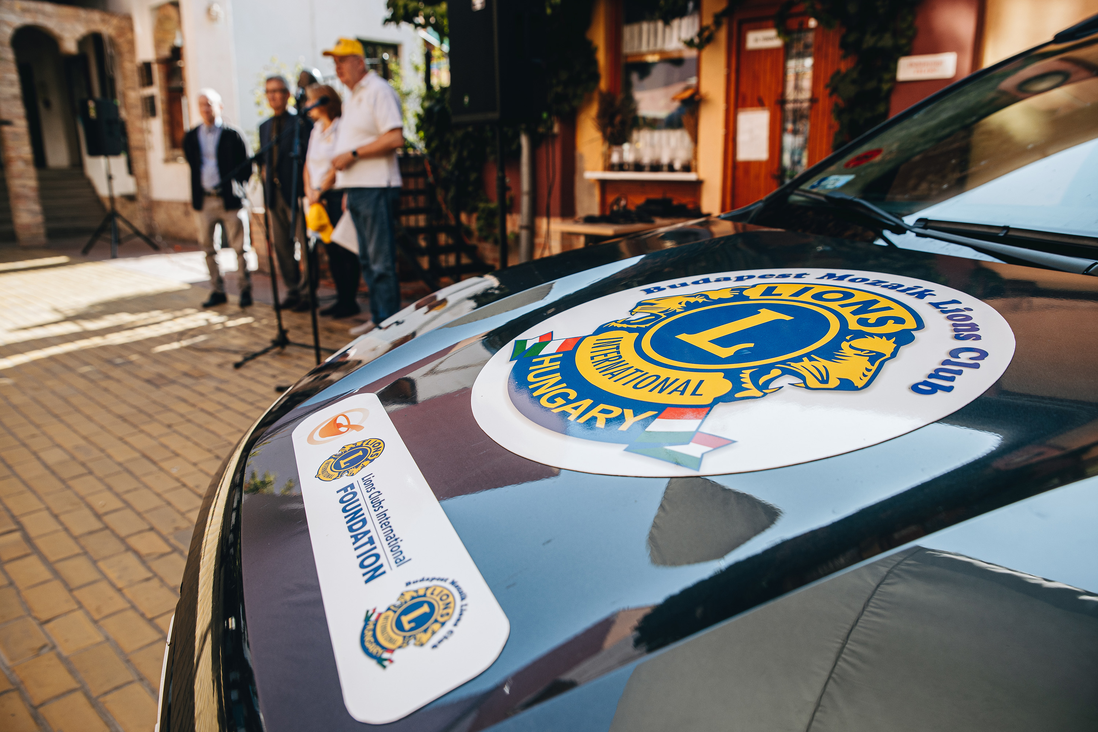
Hunger Grant
District 119 received a Hunger Grant of US$84,225
Purchased transport vans for the Dankó Street Communal Kitchen to provide daily meals to those in need
Notes:
The District 119 Lions, Hungary, purchased transport vans for the Dankó Street Communal Kitchen, run by the Hungarian Evangelical Fellowship (HEF). The kitchen provides daily meals to those in need, including hospitalized people, daycare recipients, and children from disadvantaged backgrounds. Due to the kitchen's increasing demand, the current one bus is insufficient to deliver meals and purchase supplies efficiently. The Hunger grant allowed the Lions to purchase vehicles to improve the kitchen's ability to serve its clientele. It is estimated that 500 people will benefit annually.

Slide 19
Leo Service Grants
US$1,500 - US$5,000
Support Leos in assessing, planning, implementing their own service projects
What do we fund? Hands-on, community-based humanitarian service projects directly developed, implemented, and carried out by Leo Clubs, in collaboration with Lions
Applicable for districts and multiple districts
Matching funds: 25% of total project cost
15

Slide 20
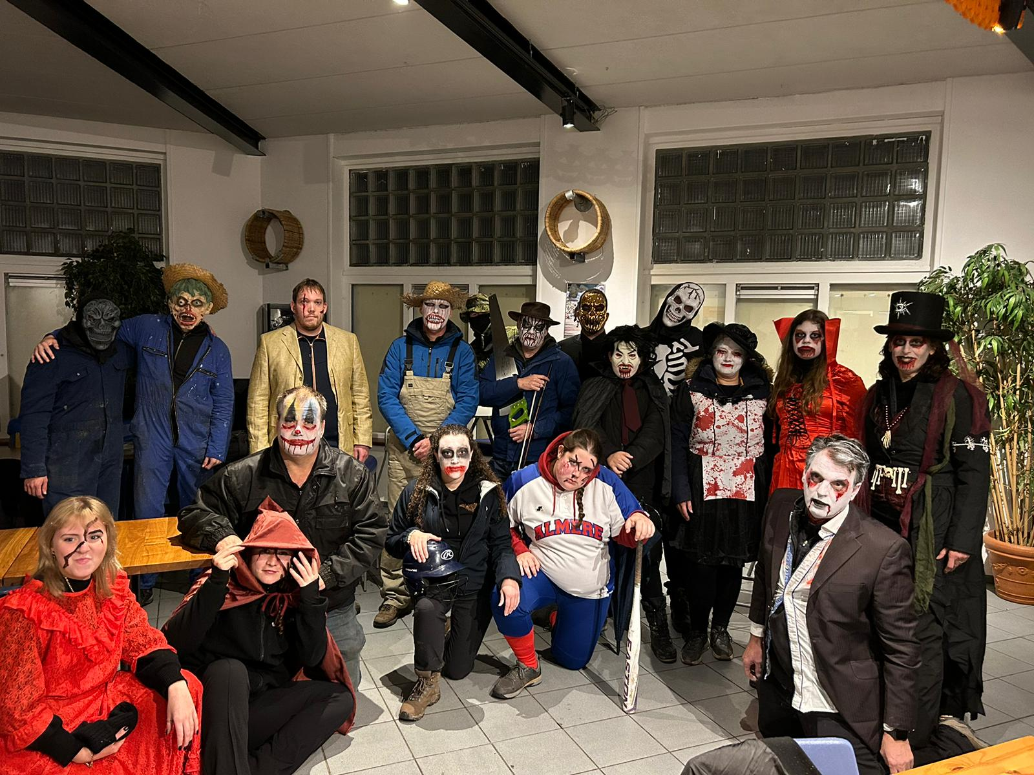
Leo Service Grant
MD-110 AN received a Leo Service Grant of US$5,000
Leos put on a fun Halloween-inspired activity for families and children in domestic abuse shelters and receiving services as informal caregivers
Notes:
The Leos received a grant to put on a fun Halloween-inspired activity for families and children in need of a break from their home situation. They worked with two organizations: the VMCA, which is an organization that supports informal caregivers, including children and youth who care for their siblings, parents, or grandparents, and Oranje Huis, a domestic violence shelter. These families need a chance to forget their worries. Leos organized a socially responsible event to bring fun to those who can't afford it. Leos used the grant to purchase decorations to create the “Ghost Tour,” a haunted forest maze with spooky decor and Leo volunteers providing jump scares. The event also included pumpkin carving, games, and refreshments. The total project cost is US$2,262. 170 children benefitted from the activity.

Slide 21
Lions Quest Program Grants
Districts: US$10,000 - US$150,000
Multiple Districts: US$10,000 - US$250,000
Implement Lions Quest program where Lions have detailed plan and commitment from local schools, or expand program where it has been active for years and opportunity exists to reach more schools
What do we fund? Teacher training workshops; student workshop curriculum and materials; translation; trainer expenses; and program evaluation
Applicable for districts and multiple districts
Matching funds: 25% of total project cost
15

Slide 22
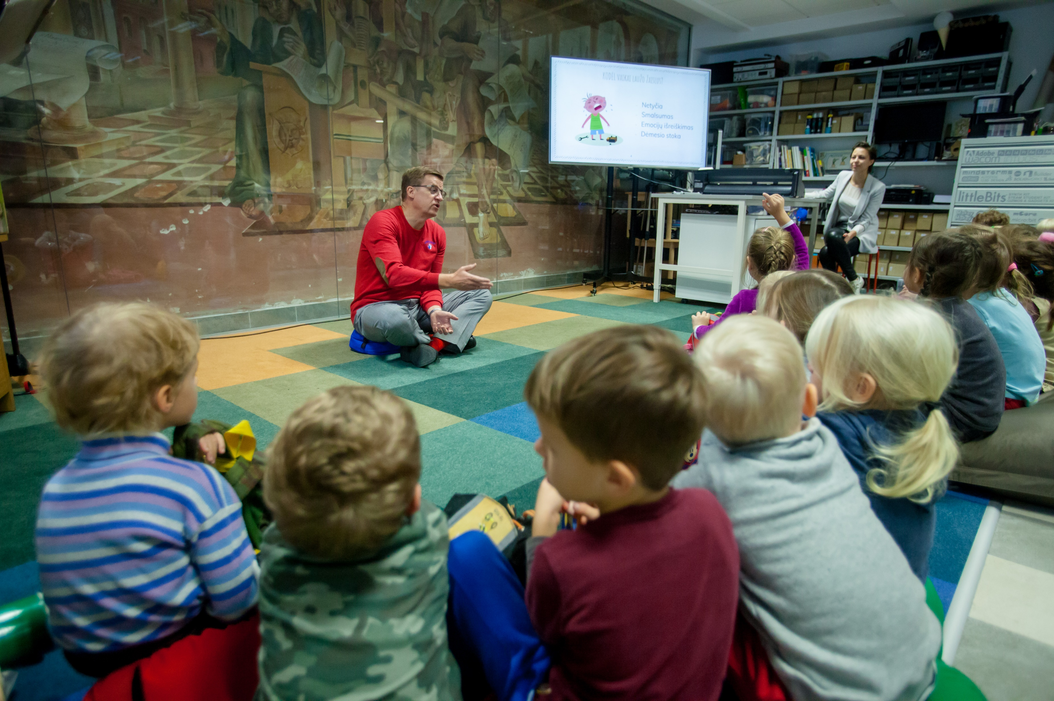
Lions Quest Grant
District 131 received a Lions Quest Grant of US$125,879
1,360+ teachers trained to teach Lions Quest skills to 20,000+ students
Notes:
Lions of Lithuania trained 1,360 teachers in Lions Quest, which will benefit 20,000 students. Schools implementing the program say that students are learning to better manage their emotions and address various issues and concerns such as drug usage, family troubles, and abuse.

Slide 23
Matching Grants
US$10,000 - US$150,000
Help establish or expand Lions-initiated projects addressing critical human and social needs
What do we fund?
  Construction and equipment costs for projects serving large and vulnerable populations
Applicable for districts and multiple districts
Matching funds: 25% - 50% of total project cost, depending on applicant location
15

Slide 24
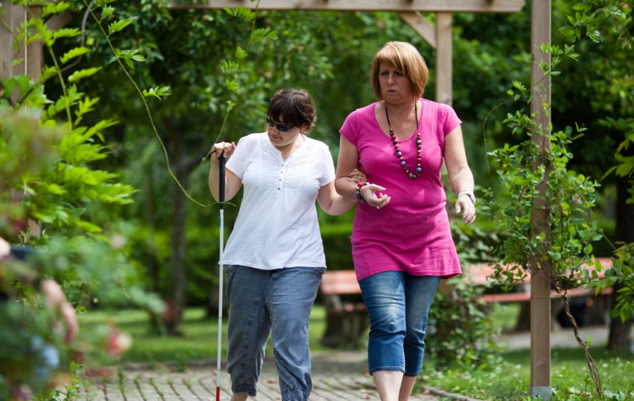
Matching Grant
District 103 E received a Matching Grant of US$42,207
Created a Sensory Garden at the Institute for the Blind in Still, France
Notes:
The District 103-E Lions constructed a sensory garden for the disabled residents of the Institute for the Blind in Still, France. The garden features a concrete path, various plants, benches, tables, a pergola, and a "sound square". The Lions also installed a pedestrian path with different textures to stimulate the sense of touch.

Slide 25
Vision Grants
US$10,000 - US$300,000
Help fight major causes of preventable and reversible blindness; provide services to those with blindness or visual impairment
What do we fund?
  Large-scale infrastructure development projects, equipment acquisition, human resource training*, limited consumables*
Applicable for districts and multiple districts
Matching funds: 25% - 50% of total project cost, depending on applicant location
*Developing countries only
15

Slide 26
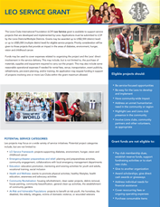
Grants for Environment Projects
Community Impact (DCG)
Matching
No stand-alone environment grant program
Existing LCIF programs that support environment projects include DCG, Matching, and Leo Service.
Award amount varies by program
What do we fund?
  DCG – community clean-up, tree planting, habitat restoration, plant pollinator gardens
  LEO Service – community clean-up, tree planting, habitat restoration, plant pollinator gardens, recycling initiatives
  Matching – clean water/WASH projects
Matching funds: amount required locally varies per program
Leo Service
15
Notes:
This slide shows the actual grant applications for the respective grant programs. They are organized under the categories of Global Cause, Youth, Humanitarian and Disaster.
The Global Cause grant programs specifically support, childhood cancer, diabetes, hunger and SightFirst.
The Youth grant programs specifically support Leo Service and Lions Quest projects.
Humanitarian grant programs provide the broadest variety of projects that address unmet humanitarian needs for vulnerable populations.
And last, but not least, Disaster grants support disaster relief at every stage including, disaster preparedness, immediate and mid-term needs, as well as long-term reconstruction.
For the past year, the Global Grants team has been reviewing applications with the intent to revise. These revisions are meant to make our applications clearer and ensure our programs still meet relevant international needs related to our Global Causes. The Global Grants Team is now in the process of presenting suggested changes to the Board of Trustees. The changes do require Board approval so the process will take time.

Slide 27
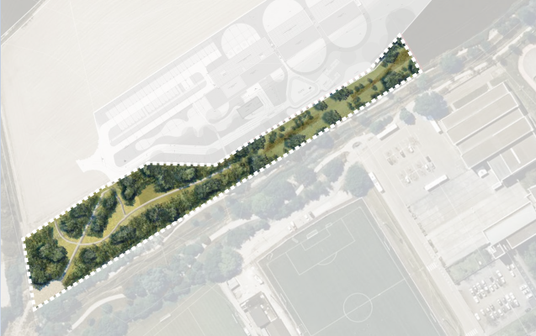
DCG’s for Environment
District 103 E received a District & Club Community Impact Grant of US$2,717
Planted 6,000 trees in the Bas Rhin, near the town of Truchtersheim
Notes:
District 103-E used US$2,717 of their available DCG credits to help plant 6,000 trees in the Bas Rhin, near the town of Truchtersheim. The entire project costs 25,000€ and consists of purchasing 6,000 trees, bamboo stakes, and protection sleeves. Planting was completed in the fall of 2023. In addition to the member of Lions Club and Leo Club of Strasbourg, they held a college day with some 700 student volunteers and a Volunteer Day where area residents can also come plant a tree.

Slide 28
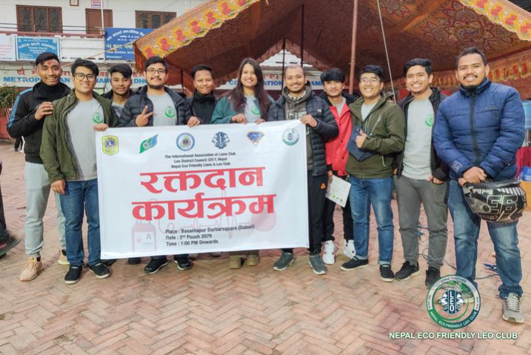
Leo Service Grants for Environment
District 325J Leos received a Leo Service Grant of US$5,000
Created a Leo-Lions Eco Friendly Park

Slide 29
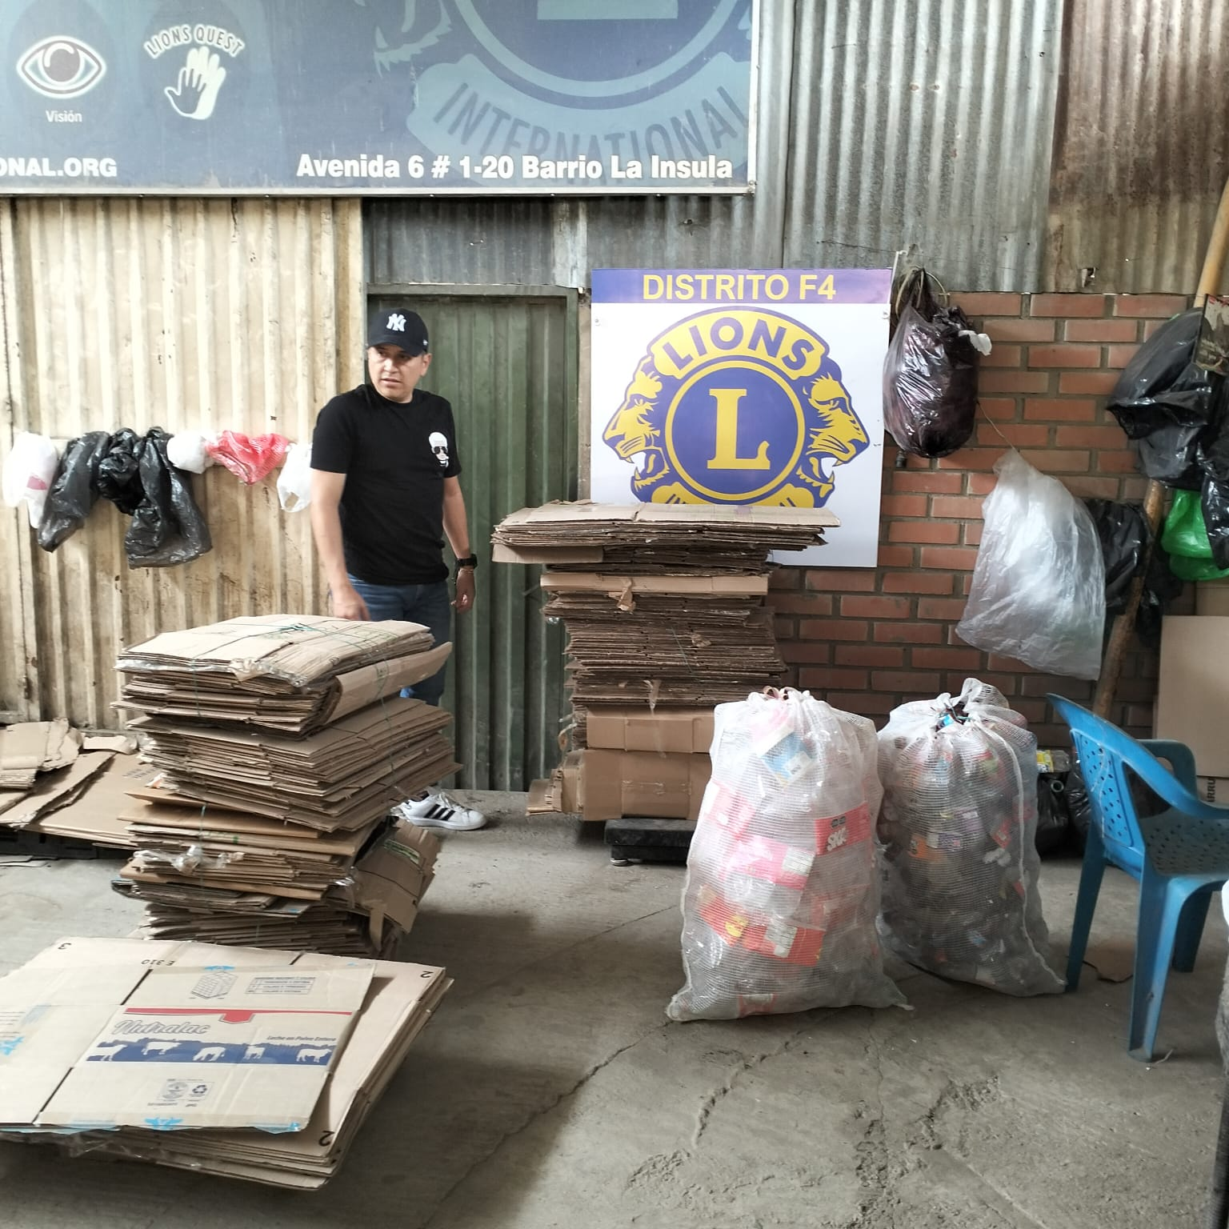
Matching Grant for Environment
District F4 received a Matching Grant of US$36,945
Equip a Recycling Program in Colombia
Notes:
The Lions of District F4 was awarded a Matching grant to acquire machinery to recycle waste materials and generate income for community service activities. In Cúcuta, Colombia, the 10 Lions clubs have been collecting and selling recyclables since 2017. They plan to expand their operations by purchasing waste from small businesses and a cooperative. The Lions will sell the processed waste to companies and use the income to support community service initiatives. They will own and operate the recycling machines and establish a committee to manage the operations. The project aims to recycle four hundred tons of waste annually and will be evaluated in December 2025.

Slide 30





Typical Grant Projects
Matching Grants | Childhood Cancer Grants | Hunger Grants | Diabetes Grants
Equip vision screening program Renovate orphanage for disadvantaged children Construct school for children with visual impairments Equip public hospital that serves low-income patients | Construct and equip hostel for patients to stay close to hospital during treatment with families Upgrade waiting room of childhood cancer clinic to make more child-friendly Palliative care center for children with cancer | Construct food pantry Upgrade senior meal site program Expand and equip school feeding program | Youth diabetes camps Community screening events Upgrade and equip existing diabetes medical facility
30

Slide 31


Typical Grant Projects
Lions Quest Program Grants | Leo Service Grants | Disaster Relief Grants | Disaster Preparedness
Workshops and trainer expenses for teachers learning to implement curriculum Translation and adaptation of curriculum Program materials for teachers and students | River clean-up and tree planting Prepare, package and distribute food to homeless Clean and repair school for disabled | Provide basic necessities for victims of disaster Cleaning supplies Supplies for minor repair or refurbishment of vital public facilities | Assemble disaster relief kits for future disasters Participate in local emergency response training programs Stockpiling of key materials and supplies for future response Emergency training for Lions
31

Slide 32
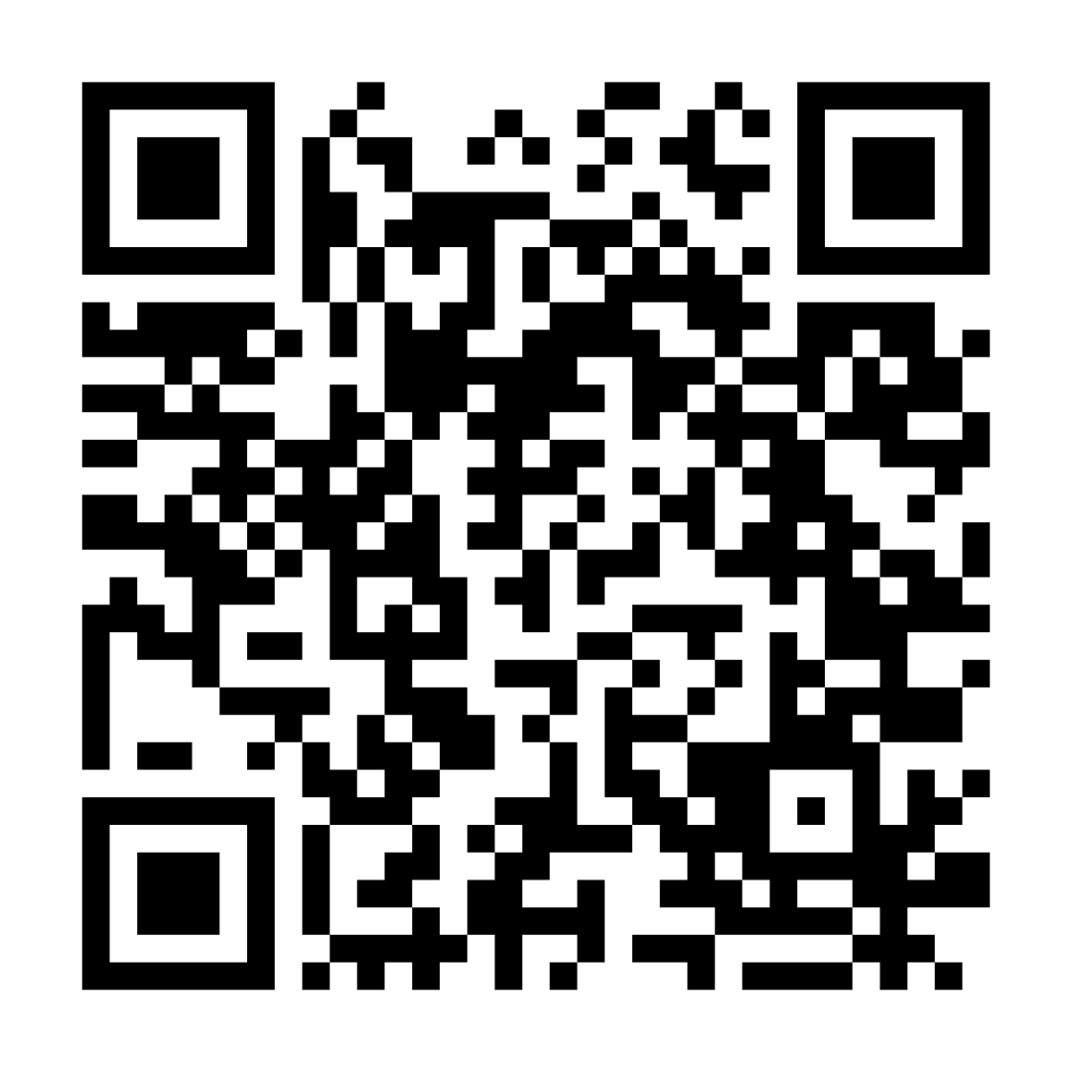
Thank You!
Scan the QR Code to access the LCIF Grants Toolkit and learn more.
32
Notes:
Thank you so much for your interest in LCIF Grants. Do not hesitate to contact us if you have any questions and thank you for everything you do. Please scan the QR code to visit the LCIF Grants Toolkit

