Slide 1
Lions for Ukrainians

Slide 2
Lions for Ukraine 2023/2024

Slide 3
Lions for Ukrainians 2023/2024
Which day of the war in Ukraine is it today?
935

Slide 4
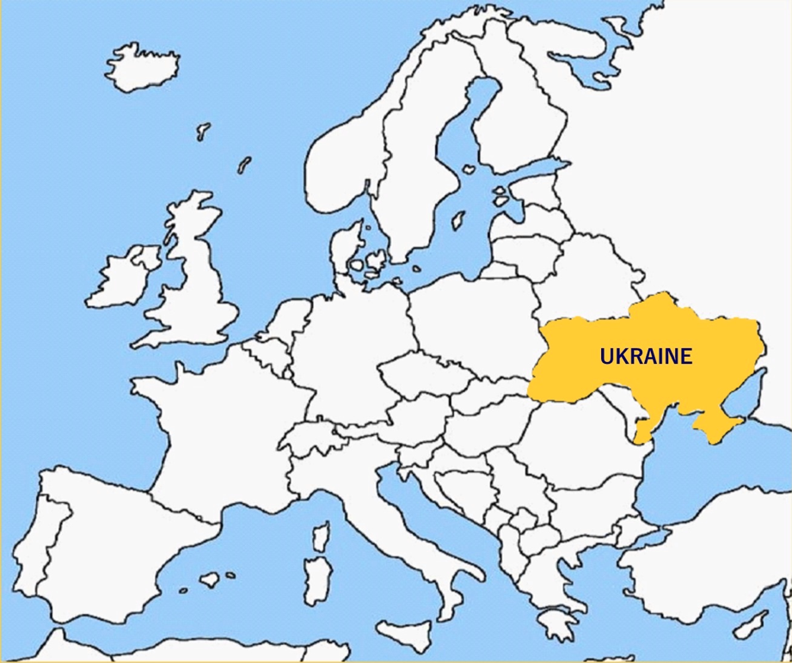
Lions for Ukrainians 2023/2024
Poland
Czech &
Slovakia
Hungary
Romania

Slide 5
Ukrainian Lions for Ukrainians 2023/2024
PDG Valentin Kravchenko
LCIF Coordinator
D134 Ukraine

Slide 6
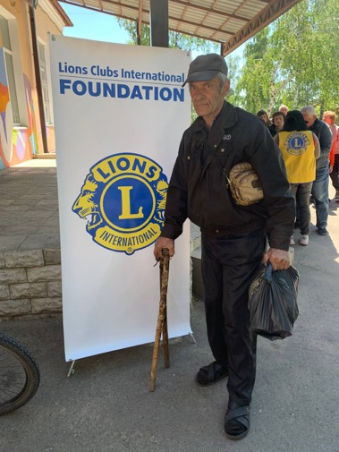
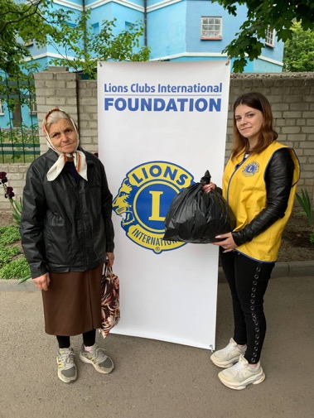
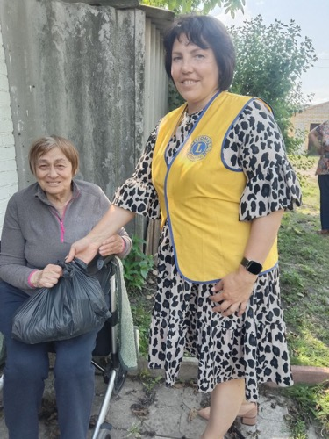
Ukrainian Lions for Ukrainians 2023/2024

Slide 7
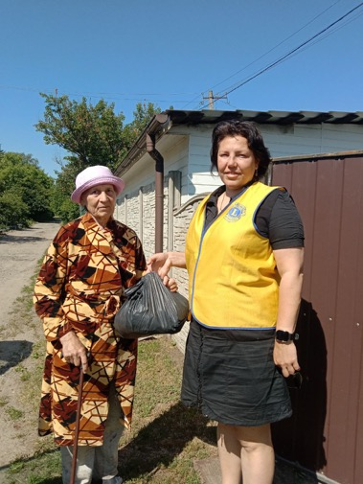
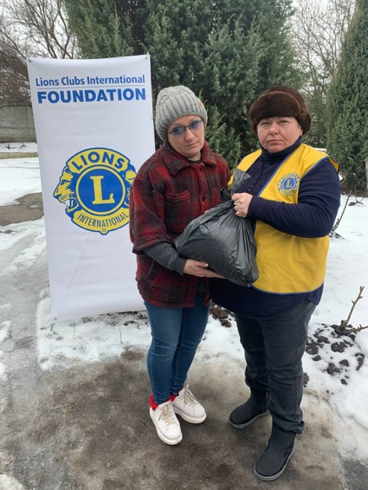
Ukrainian Lions for Ukrainias 2023/2024

Slide 8
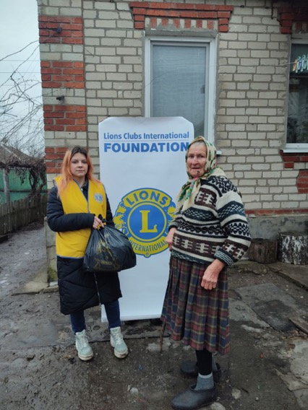
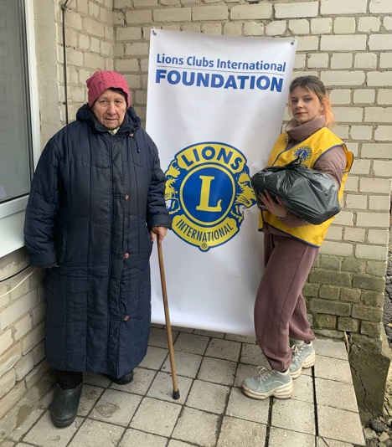
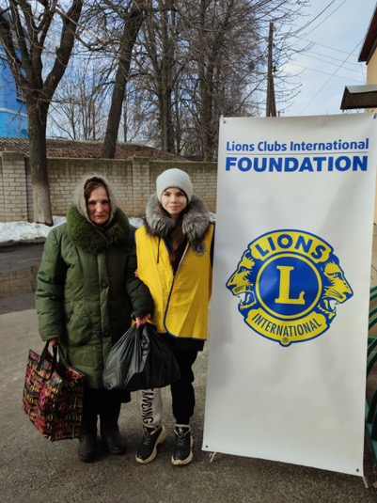
Ukrainian Lions for Ukrainias 2023/2024

Slide 9
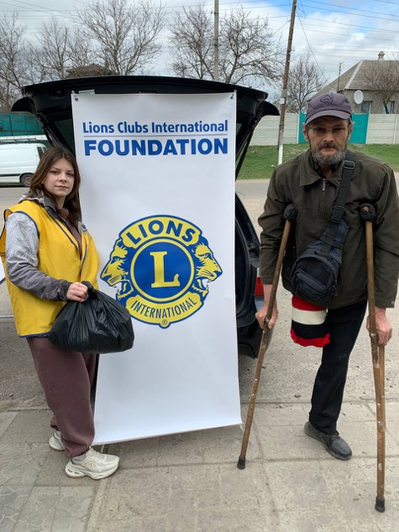
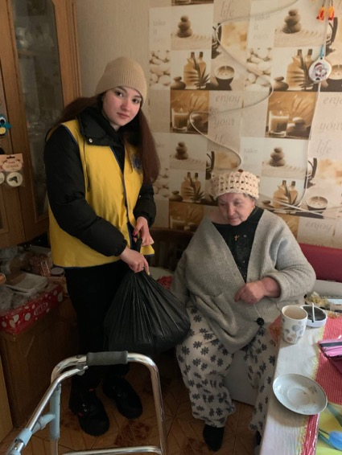
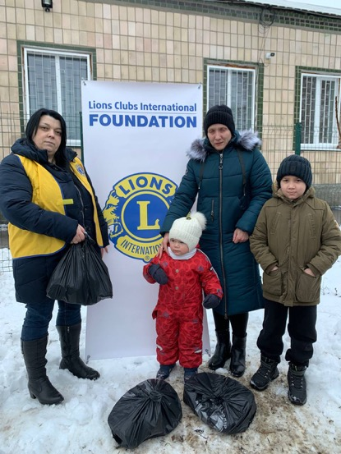
Ukrainian Lions for Ukrainias 2023/2024

Slide 10
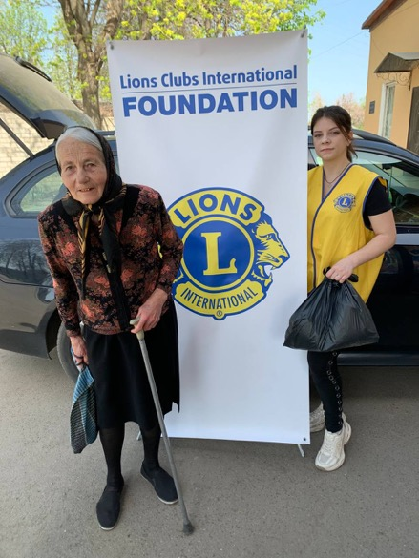
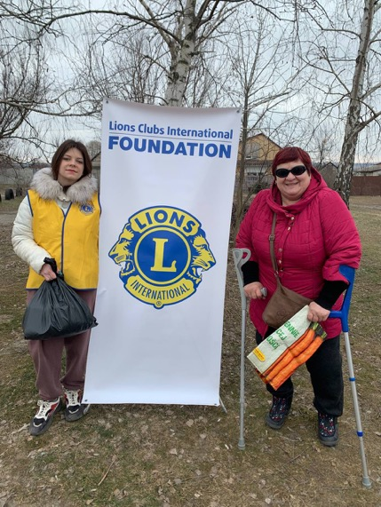
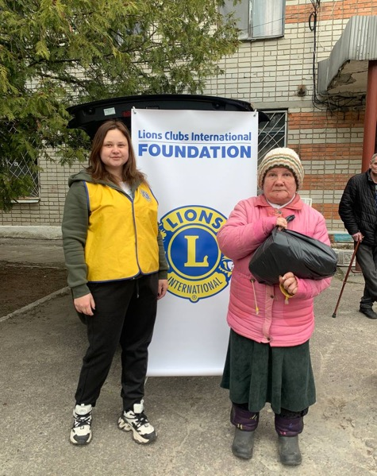
Ukrainian Lions for Ukrainias 2023/2024

Slide 11
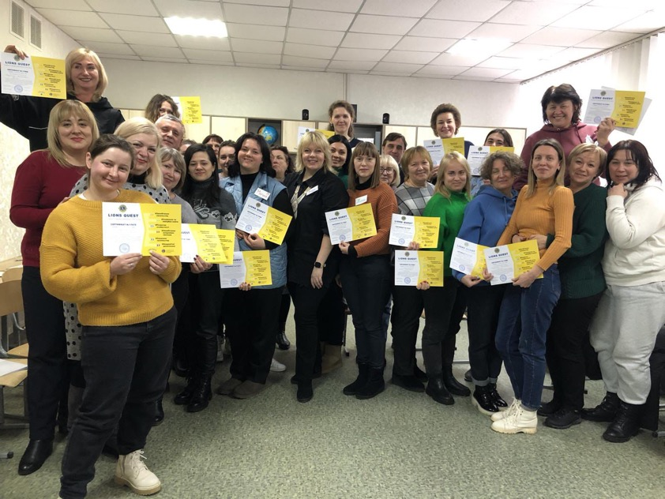
Lions Quest workshops in Ukraine 2023/2024

Slide 12
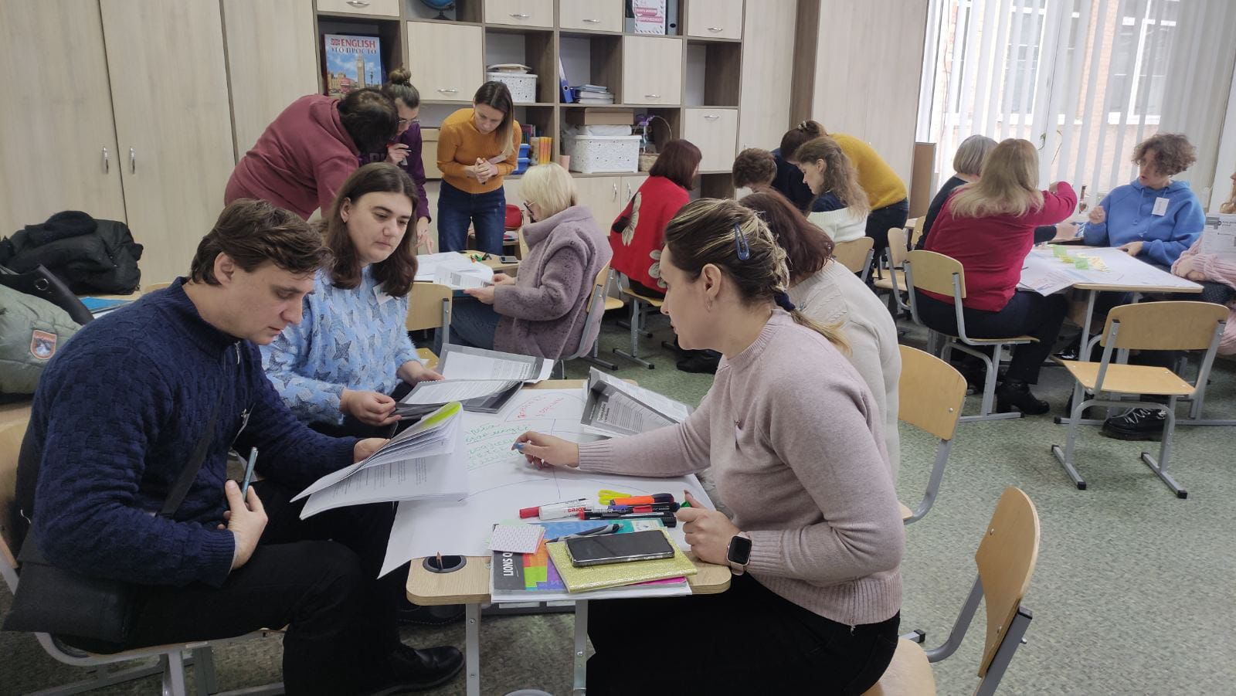
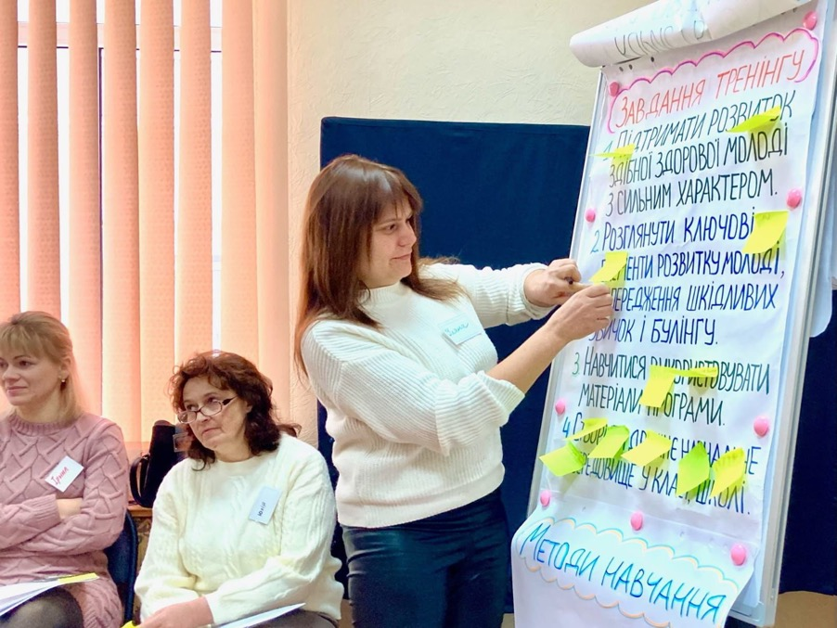
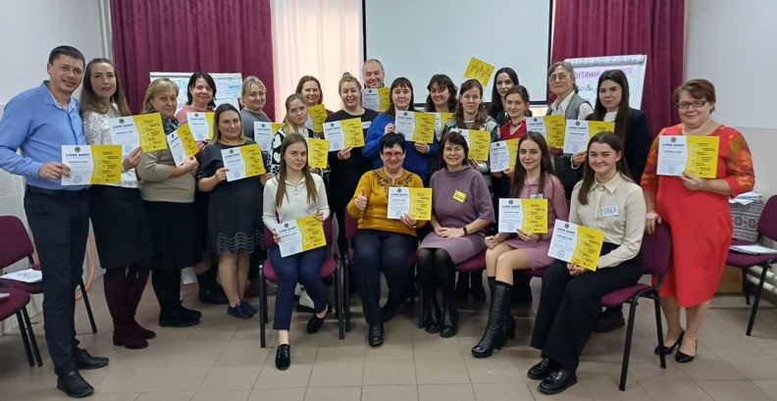
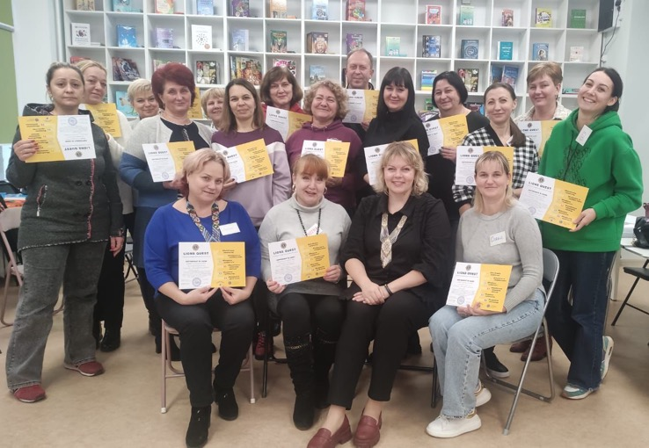
Lions Quest workshops in Ukraine 2023/2024

Slide 13
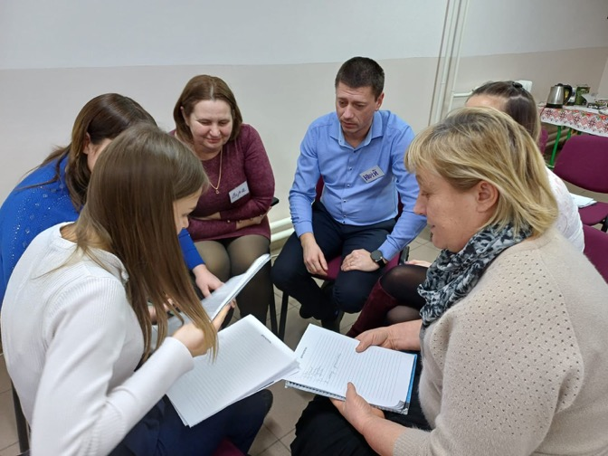
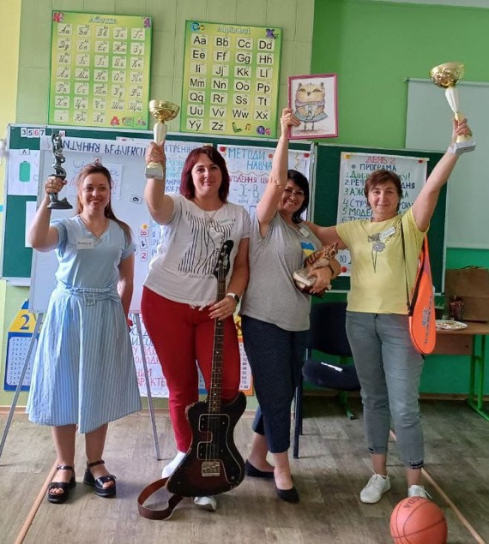
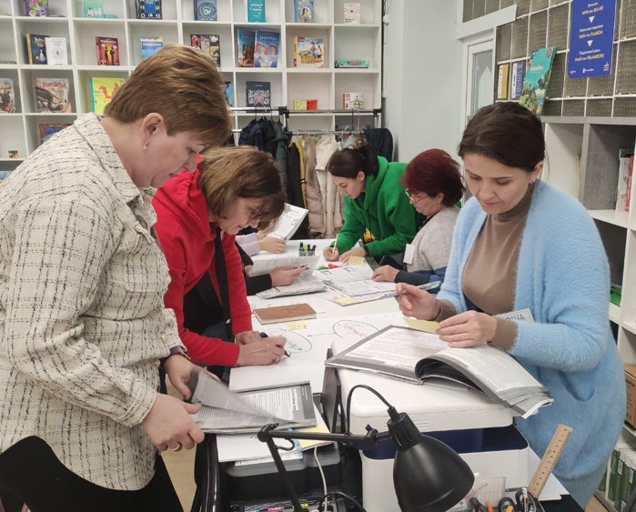
Lions Quest workshops in Ukraine 2023/2024

Slide 14
Thank you for your attention
PDG Valentin Kravchenko
LCIF District Coordinator
D134 Ukraine

Slide 15
LCIF Berlin 2024.09.13.Friday
... At the airport, Holiday Inn ...

Slide 16
Ukraine aid mission
To help people of various nationalities, including Hungarians, Russians and Ukrainians, who have escaped from Ukraine

Slide 17
This program would not have been possible without the help of LCIF.

Slide 18
Response to the refugee crisis in Ukraine
It has been the focus over the last two years of all our clubs and of our active support at home in Hungary, and almost 100% of the financial support we have given out has been focused on this task.

Slide 19
The total domestic funding – until now – is close to €2.5 million.
Immediate assistance from LCIF amounted to U$D 20,000 in the first round; and U$D 331,000 in the second round, which was implemented („We served”) by 17 Lions clubs.

Slide 20
How can we continue? The big question for us is when this war will end.
Time is flying by, peace is still a long way off, and our traditional programmes will have to be delayed until then.
We are seeking resources both at home and abroad to continue.

Slide 21
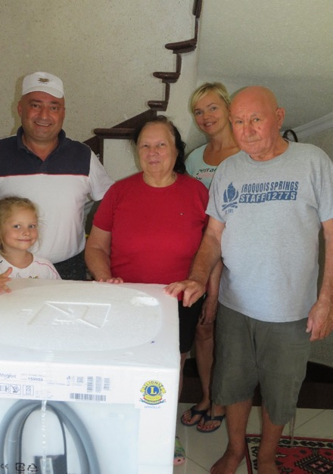
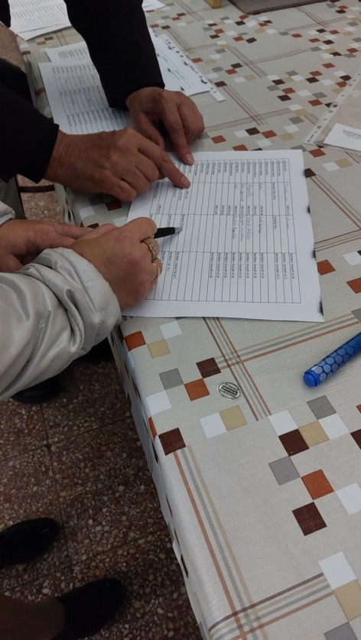
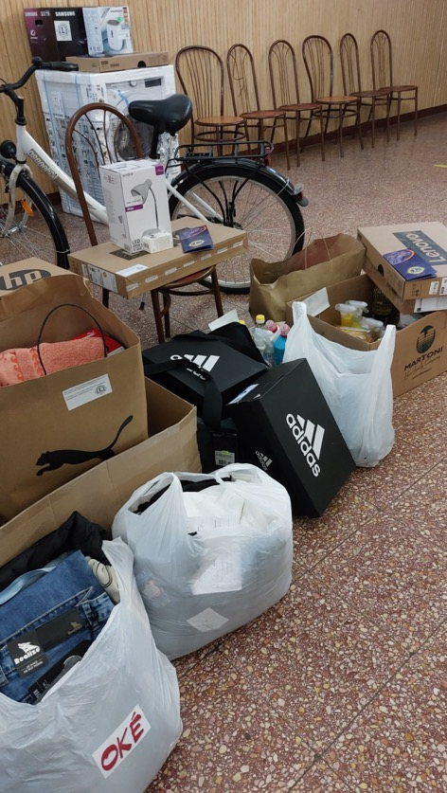
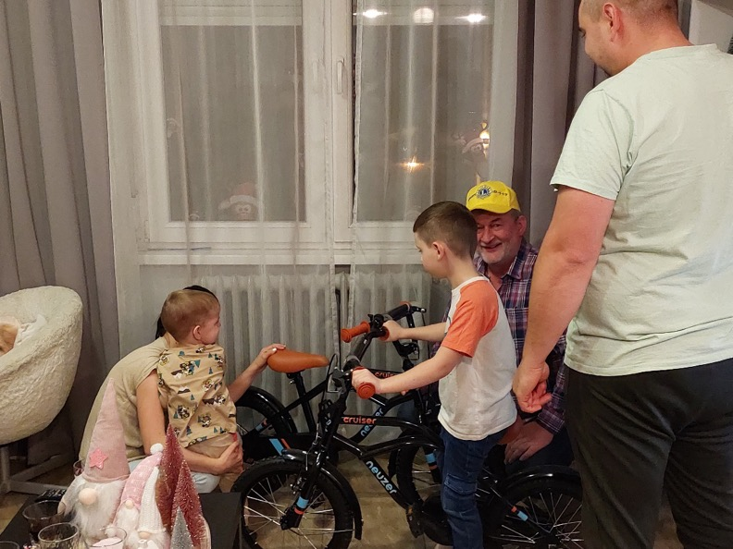
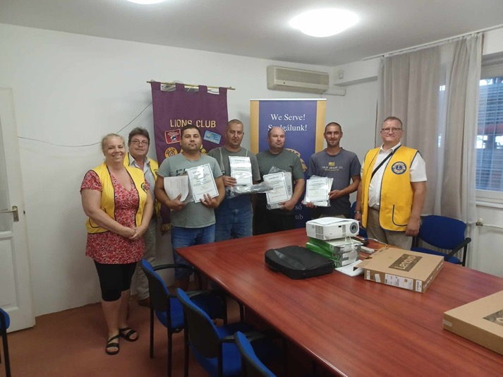

Slide 22
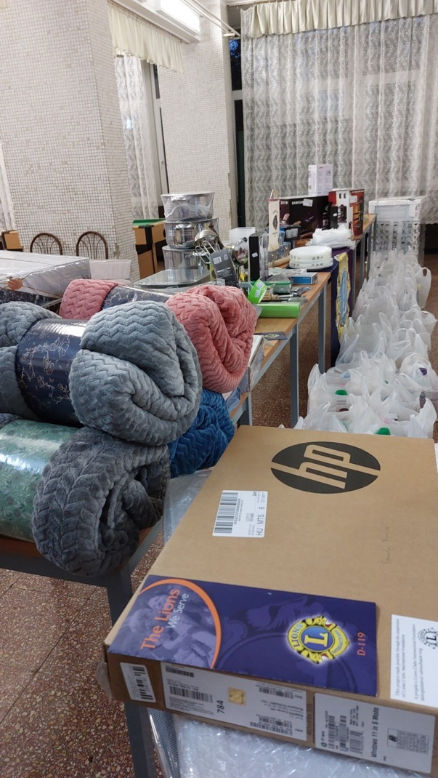
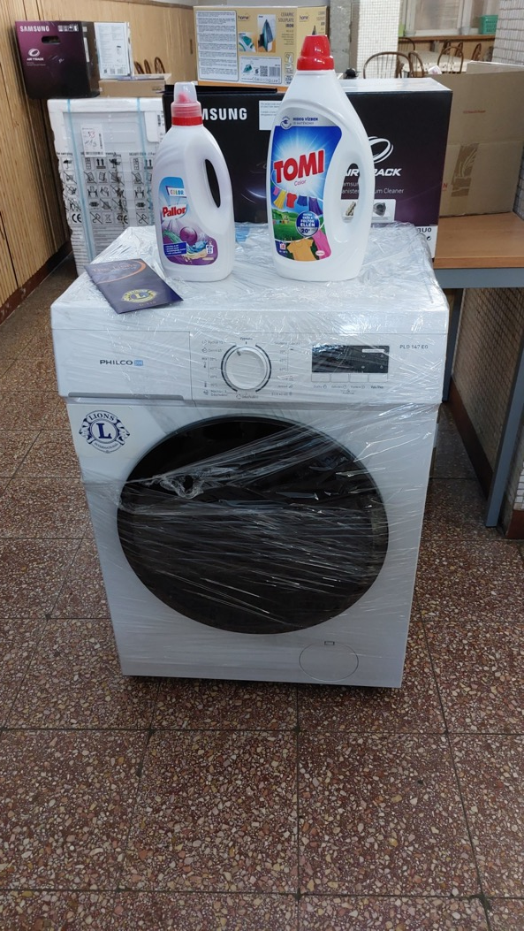

Slide 23
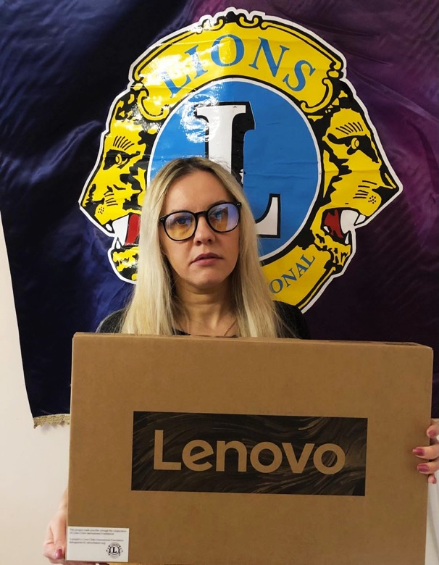
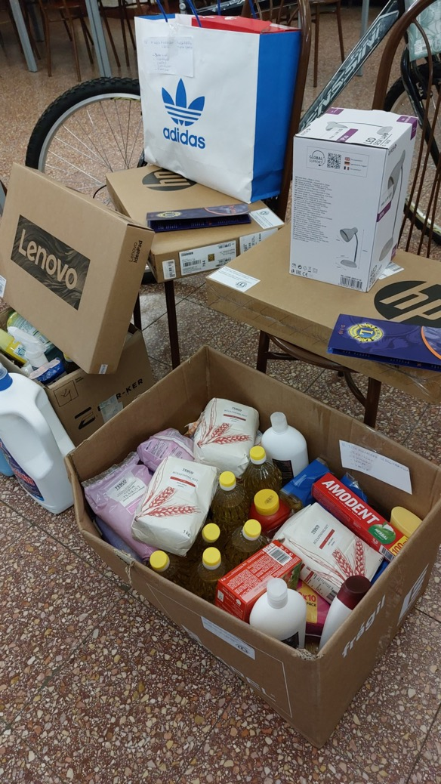

Slide 24
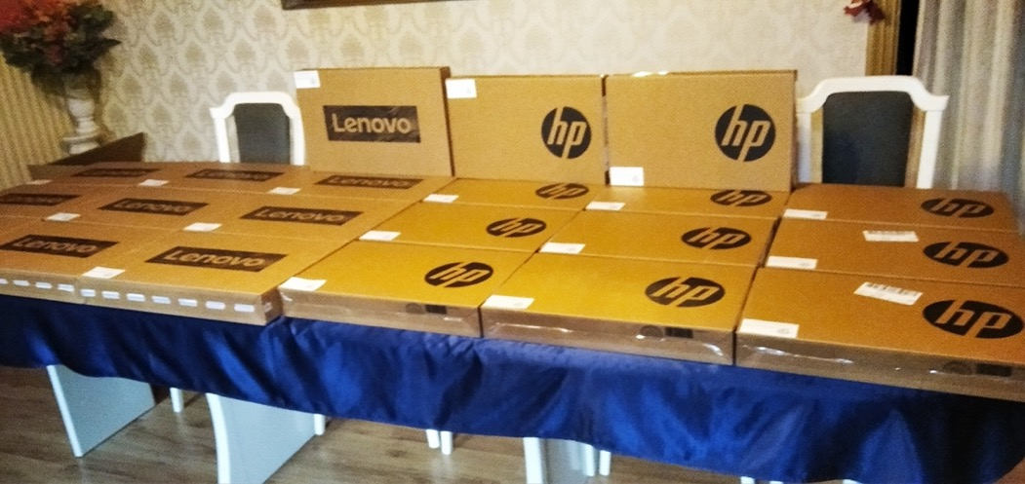
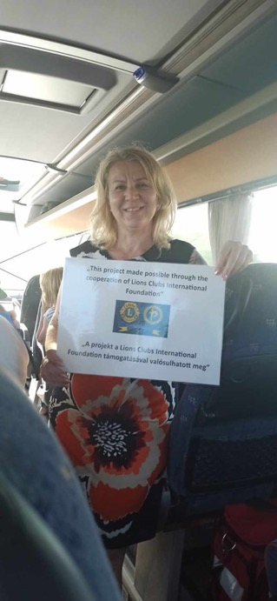
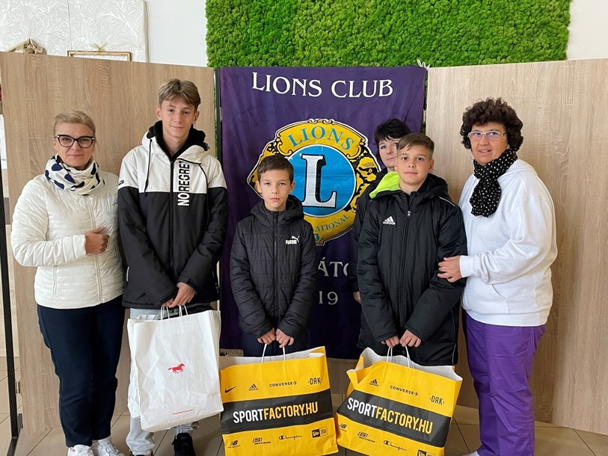
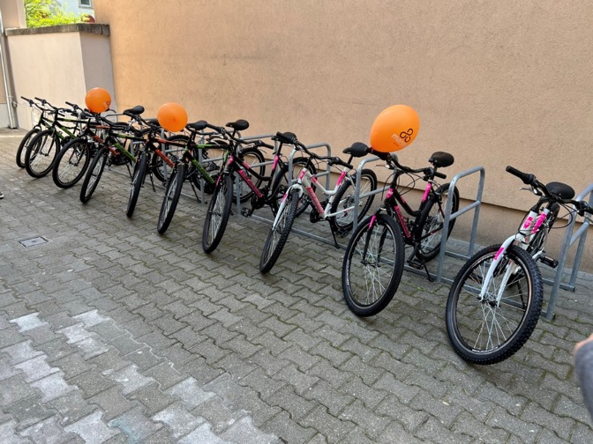

Slide 25
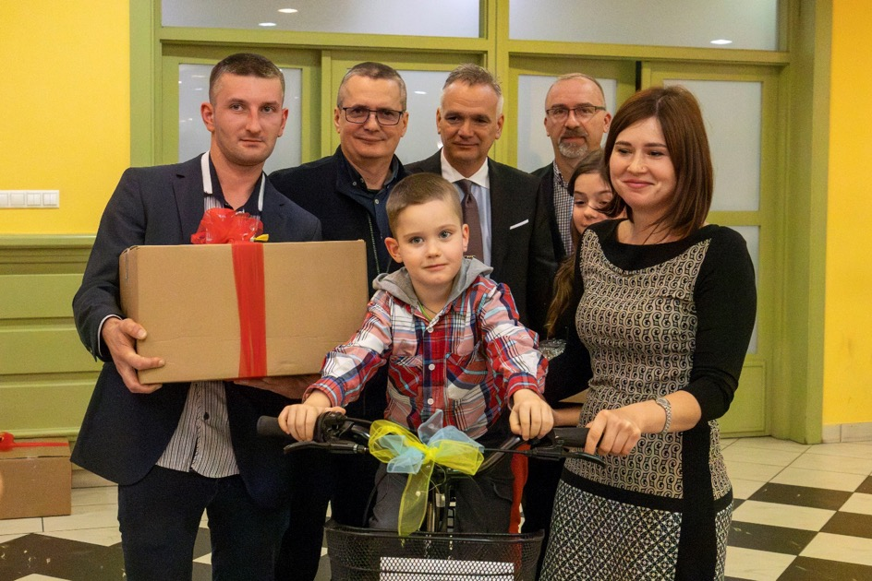
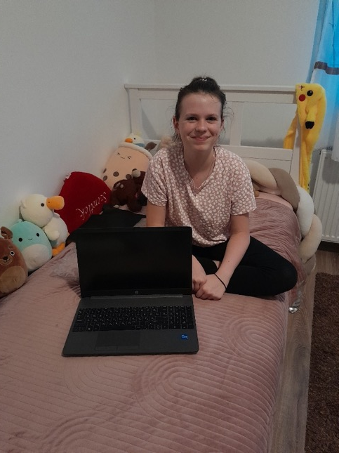
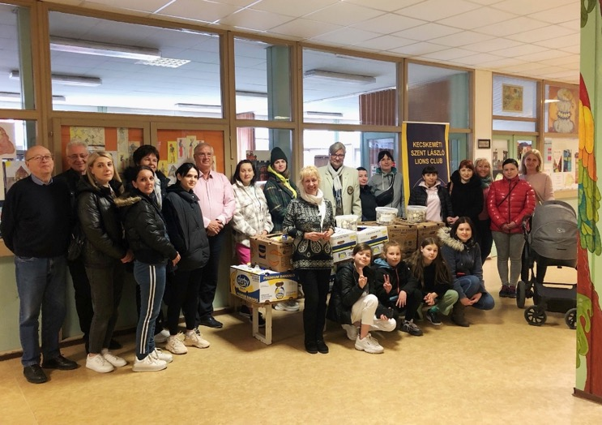
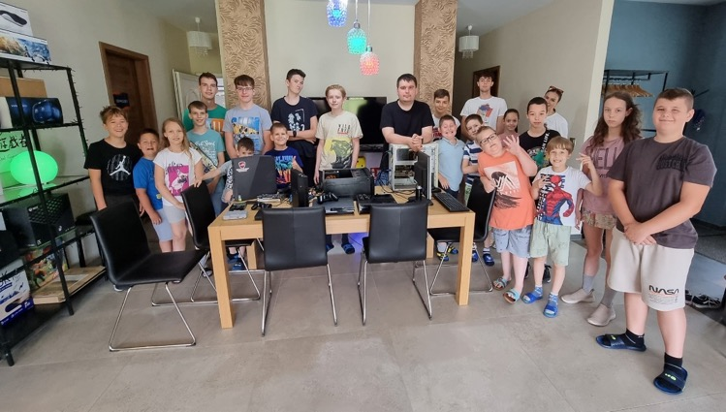

Slide 26
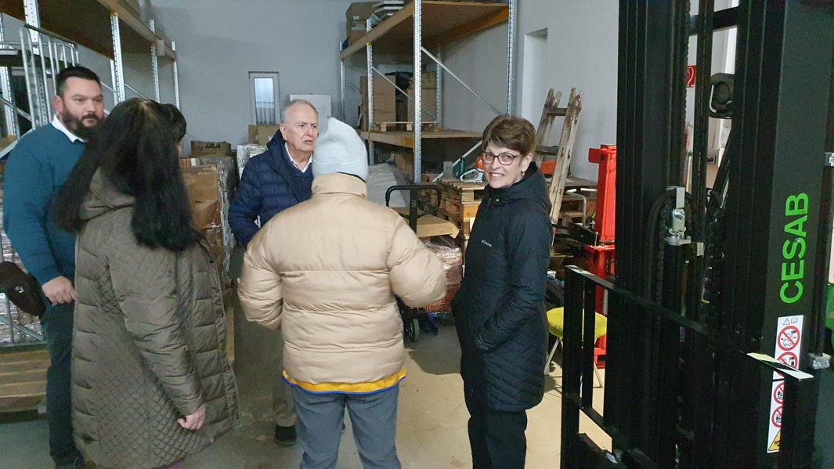
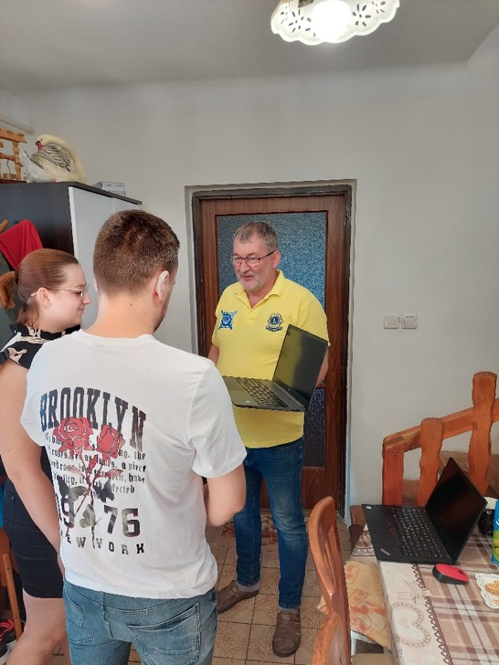
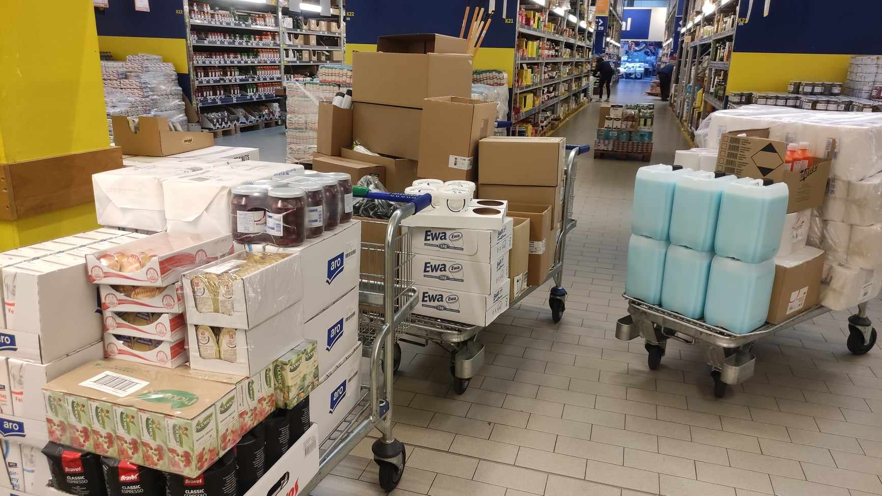
More photos for scrolling!!!

Slide 27
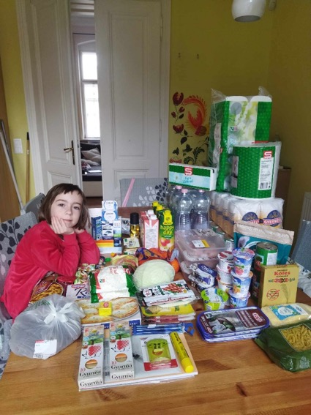
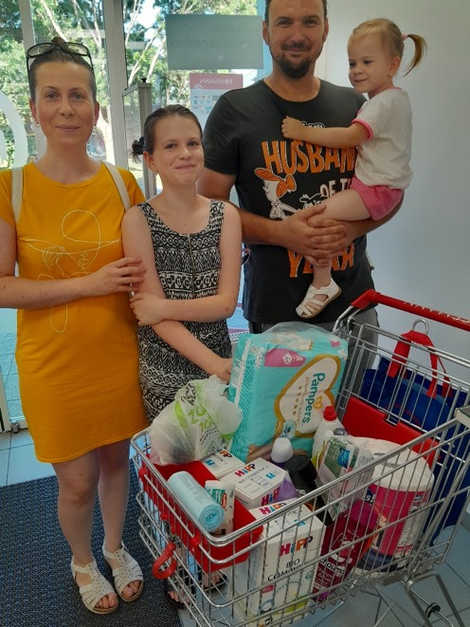
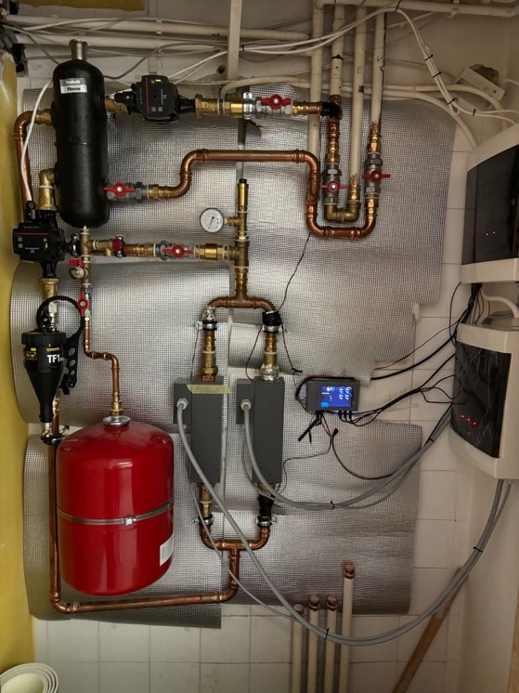

Slide 28
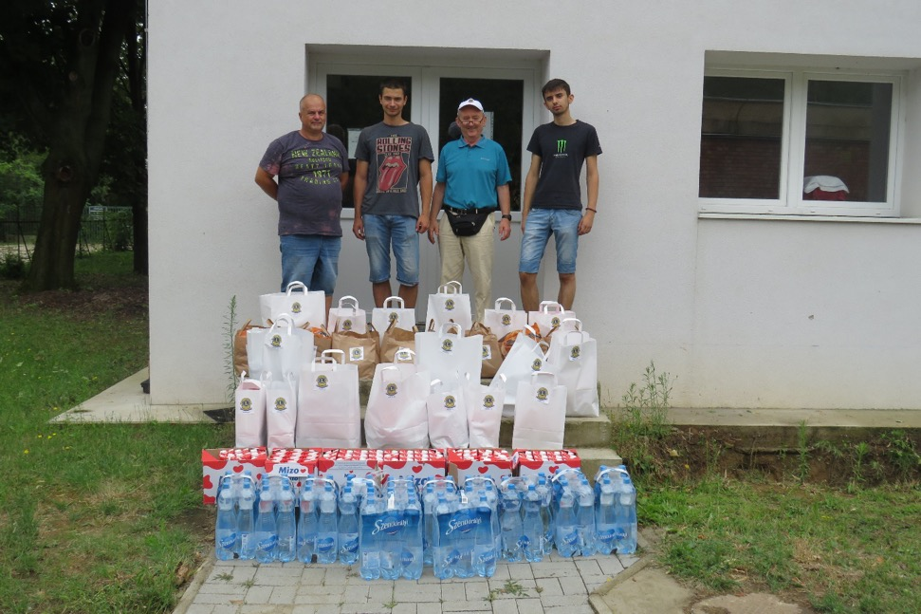
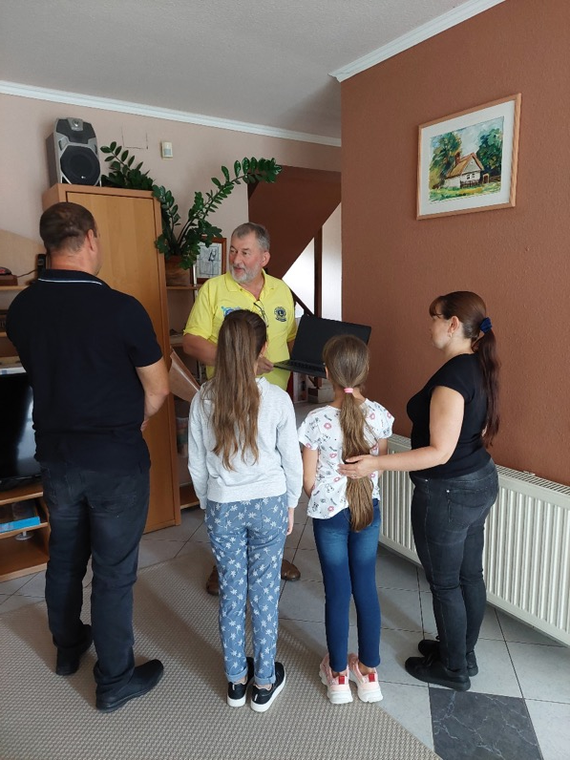
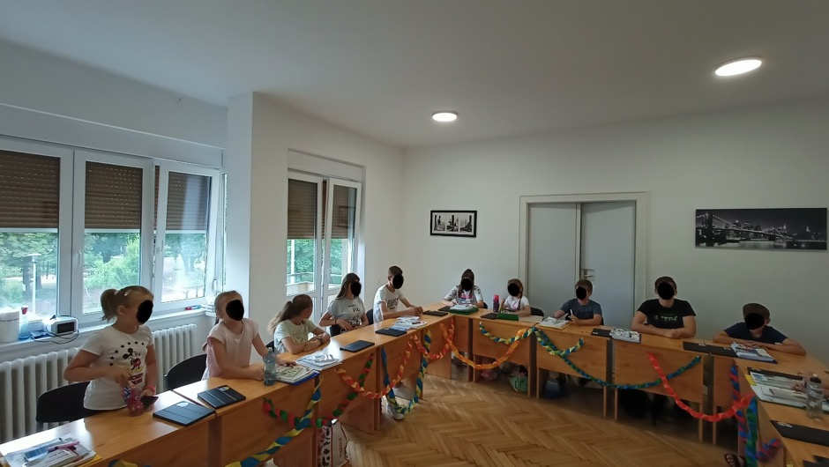

Slide 29
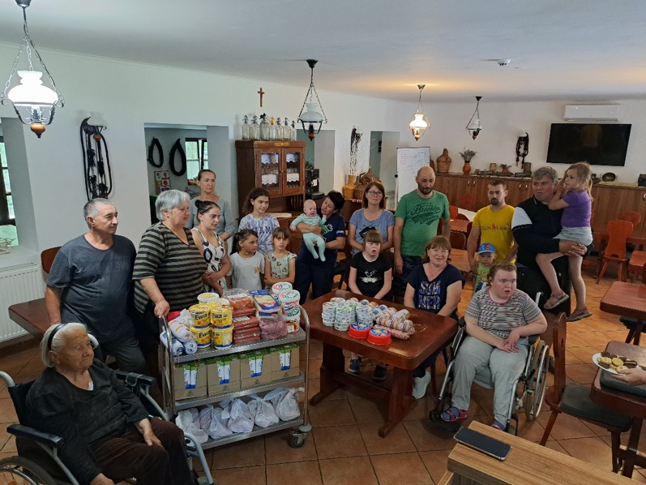

Slide 32
More photos for scrolling!!!

Slide 34
In the Lionistic year 2023/24 our most important project was a Hunger Grant. This is a classic core four grant worth nearly 80.000 U$D
The project was implemented by our club, the Budapest Mozaik Lions.

Slide 36
Thanks for Your attention, András Fésűs PDG, LCIF, YCE
Mobil: +3630-3303063
E-mail: fa@europr.hu

Slide 37
Slovak & Czech Lions for Ukrainians
Milan Taskar
LCIF District Coordinator
D122 Slovak & Czech
Czech &
Slovakia

Slide 38
Slovak and Czech Lions for Ukraine
In cooperation with German Districts, we delivered humanitarian help in volume more 1 million EUR from beginning of conflict.
Our clubs in eastern part of Slovakia acted like logistic hubs.

Slide 39
Slovak and Czech Lions for Ukrainian
LCIF supported this activity by 13’400 EUR
Danish Districts help by 10’000 EUR supported by PID Bent Jespersen
D122 CZ & SR arranged accomodation for more than 300 refugees, collected about 24’000 EUR for various help.

Slide 40
Slovak and Czech Lions for Ukrainian

Slide 41
Slovak and Czech Lions for Ukrainian
Thank you for your attention
Milan Taskar
LCIF District Coordinator
D122 Slovak & Czech

Slide 42
Polish Lions for Ukrainians
PDG Kasia Gebert
D121 Poland
Area Leader CA 4c

Slide 43
How many refugees are there in Poland now?
In the period from February 24, 2022 to July, 2024, almost 13 million Ukrainian citizens crossed the Ukrainian-Polish border.
More than 12 million people left Poland.
The latest analyses show that there are currently around 953,000 refugees from Ukraine in Poland (end of May 2024)

Slide 44
Polish Lions activities to help refugees
during the period III’2022 – IX’2024 (activities through the District)
14 grants from LCIF US$ 3,049,030
97 projects financed by LCIF grants
33 projects financed by foreign Lions ~290,000 EUR

Slide 46
What projects for refugees are Lions organizing
in Poland ?
In the first months of the war it was mostly humanitarian aid:
food,
hygiene and cleaning items,
medicines,
home furnishings (beds, washing machines, furniture, bedding, towels),
and clothing

Slide 47
Survey for refugees
A survey with 30 questions was distributed among refugees in 3 Polish cities 3 months ago. I received several hundred responses.
Currently, Poland is inhabited mainly by women with 1-2 children. Children study in schools or kindergartens. Mothers work 8-12 hours a day, half of the time legally.

Slide 48
Survey for refugees
The number of collective housing places has been greatly limited - Ukrainians have to rent apartments at their own expense and this is currently their biggest financial problem.
Refugees receive the same social assistance from the Polish government as Polish citizens. They are supported by various organizations, but 2.5 years after the war began, enthusiasm for support is much lower.

Slide 49
What should Lions support be like now?
wise and reasonable help
~ 25% / ~ 75%
elder people
chronically ill people
mothers with very small children
there is still a need for
humanitarian support

Slide 50
What should Lions support be like now?
~ 25% / ~ 75%
integration with local communities
facilitating independence (e.g. equipping temporary apartments, languages and education courses, centers with care for younger children when mothers work)
supporting children and young people in their education and development (compensatory classes for children and teenagers, language courses,, medical exams)
rehabilitation for people injured as a result of war activities
elder people
chronically ill people
mothers with very small children
humanitarian support

Slide 54
Greates needs of Ukrainian refugees
paid rental of apartments
healthcare
nostrification of documents so that they can work in their professions
education for adults and children

Slide 55
Polish Lions are honored that you - Lions from all over the Europe - entrust us through LCIF with such huge funds to support Ukrainian refugees.
I think this is one of the greatest values that unites us.
THANK YOU Lions !
thank you LCIF staff for support!
PDG Kasia Gebert
Area Leader CA 4c
LCIF Coordinator D121 Poland

Slide 56
My personel succes story
Bent Jespersen, PID
Member of Lions Hellerup

Slide 57
Not all grant have to be large sums and large projects
At the Lions Hellerup's club meeting in November, the club had a visit from doctors Gøril Boberg-Ans and Jannik Boberg-Ans, who spoke about their project Red Synet. (save the sight)
.
Notes:
Where most people choose to spend their free time and holidays with family and friends, the medical couple have decided to use their holidays to make a difference. Several times a year they traveled to some of the world's poorest countries and helped blind people regain their sight. They make this effort from the heart. Therefore, all donations go directly to equipment, medicine and travel expenses.
The couple have now established a permanent eye clinic in Karatu, Tanzania, where they give poor, blind people their sight back. These people will never be able to afford or have the opportunity to have cataract surgery on their own. Cataract is a condition where the natural lens has turned brown and cloudy. During the operation, the cloudy lens is replaced with a clear artificial lens, and thus the person will see and be able to help their families again.
.

Slide 58
At the meeting, they talked about one of the biggest wishes - a CataRhex3 device, which is a portable instrument. CataRhex 3 makes cataract surgery incredibly fast, safe, calm and – thanks to its excellent mobility, it increases flexibility. It saves space and ensures safe cataract surgery at the highest level.
Notes:
Unfortunately, the price was a challenge, as the device costs a little more than DKK 200,000.
Lions Hellerup took up the challenge and contacted Lions Gladsaxe and presented the idea. The clubs jointly found half the amount and then decided to apply for LCIF for a grant. It was not possible to make it to the LCIF board meeting in January, and the goal was therefore an application that could be included in the May meeting.

Slide 59
APPLICATION FOR A MATHING GRANT
Date: 10th January 2023
Project name/title: CataRhex 3 surgical platform Amount of funding requested from LCIF in US$:30.000
The Danish organization Eye Rescue came In September 2022 in contact with Lutheran Hospital Karatu, Tanzania and have now established a permanent eye clinic at the hospital.
For information about the organization Eye Rescue please see here
Notes:
The eye clinic covers an area of ​​over 300,000 people, there is no permanent eye clinic, and the nearest eye center is 250 km away.
We will cooperate with District 411 C. We intent to set up an agreement concerning help to logistic and following the project as good as they are able to do taking into consideration the big distances in that area.
During the proces we had soe feed back from Julie, asking for some more details, but all in due time for the board meeting.

Slide 60
Total USD 33.000 USD 33.000
Notes:
The we just have t wait for the reply.

Slide 61
Finally at 5 of June, an email arrived
“Congratulations! I am pleased to forward you the official award documents for the recent grant MAT24076/106-A approved by LCIF in the amount of US$16,500. The attached documents include the grant agreement, banking forms, and a report form.”

Slide 62
The equipment was bought and brought to the hospital and are now in use every week.
62

Slide 63
Thank you for your attention

