Slide 1

Lions Project 2024:
Stoves to Ukraine
Projectizing LCIF donations
LCIF Area Leader Jyri Kurki
1

Slide 2
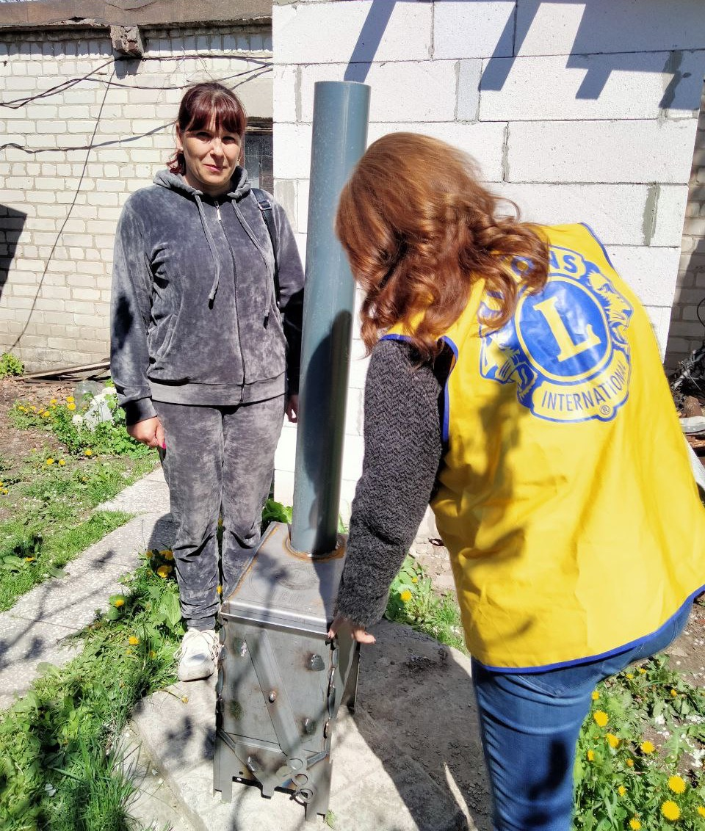

Agenda
Great story of how LCIF donations were successfully concepted to crowdfunding project with concrete productized donations.
2

Slide 3
Getting started
After a very popular generator project project team continues with a new needed product and invites LCIF to participate in.
2022 DEMAND
Ukrainian families suffer from war
2023 GENERATORS
1.5 MEUR & about 2300 generators for 300,000 children in schools
2024 NEW PROJECT
High demand for support in Ukraine. Agree a new needed product for this project
2024 INVOLVE LCIF
Agree a new project concept for donations via LCIF to a specific target
3

Slide 4





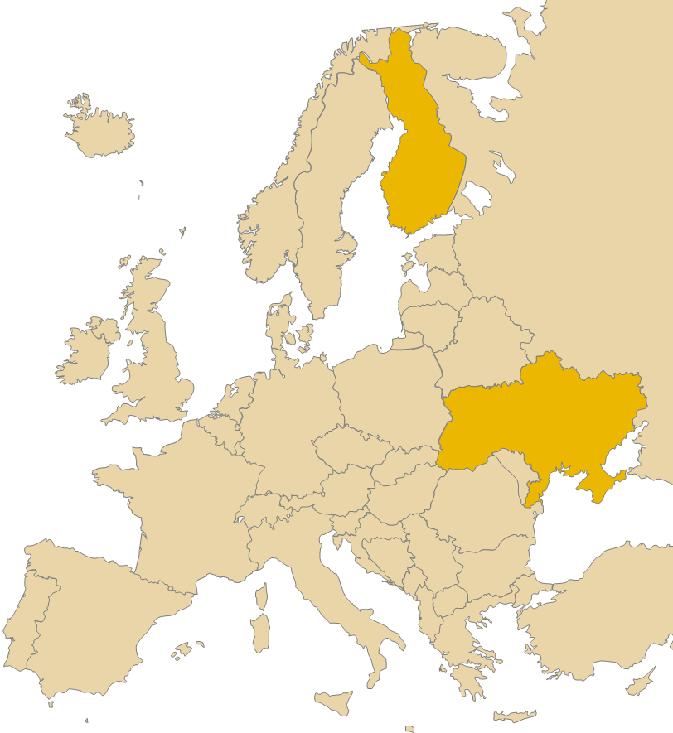




















































Project in practice
MJF credit
4
PROCESS
Flow of money
Journey of products
Happiness of donor + people in need

Slide 5

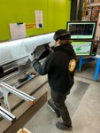



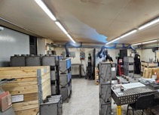
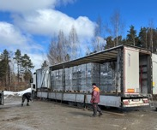
Creation of Stoves
Material purchase of 24 tons of steel (900 stoves = 1 truck load)
Production capacity of 600 per week
Laser cutting the parts
Bending & Welding
Packaging & Shipping
5

Slide 6
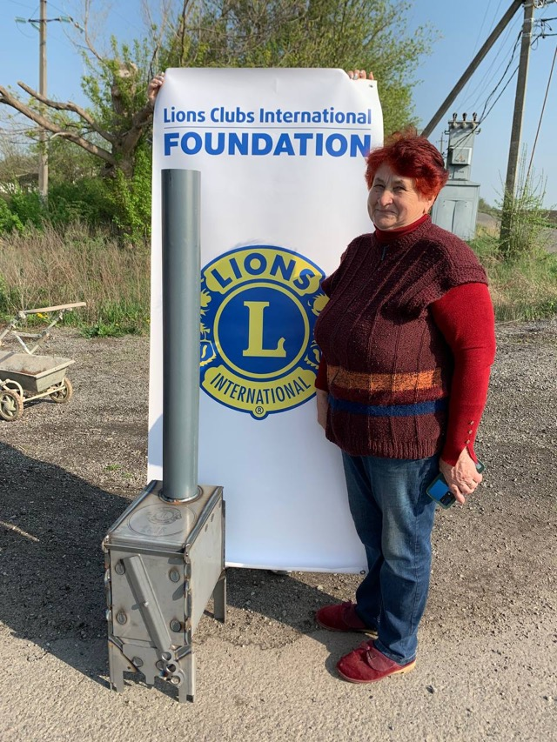
8100 Stoves
Amazing generosity of people in Europe and outside have made it possible to support thousands of households and communities in Ukraine.
6

Slide 7
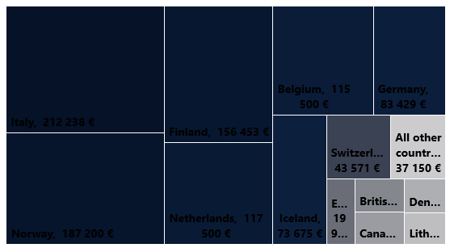
Project Results
1.2
Million
USD
25 countries participated, from 5 Constitutional Areas.
TOP 5 donated over 100,000 EUR each, and 13 countries donated over 10,000 EUR.
7

Slide 8









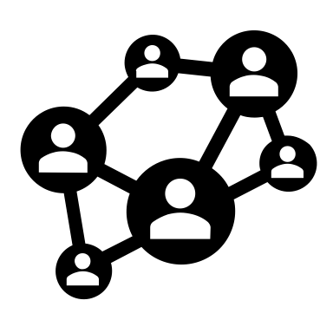




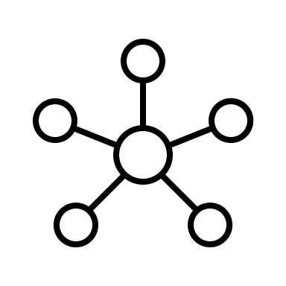


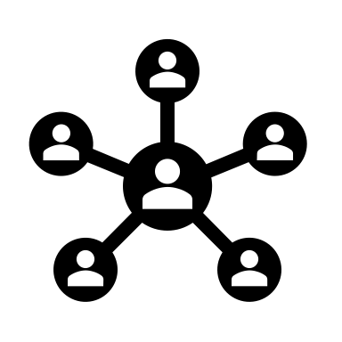








From generic cause donations to crowdfunding of productized projects
?
?
€
€
?
?
€
LCIF
€
LCIF
?
?
€
€
8

Slide 9




aa
New Productized Crowdfunding Model
Network & Marketing + External Reach
Lions network utilized effectively to reach donors. There are great opportunities for external crowdfunding reach & online payments
LCIF Project Agreement for MJF Credits
LCIF holds key role in assessing the project (need, production to delivery, and coordinator), and deciding to participate in project.
True, Emotional Need & Concrete Product
Project is always based on real need and characterized products in high demand that relatable emotional value to donors.
Trusted Contact Person / Coordinator
It is all about trust! LCIF must trust coordinator & team, and donors must be able to trust project team.
9

Slide 10
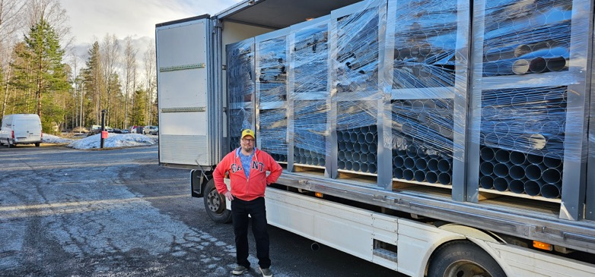
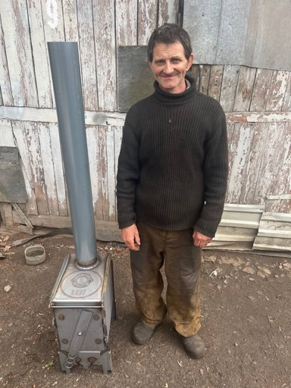

Slide 11
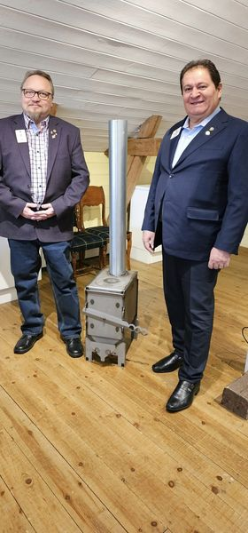
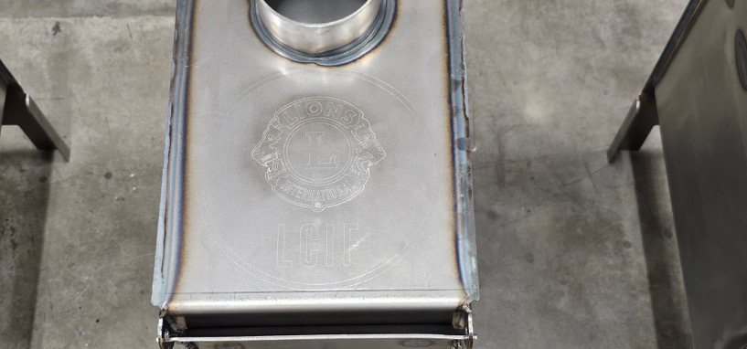

Slide 12
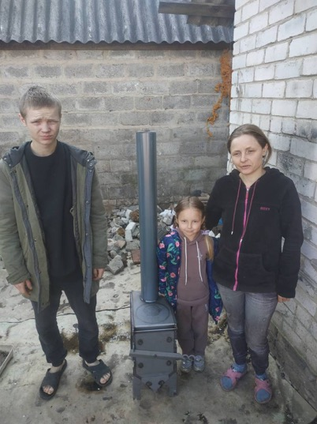
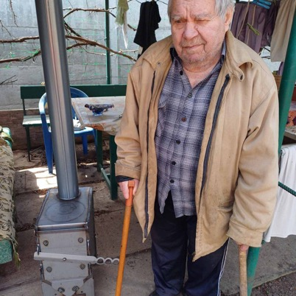
Thank you!

