Slide 1
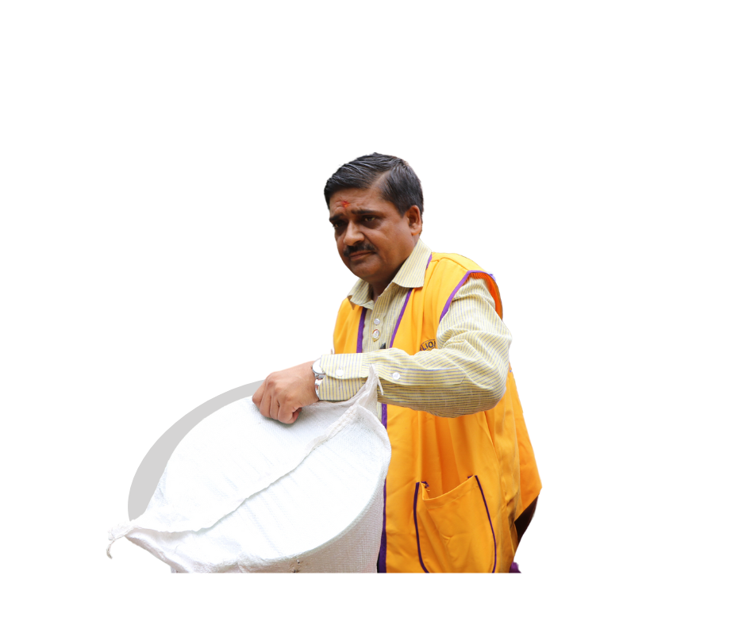
Messages that inspire giving 1-3
PID Bent Jespersen
MD106 CAIV LCIF Constitutional Area Leader

Slide 2
OFFICERS | CA I | CA II | CA III | CA IV | CA V | CA VI | CA VII | CA VIII | CURRENT WORLDWIDE AVERAGE
Past International President | 58% | 100% | N/A | 100% | 80% | 100% | 0% | N/A | 79%
International Director | 100% | 100% | 100% | 100% | 100% | 100% | 100% | 100% | 100%
LCIF Trustee | 100% | 100% | 100% | 100% | 100% | 100% | 100% | 100% | 100%
Past International Director | 59% | 58% | 46% | 44% | 73% | 50% | 50% | 71% | 58%
Council Chairperson | 80% | 100% | 56% | 50% | 95% | 67% | 67% | 100% | 74%
District Governor | 81% | 83% | 65% | 47% | 77% | 69% | 69% | 50% | 65%
LCIF Multiple District Coordinator | 96% | 89% | 89% | 82% | 91% | 71% | 71% | 80% | 82%
LCIF District Coordinator | 79% | 77% | 69% | 44% | 65% | 62% | 62% | 94% | 63%
GAT Coordinator | 51% | 59% | 53% | 17% | 62% | 40% | 40% | 31% | 42%
Club President | 11% | 5% | 22% | 2% | 33% | 6% | 6% | 9% | 12%
Club LCIF Coordinator | 26% | 18% | 27% | 6% | 47% | 17% | 17% | 19% | 19%
Leadership Giving
2

Slide 3
Why people choose to give:
They believe in the mission of the organization.
They believe that their donation can make a difference.
They want to give back to their community.
Notes:
Yesterday we discussed the pillars that inspire donations: learning, trusting and engaging. Research suggests that all three need to be built before someone is inspired to donate. We also shared a few of the reasons that people give once they are inspired. The top three reasons are up on the screen now, and we will be discussing them today.

Slide 4
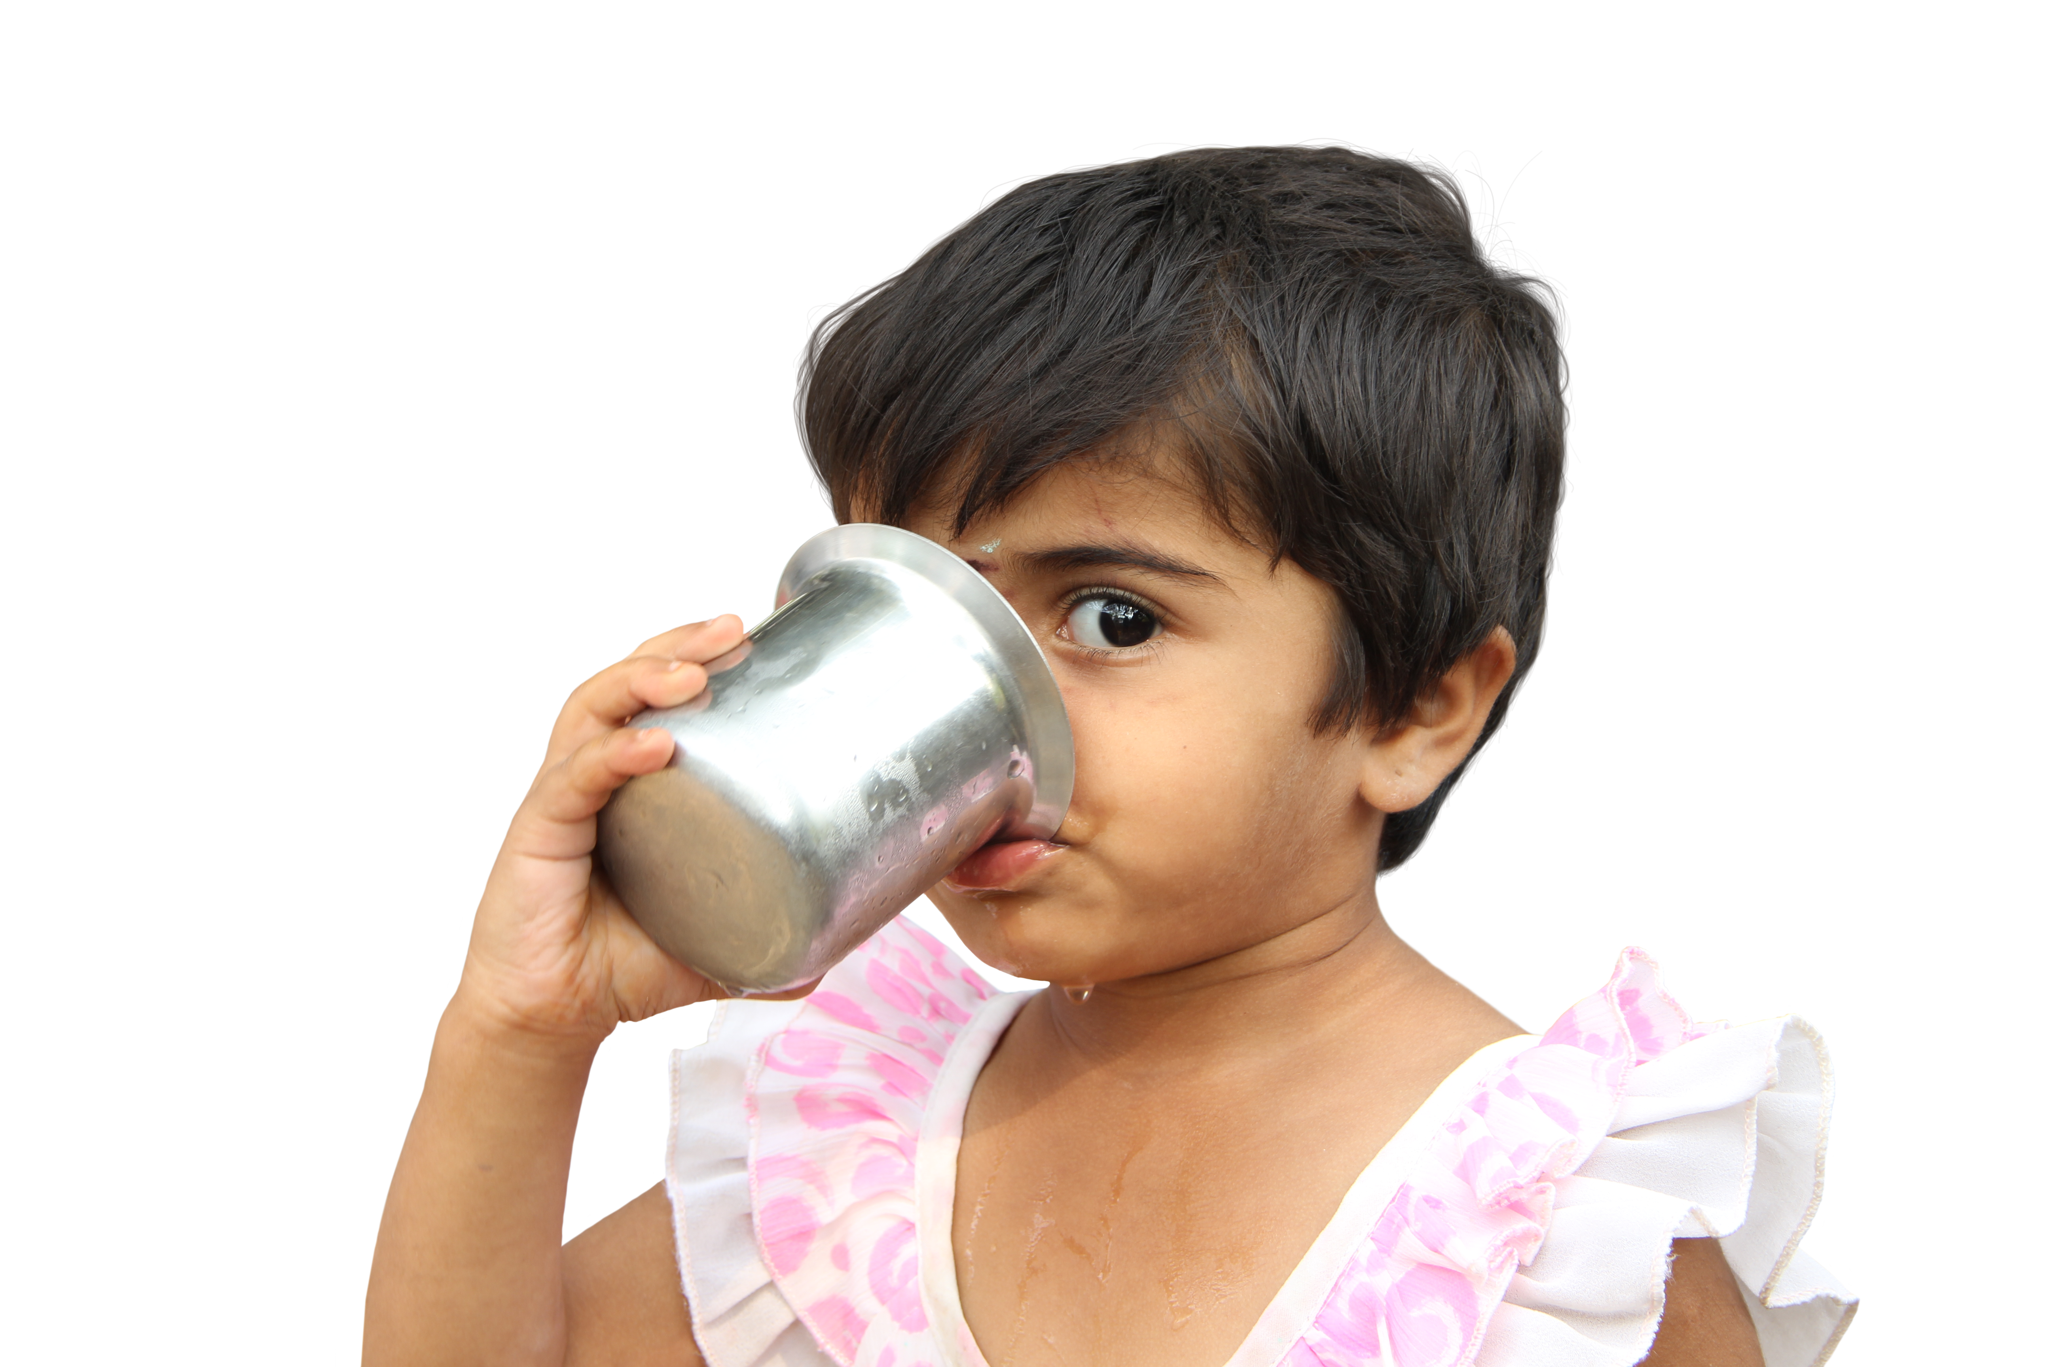
#1. They believe in the mission of the organization:
How you share the organization’s mission.
What resources you use to access information on this topic.
Notes:
There are so many important things to talk about that relate to this topic.
Around your tables now, please begin by discussing:
How you share the organization’s mission
What resources you use to access information

Slide 5
#1. They believe in the mission of the organization:
How you share the organization’s mission.
What resources you use to access information on this topic.
Resources:
LCI’s mission statement (website).
Causes and their case for support (website or the news).
LCIF’s impact: (Stories of Pride; LCIF’s YouTube playlist; LCIF’s Facebook page).
Grant histories.
The Programs teams support of project quality and donation stewardship.
Notes:
LCI’s mission statement (the website)
Causes and their case for support (website, but also the news!)
ICLF’s Impact is often told on Stories of Pride or on YouTube playlists.
Grant histories can be requested through LCIF and can include:
Districts
Country
CA
The world
We have had several discussions about quality grants and the best one. KaSondra will have some presentations on that topic later today.
Ask the group for two to three additional comments.

Slide 6
#2. They believe that their donation can make a difference:
What messages or stories do you use to let people know their donation makes a difference?

Slide 7
#2. They believe that their donation can make a difference:
What messages or stories do you use to let people know their donation makes a difference?
Possible answers:
100% of donations go toward grants.
Local design, and local implementation of grants helps ensure sustainability and impact.
Personal stories with grants, or by third party.
Notes:
Ask tables for two-three additional comments

Slide 8
#3. They want to give back to the community:
How do you talk about our membership in a global Lion community of humanitarians?
Are there ways to show instead of tell?
Do District and Community Club Impact Grants (DCGs) fit into this discussion?

Slide 9
#3. They want to give back to the community:
How do you talk about our membership in a global Lion community of humanitarians?
Are there ways to show instead of tell?
Do District and Community Club Impact Grants (DCGs) fit into this discussion?
Possible answers:
Lions are united by our desire to make a difference in the world.
Lions are a circle of humanitarians united by our experience of service.
Qualifying for District and Community Club Impact Grants (DCGs) is a good way to give to geographically local and international communities at the same time.
Notes:
Ask the group for two-three additional comments.

Slide 10
Why people choose to give:
They believe in the mission of the organization.
They believe that their donation can make a difference.
They want to give back to their community.
Reflections:
Which messages are currently successful: why, when, and with whom?
Who is currently being inspired to give by our messages?
Is there messaging that we are currently not using that might inspire more people?
Are colleagues using messaging that is different from ours that we might try?
Notes:
These are the original reflection questions. You don’t have to discuss them again. This is just some time to allow you to get any final thoughts or consolidation about these questions out.

Slide 11
Messages that inspire giving 4-6
Name
Paul Steele
Region
Regional Development Manager

Slide 12
Fundraising Pillars: Why People Choose to Donate
They believe in the mission of the organization
They believe that their donation can make a difference
They want to give back to their community
Personal satisfaction, joy and fulfillment
They were asked
Spontaneous response to a need
Notes:
This first slide includes the most common reasons people donate according to academic research in fundraising. These are the top 6 starting from the most common to the least common.
It is my suspicion that you will recognize some of these reasons from your interactions with donors, as well as from our past and current trainings.
1.believe in the mission of the organization
2.believe that their donation can make a difference
3.want to give back to their community
4.Personal satisfaction, joy and fulfillment
5.They were asked
6.Spontaneous response to a need
The good news here is that non of these reasons are personal, which means if people hate us, that doesn’t mean they cannot be moved by our causes. As we’ve said, the best place for the origin of another person’s donation is from their heart.
These are the ending motivations, but before we talk about those more, we should talk about how we get here.

Slide 13
Pillars of stewardship
Learning
(Head)
Trusting
(Heart)
Engaging
(Hands)
Notes:
These are three pillars of stewardship that people must experience before they donate. The process most people go through before they donate for the reasons in the previous slide.
I’ve added nicknames to them, like head, hearts and hands. I’ve been told that Leadership uses the terms head, heart and guts as well. These terms are used in a different context.
We are going to review this journey in detail, and as we review some questions, I’d like you to answer some of the questions it includes according to yourself:

Slide 14
Why people choose to give:
4. Personal satisfaction, joy and fulfillment.
5. They were asked.
6. Spontaneous response to need
Notes:
Yesterday we discussed the pillars that inspire donations: learning, trusting and engaging. Research suggests that all three need to be built before someone is inspired to donate. We also shared a few of the reasons that people give once they are inspired. The top three reasons are up on the screen now, and we will be discussing them today.
Reflect on:
Which messages are we currently successful for us? Why and when are those messages successful?
Who is currently being inspired by our messages: by moving pillar to pillar, and to give?
Is there messaging that we are currently not using that might help brining in more donors?
Are colleagues using messaging that is different from ours that we might try?

Slide 15
#4. Personal satisfaction, enjoyment or fulfillment:
When has donating made you feel good?
What role does recognition play in this feeling?
At times when recognition is not important what takes its place as a reward?
To what extent is it important to lead through your values by donating?
Is your feeling about donating similar or different to other people in your district? Why or why not?
Notes:
We’ve talked about how people benefit when they donate.

Slide 16
#5. They were asked:
When has asking for donations been successful for you?
What have you said in your successful solicitations?
When do you know the time is right?
Can you sense a relationship between the success and the pillars of stewardship, and the reasons people give that we have talked about?
Notes:
We’ve talked about how people benefit when they donate.

Slide 17
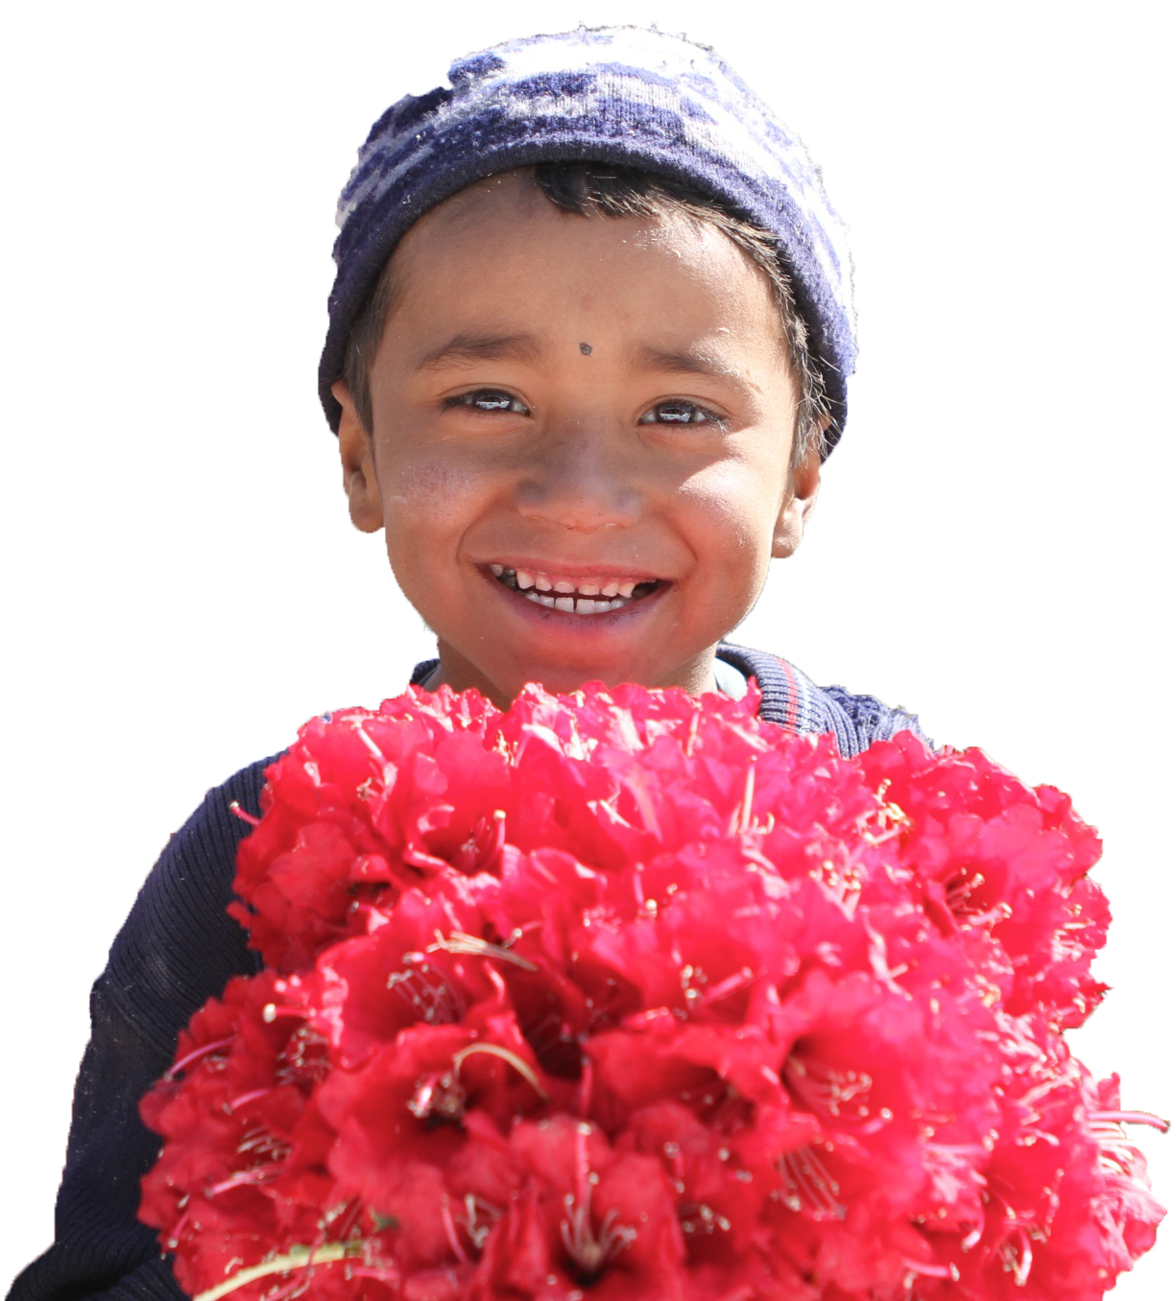
#6. Spontaneous response to a need:
How and when does this work in your district?
What is important to your message?
What kind of support is needed from LCIF?
What kind of additional support can you provide?
Notes:
We’ve talked about how people benefit when they donate.

Slide 18
Why people choose to give:
They believe in the mission of the organization.
They believe that their donation can make a difference.
They want to give back to their community.
Reflections:
Who is currently being inspired to give by our messages?
Is there messaging that we are currently not using that might inspire more people?
Are colleagues using messaging that is different from ours that we might try?
Notes:
At the start of this discussion, we asked you to consider the reflection questions at the bottom of this slide.
Take some time at your tables now, to discuss these reflection questions together again.

