Slide 1
LCIF Volunteer Training Overview
Knowledge, Skills and Attitude Competencies
Overview of the materials shared in 2021-2022 and 2022-2023 CA IV Volunteer trainings
Notes:
This is an overview of our training approach, inclusive of goals and materials covered in the past.

Slide 2
Types of learning
Knowledge
(concepts, ideas and information)
Behaviors
(how to implement knowledge)
Attitude
(confidence to execute)
Notes:
Trainings for LCIF volunteers focuses on:
Knowledge- helping participants remember important details and information useful to their roles
Behaviors- introducing actions and skills that may be useful to implement in their efforts
Attitudes- building confidence, resilience and optimism that will help our volunteers embrace the good days, learn from the tougher ones, and give themselves the opportunity to reflect.

Slide 3
Stages of material mastery
Recall learning
(past oriented)
Create & implement plans
(present oriented)
Change plans & plan strategy
(future oriented)
Notes:
As you embrace the training material, it may be helpful to consider levels of mastery as well:
Recall: At the most basic stage of mastery, participants are able to recall things they learned
If participants are able to use the information they received to create and implement plans, that is the second stage of material mastery.
If participant are able to use the materials in real time, to improvise and to integrate it into strategy, that is the third stage of mastery.
As we discuss ideas today, it may be helpful to consider they look like at level 1, 2, and 3 of material mastery.

Slide 4
The last 2 years in review:
LCIF’s mission
Our united community of service as Lions
LCIF fundraising team roles
Donation stewardship
Grants as community empowerment
Recognition and thanking donors
Cause areas and their case for support
Impact and grant examples locally and around the world
Global partnerships
Operational understanding of LCIF
Notes:
Over the last two years, these are some of the topics we have covered:
LCIF’s mission: found on the website. We reviewed it last year and found it to be useful as a guiding text.
Our united community of service as Lions: as Lions we have all been involved with projects, and that feeling of satisfaction is what unites us as a global community of Lions. We want people to know that they are a part of both their local and internation a community of Lions.
LCIF fundraising team roles: we reviewed each volunteer’s role, and I think some of us were surprised by the details of the position description; but understanding the importance of our fundraising role to support the availability of the grants that make our community of service possible is important.
We have discussed the standards that the programs team has, which ensure that LCIF spends donations in a way that maximizes efficiency, impact and sustainability for projects.
We have discussed how grants empower communities, that they are not intended as charity. Donation that support grants are available to us all to address our needs. As Lions we are here for each other as equalis.
We have discussed how recognition insulates grant recipients from being beholden to any identifiable group of donors, and how that insulation allows them to feel empowerment in grant implementation. LCIF provides thanks to donors because donors should be thanked. It is up to our volunteers to help donor understand this dynamic.
We have discussed our cause areas and the case for support on many occasions, it is important that we all remember that we can get information on them from LCIF’s website, but that these cause areas have been chosen because of their relevance, they are available for discussion in the news as well. As LCIF volunteers, we should make ourselves aware of the current events relevant to our cause areas.
We have provided examples of grants that demonstrate our service and impact, there are also examples on Stories of Pride, and from Lions within our own community. Remember: LCIF grants are implemented by local people. They understand the needs and contexts of their communities the best. That is what makes local implementation so impactful.
The most important thing I want our volunteers to know about LCIF’s partnerships is that they are inspired by the successful implementation of local grants. That means everyone here that has been involved with a grant has helped to inspire our global partnerships.
Operational understandings of LCIF are important for our volunteers to know because misunderstandings about Donor Services or our grants can feel very personal and alienating. Sometimes the confusion is the result of a mistake, but more often than not, it is the result of Lion not knowing or understanding our procedures. Helping them understand both mistakes and misunderstood operational procedures can help alleviate the bad feelings and the errors.

Slide 5
Attitude: empowerment of learned materials to support ability and teamwork
Confidence: in roles as leaders, the mission of LCIF, and in oneself to perform tasks in local context.
Enthusiasm: for representing and supporting the foundation.
Reflective practice: for improvement of approach and resilience.
Team building: for learning, sharing, and support.
Leadership: in supporting service through LCIF in local context.
Notes:
These are some elements of attitude we try to encourage in our training.
Confidence is important, because that is what empowers our volunteers to initiate ideas. We remember more when we are happy.

Slide 6
Topics for this training:
Topics in fundraising and strategies for engagement
Fundraising leadership
Asking for help
Approaches to thanking donors
Grant program updates
Notes:
This is the third year of our training now, and it has built topically over the years.
Here are a few of the things we hope to cover today:

Slide 7
Questions for this year:
What personal goals do you want to accomplish this year?
What expectations are you brining to this training?
Notes:
In the past we have had separate trainings. This is the first time we have come together as a single group. The goal is to increase the scope of peer learning that is possible for our circle of LCIF volunteers.
Each District and Single District does things in slightly different ways. In an effort to facilitate sharing as much as possible, we will ask your team to keep notes on the most important ideas and learnings from each activity and to consider why it is relevant to your fundraising activity this year.
At the end of each day, we will ask your team to break up into a presentation team and a touring team. The presentation team will stay near your station to share thoughts with touring teams, which will rotate around the room, listening to presentations asking questions, and sharing thoughts and ideas.

Slide 8
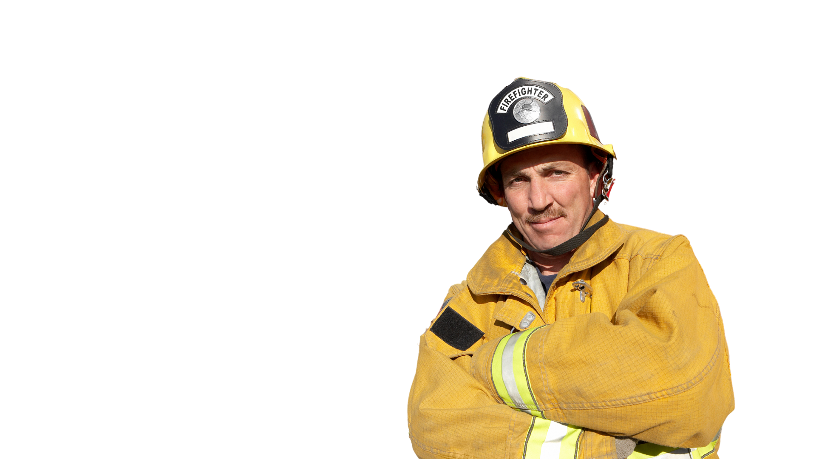
Successes and challenges
When did you last feel pride or joy in your efforts for LCIF?
Notes:
This question is asking when you felt successful. If you are more of a thinker than a feeler, the question be: when you felt most successful.

Slide 9
Successes and challenges
When did you feel challenged or frustrated during your work supporting LCIF?
Notes:
These feelings reflect challenges to our values.
Reflect on how those moments related to your values.

Slide 10
Sharing is caring
Take turns sharing some of your key moments together at your table. Work together to identify:
Similarities
Themes
Opportunities to learn about yourself and your work with your fellow Lions.

Slide 11
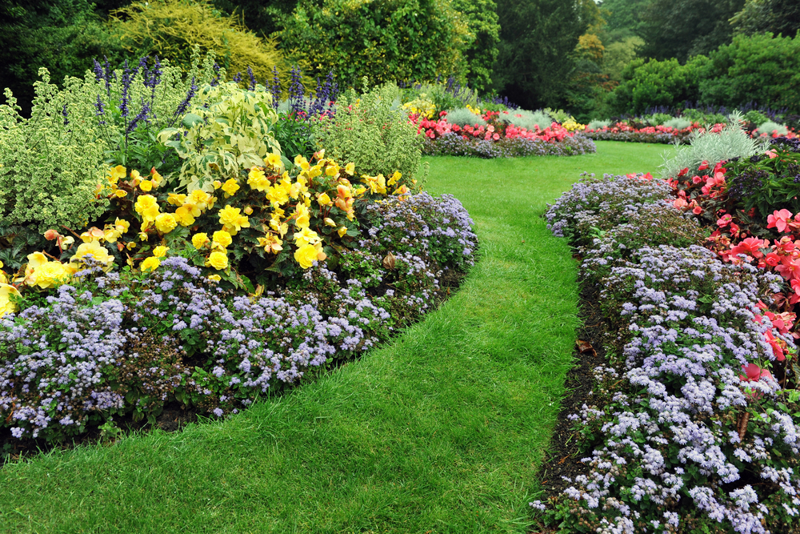
This year’s garden:
Personal goals
Personal challenges
The values that guide you in supporting LCIF
Plant your garden of and for success:
Notes:
Using what you have thought about and discussed as a team, I’d like to ask you to work together to draw a garden that symbolizes your ambition for this year. You might need to use some of the seeds from those challenges, and some from your personal goals. What elements did your team have in common?
I’ll give you 10 minutes to complete this exercise now.

