Slide 1
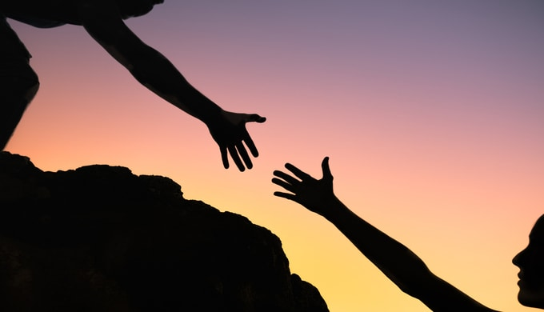
Morning ice breaker
Paul Steele
Development Manager: Europe & Africa
Notes:
We are going to play a game
Select a manager at each table by height

Slide 2
Manager’s Role:
Make sure your team:
Follows instructions.
Does not begin the activity until all directions are provided.
Completes the task to the best of their ability.
Notes:
Managers, please note your instructions for this activity.

Slide 3
Team Role:
When I say go, all members of the team will:
Draw a picture of a smiley face with two eyes and a mouth.
Will have 30 seconds to complete their task.
Notes:
There will be one more step once the 30 seconds is done, so please try to remember to leave your mask on.
Managers, remember your role:
Make sure your team:
Follows instructions.
Does not begin the activity until all directions are provided.
Completes the task to the best of their ability.

Slide 4
One more thing:
Team members:
Find your paper and a pen now.
Before you draw your picture, please secure your masks.
Notes:
One more thing…

Slide 5
Manager’s Role: Remember!
Make sure your team:
Follows instructions.
Does not begin the activity until all directions are provided.
Completes the task to the best of their ability.
When time is up, please leave your masks on.
Ready…
Notes:
Managers, remember your roles.
Ready everyone… go!
Once the time is up and everyone has stopped drawing, ask people to also draw a nose.

Slide 6
Art Show!
Remove your masks.
Share your art.
Choose your team’s best picture!
Notes:
After managers select a winner:
As you went through this exercise, managers and team members, ask yourselves the following questions:
What kind of feelings were involved in with this exercise?
How did you approach completing this task?
Let’s remove our masks and show each other our work.
Managers, work with your team to select the winner!
Managers, was it easy to select a winner?

Slide 7
Reflection:
How did you feel when:
You heard there would be a game.
When we chose a manager.
When you learned the task was drawing a happy face.
You learned you had to do it blindfolded.
You knew you had a time limit.
You shared your art with the team.
Notes:
Ask people to close their eyes and review the emotions of their experience.
Final two questions are on the next slide.

Slide 8
Reflection:
How did you feel when:
You heard there would be a game.
When we chose a manager.
When you learned the task was drawing a happy face.
When you learned you had to do it blindfolded.
When you knew you had a time limit
Did you ask your manager for help? Why or why not?
Managers, did you offer help? Why or why not?
Notes:
Give additional time to reflect on the last two answers, then ask tables to share their answers.
Managers, did you help your team? Why or why not?
Team members did you ask for help? Why or why not?

Slide 9
Working Together
Let's try one more time:
Notes:
This time the shortest person at your table should be the manager

Slide 10
Manager’s Role:
Make sure your team:
Follows instructions.
Does not begin the activity until all directions are provided.
Completes the task to the best of their ability.

Slide 11
Team Role:
When I say go, all members of the team will:
Draw a picture of a smiley face with two eyes and a mouth.
Will have 30 seconds to complete their task.
Find your paper and a pen now.
Before you draw your picture, please secure your masks.
Notes:
There will be one more step once the 30 seconds is done, so please try to remember to leave your mask on.
Managers, remember your role:
Make sure your team:
Follows instructions.
Does not begin the activity until all directions are provided.
Completes the task to the best of their ability.

Slide 12
Manager’s Role: Remember!
Make sure your team:
Follows instructions.
Does not begin the activity until all directions are provided.
Completes the task to the best of their ability.
When time is up, please leave your masks on.
Ready…
Notes:
Once the time is up and everyone has stopped drawing, ask people to also draw ears.
During this process note how the managers behave. Particularly any activity that displays learning or stress over the course of the exercise.

Slide 13
Art Show!
Remove your masks.
Share your art.
Choose your team’s best picture!
Notes:
Review some of the manager approaches.
You might have noticed that they were just staring. Or that they were overwhelmed. They might have had to learn the best way to help.
We all have multiple teams:
District Cabinets
Club Coordinators
Zones
MDCs are part of different teams
Area leaders too

Slide 14
Asking for help
Reduces stress
Increases confidence
Gets better results
Stronger relationships
Sense of belonging
Builds trust
Improves resiliency
Increases authenticity
Provides a helper's high
Notes:
Reduced stress: Asking for help can relieve worries and doubts, and decrease stress and negative thoughts.
Increased confidence: Asking for help can boost confidence and self-esteem, and help you overcome self-limiting beliefs.
Better results: You might find solutions to problems faster with help, and become more efficient and creative.
Stronger relationships: Asking for help can strengthen your relationships with others, and create opportunities for them to contribute their knowledge and expertise.
Sense of belonging: Asking for help can foster a sense of interconnectedness and belonging in your community.
Builds trust: offering help is an act of humanity, asking for help is an act of trust.
Resiliency: Asking for help can be a resiliency skill that can help you live a happier life.
Authenticity: Asking for help can reveal your authenticity and vulnerability to others, and make you feel real.
Helper's high: The person who is asked to help can also benefit from the experience, strengthening social ties and feeling generous
To ask for help you have to have the awareness and willingness to ask. But it can feel good, and it can feel good to help!

