Slide 1
Where to find what on the web
District Goals
Real Time Dashboard and Drill-down Reports
LCIF Marketing Portal
lcifday.eu
Lionsclubs.org
Monthly reports
MyLCI

Slide 2
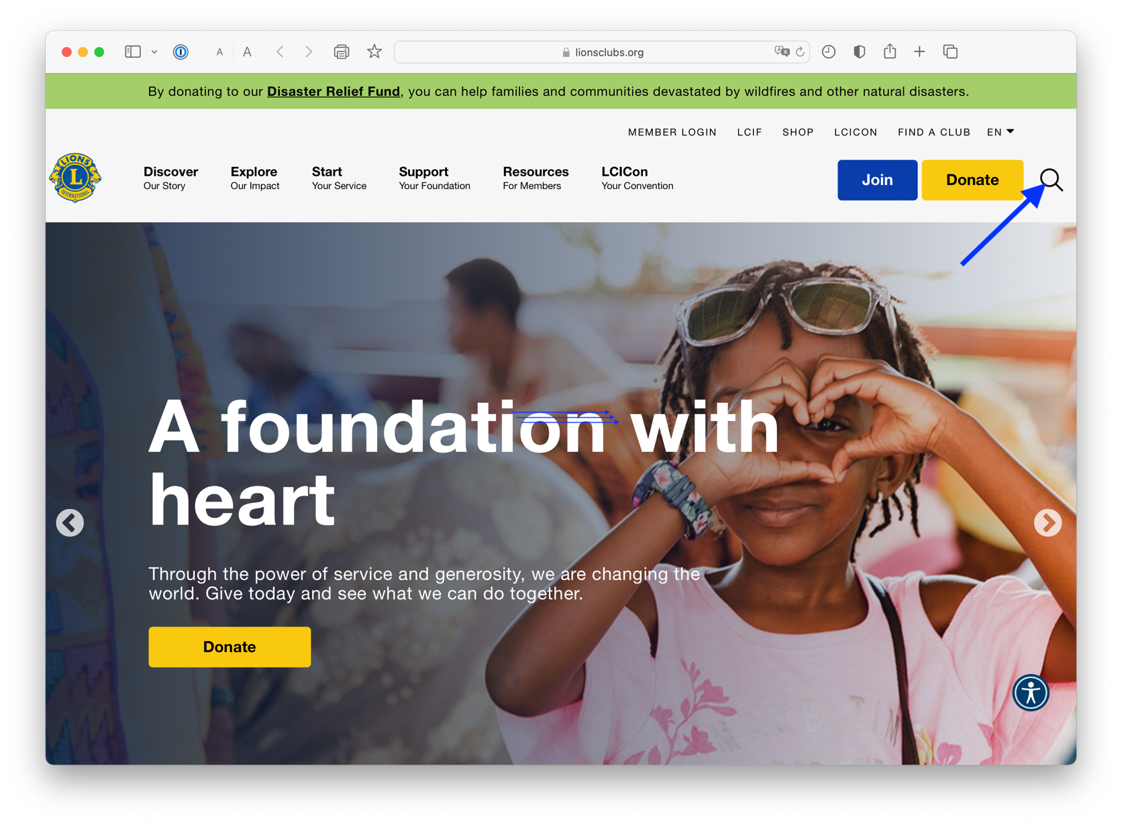
Notes:
Your role is stragegic

Slide 3
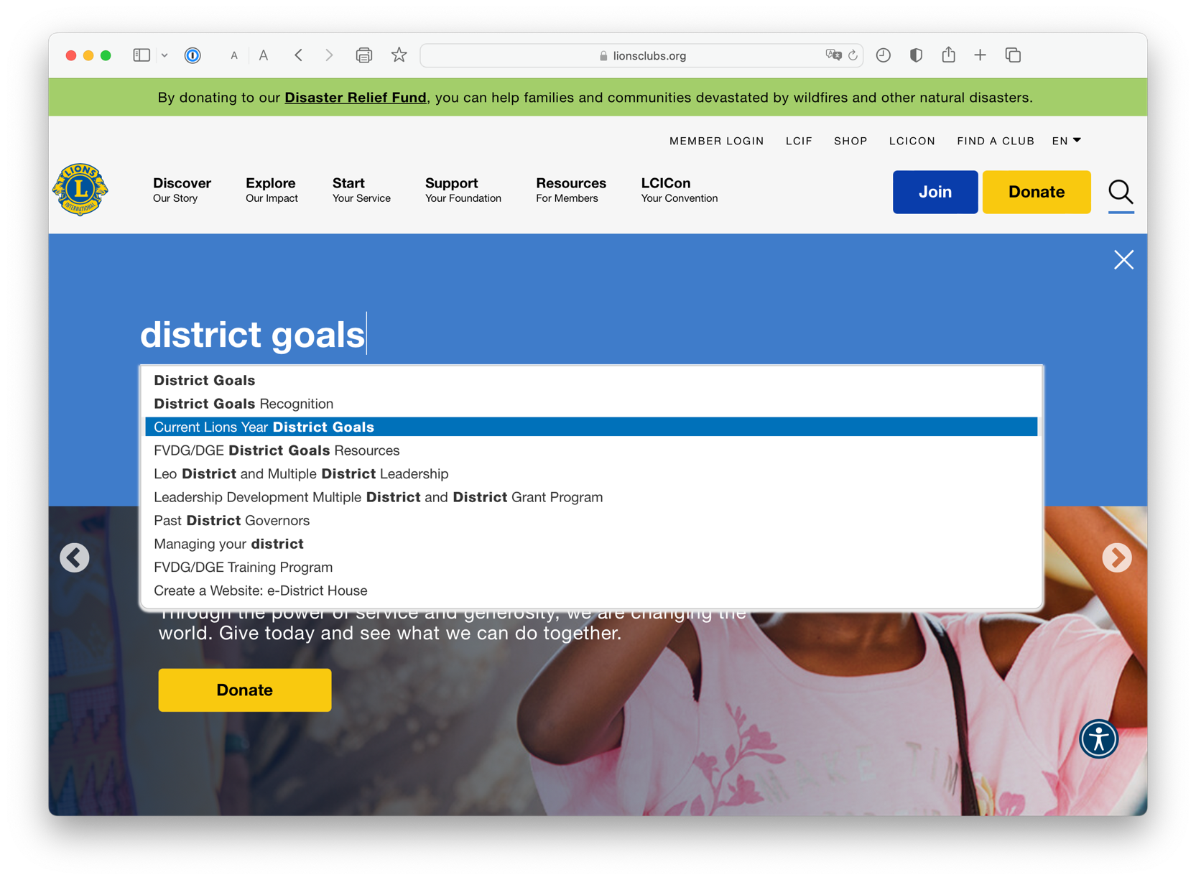
Notes:
Your role is stragegic

Slide 4
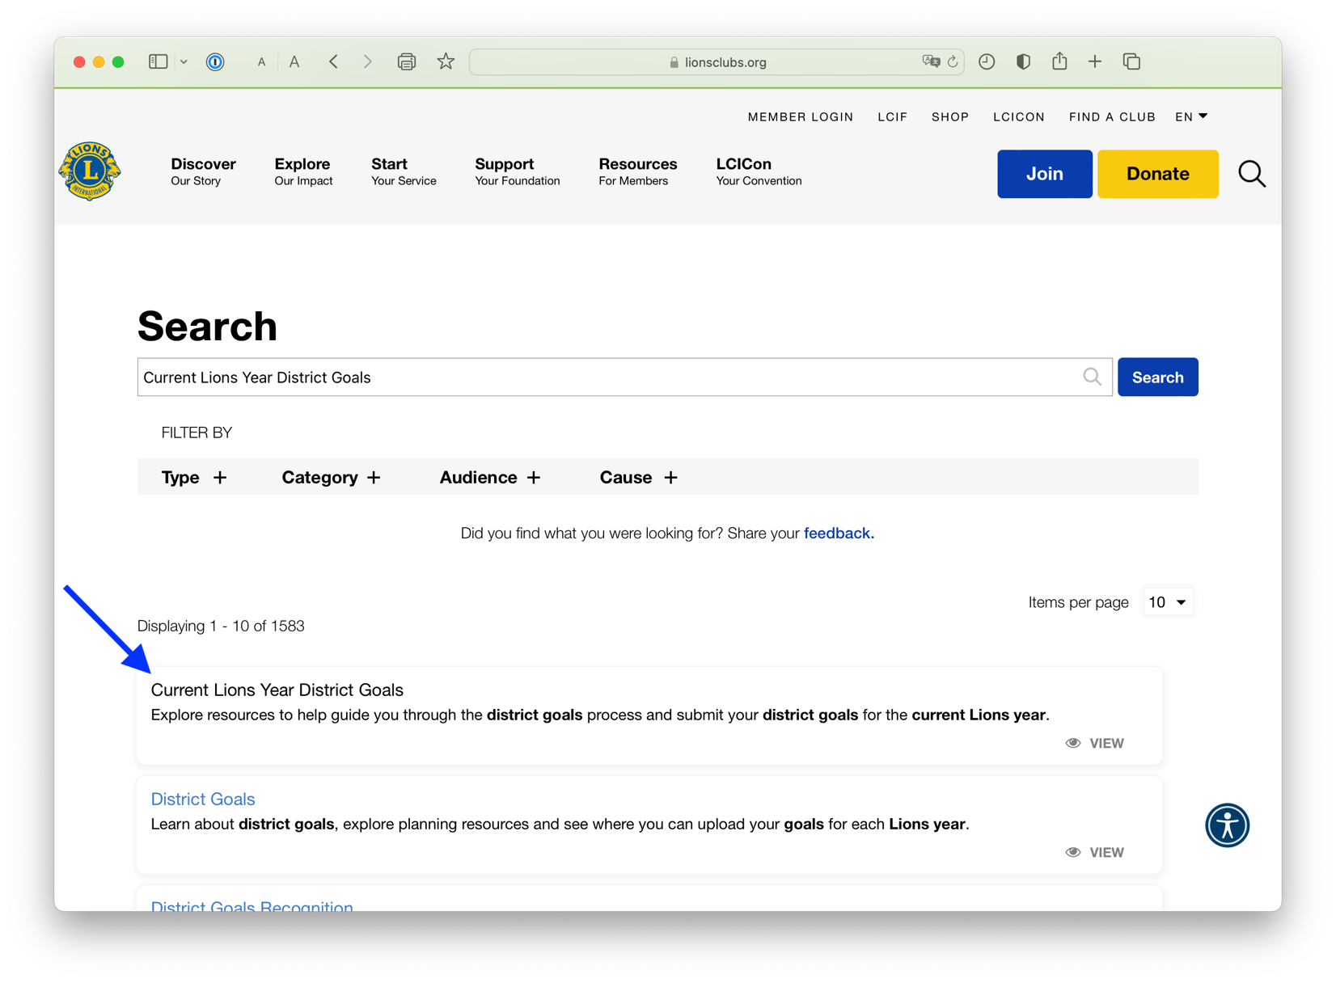
Notes:
Your role is stragegic

Slide 5
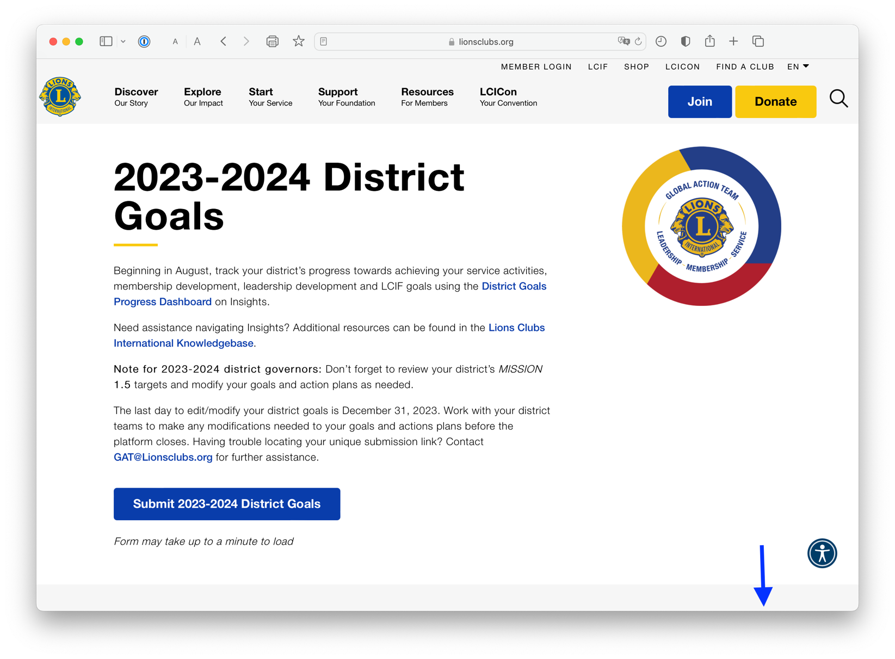
Notes:
Your role is stragegic

Slide 6
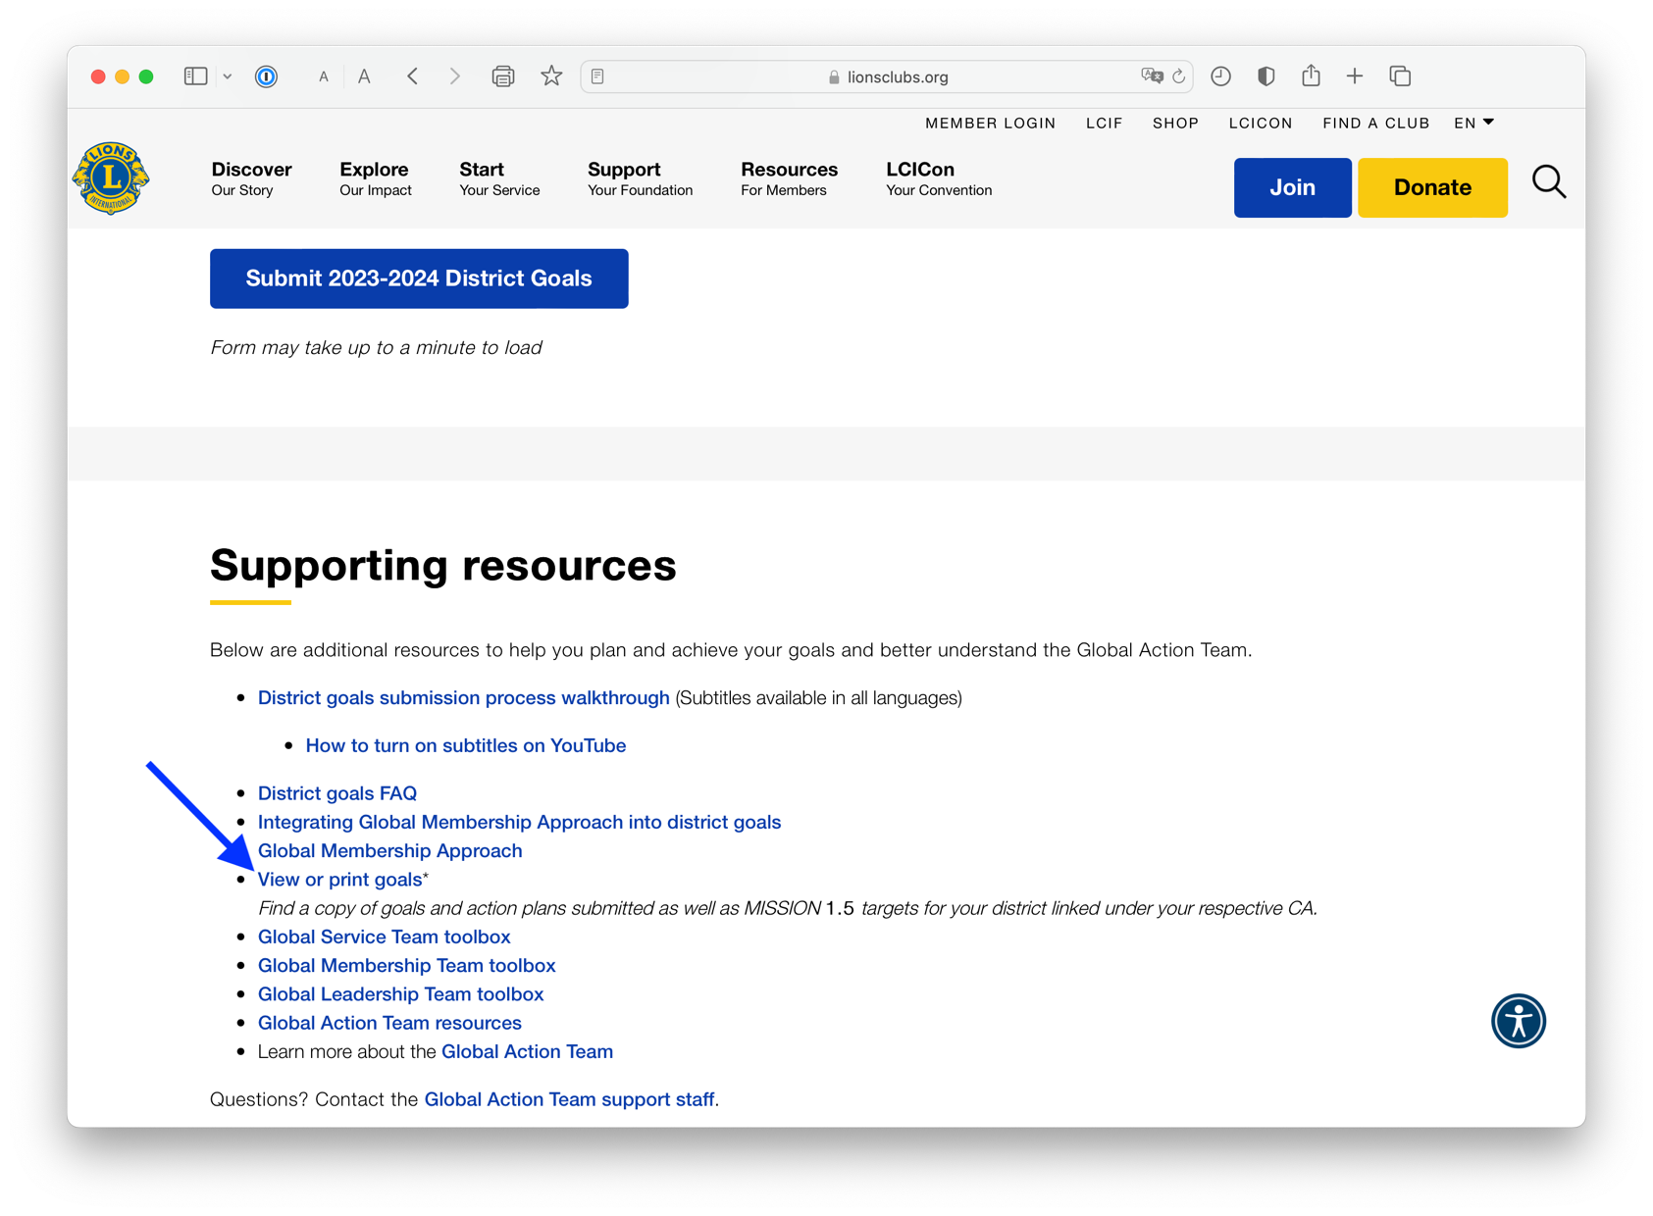
Notes:
Your role is stragegic

Slide 7
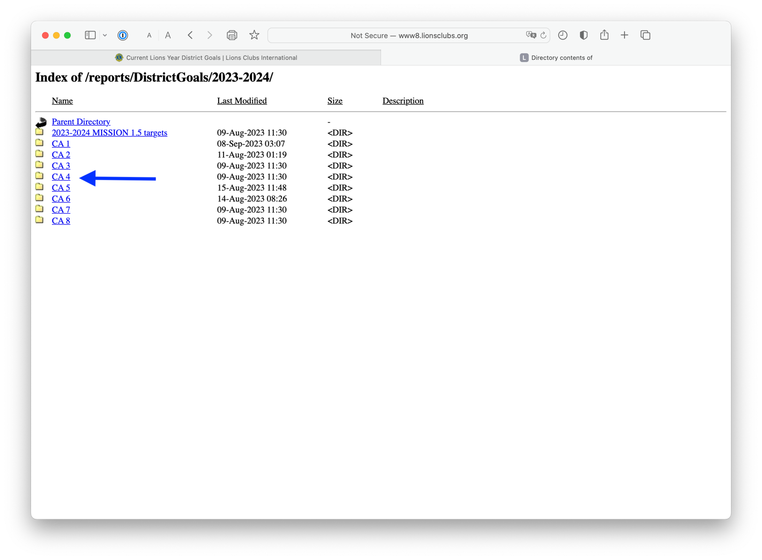
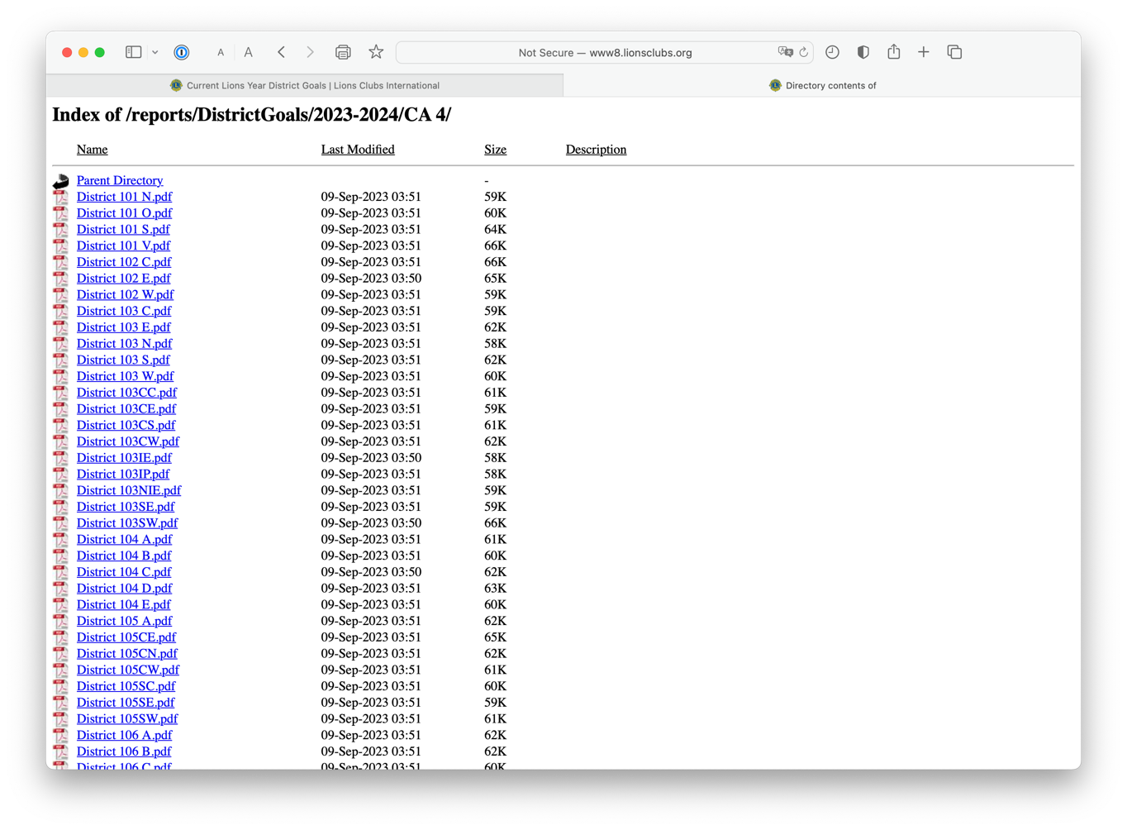
Notes:
Your role is stragegic

Slide 8
Notes:
Your role is stragegic

Slide 9
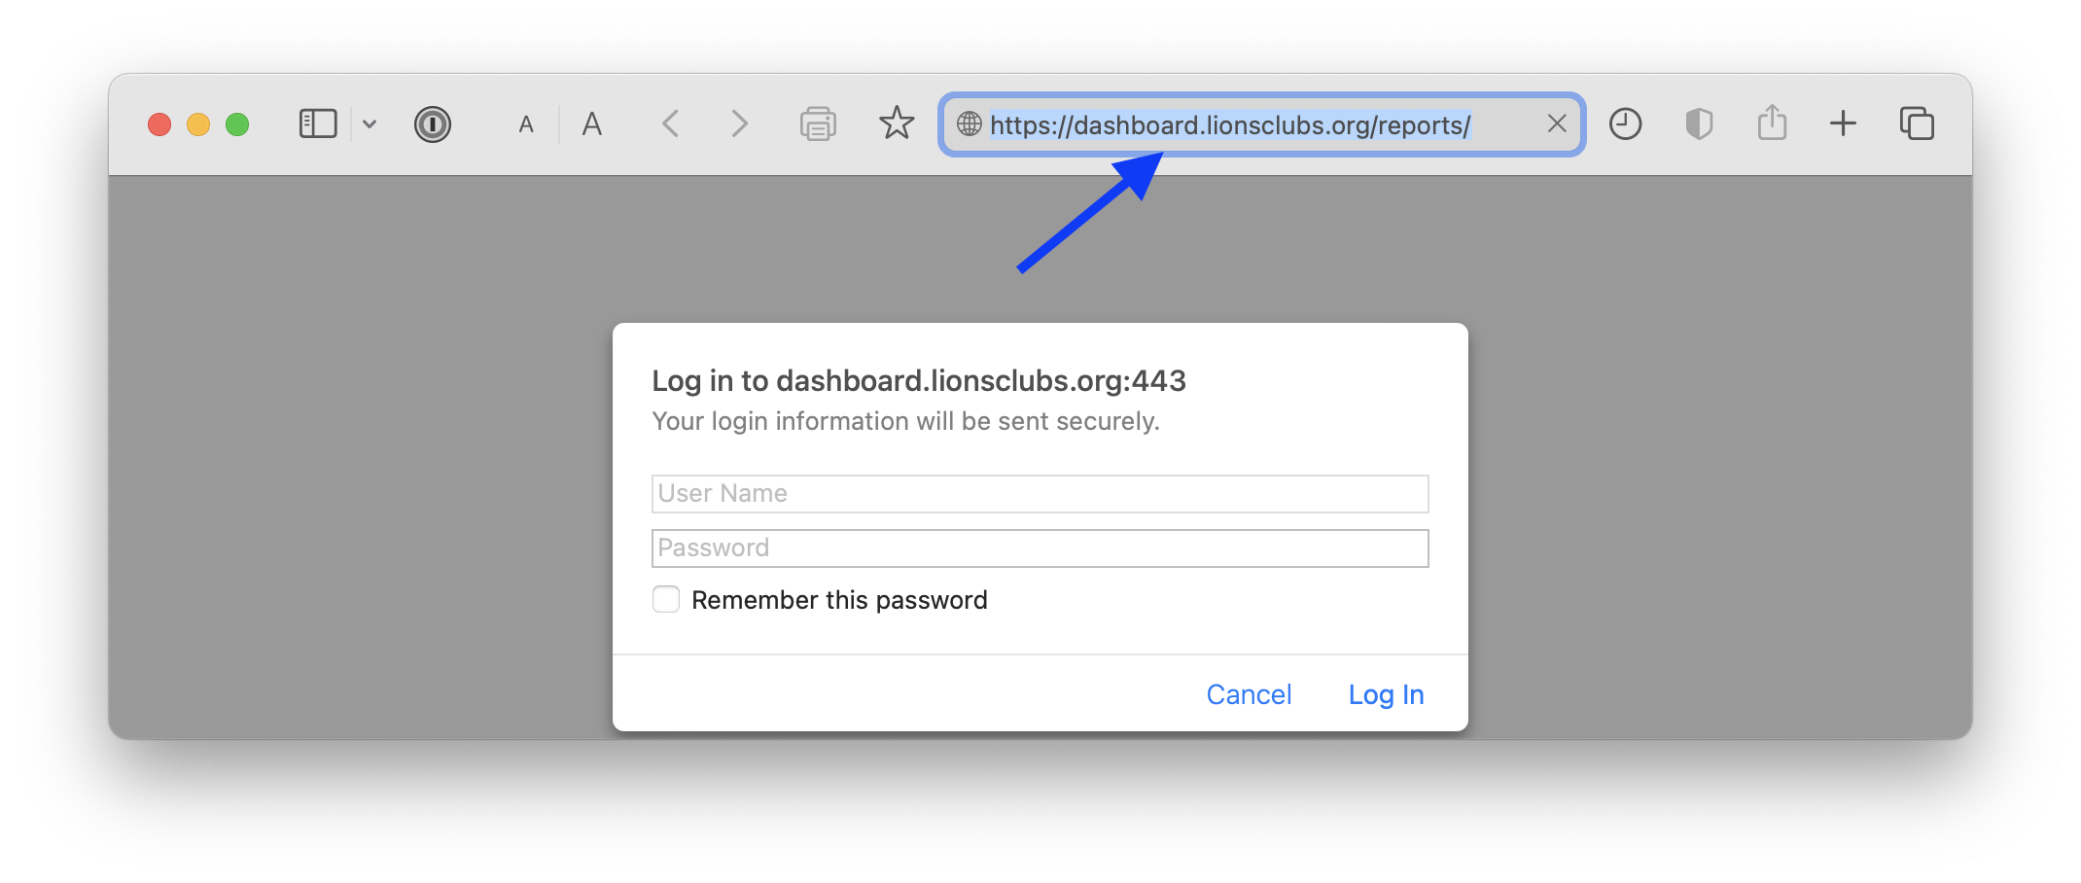
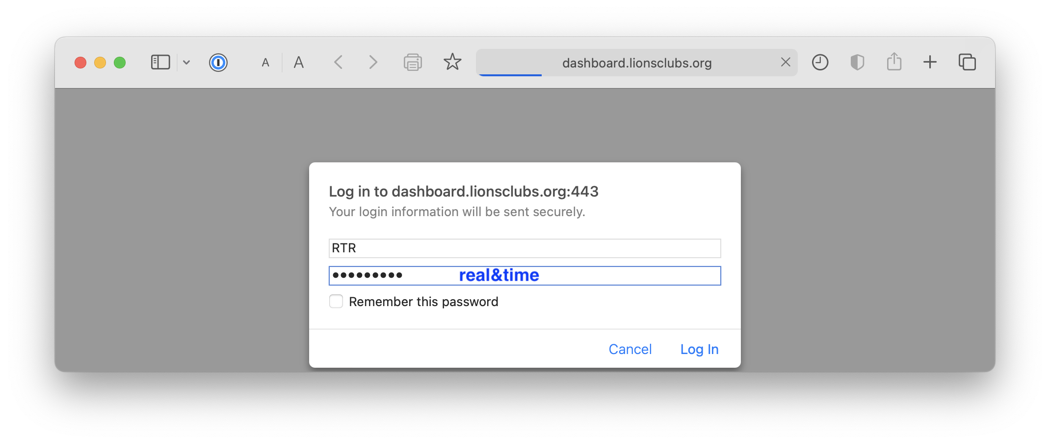
Notes:
Your role is stragegic

Slide 10
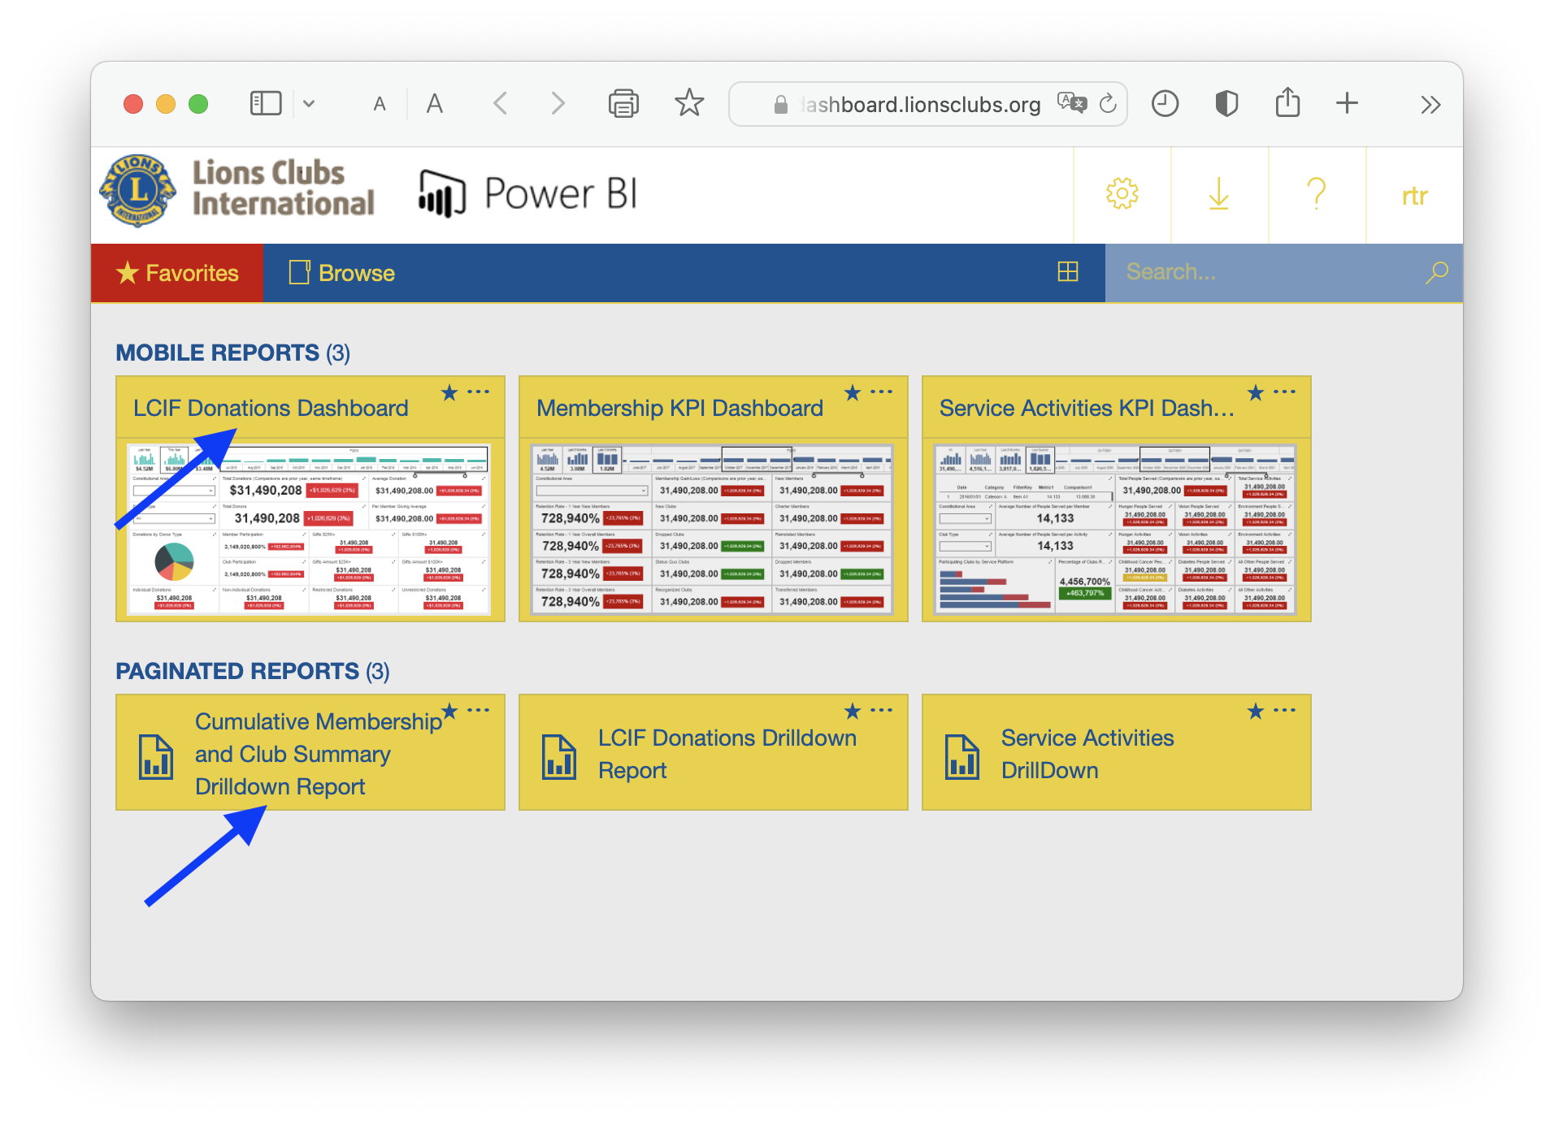
Notes:
Your role is stragegic

Slide 11
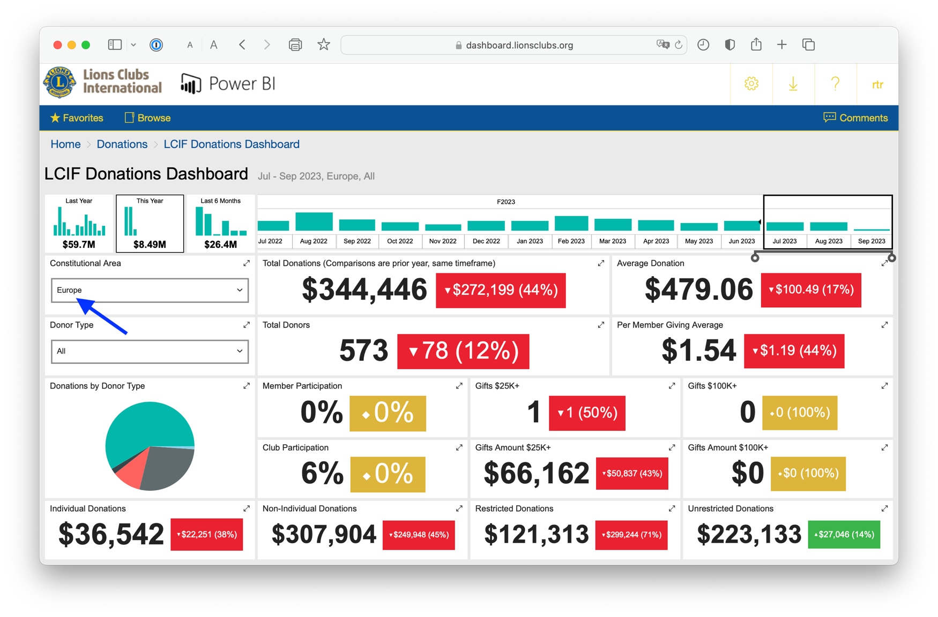
Notes:
Your role is stragegic

Slide 12
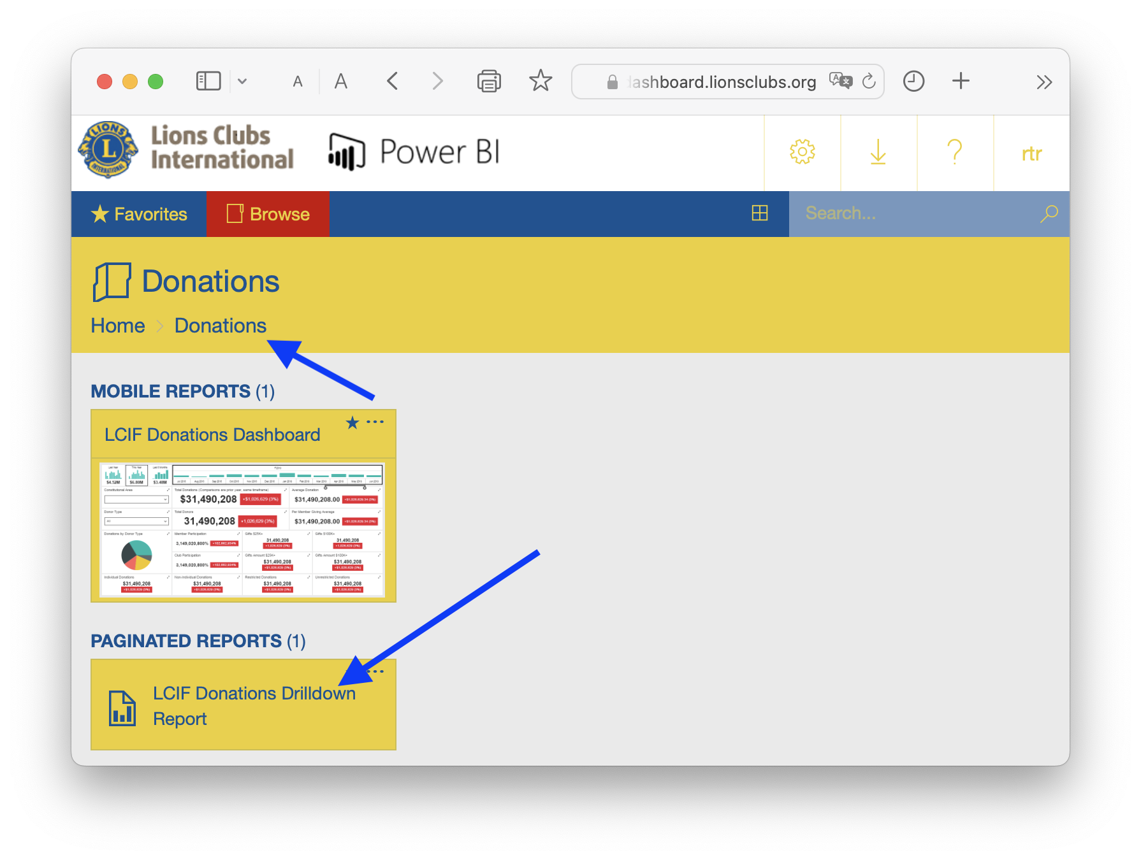
Notes:
Your role is stragegic

Slide 13
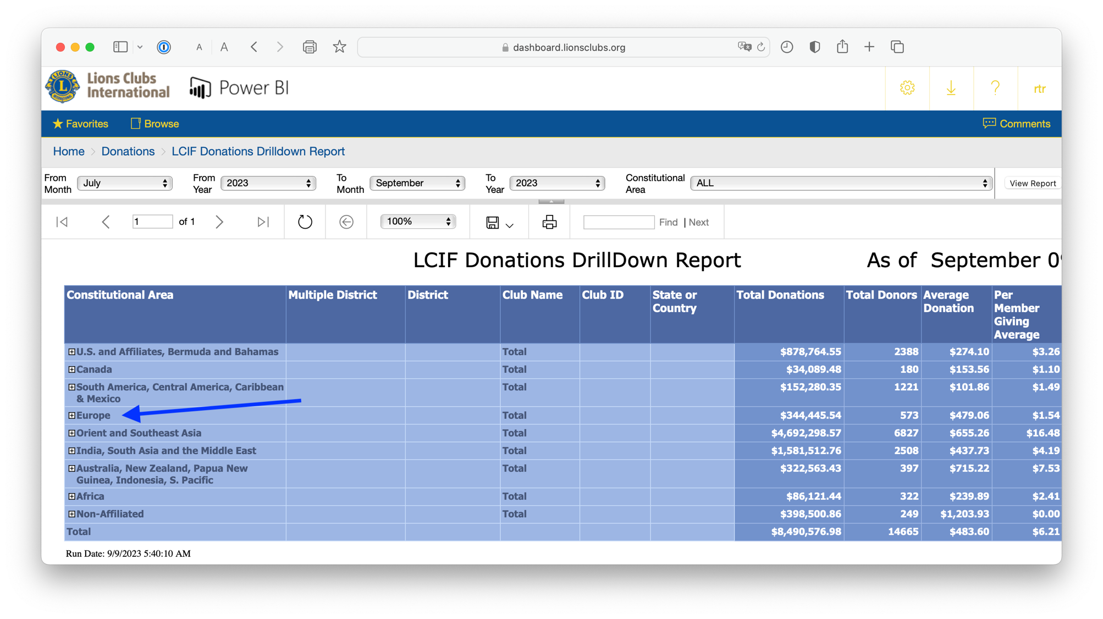
Notes:
Your role is stragegic

Slide 14
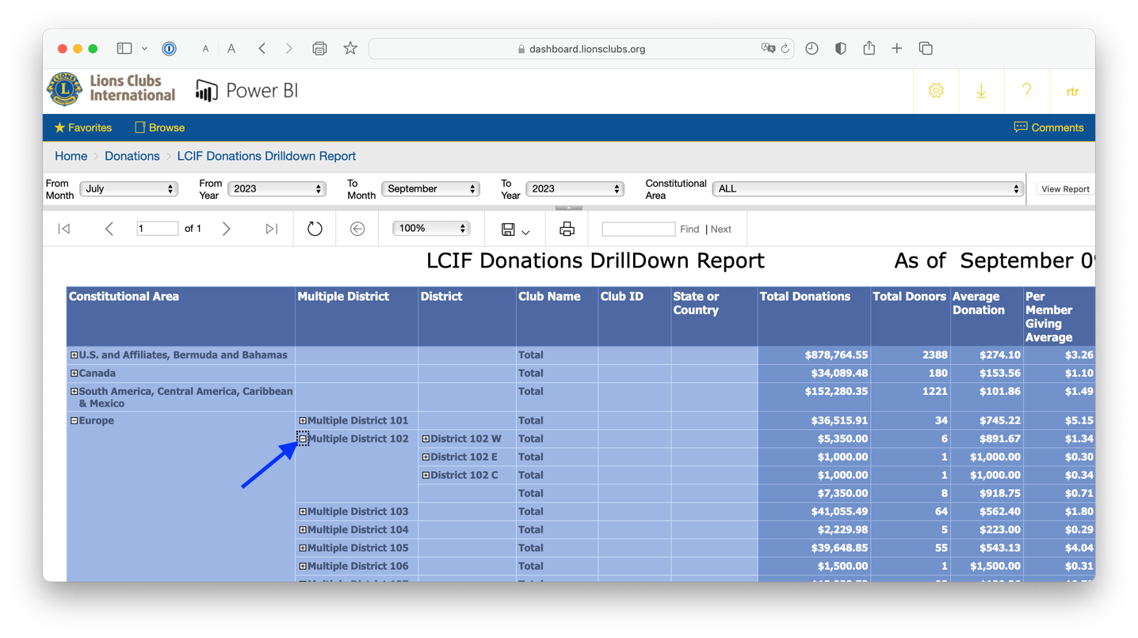
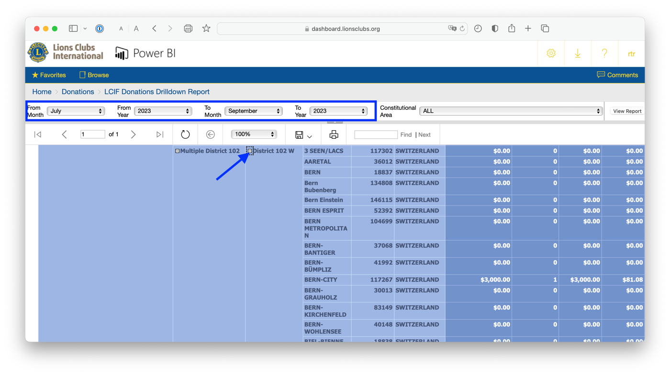
Notes:
Your role is stragegic

Slide 15
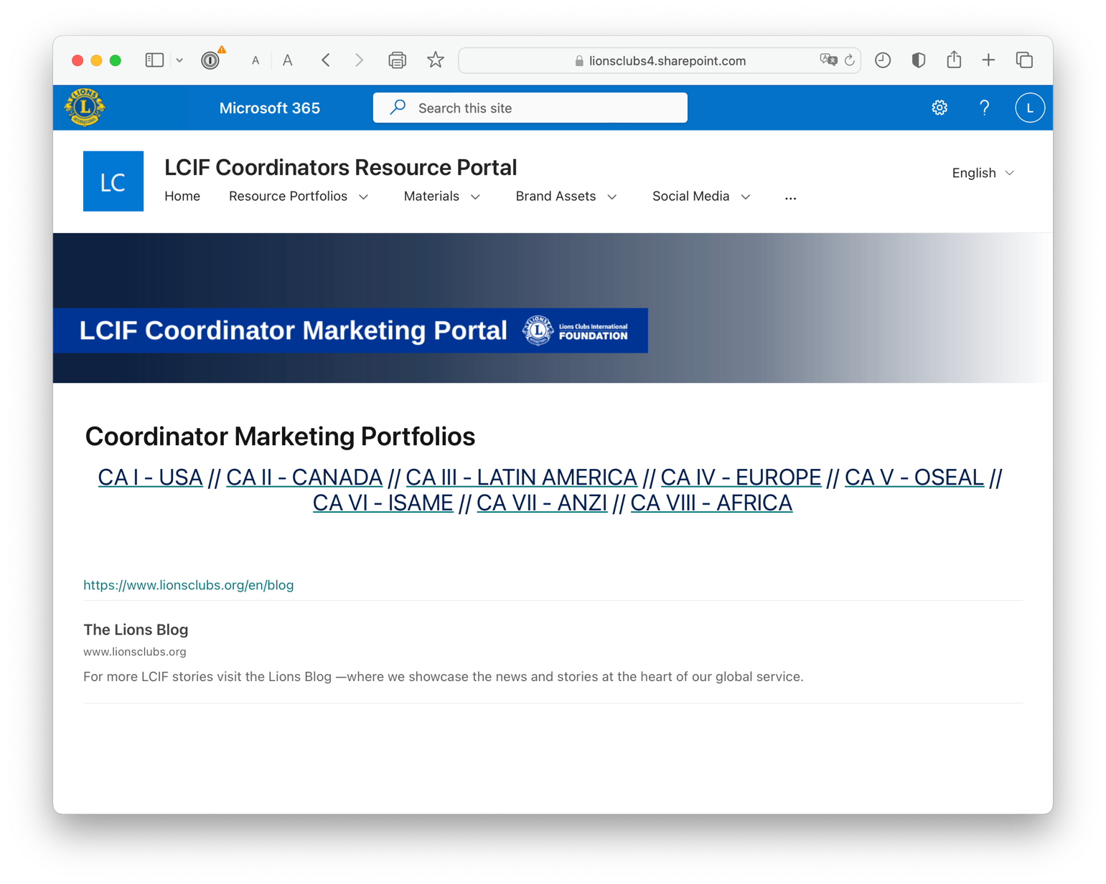
Notes:
Your role is stragegic

Slide 16
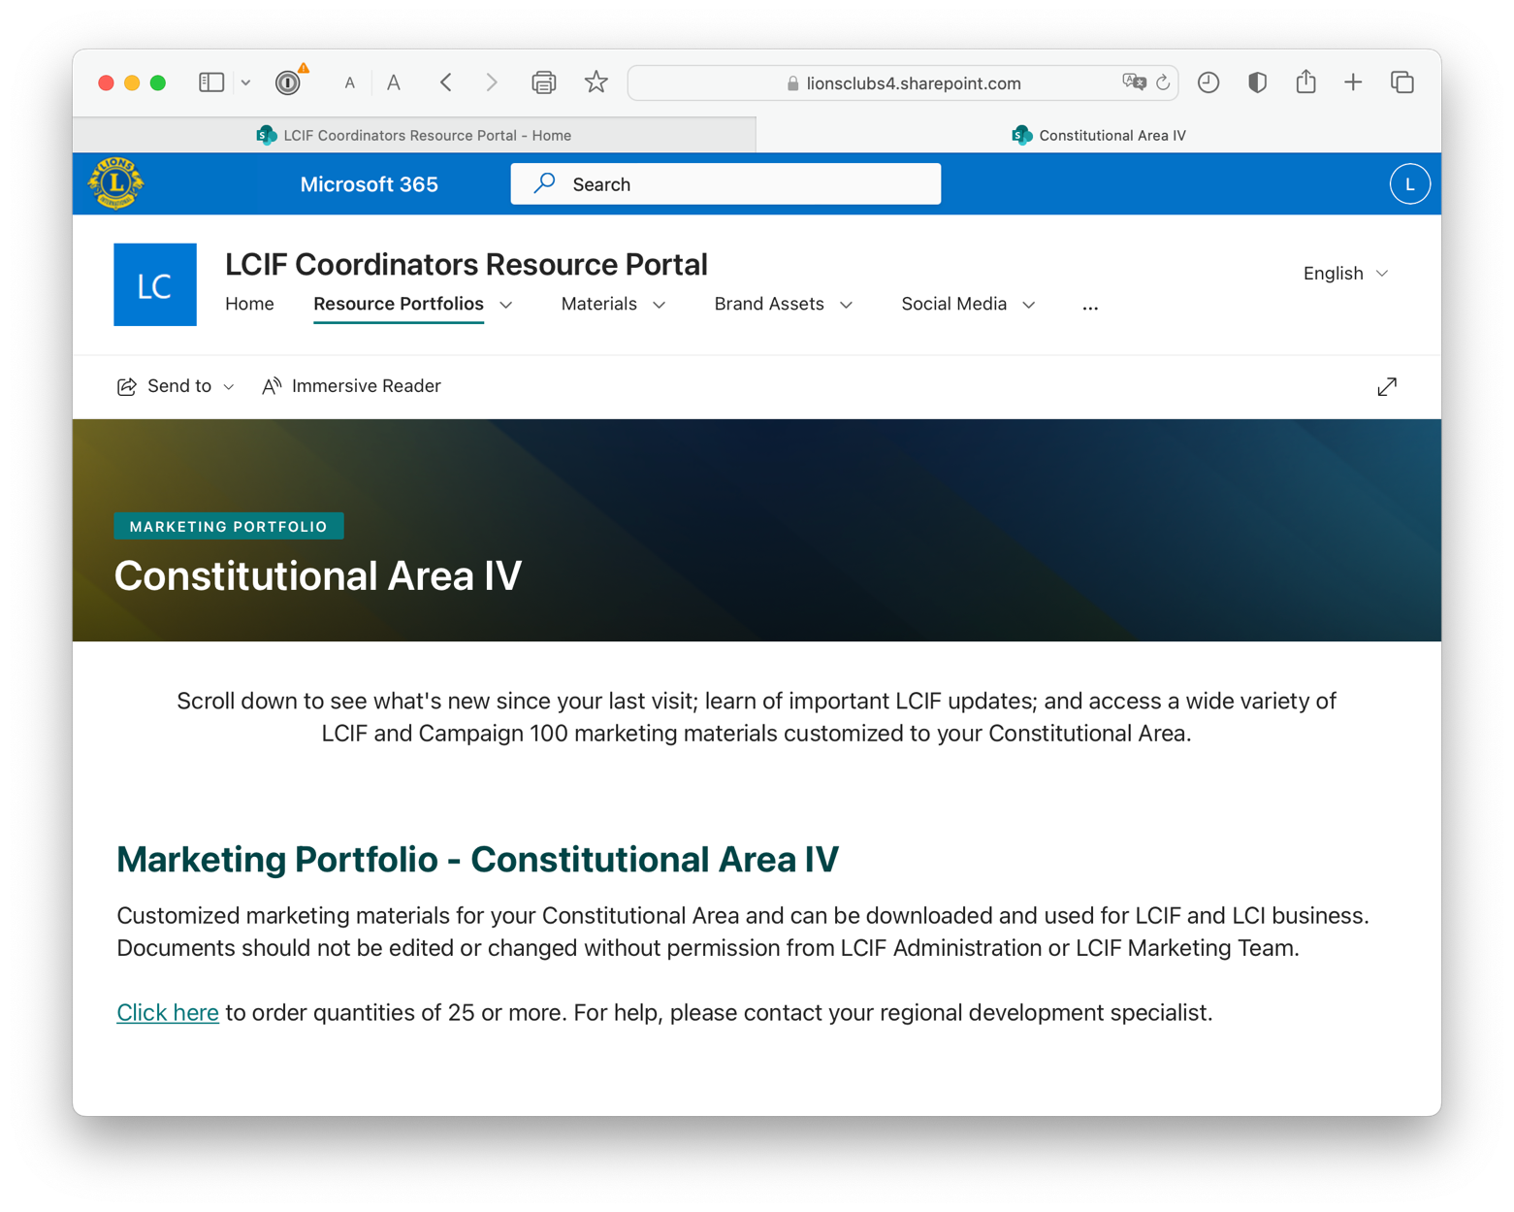
Notes:
Your role is stragegic

Slide 17
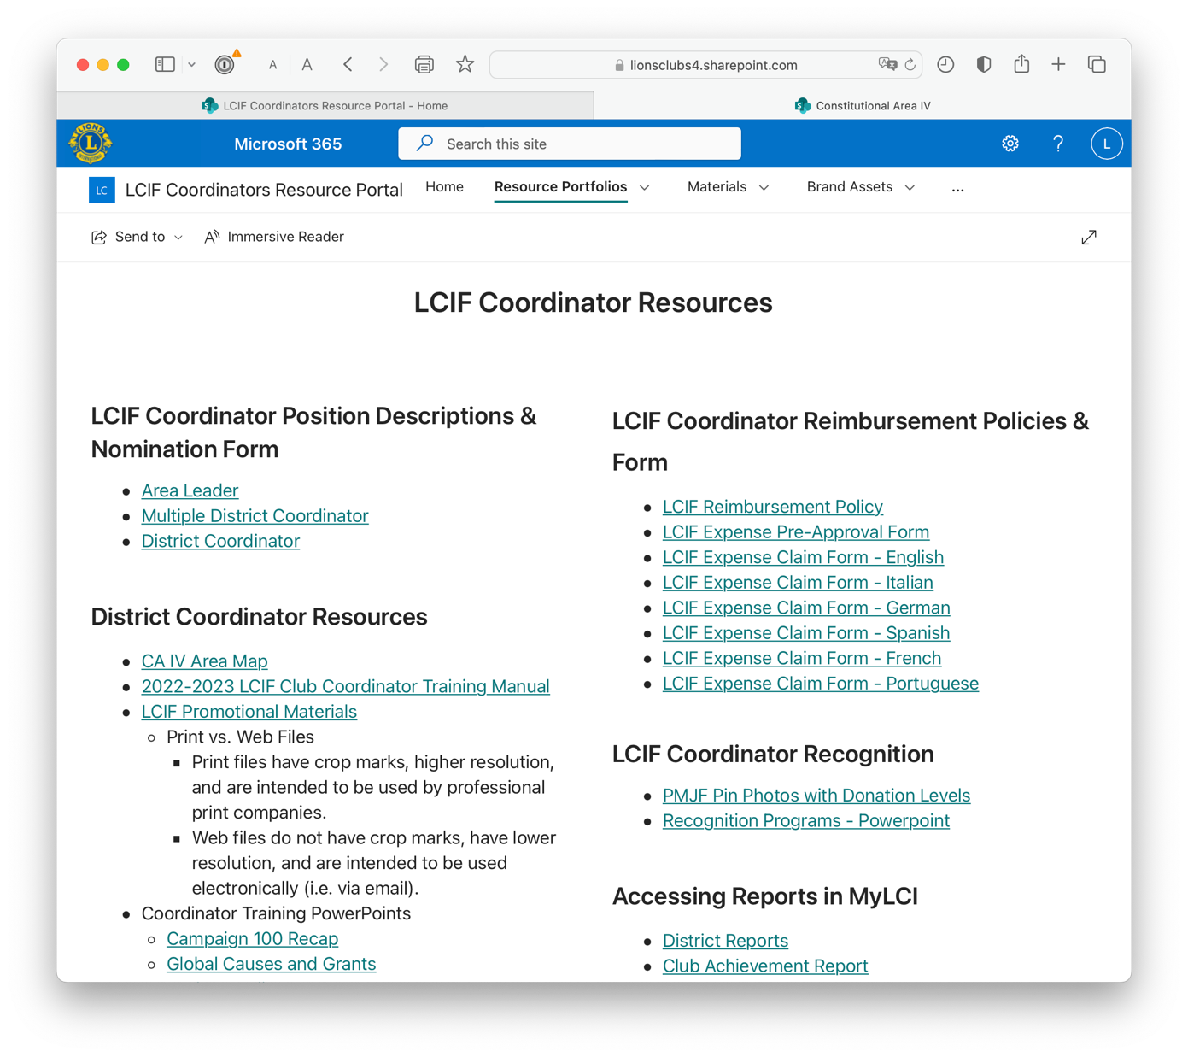
Notes:
Your role is stragegic

Slide 18
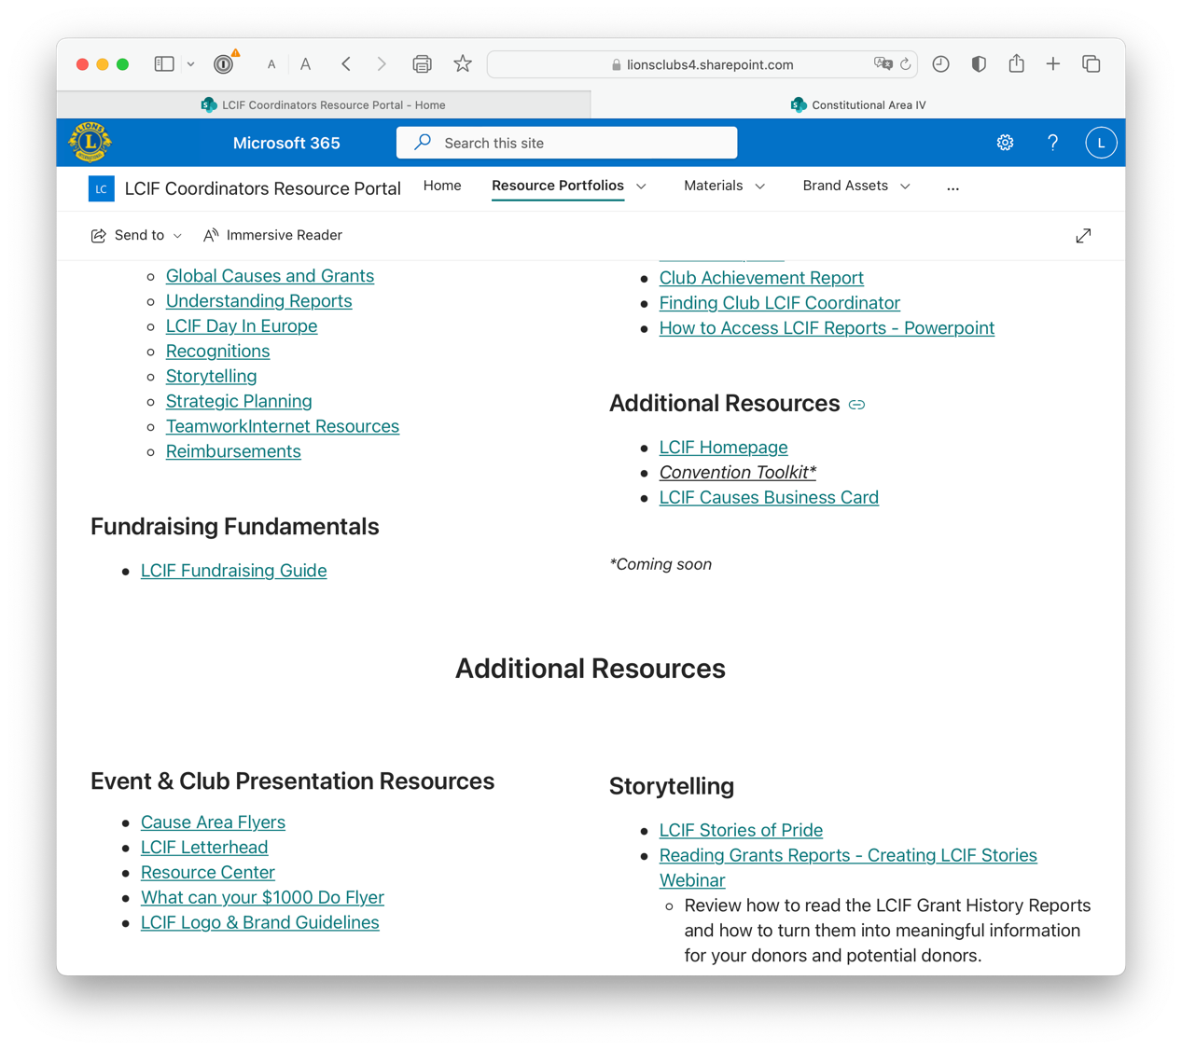
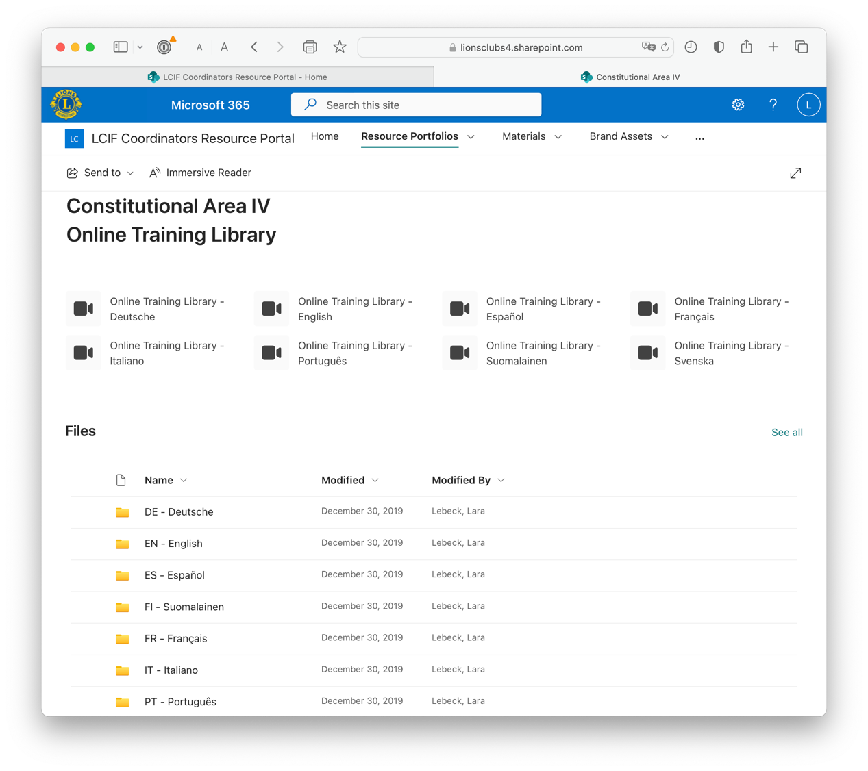
Notes:
Your role is stragegic

Slide 19
Notes:
Your role is stragegic

Slide 20
Notes:
Your role is stragegic

Slide 21
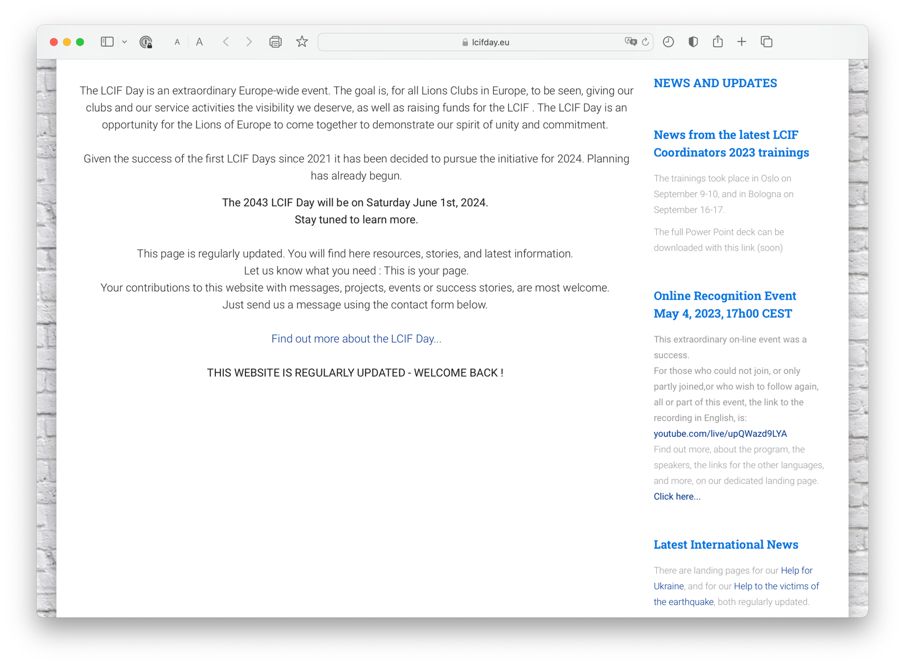
Notes:
Your role is stragegic

Slide 22
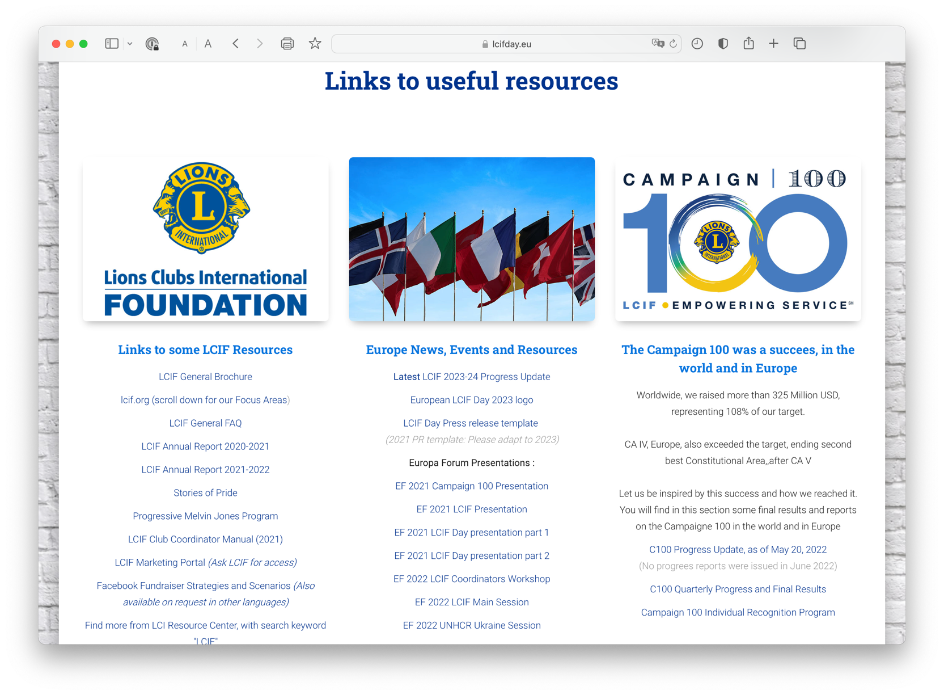
Notes:
Your role is stragegic

Slide 23
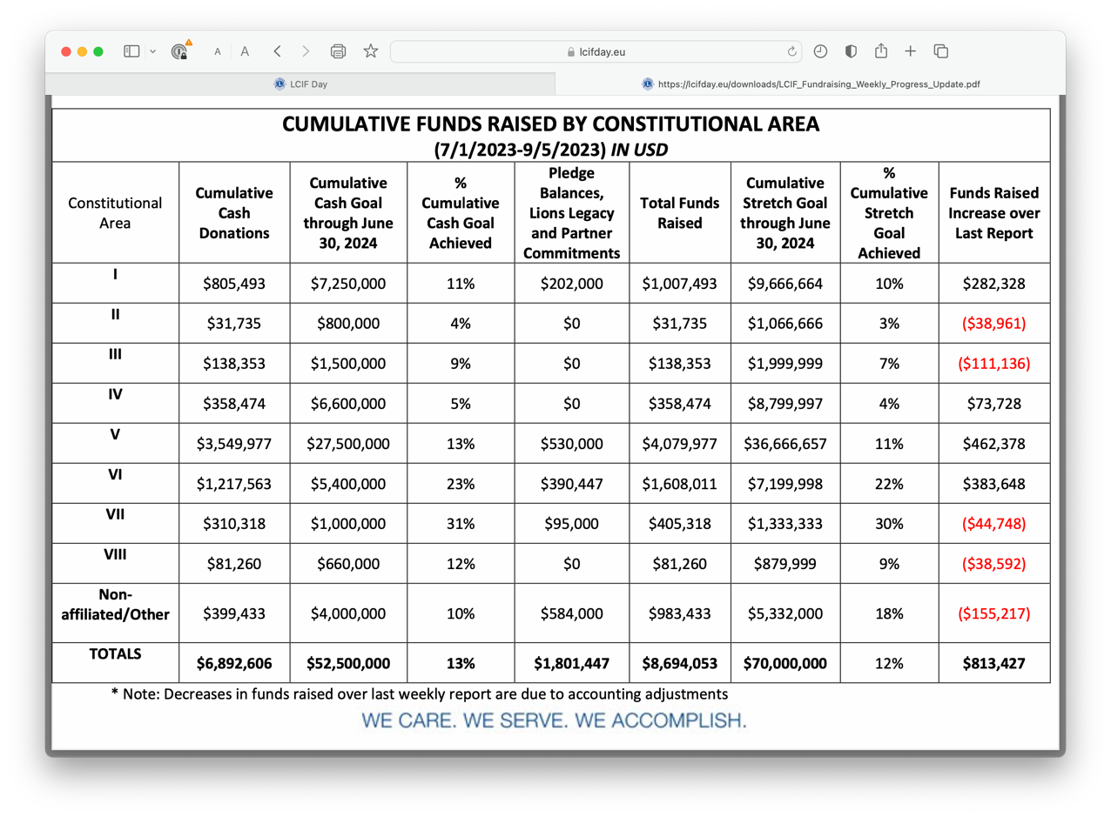
Notes:
Your role is stragegic

Slide 24
Monthly Reports
Each month, Donor Services sends an email including the following reports:
MJF/PMJF listing
Status of installments
Recap of donations
Reports are sent after the close of the previous month
Questions on this report can be sent to donorassistance@lionsclubs.org
24

Slide 25
Recap of Donations
Totals reset every July 1
Reflects donations, not MJF credits
Only counts donations processed by LCIF (not in The Queue)
This report is useful to track:
Progress toward 100% Contributing Member for clubs
Donations by club, districts or multiple districts
Notes:
Oral comments???
Some additional important points include:
• This report clears after June 30 each year and restarts at $0 on July 1.
• This report is not an accounting of credits toward Melvin Jones Fellowships, it reflects donations
and transfers of donations received within the designated fiscal year.
• This report is a useful tool in tracking 100% Contributing Member status or simply tracking
donation totals by club, district, or multiple district.

Slide 26
Recap of Donations
Notes:
Let’s start with the Recap of Donations:
This report displays all donations by clubs within each district; broken out by quarter for the
specified fiscal year.
A couple of important points when reading this:
• When “Unnamed Donation” appears, this refers to a donation without a recipient designation at the
time of donation submission- If you see this on the report, it is possible that the transferring body (club, district or multiple district) forgot to attribute the donation to an individual when transferring the donation. They may be grateful for a follow up communication from you. It is important to note that it may also be because Donor Services received a long list of donors with a transfer and has not finished distributing donations from the list.
• When “General Donation” appears, this refers to the designation LCIF Donor Services uses for
Memorial donations or a donation without specific fund designation

Slide 27
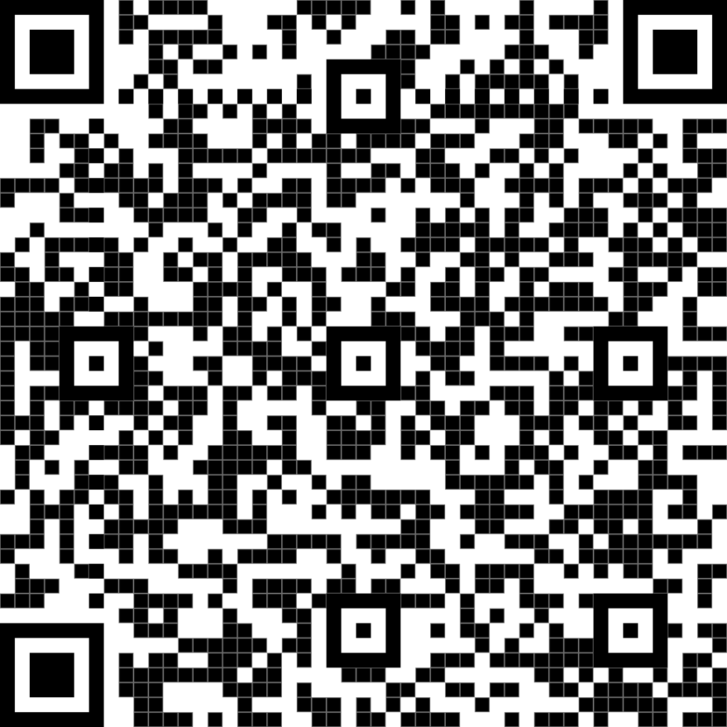
Status of Installments
MJF or PMJF recognition applications are here: https://www.lionsclubs.org/en/give-how-to-give/melvin-jones-fellowship
Member credits cannot be transferred to a club without written authorization provided to Donor Services.
A club cannot combine credits with a member’s credits to give recognition without that member’s written consent.
Notes:
Τηισ ισ τηε ονλινε αππλιχατιον. Λετ’σ ινχλυδε ιτ ασ ωελλ. Ιτ ωιλλ βε γοοδ το ταλκ αβουτ: ηττπσ://λιονσχλυβσ.ϕοτφορμ.χομ/212553776499875?λανγυαγε=εν
• Ωηεν Λιονσ qualify for an MJF or PMJF they can access the application at this address on LCIF’s website:
• Clubs and Districts must also use the application to also request recognition
• Individual member credits are not transferrable to the club without written authorization
provided to LCIF Donor Services
• A club cannot complete an individual’s fellowship by combining club credits and personal credits
without the individual’s authorization provided to LCIF Donor Services
Basically, only the person or institution holding credits may give permission for those credits to be used.

Slide 28
Status of Installments
Notes:
This historical report displays all unconsumed Melvin Jones Fellowship credits that individuals,
clubs, and districts have accrued through eligible donations.
Some important notes about this report include:
• Club and district credits are identified as “unnamed” on this report.
• There is a designation section inclusive of this report where all canceled clubs and deceased
member’s credits are displayed. This is for internal use only. This data set is not made public since these
credits are not meant to be transferred to others, without special authorization.
• This report is a useful tool when looking for opportunities to recognize Lions. Particularly during conventions or by visits from executive officers. It can also show you who is close to their next donation level of recognition if you want to encourage them to make a donation for a special event.

Slide 29
MJF/PMJF Report
29
Notes:
This last report, the MJF/PMJF report displays a historical listing of all MJF recipients with dates the recognitions were
issued. It shows the highest level of PMJF obtained.
Important to remember:
If a new level of recognition was recently bestowed, it may take a month for it to be reflected in this report.
This report uses membership data to sort the recipients by club, so deceased and non-members
may not be listed under the sponsoring club.
This report is useful for identifying the club members members that have been
recognized and what new levels of recognition, they may be approaching.
It is a great way to track progress toward 100% MJF Club status as well.

Slide 30
How To Access Reports On MyLCI
When members transfer, their details appear under the new club.
MJF recipients listed as “Undistricted” are not linked to clubs or districts
The names of former members are anonymized.

Slide 31
How To Access Reports On MyLCI?

Slide 32
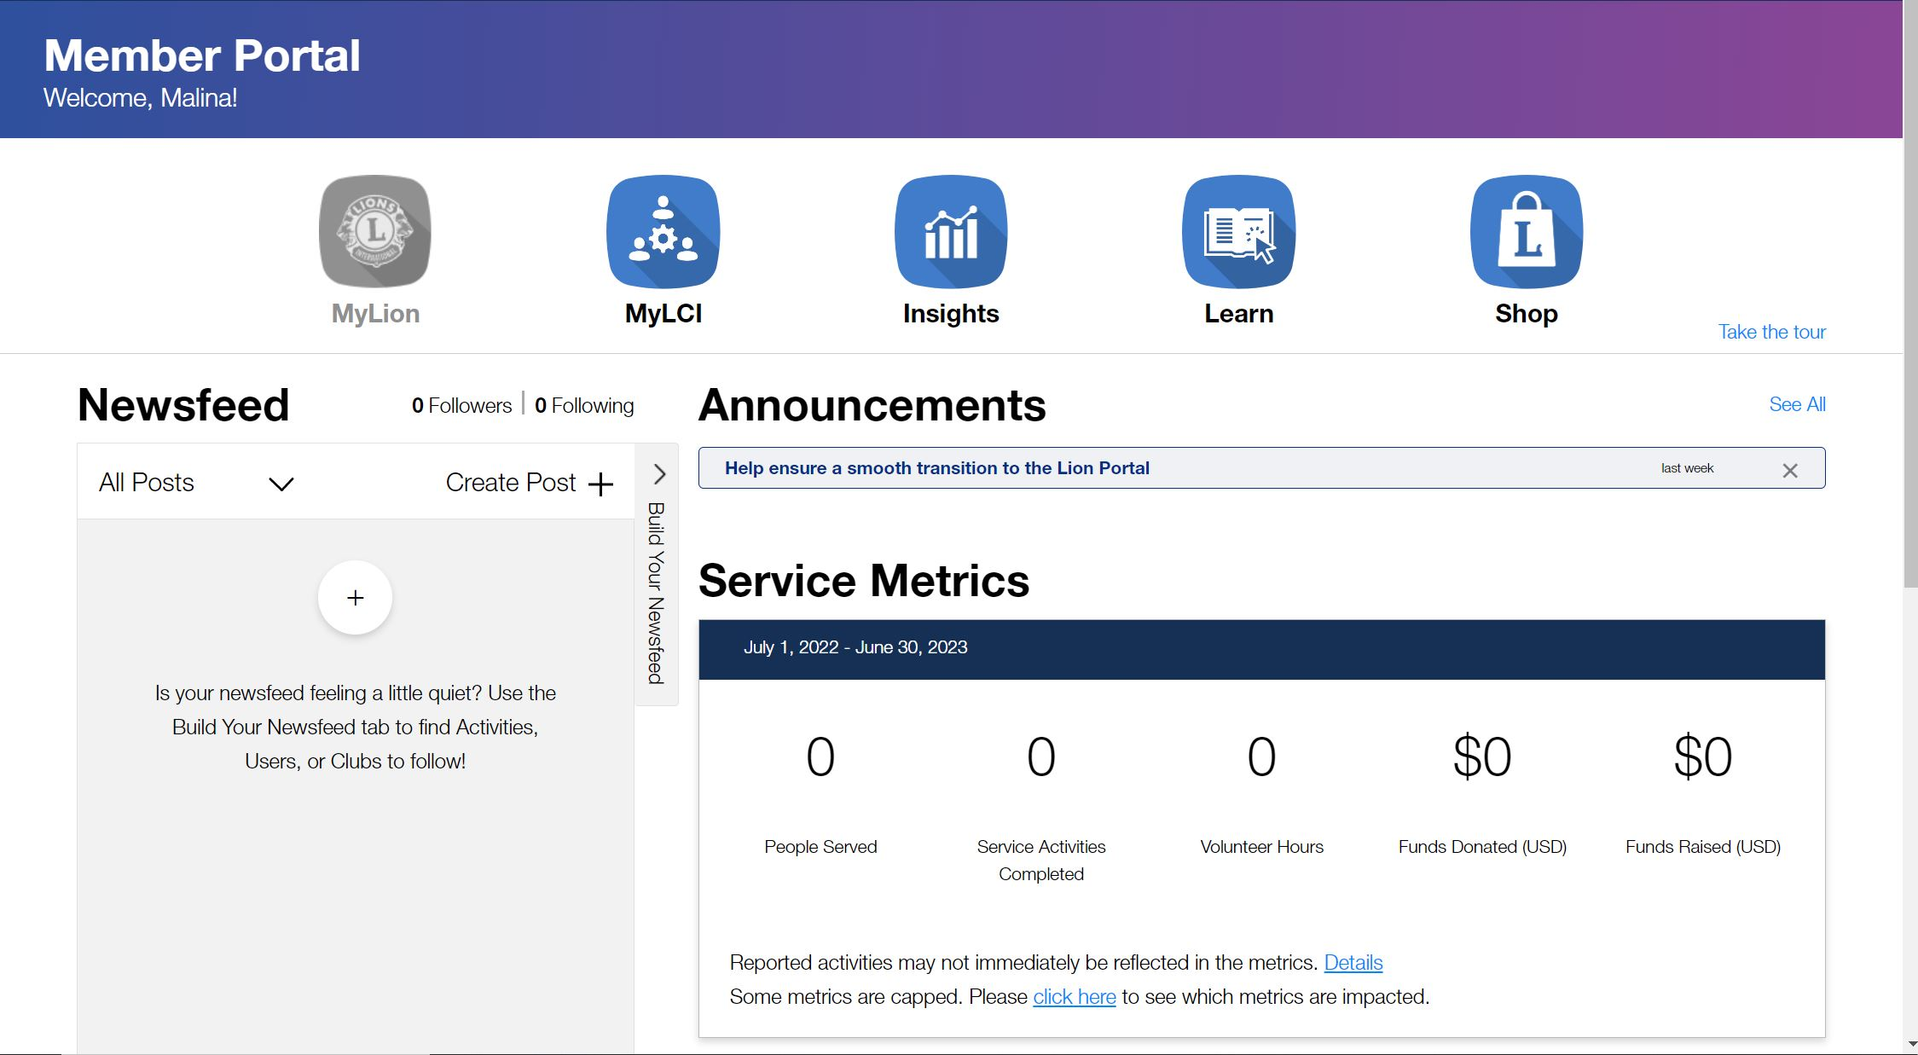
When you first log, this is your screen. Click on MyLCI

Slide 33
It will navigate you to this page. Select the My Districts tab.

Slide 34
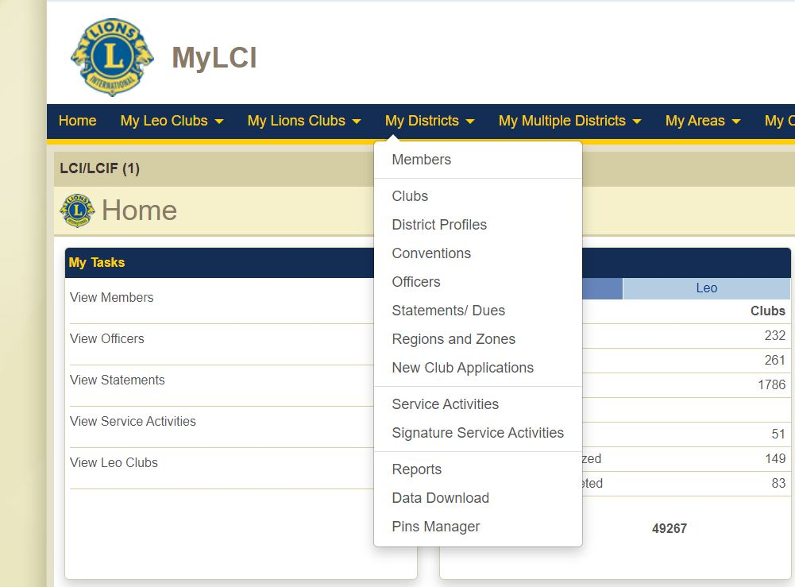
The following dropdown menu will appear.
Select Reports

Slide 35
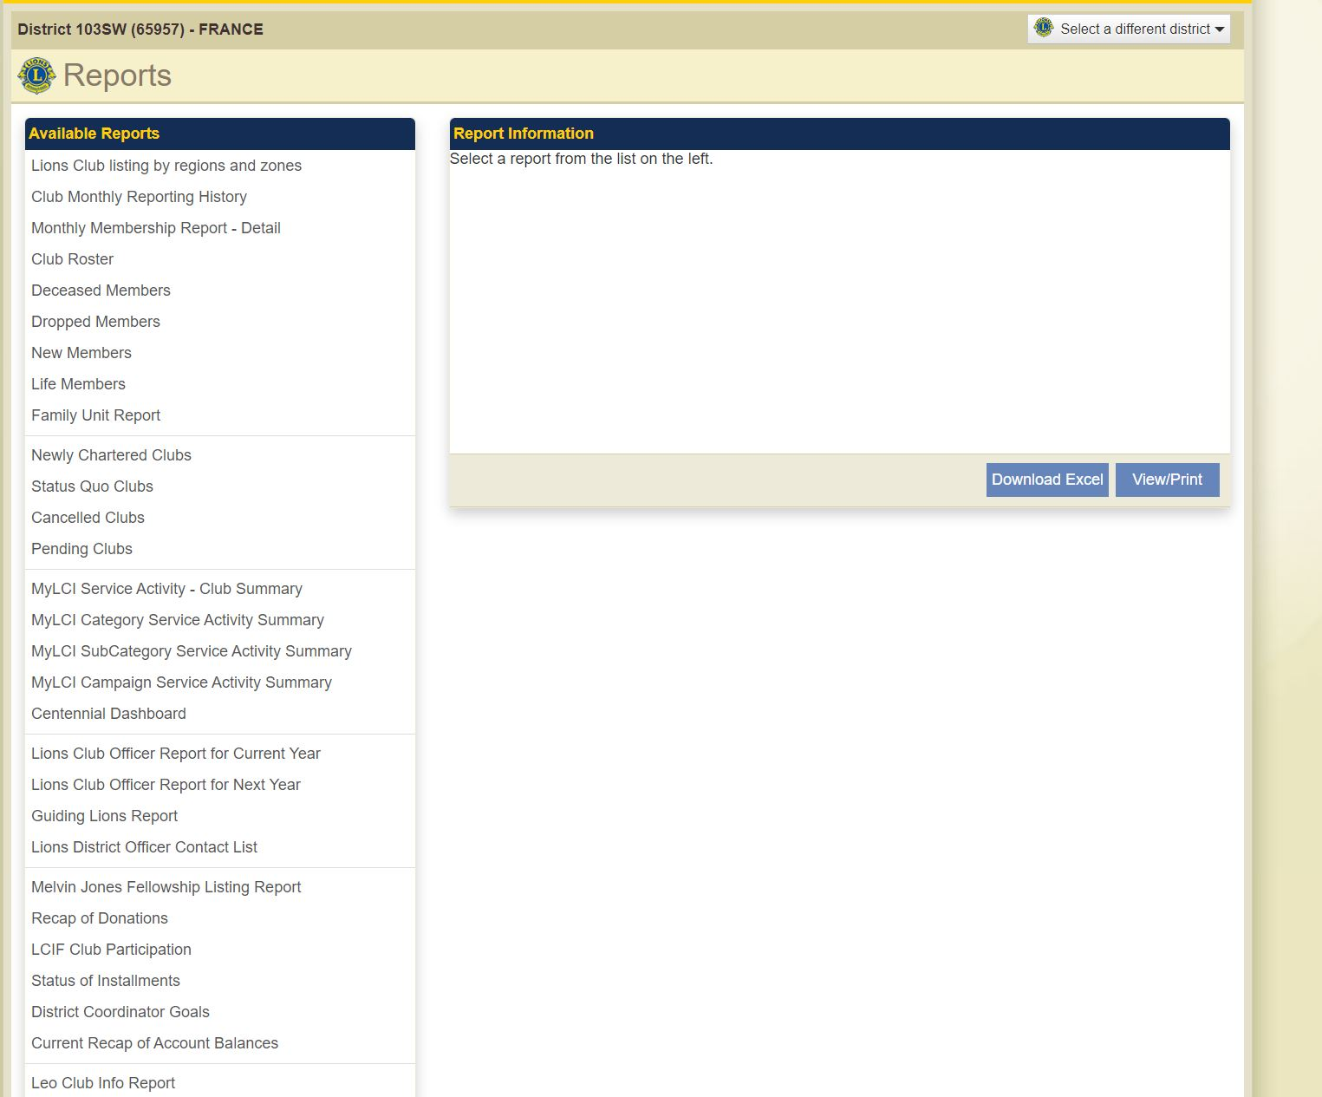
Select the reports you want to run.
You will be prompted to enter dates.
Select view.

Slide 36
When Donations Are Counted?
Send receipt to Donor Assistance
Send receipt & application to staff
4 – 6 Weeks process… or more…
No later than the end of the Lion Year
Notes:
Encourage your clubs to communicate with their District or Multiple District level representatives throughout this process.
Plan for the end of the Fiscal Year.
Send documentation for donations to donorassistance@lionsclubs.org

